Slide 1

Welcome
MYHA Membership
Meeting & Awards
2021-2022

Slide 2
Agenda!!
Welcome
LTS/Mini-Mite/Mite Team Recognition
Scholarships and Donations
Team Recognition & Awards
Annual Meeting
  Season Overview
  Survey
  Moving Forward

Slide 3
LTS
Coach: Vincent Wheeler, Emma Czechowicz,
John Jebamani, Cole Beckstead
Team Manager: Jennie Cimino

Slide 4
LTS
Brynnlee | Evans
Charlie | Warner
Ever | Redding
Beau | Gilberts
Mack | Gilberts
Temperance | Eichmann
Vicente | Urriola
Charlie | Kinney
Dierks | Havlicek
Jackson | Stoeklen
Maddix | Moore
Briella | Carothers
Porter | Steinlicht
Lawrence | Hewitt
Finn | Wachewicz
Shania | Casper
Kellan | Binder
Josenda | Hauge
Bawornvong | Srisujaritpanich
Maggie | Johnson
Wyatt | Einertson
Deegan | Gilbertson
Holden | Cook
Jasper | Bjork
Ava | Brey
Gabriel | Cimino
Cameron | Chambers
Leif | Paulson
Henry | Raff
Owen | Rockwell
Abraham | Rockwell
Marlowe | Wheeler
Andrew | Czechowicz
Mickinzley | Hoffman Leach
Zoey | Leach
Kash | Chermack
John | Keesling
Josie | Jeske
Bentley | Iverson

Slide 5
Mini-Mites
Coach: Denise Husby
Assistant Coaches: Adam Kramschuster, Mike MacDonald,
Joey Petronack, Tomi Vargonen, Dave Schwedler
Team Manager: Nicole Watkins

Slide 6
Mini-Mites
Micah | Cimino
Liam | Gaslin
Tommy | Raff
Lily | Kramschuster
Bennett | Macdonald
Lucas | Kirby
Vaughn | Wheeler
Eli | Bjorkman
Nova | Chermack
Colton | Wayne
Gunnar | Watkins
Keaton | Marlett
Jack | Warner
Emma | Wielinski

Slide 7

Mites
Coach: Brian Gowling
Assistant Coaches: Casey Delanghe, David Schwedler, Jacob Cimino, Kyle McRoberts, Nate Richartz, Nicole Cropp, Dave Schwedler, Sarah Schwedler
Stout Coach: Landon Lushanko
Team Manager: Erin Bailey

Slide 8
Mites
Kasey Krueger
Spencer DeVries
Luke Hendrickson
Charli Jax
Micah Cimino
Adeline Xu
Christine Tavares
Raylee Kouba
Emily Gibbs
Brantley Bahr
Kolten Hintzman
Caleb Cropp
Issac Schwedler
Malachi Kirby
Nora Gowling
Lilian Dowd
Gregory Delanghe
Noah Kramschuster
Taylor McRoberts

Slide 9

2013 Mites
Molly Berg
Bryson Wayne
Zeke Skoug
Madelyn Cimino
Ava Bjorkman
Emma Noble
Emmitt Bailey
Jase Chevatal
Finley Marincel
Leif Paulson
Hudsen Richartz

Slide 10
Special Recognition
Dale and Fisher Families

Slide 11
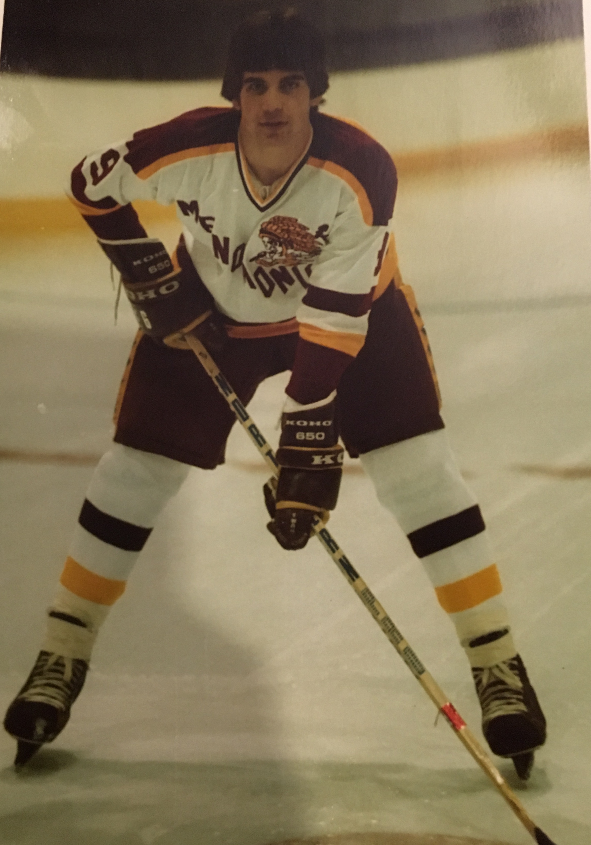
John R Dale Memorial
Youth Hockey Squirt
Scholarship Fund
2021/2022 Recipients
Easton King & Kinzleigh Cody

Slide 12
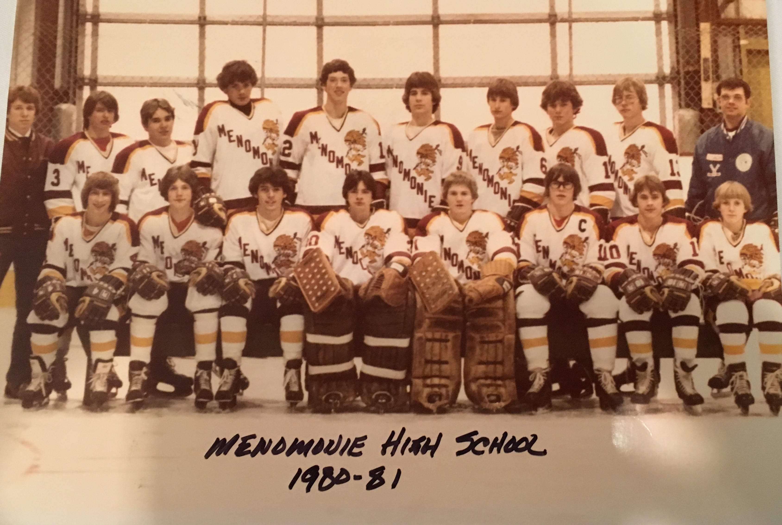
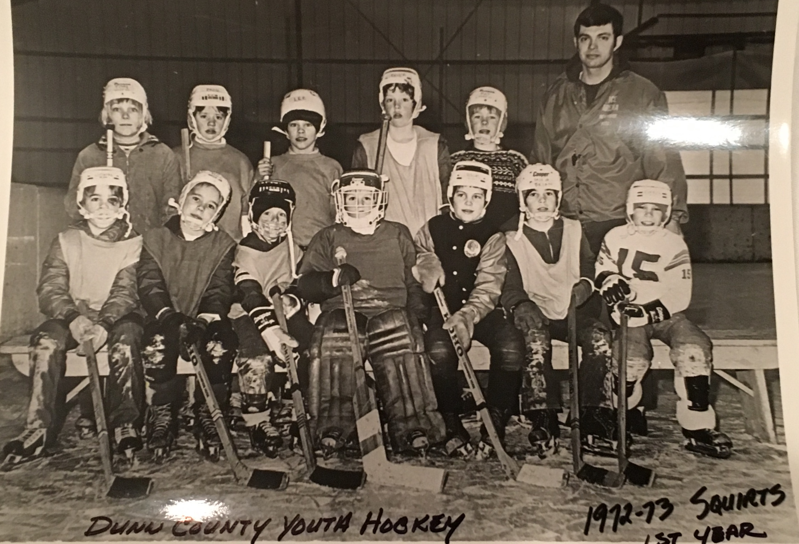

Slide 13
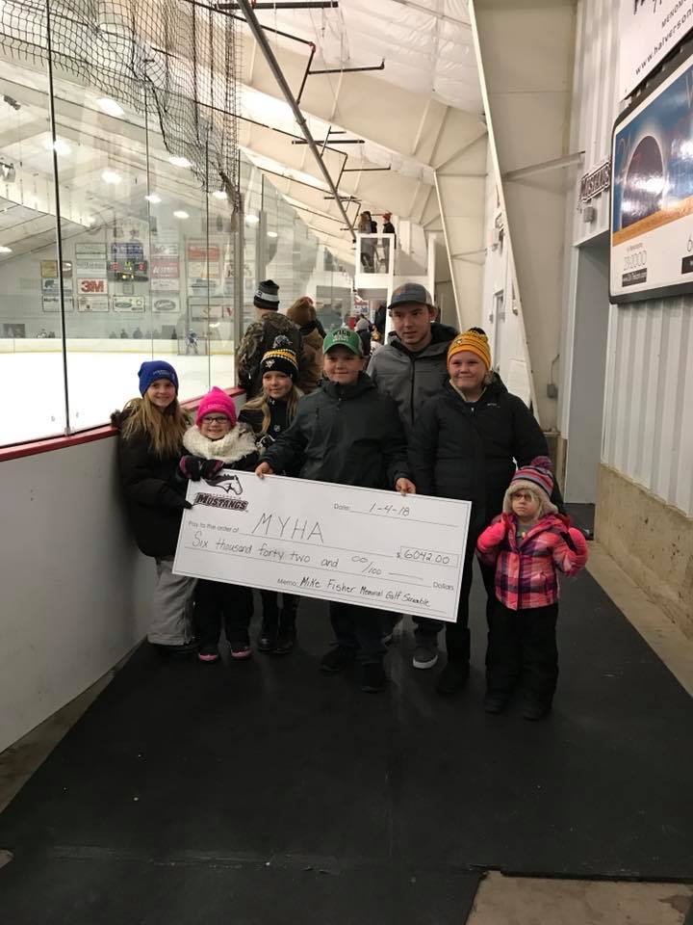
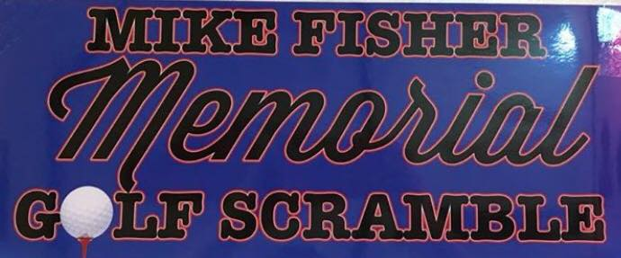
Thank you!
For your continued support of MYHA!
Mike Fisher Family
**Be sure to watch our FB page for details on the Fisher Golf Outing this summer**

Slide 14
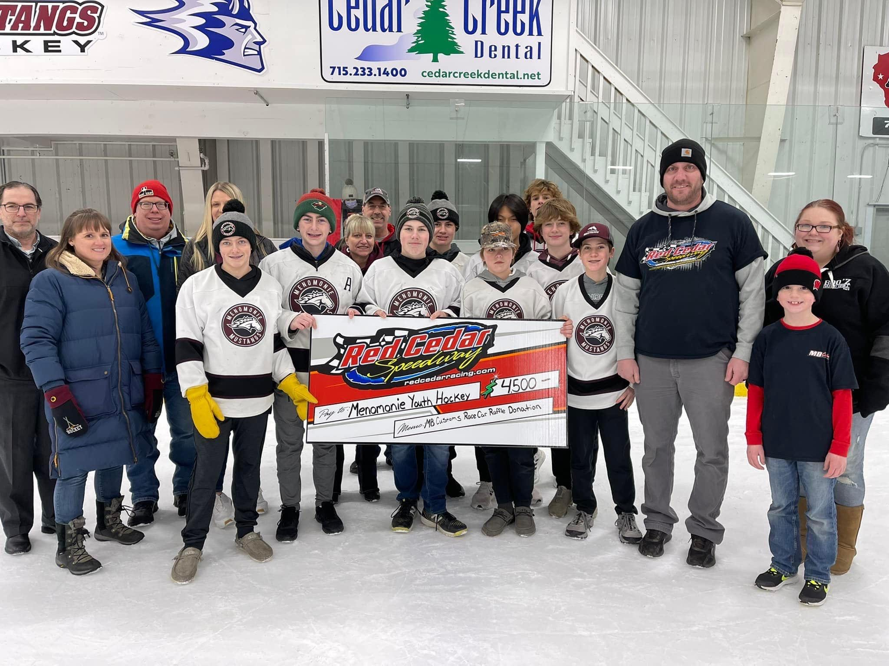
Thank you to the Red Cedar Speedway!!

Slide 15
Celebrate!!
Squirt A Region 6 Champs
PeeWee A Region 6 Champs
Squirt A, B & C and Peewee A Qualified for State
Squirt C placed 4th at State
Squirt B State Runner Up
14U Girls Co-op 3rd Place at State
3 Players representing MYHA on the Region 6 Kohlman Cup Team: Ed Dowd, Jaxon Giertz & Allison Wei

Slide 16
Team Recognition & Awards

Slide 17
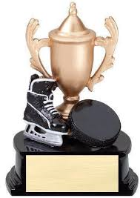
Squirt, Peewee, and Bantam Awards
Patches
Most Improved Award
Leadership Award
Sportsmanship Award

Slide 18
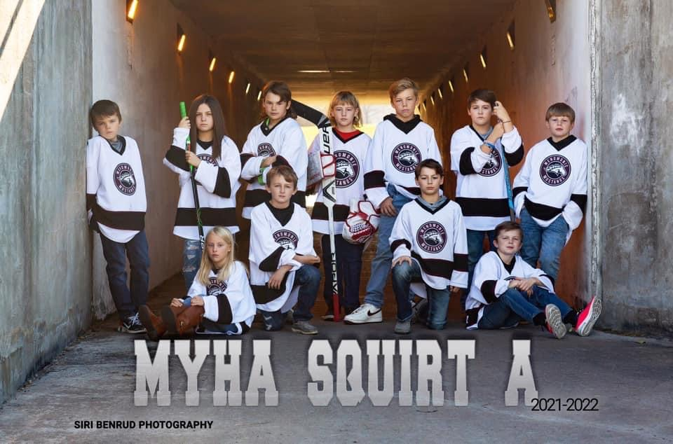
Squirt A
Head Coach: Logan Miller
Assistant Coach: Derek Kahl & Mark Chambers
Stout Coach: Alec Skar
Team Manager: Sara Bahr

Slide 19

Congratulations Squirt A Players…
Hat Trick:
    Graysen Bahr
    Isaac Cimino
    Joe Gowling
    Kynlee Hintzman
    Clayton Slupe
    Wes Weir
Play Maker:
  Joe Gowling
  Kynlee Hintzman
  Wes Weir
Zero Patch:
  Oliver Bjork

Slide 20
Squirt A Awards
Most Improved: Esmeralda Chambers
Leadership: Oliver Bjork
Sportsmanship: Kynlee Hintzman

Slide 21
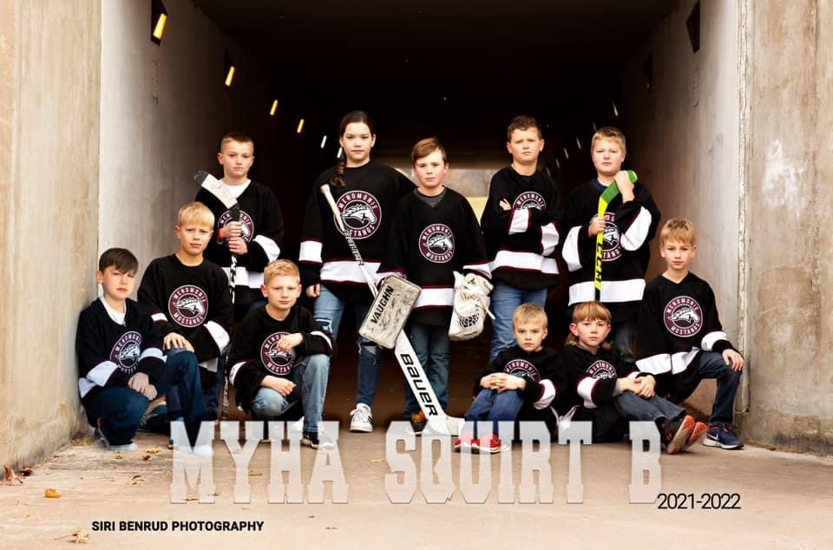
Squirt B
Head Coach: JonPaul Twohig
Assistant Coaches: Mitch Weber, Jacob Miller, Ashleigh Cody
Stout Coach: Jacob Halvorson,
Team Manager: Bruce Freeland

Slide 22
Congratulations Squirt B Players…
Hat Trick:
    Kinzleigh Cody
    Tyler Pember
    Eli Schwedler
    River Styer
Play Maker:
    Kinzleigh Cody
    Tyler Pember
    Eli Schwedler
Zero Patch:
  Mason Freeland

Slide 23
Squirt B Awards
Most Improved: Dayton Dunham
Leadership: Kinzleigh Cody
Sportsmanship: Franklin Pogorelski

Slide 24
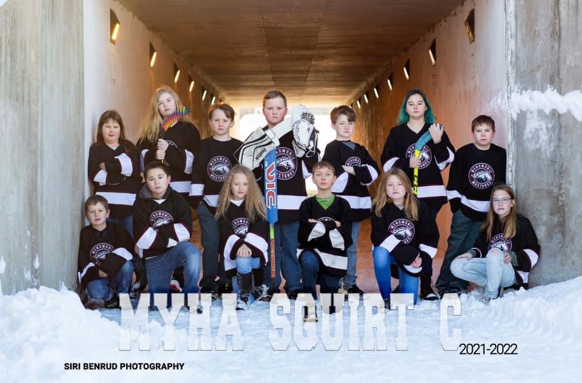
Squirt C
Head Coach: Rob Lindall
Assistant Coaches: Kyle McRoberts, Russ Bahr, Josh Delaney
Stout Coaches: Nick Bowlin
Team Manager: Nicole Delaney

Slide 25
Congratulations Squirt C Players…
Hat Trick:
    Ava Evans
    Tatum Giertz
    Kolten Hintzman
    Levi Mahder
    Zoe Skoug
Zero Patch:
  Maddux Johnson

Slide 26
Squirt C Awards
Most Improved: Ava Brey
Leadership: Maddux Johnson
Sportsmanship: Tatum Giertz

Slide 27
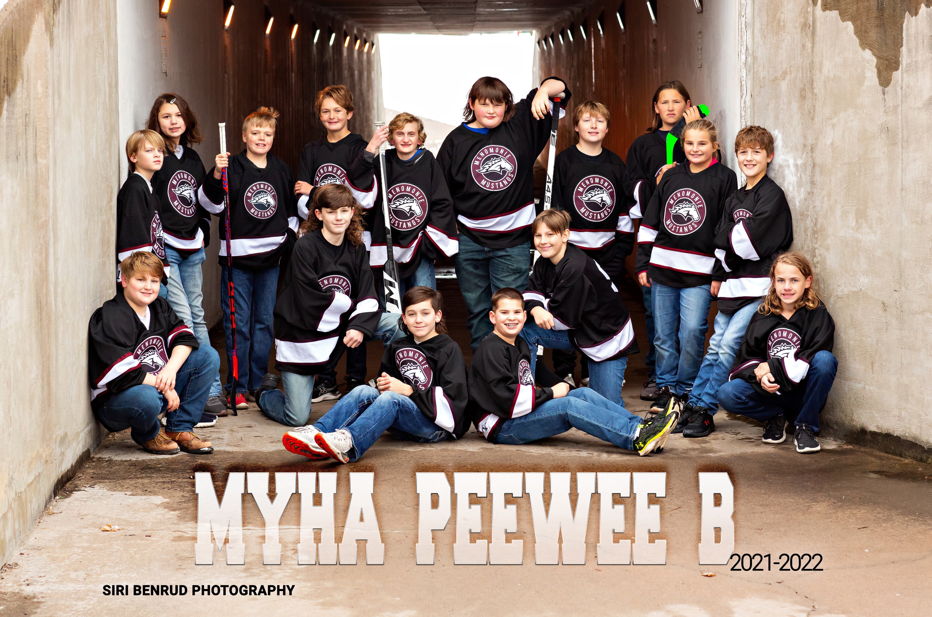
Peewee B
Head Coach: Dan Paulson
Assistant Coaches: David & Sarah Schwedler, Lewis Bjork
Stout Coach: Alex Stuckert
Team Manager: Kari Berthiaume

Slide 28
Congratulations Peewee B Players…
Hat Trick:
  Ryder Anderson
  Quin Rabeneck
  Kellen Turner
Play Maker:
  Blane Anderson
  Ryder Anderson
  Quin Rabeneck
Zero Patch:
  Mason Douglas
  Cashton Steinmeyer

Slide 29
PeeWee B Awards
Most Improved: Breeana Mittlestadt
Leadership: Blane Anderson
Sportsmanship: Kellen Turner

Slide 30
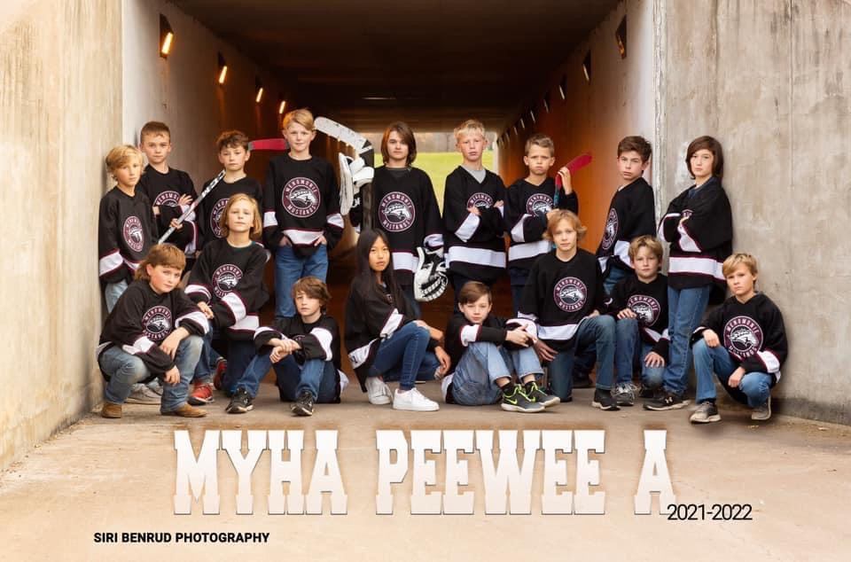
Peewee A
Head Coach: Kaleb Miller
Assistant Coaches: Paul Wurtz & Nolan Dowd
Stout Coach: Matt Dahlseide
Team Manager: Joyce Dahms

Slide 31
Congratulations Peewee A Players…
Hat Trick:
  Brekkin Cody
Play Maker:
  Scott Holcomb

Slide 32
PeeWee A Awards
Most Improved: Jack Czechowicz
Leadership: Jaxon Giertz
Sportsmanship: Allison Xu

Slide 33
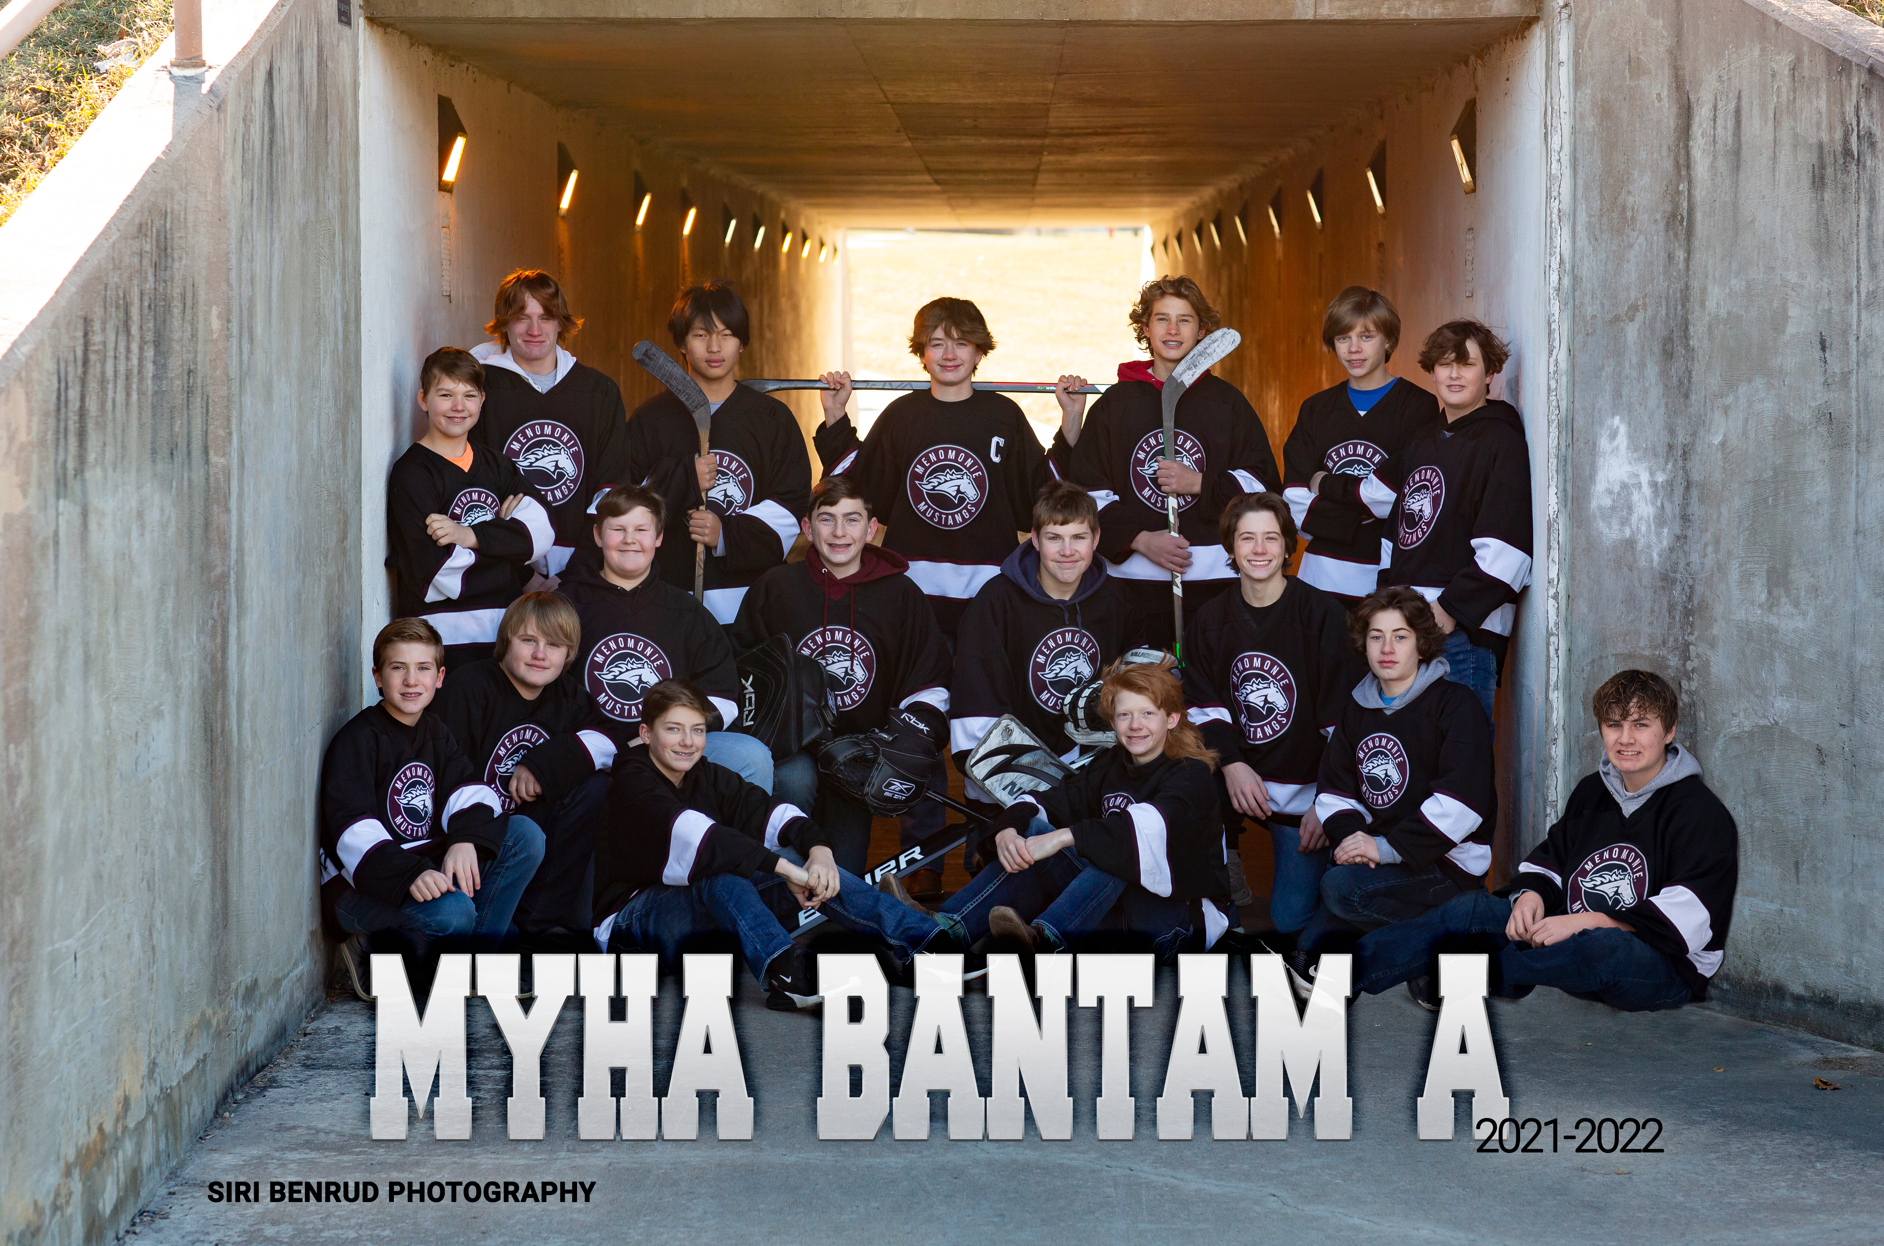
Bantam
Head Coach: Brian Clark
Assistant Coach: Matt Ellis
Stout Coach: Riley Jensen & Logan Nelson
Team Manager: Ginnie Prechel

Slide 34
Congratulations Bantam A Players…
Hat Trick:
    Logan Cockeram
    Mitchell Kopaczewski
    Wren Swaenepoel
    Ryan Xu
Play Maker:
  Peter Cimino
  Liam Wachewicz
Zero Patch:
    Caleb DeVries
    Davin Ellis

Slide 35
Bantam Awards
Most Improved: Conner Berthiaume
Leadership: Peter Cimino
Sportsmanship: Liam Wachewicz

Slide 36
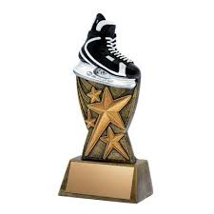
Rob Smith Memorial Award
Rob Smith, who played youth hockey from 1977-1987 and was a gifted and committed athlete.
The criteria used to select the recipient best describe Smith’s ideals on the ice, and include:
  1.) Appreciate and respect your coaches
  2.) Develop an understanding of organized sports
  3.) Learn the importance of team play
  4.) Represent team spirit and good sportsmanship
  5.) Be the best that you can be

Slide 37
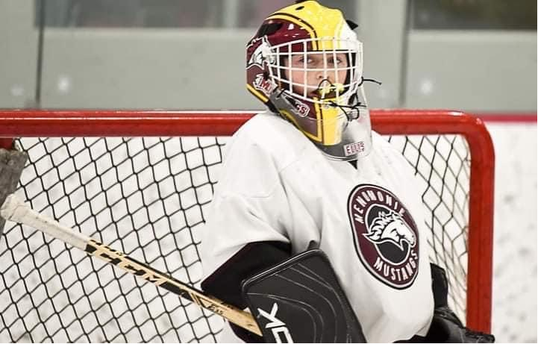
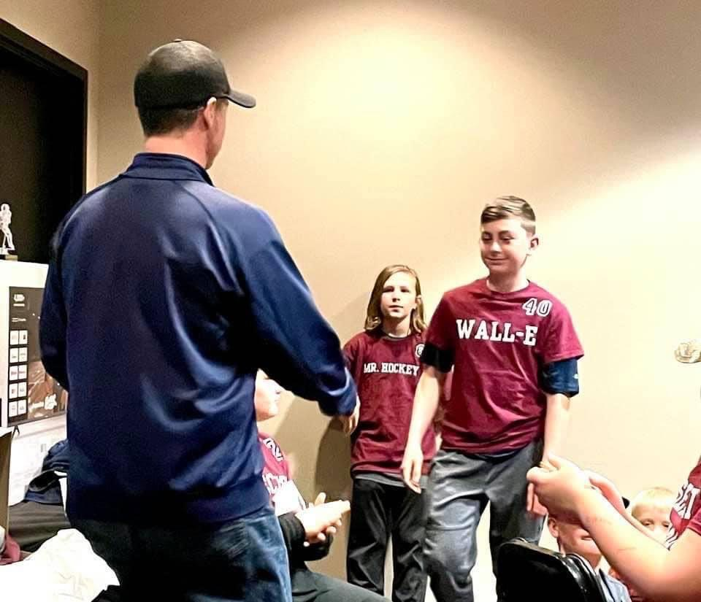
Rob Smith Memorial Award
LAST SEASON
2020-2021 Winner
Davin Ellis

Slide 38
Congratulations to the 2021-2022
Rob Smith Memorial Award Recipient…
Brekkin Cody

Slide 39

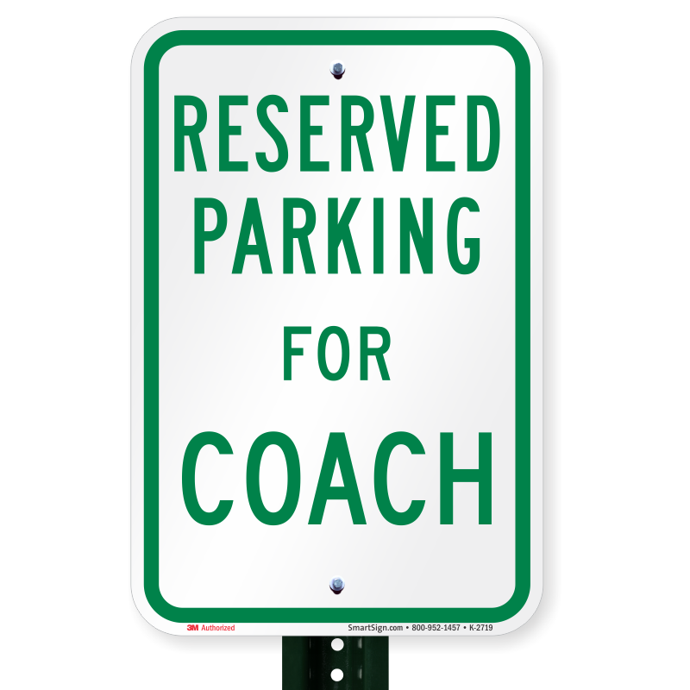
Reserved For…

Slide 40
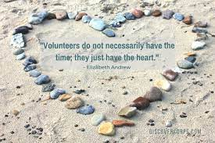
Member of the Year Nominations:
Bob Weir
Brent Pember
Bruce Freeland
Dave & Sarah Schwedler
Heidi Bjork
Jake & Jennie Cimino
JP & Kari Berthiaume
Kelly Gowling
Kyle DeVries
Mike Jax
Rhonda Messerschmidt
Russ Bahr
Stacy Hintzman
Troy Wilkens

Slide 41
Member of the Year:
Congratulations & Thank You to…
JP & Kari Berthiaume

Slide 42
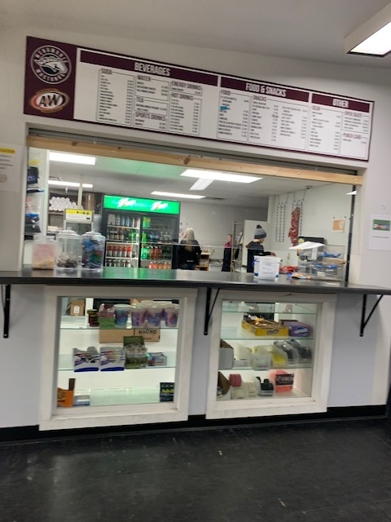
Honorary Outstanding Member of the Year
Outstanding Member of the Year
TROY WILKENS

Slide 43
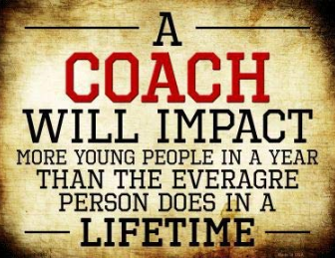
Coach of the Year Nominations:
Alec Skar
Brian Clark
Brian Gowling
Denise Husby
Dave Schwedler
Jacob Halvorson
JonPaul Twohig
Kaleb Miller
Lewis Bjork
Logan Miller
Nolan Dowd
Rob Lindall
Vince Wheeler
Notes:
32 Nominations

Slide 44
Coach of the Year:
Congratulations & Thank You to…
Brian Clark
Notes:
Russ

Slide 45
Annual Meeting
March 22, 2021

Slide 46
MYHA Board & Committee Recognition
Coaches & Team Managers
Peewee Team & Coaches
Committees
Register
Board
  President- Stacy Hintzman
  Vice President - OPEN
  Treasurer – Gary Messerschmidt
  Secretary – Kate Kramschuster
  Director General Operations & Registration – OPEN
  Director Scheduling & Tournaments – Mike Jax
  Director Concessions – Troy Wilkens
  Director Hockey Operations – OPEN
  Director Fundraising –Heidi Dowd
  Director Growth and Retention - OPEN
  Director of Equipment – Kelley Gowling
  Non-Member Representative – Adam Wamboldt
Thank
You!!

Slide 47

Thank you for years of dedication…
Brent Pember
Bob Weir
Dave Schwedler
Kris Wilkens

Slide 48
Board Election
Russ Bahr
Jake Farrah
Tucker Giertz
Rhonda Messerschmidt

Slide 49
Season Overview

Slide 50

MYHA 2019-2020 Goals Recap
  Revenue Growth
  Membership Growth & Retention
  Utilization & Maximization of Volunteer Hours & Facility Improvements
  Increase Skill & Competition Level
  Create a FUN & positive culture

Slide 51
Revenue Growth: Financials
Expenses:
  Ice Bill: $90,000.00 ($75,000.00)
  Fundraising: $61,371.96 ($39,275.49)
  Hockey Operations: $35,878.70 ($43,994.61)
  Concessions: $1,690.42 ($18,577.80)
  General Ops: $13,571.30 ($18,449.31)
    TOTAL: $227,639.09 ($180,879.50)
Income:
  Registration: $45,863.30 ($41,249.44)
  Fundraising: $114,321.86 ($85,661,20)
  Concessions: $43,578.91 ($2,023.63)
  Tournaments: $13,595.00 ($8,276.87)
  General Ops: $10,947.50 ($14,166.47)
  Misc Income: $2,007.18 ($8,766.09)
    TOTAL: $230,313.75 ($160,143.70)
Net Profit/Loss: $2,674.66 (-20,735.80)
Note: The current year column runs only through 2/28/22 and the fiscal year runs to 4/30. Still have coach/official payments to be made.

Slide 52
Membership Growth/Registration Trends:
113

Slide 53
Utilization & Maximization of WAP Hours & Facility Improvements
On-Ice Equipment Donation (attack triangles)
  Thank you Jake Farrah!
New Roof & Humidification System
Orkin Contract
Internet Upgrade
Security Fobs for Trainer Room (to use as Girls Locker Room)
Fully Staffed Concession Stand & Beer Sales
Opportunity: WAP Hours via Positions (vs Concession Stand)

Slide 54
Increased Skill/Competition Level
10 Non-Parent Coaches
Stout Coaches
PeeWee A & Squirt A Region 6 Champs
4 Teams went to STATE: Squirt A, B, C and Peewee A
Squirt C placed 4th at State
Squirt B State Runner Up
Bantam A 1st at the Shawano & 3rd at Barron
WEHL Representation: Aubrie Dowd, David Ellis, Hayden Weir, Ayden Bahr
3 Players representing MYHA on the Region 6 Kohlman Cup Team: Ed Dowd, Jaxon Giertz & Allison Xu
Winning Records & Collective Hardware

Slide 55
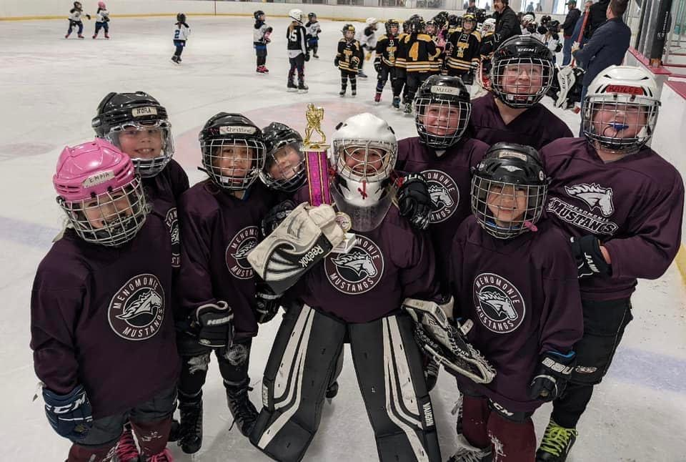
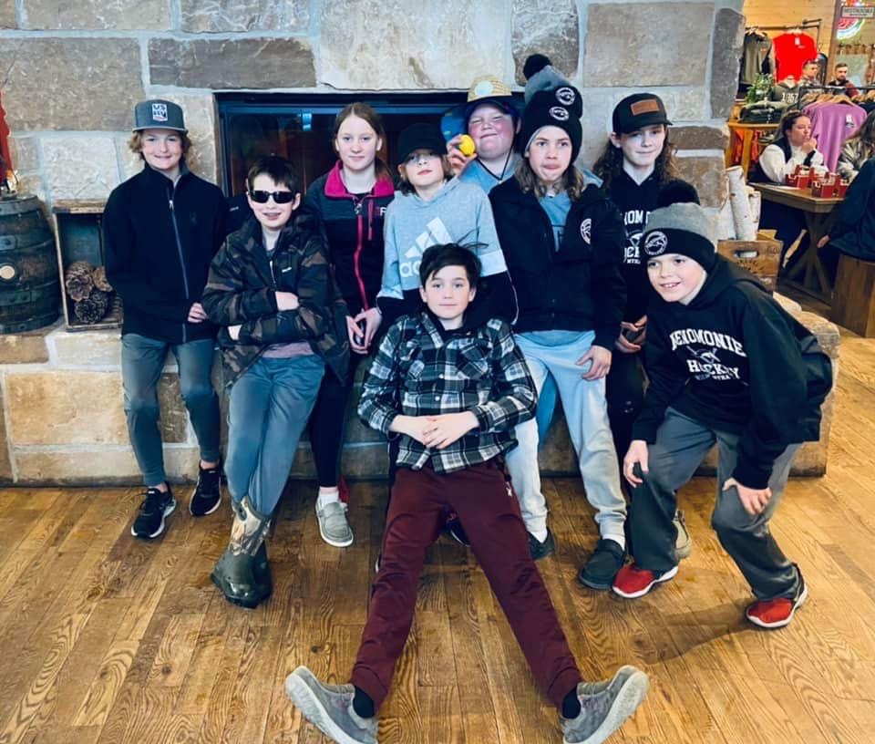
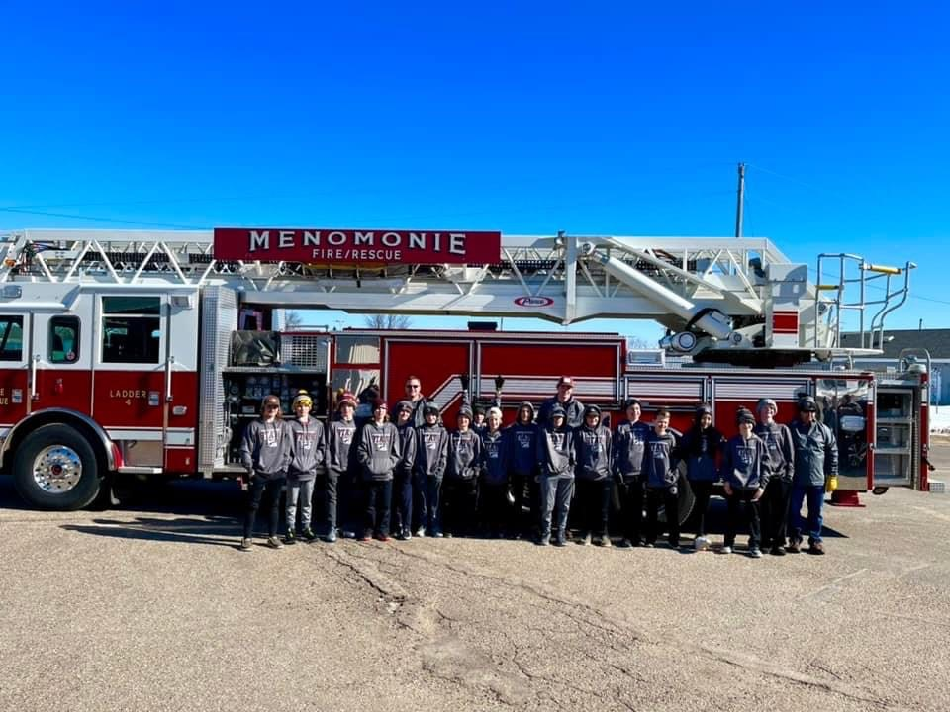
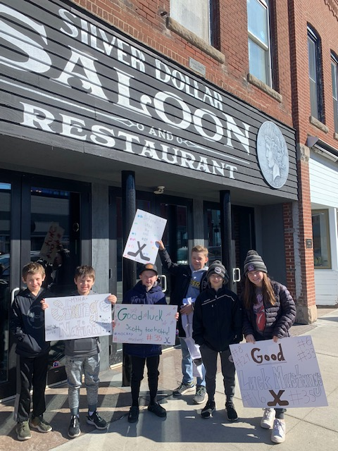
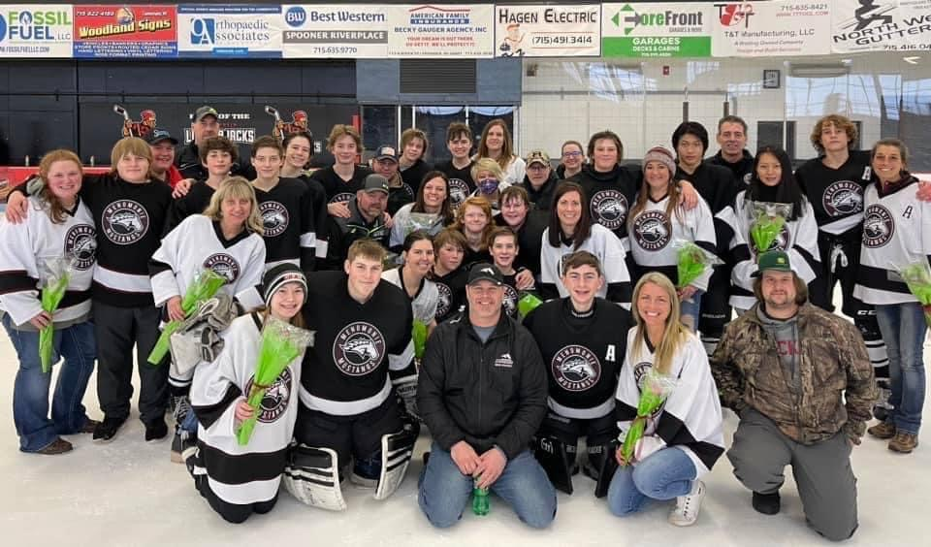
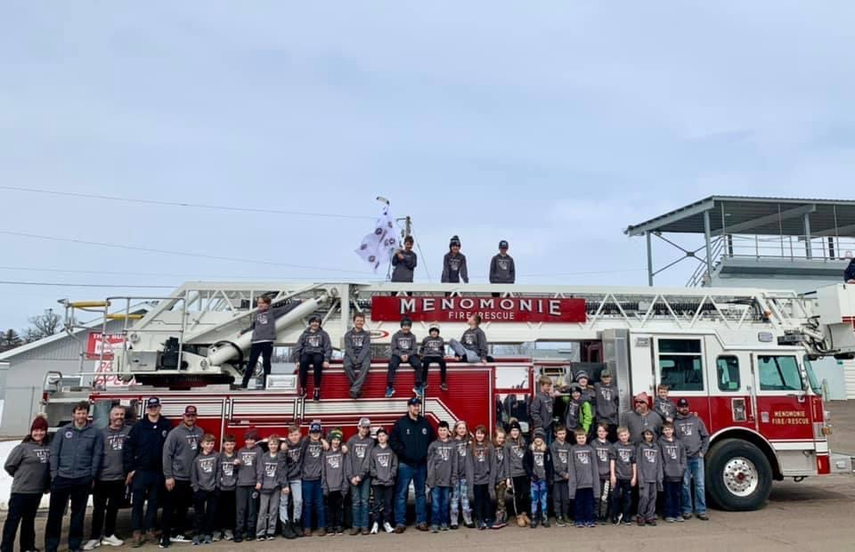
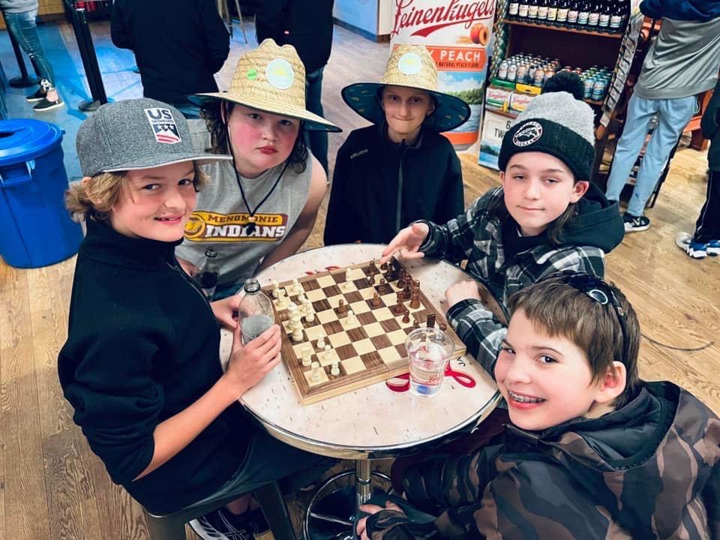
Create a fun & positive culture

Slide 56
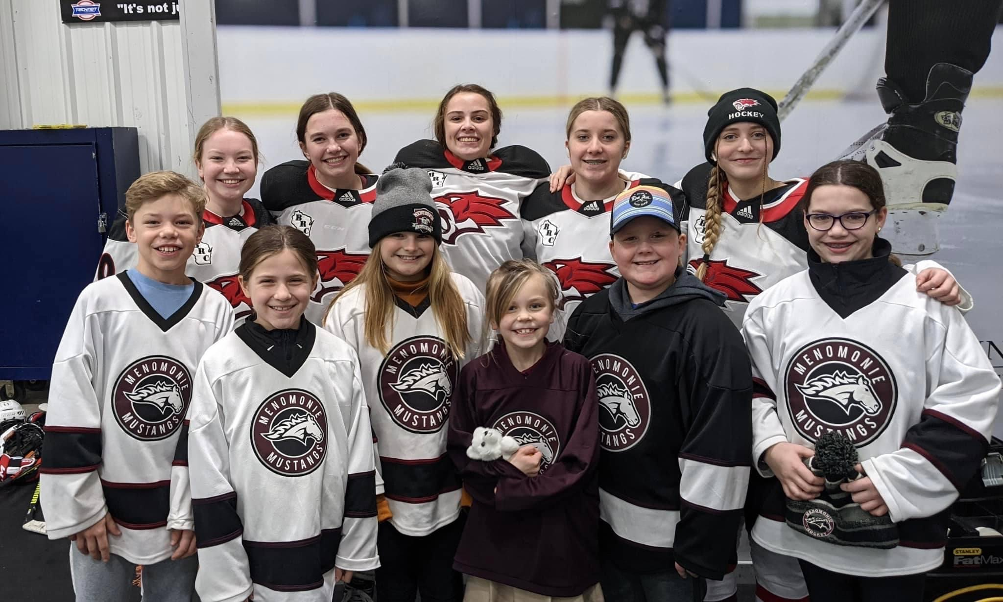
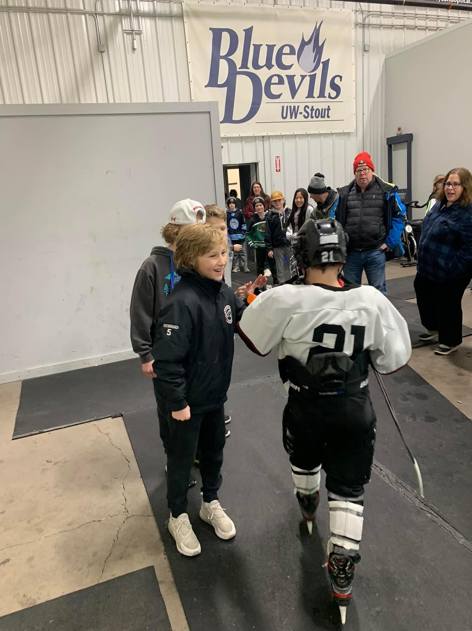
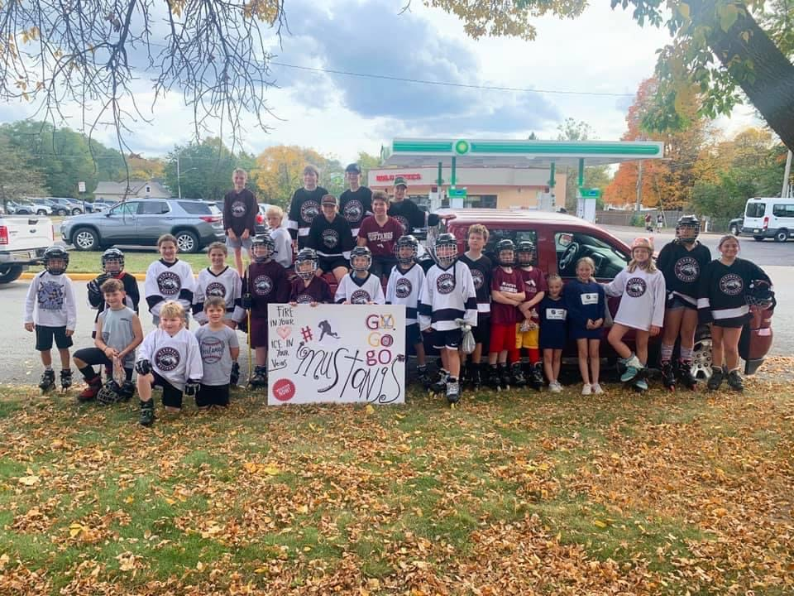
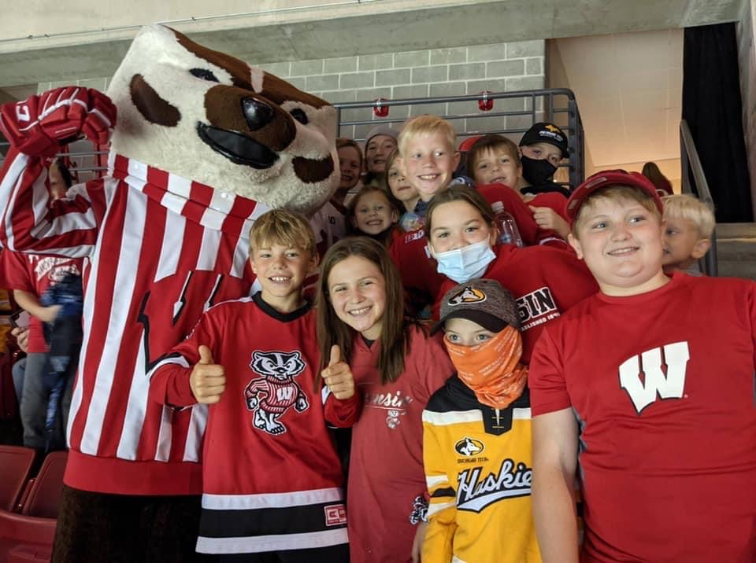
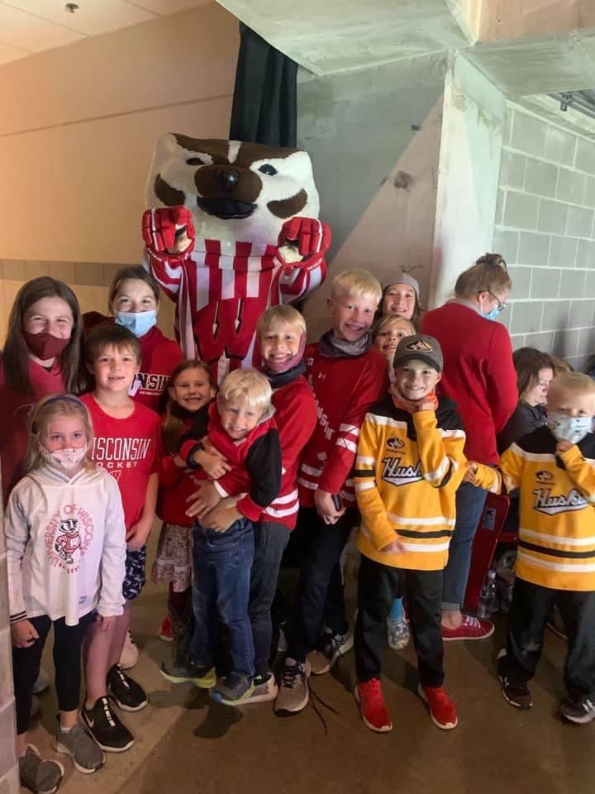
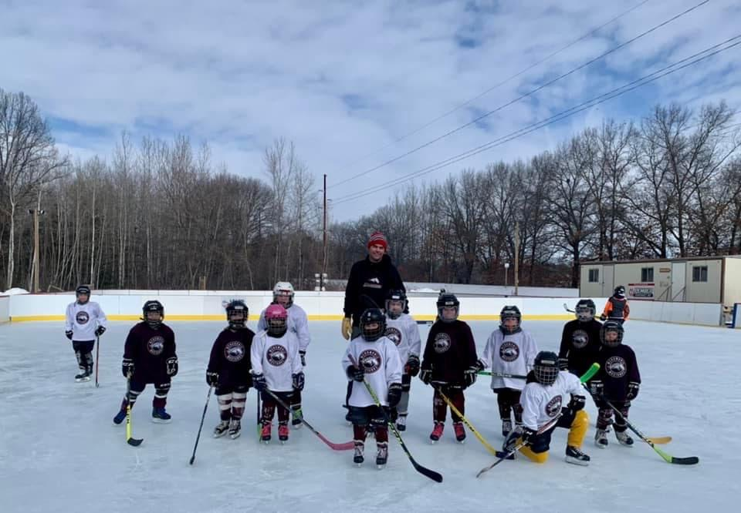
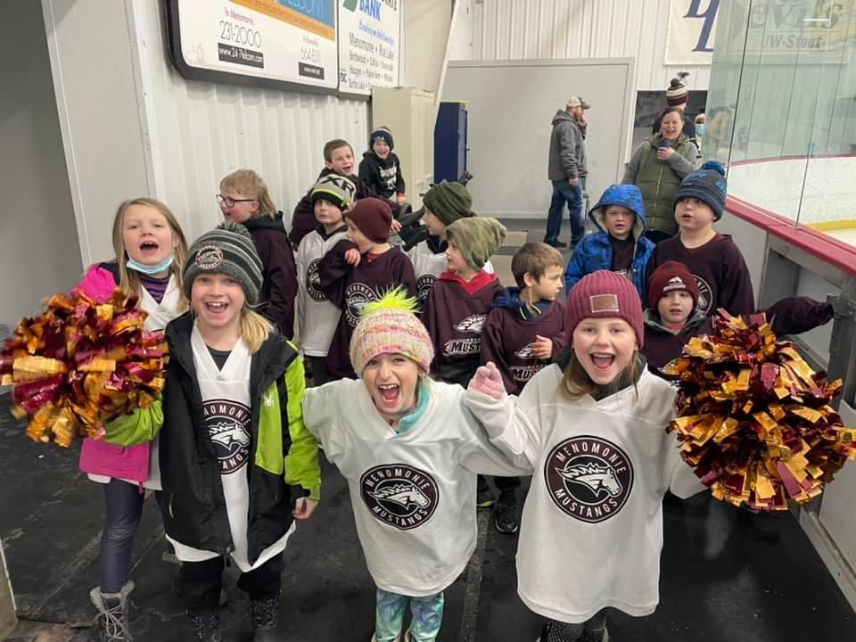
Create a fun & positive culture

Slide 57
Survey
Overall, 85% Satisfied or above
  Unsatisfied gave very good and productive feedback that we can use to improve on.
26.6% think too many work hours
30+% willing to pay more for the same or additional programming
80% feel amount of fundraising is fine (or would even do more)
Split on who likes to play on Holidays/School Breaks but 65%+ willing to play (if home)
89% plan to come back next year!

Slide 58
Fundraising Update
Heidi Dowd

Slide 59
Fundraisers we did in 2021-2022
Pedal Pull
Punky Manor Camping
Community Pancake Breakfast
Purse Bingo
Tournament Raffle Baskets
Wreath Sales
Amazon Smile
Chippewa Valley Energy
Aluminum Cans
Kwik Trip Cards
Sponsorship Program
Test drive event
Red Cross Blood Drive
This resulted in a net fundraising income of $52,498.

Slide 60
Fundraising Team
There are lots of opportunities to be part of this team.
  Chair one of our events
  Contact potential donors
  Pick up items from donors
  Come brainstorm future fundraising activities
  Create raffle baskets from items
  And many more
  All positions have DIBS hours attached. Amount is dependent on hours put in.

Slide 61




MYHA Sponsors

Slide 62


Press Box Sponsors

Slide 63

Zamboni Sponsor

Slide 64
Sign Sponsors
Andersen Windows
Pember Excavating
Kado Insurance
Halverson Bros
Lions Club
Ace Hardware
SOS Security
CR Cooks Concrete
Lee Real Estate and Auction
Marquarkart Motors
Integrity Auto
WestConsin Credit Union
Sunny Daze Management
Royal Credit Union
Accurate Construction
3M
Benedicts Refrigeration
Rassbach Realty
J. F. Ahern Company
Lewis Bjork
Jackie Hunt Office
Kayres Counseling LLC
Indianhead Insurance
Mayo Clinic Health Systems
Mac Contractors
Perkins (TJ Food Service)
Toppers Pizza
Dairy State Bank
24/7 Telecom
Menomonie Optimist
Scheels
Keyes Chevrolet
Bills Distributing
Taco Johns
American Family Insurance Lori Davidson
Cedar Falls Building Systems
Culvers
Stout Craft House
Bob and Steves BP Amoco
TriMart- Midwest Mfg
Markeplace Foods (Coborn's Inc)
Menomonie Eye and Optical
A& J Management
Sears Hometown (Adger Corp)
Red Cedar Chiropractic
Teds Pizza
Burstad Insurance
Lane Tank

Slide 65
Raffle Sponsors
Pember Excavating
Ace Hardware
CR Cooks Concrete
Rassbach Realty
Lewis Bjork
Indianhead Insurance
Dunkin Donuts
Riverside Bike and Skate
Valley Sports Academy
Airtec Sports
Big Dot of Happiness
Wal-Mart Distribution Center
Kwik Trip
Stadium 7 Theater
Synergy
Whitetail Golf Course
Pinewood Golf Course
Caribou Coffee
McDonalds
Cut Rite
Parrot Bay Tanning
Siri Benrud Photography
Scheels
Bills Distributing
Taco Johns (Vance Business Investments)
Culvers
Stout Craft House
Sears Hometown (Adger Corp)
Shine
Rejuvenate Salon and Spa
Marion’s Legacy
324
Color Street
D2
Body Works Athletic Club
Sweet Dessert Temptations
Shackleton Tree Service
Tractor Central
Xcel Energy
Zia
Senegence
Stella & Dot
Fire
Dean & Sue’s
Painted Iris Photography
Jessica Wayne Photography

Slide 66
Raffle Sponsors
Anshus
Applebees
Silver Dollar
Simple Sports
Culvers
Fleet Feet
Play It Again Sports
Stout Craft Co
CJ Candy Store
Log Jam
Bill’s Distributing
Lucette
Scheels (Glen Buschbeck
)

Slide 67

State Shirt Sponsor

Slide 68
Moving Forward

Slide 69
Critical Action Areas
Player Development
Culture
Growth & Retention
Communication
Organization & Project Planning

Slide 70

Critical Action Ideas:
Hockey Player Development:
  Project Calendar & more planning ahead
  Coaching Onboarding
  Hire help, Hire Experts?
  Playbooks with training
  Team Numbers
  Define roles & responsibilities
  Realistic Expectations
  Lushanko Camp
  Team Size
  Board Re-Design
Growth & Retention:
  Member Survey to better understand needs
  Girls Summer Program “Girls Play Too Club”
  Mite Off-Season Program (Puck in the Park)
  School District Involvement
  50th Year Anniversary
  Change Mite/Mini-Mite format
  Early Registration
  Bantam Retention
  8U & Under Director

Slide 71
Critical Action Ideas:
Culture:
  Need for Shared Vision
  Fun ways to bring families together
  50 Year Celebration
  Make MYHA something people “want’ to be part of
  Community Involvement
  School Involvement
  Best Team vs Best Player mentality
Communication/Project Plan:
  Coaching Onboarding
  Communication between PDC & Board
  Leveraging TM for increased communication
  Better Define Role & Responsibilities
  Transparent and early communication around “decisions”
  Develop Communication Plan
  Accountability Calendar
  Plan early

Slide 72
MYHA Highlights & Announcements
  Highlights from this Season:
    Only 33 Unused Hours of Ice (typically around 100 or more)
  Looking forward to next Season:
    2-3 Teams at every level
    Free Bantams (HS eligible)
    Non-Parent Coaches & Parent Coach Mix
    Board Responsibilities/PDC Re-design
    Possible fee increase
    Website Updates (Communication/Level Coordinator)
    Association & Board Accountability

Slide 73

50 Years of MYHA
Meeting on Thursday March 23rd @ 7pm
Ideas:
Hockey Day Menomonie
Alumni Game/Event
Lobby Update
Season Kick-Off
Logo
Jerseys
Fan Gear
HS Flag Skater

Slide 74
50 Years of MYHA – Advertising Opportunities
Trophy case
Historical displays
Jerseys
Alumni Reception
Jersey/shirt for Alumni
Kick off reception/Event
Other Ideas??

Slide 75




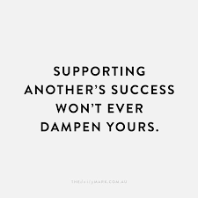




Off-Season
Check out the Off-Season tab on the website.
Good Luck Mustangs…

Slide 76
How can you help?
More Engagement!
Volunteer
  Positions Open (sign-up sheet)
    Fundraising, Growth & Retention & 50 Year Committee Positions
    We need skilled help – use your talent!
Fundraise!
Be committed!
Spread the word!
Go above & beyond!
Be part of the solution, be positive, share ideas!

Slide 77

Board Election Results
Russ Bahr
Tucker Giertz
Rhonda Messerschmidt

Slide 78


