Slide 1
NWBA Webinar Series Presented by ABC Medical 101 on NWBA’s Military Division
January 20, 2022
Notes:
Moderator: (5 minutes for this section)
CLICK RECORD ;)
Welcome to the NWBA Webinar Series Presented by ABC Medical! We are very excited to have you participating in tonight’s session!
Before we get started tonight, I want to share a few housekeeping items:
Everyone attending is asked to mute your audio during the presentation to reduce background noise for the presenters.
If you have any questions, please use the chat box. We will be monitoring this throughout the presentation, and we have time reserved at the end for Q&A.
If you cannot stay for the entire presentation, we will provide a recording of tonight’s session on the NWBA website.

Slide 2
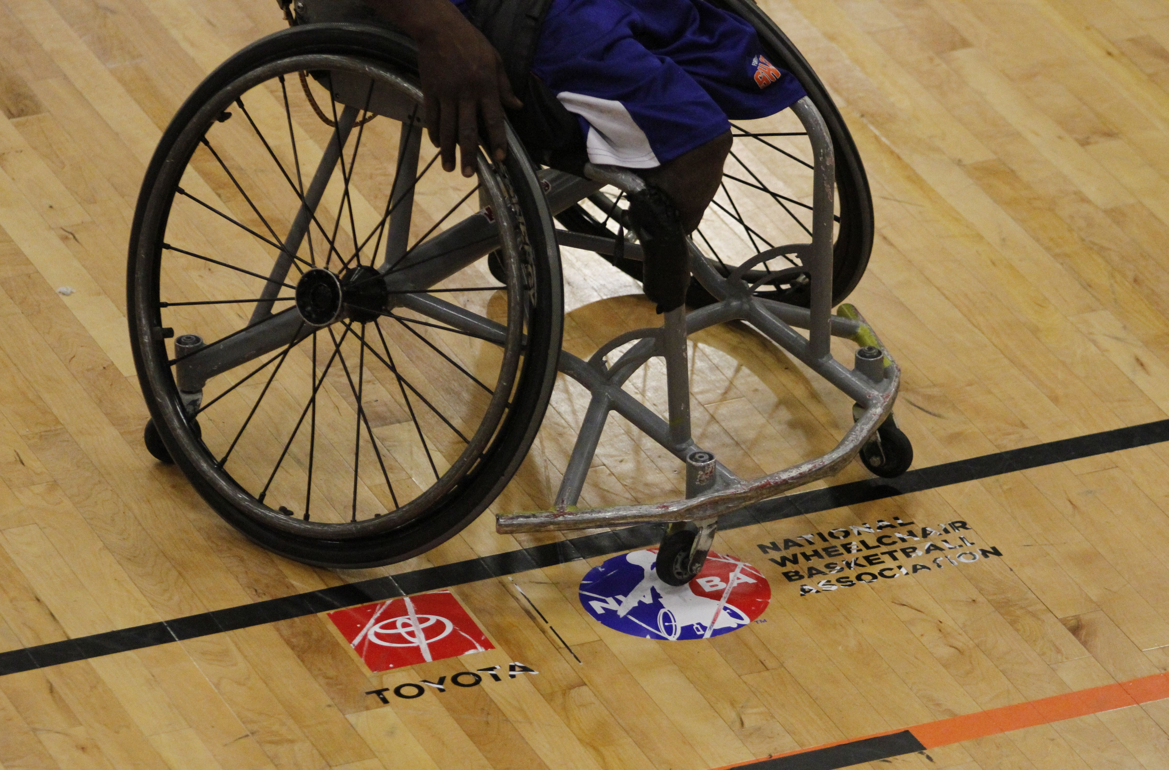
Agenda Topics
NWBA Overview
Collaboration of Military Programming
Background of the Military Division Pilot Program
Expectations
Next Steps
Question and Answer (Q&A)
Notes:
Moderator:
This installment of the NWBA Webinar Series Presented by ABC Medical, will be our discussion entitled “101 on NWBA’s Military Division”. The agenda includes about 45 minutes of content and 15 minutes for Q&A. We will do our best to stay on schedule.

Slide 3
NWBA Overview
Will Waller
Notes:
Will: (10 minutes for this section)

Slide 4
NWBA Overview – What is the NWBA?
What is the NWBA?
Notes:
Will:

Slide 5
NWBA Overview – Qualification
Qualification
Notes:
Will:

Slide 6
NWBA Overview – Eligibility
Eligibility
Notes:
Will:
Next slide goes to Connie to cover “Military Programming Collaboration”

Slide 7
Military Programming Collaboration
Connie Moore
Notes:
Connie: (10 minutes for this section)

Slide 8
Military Programming Collaboration
Warrior Games, Invictus Games, NWBA Military Division and how they all work together
Notes:
Connie:

Slide 9
Military Programming Collaboration
Who to contact to get involved
Notes:
Connie:
Next slide goes to Hannah and Lee to cover “Military Division Pilot Program Background ”

Slide 10
Military Division Pilot Program Background
Lee Montgomery and Hannah Walker
Notes:
Hannah/Lee: (10 minutes for this section)

Slide 11
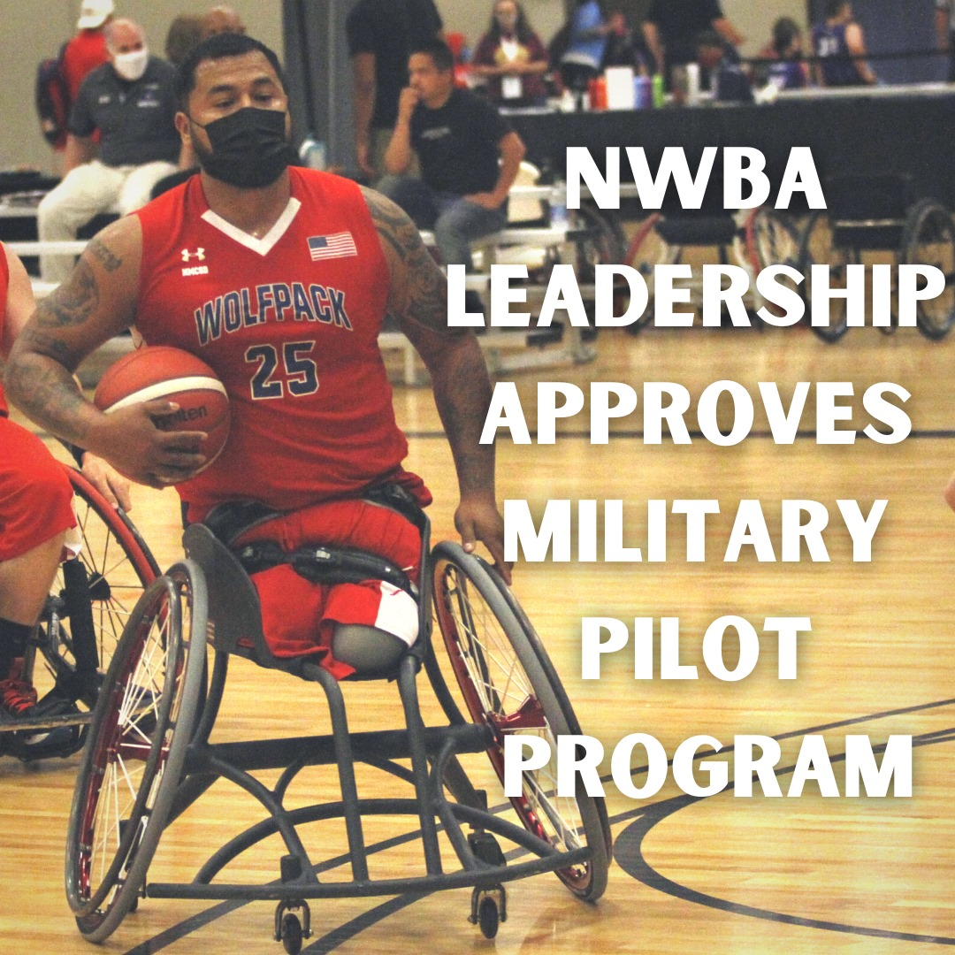
Military Division Pilot Program
Pilot Program – Aug. 10, 2021 Announcement: https://www.nwba.org/news_article/show/1177990
Mission/Vision of the program - NWBA committing to its roots
Leadership support
Notes:
Hannah/Lee:

Slide 12
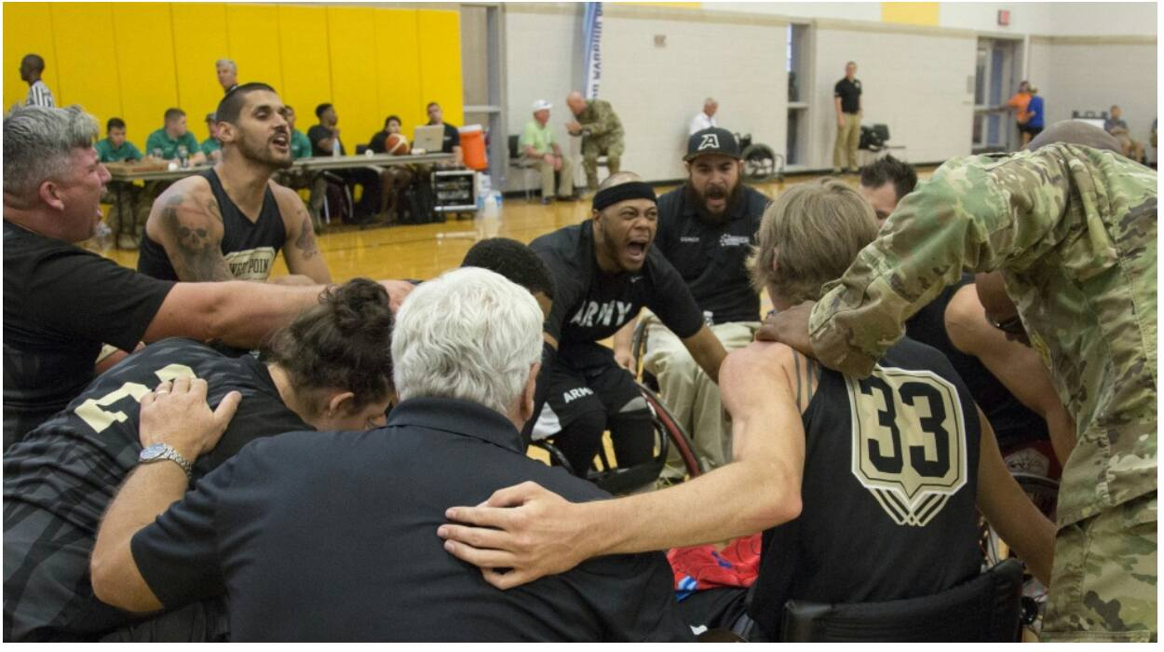
Military Division Pilot Program
Success measures
Support in this shared responsibility
Notes:
Hannah/Lee:

Slide 13
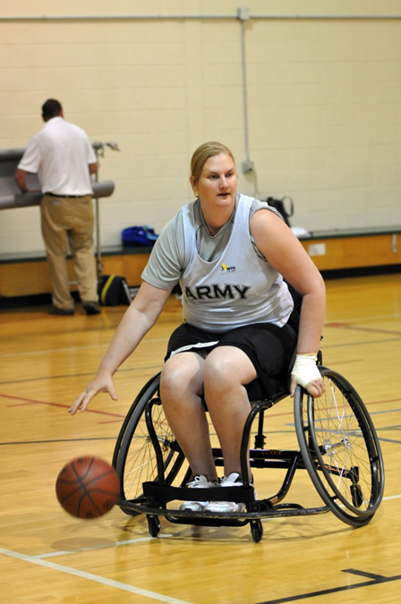
Military Division Pilot Program
After several years of discussion, excited to provide additional opportunities to the military population and expand eligibility to military athletes with non-physical disabilities
Create opportunities to bring more/new players and more/new teams into the game
WE NEED YOUR HELP – recruit teams and players
Notes:
Hannah/Lee:

Slide 14
Military Division Pilot Program
Classification
Notes:
Hannah/Lee:
Next slide goes to Brandon to cover “Expectations”

Slide 15
Expectations
Brandon McBeain
Notes:
Brandon: (10 minutes for this section)

Slide 16
Expectations
Registration – how and why (explain value proposition)
Team Composition / Team Registration / Dual Rostering
Events
Notes:
Brandon:

Slide 17
Expectations
Funding Opportunities (NWBA Website): https://www.nwba.org/funding
There are 20 Grant / Scholarship Opportunities to Consider on NWBA Link Above
Equipment resources
VA and PVA contacts/information
CAF and NWBA Training Zone videos:
https://www.nwba.org/news_article/show/1115039
Notes:
Brandon:
The first website listed on this slide is the Funding Opportunities page of the NWBA Website
Some grants are for individuals, some are for programs/organizations
The grants listed provide a wide variety of financial support for equipment, travel expenses, program support, childcare expenses, etc.
Check them out—take advantage of this list!
Next slide goes to Hannah and Lee to cover “Next Steps”

Slide 18
Next Steps
Lee Montgomery and Hannah Walker
Notes:
Hannah/Lee: (10 minutes for this section)

Slide 19
Military Division Pilot Program
Next Steps
Notes:
Hannah/Lee:

Slide 20
Questions?
Notes:
Hannah/Lee: (15 minutes for this section)
Thank you to all our presenters for sharing those updates and information. We will now move to the general questions and answer portion. Please feel free to unmute yourself to ask a question or type it in the chat.
Next slide goes to Moderator to close

Slide 21
Thank you!
Notes:
Moderator:
Thank you to all of you for taking time out of your busy schedules to participate in the NWBA Webinar Series Presented by ABC Medical. We are currently scheduling a follow-up webinar to continue this discussion of our Military Division so be on the lookout for those details and be sure that you are following the NWBA on social media. We hope you have a great evening and a successful season!

