Slide 1
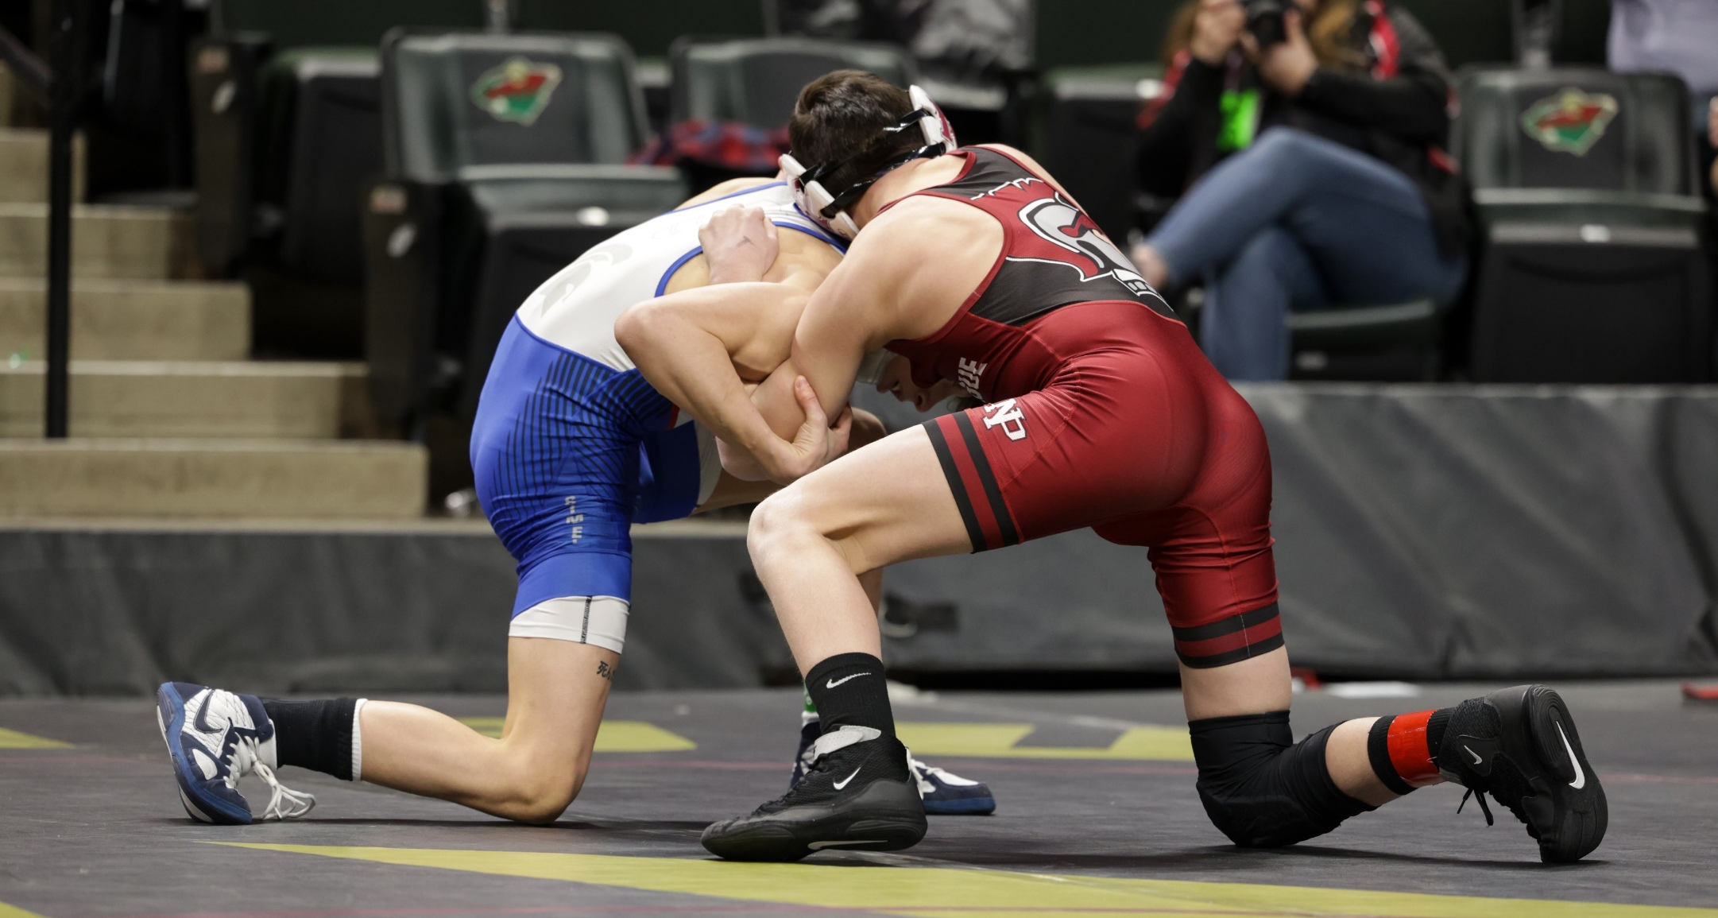

2024-25 NFHS Rules changes
Notes:
These are the NFHS Wrestling Rule Changes for 2024-25 that have been accepted by the MSHSL. MN State Coordinator, Rick Rud, will review these changes with you.

Slide 2
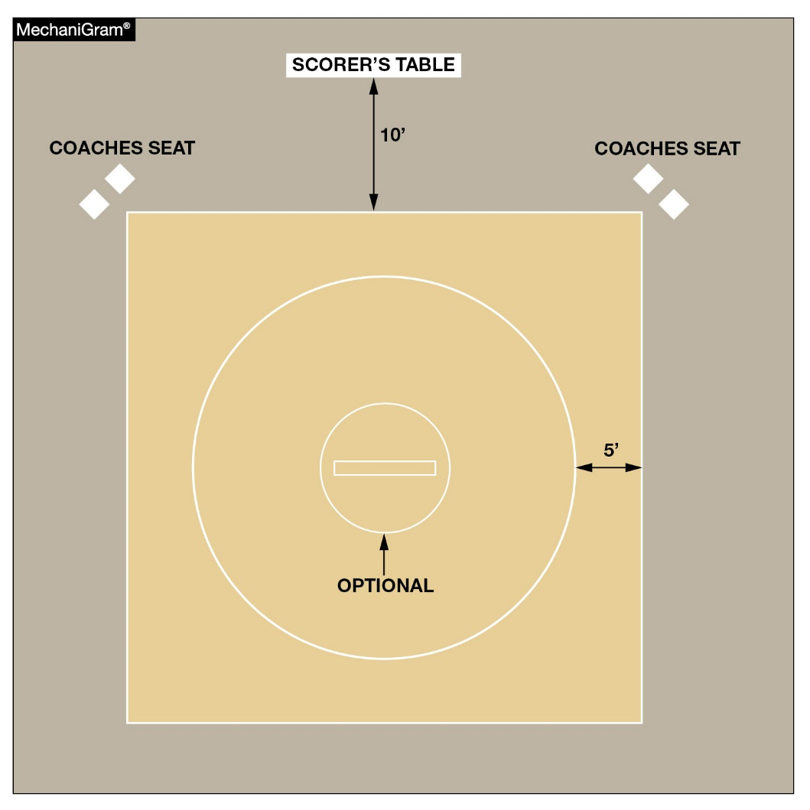
Rule 2-1-3 mat
The 10-foot circle at the center of the mat is now optional.
Notes:
The starting lines of a mat indicate the center of the mat and the 10-foot circle is not needed. With the new mat designs that have a large mascot or logos, it gives a refreshing look to the wrestling mats. Wrestlers and officials know where the center of the mat is located without the 10-foot circle being present.
All rules that referred to “the 10’ circle” have been modified to say, “the Center of the mat”.

Slide 3
Optional 10’ circle rule 2-1-4
ART. 4 . . . Starting lines, 1 inch wide, shall be placed at the center of the mat and the front line should lie on the diameter of the optional 10-foot circle or the diameter of the circle that encloses the wrestling area. These 1-inch starting lines shall be parallel, 3-feet long, and 12 inches from outside to outside. The two 3-foot lines shall be connected on one end by a 1-inch red line and on the other end by a 1-inch green line.
Rationale:
Same.
Notes:
The starting lines are required and remain the same as in the past.
When a referee is in conference with a coach, the wrestlers are ordered to the “center of the mat” rather than the 10’ circle as in the past. Rule 6-6-6
The referee will require each wrestler to make an honest attempt to wrestle within the “center of the mat”. Rule 7-6-1 - It is the responsibility of contestants, coaches and referees to avoid the use of stalling tactics or allowing the use thereof.

Slide 4
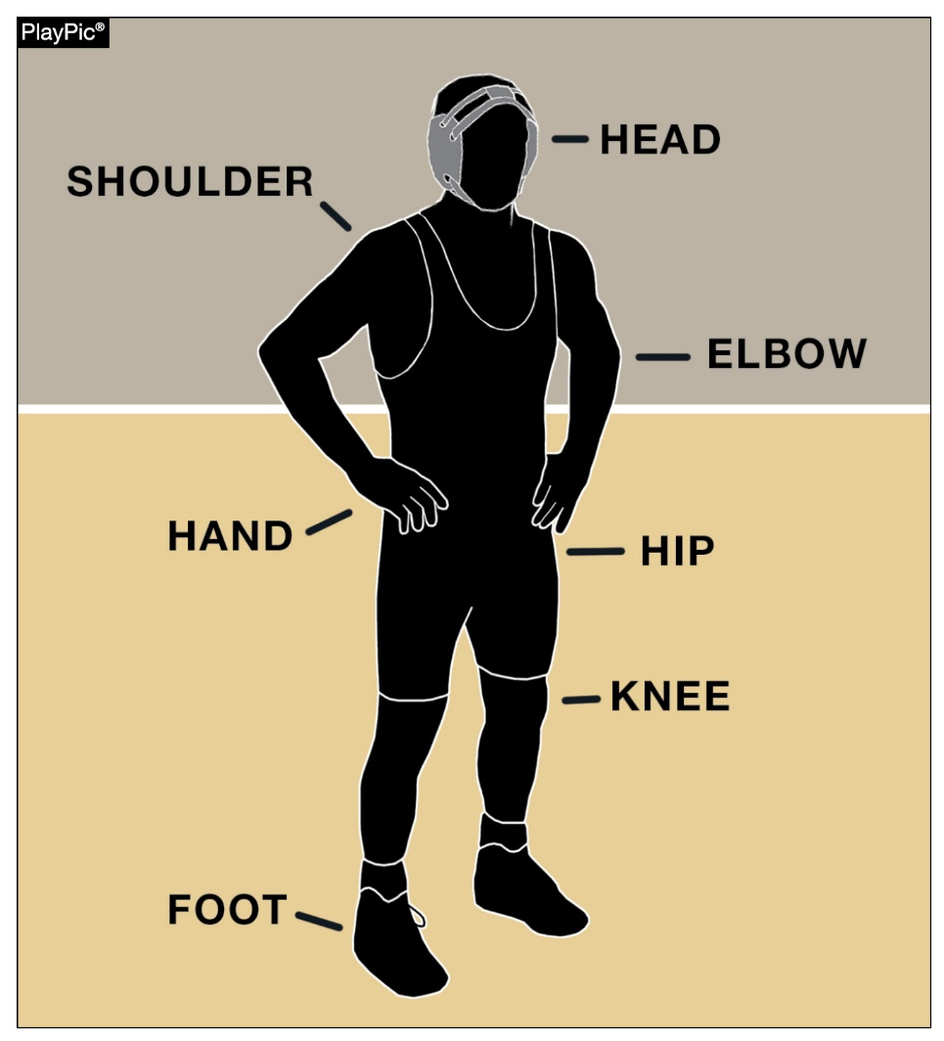
Points of contact rules 5-10, 5-15-1, 5-15-2c, 5-15-3, 5-18, 5-22-1, 5-22-2, 5-25-1, 5-25-3, 6-4-1
Only one point of contact must be inbounds (inside or on the boundary lines) in order for wrestling to continue. Points of contact include the head, shoulder, elbow, hand, hip, knee and foot.

Slide 5
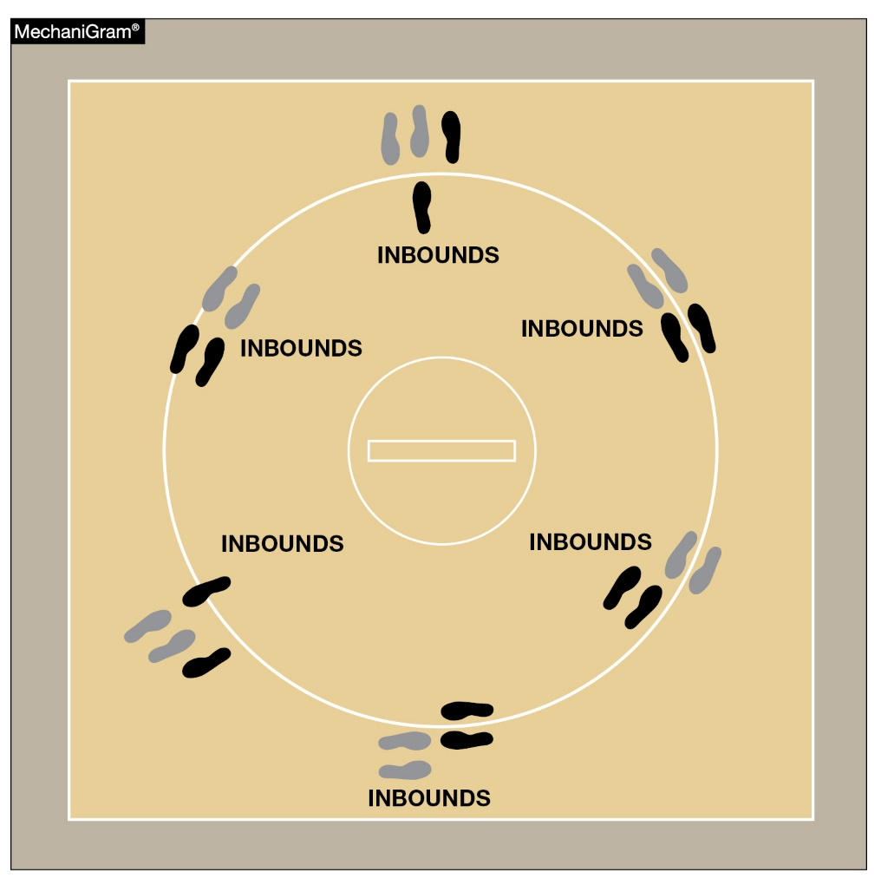
Points of contact rules 5-10, 5-15-1, 5-15-2c, 5-15-3, 5-18, 5-22-1, 5-22-2, 5-25-1, 5-25-3, 6-4-1
Only one point of contact must be inbounds in order for wrestling to continue.

Slide 6
Points of contact rules 5-10, 5-15-1, 5-15-2c, 5-15-3, 5-18, 5-22-1, 5-22-2, 5-25-1, 5-25-3, 6-4-1
Only one point of contact must be inbounds and on the mat for “Control”
This includes:
Takedowns
Reversals
Escapes
Nearfalls
Falls
One point of contact inbounds, or on the line, and it must remain in contact with the mat.
Notes:
All points relating to control are amended with this rules change. Takedowns, Reversals, escapes, nearfalls, and falls all require at least one point of contact on the mat inbounds or on the line. This rule would safely eliminate the subjectivity of the out of bounds call. The rule change would also help coaches and wrestlers understand more clearly what out of bounds is and help officials call out of bounds more consistently.

Slide 7
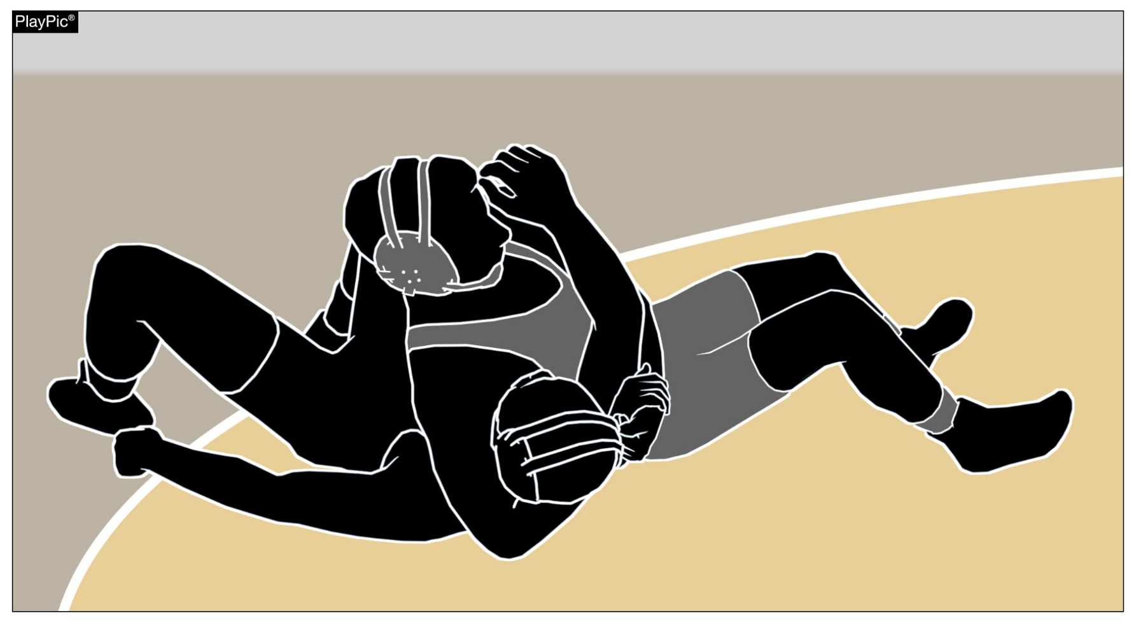
Near-fall rules 5-11-2g, 5-11-2h, 5-11-3, 9-1-5
Depending on how long criteria is met, a wrestler may score two, three, four or five points for a near-fall.
Notes:
The goal in wrestling is to pin your opponent. Changing the near-fall points awarded should motivate wrestlers to work for a fall and simplify the points award based on how long the wrestler is held in near-fall criteria.
The new near falls points awarded are as follows: If the near-fall criteria are met for two continuous seconds a two-point near-fall will be earned. If near-fall criteria are met for three continuous seconds a three-point near-fall will be earned. If near-fall criteria are met for four continuous seconds a four-point near-fall will be earned.
If the defensive wrestler is injured, indicates an injury or bleeding occurs prior to the near fall criteria being met, but the referee determines the near fall was immanent, a 2-point NF will be awarded. Likewise, if a NF has been secured with 2, 3 ,4 points and the defensive wrestler is injured, indicates an injury or bleeding occurs the NF earned plus one point for match stoppage will be awarded. There can be a five-point near fall.
While it is desirable that the visual hand count be used, it is acknowledged that there are some situations in which the referee will be unable to signal because of the necessity to move quickly from one side of the wrestlers to the other, on your feet or down on the mat, in order to be in a position to observe that criterion is being met. Under these conditions, the referee may be unable to start the visual hand count at the point when near-fall criteria is met. (9-1-5)

Slide 8
Near-fall scoring symbols
All symbols remain the same except the following:
N₂ Near-Fall 2 seconds
N₃ Near-fall 3 seconds
N₄ Near-fall 4 seconds
N₅ Near-fall (as a result of injury, indication of injury or bleeding occurs after four-points near-fall has been earned)
Notes:
All Track Wrestling scoring applications have been updated with the new scoring rules, symbols, and points.

Slide 9
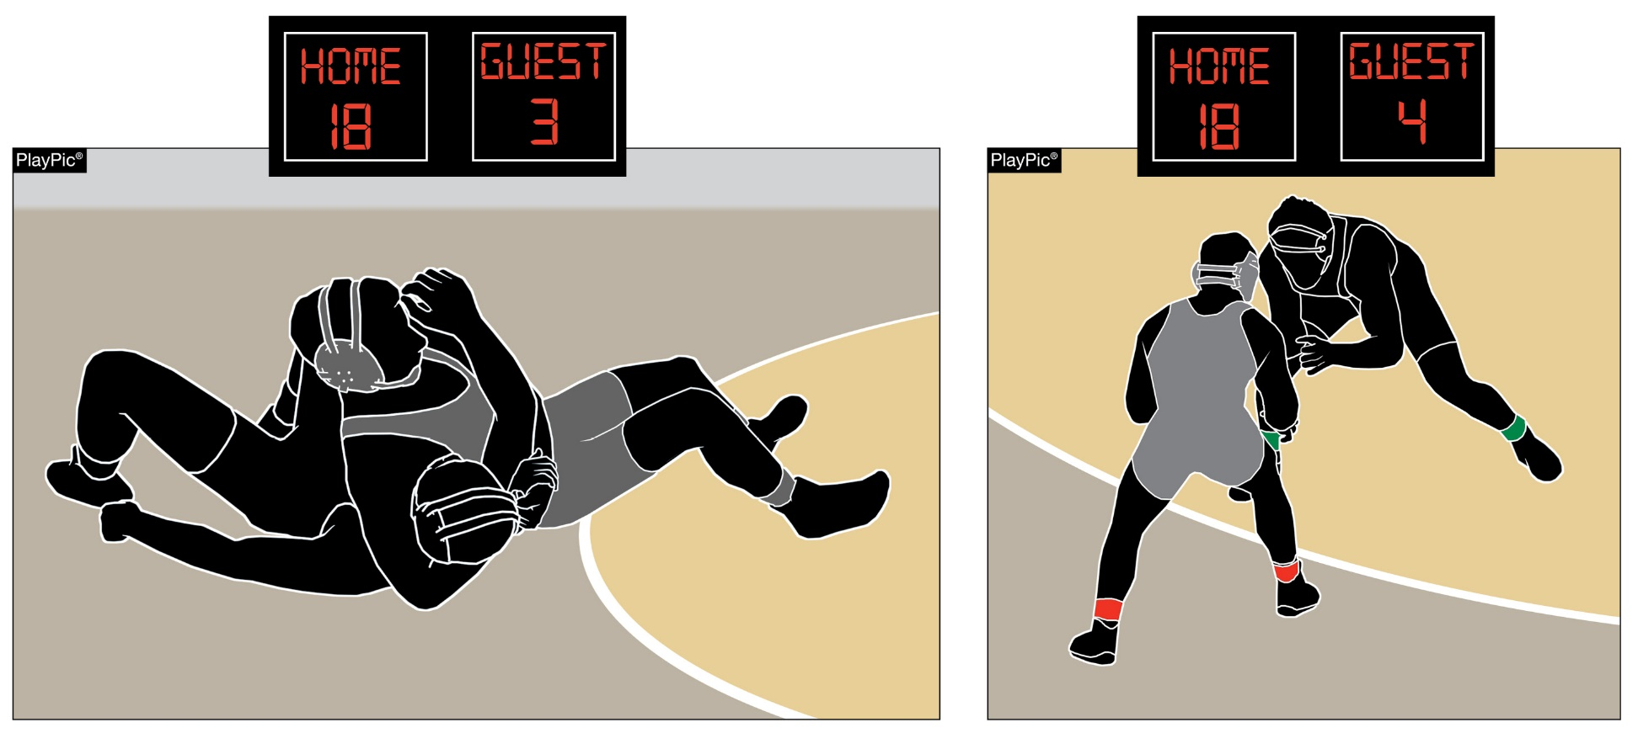
Technical fall rule 5-11-4
A
B
In PlayPic A, the offensive wrestler has met near-fall criteria to take a 15-point lead. When the criteria is no longer met, as in PlayPic B, the match ends with a technical fall.
Notes:
ART. 4 . . . A technical fall occurs when a wrestler has earned a 15-point advantage over the opponent, however;
If a takedown or reversal, straight to a near-fall criteria creates a 15-point advantage, the match shall continue until the near-fall criteria is no longer met. Conclusion of the near-fall criteria is immediate.
If the NF earned creates the tech fall, then the match continues until the pinning situations ends (the defensive wrestler can defend themselves and we are out of the pinning situation.)

Slide 10
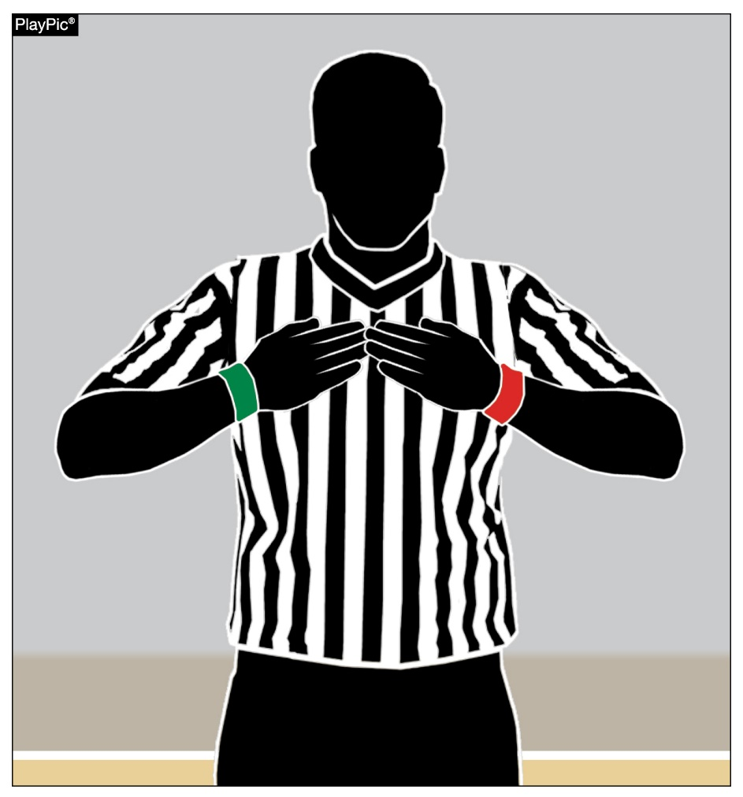
Signal chart
A signal has been added to the signal chart. Tapping the chest with hands flattened indicates a referee’s time-out.
Notes:
Referee's time-out. If the referee needs to address a situation not covered by injury, blood or recovery time, a referee's time-out shall be charged. That signal would be both hands/fingers pointing inward to the referee’s chest.
This signal is used universally in many other sports but has never been codified in the NFHS Wrestling Rules Book. An additional signal needs to be added to the Official Wrestling Signal making it signal #29.

Slide 11
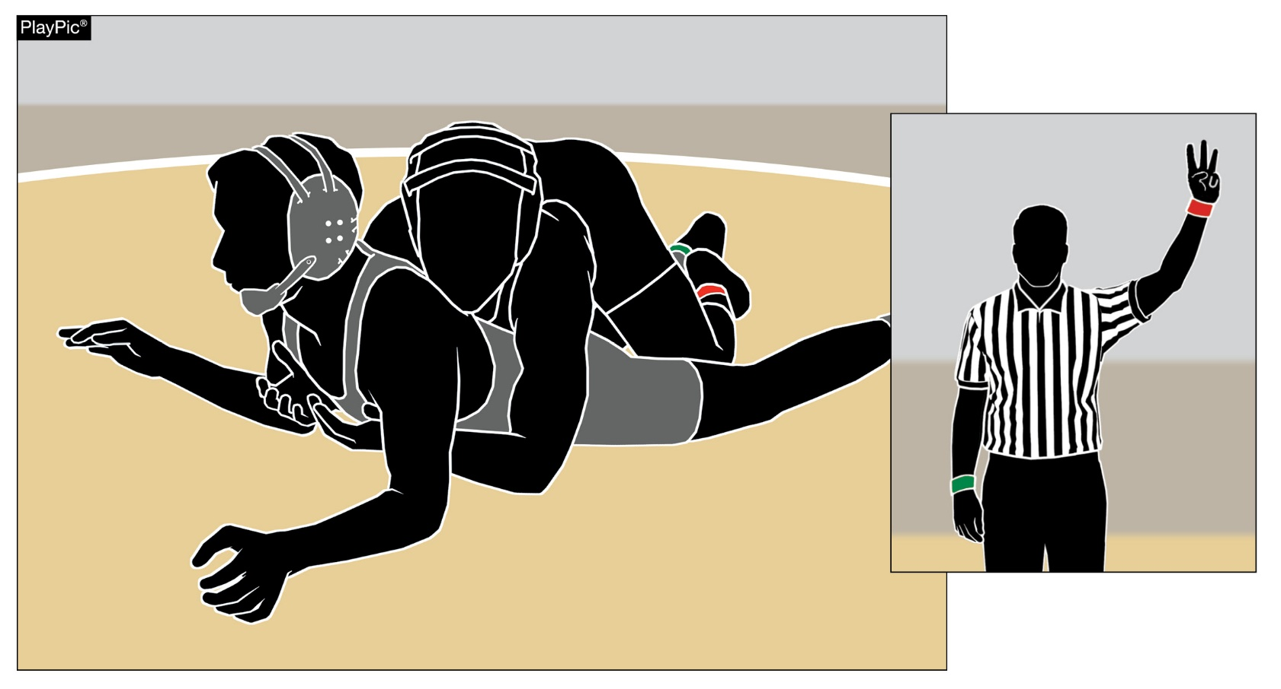
Takedown rule 9-1-2, summary of scoring
When a takedown is secured, the wrestler shall be awarded three points.
Notes:
When a takedown is secured, the wrestler shall be awarded three match points.
The Rationale behind this change was to promote more scoring activity when wrestlers are in neutral position.
The scoring symbol for a takedown is T3

Slide 12
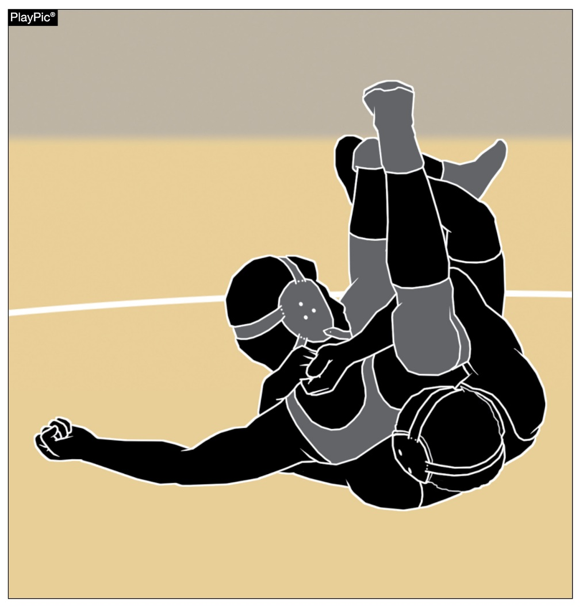
Dangerous maneuvers and holds
Coaches and referees must work together to keep certain techniques out of wrestling. Illegal holds as the nelson cradle shown here must be eradicated from the sport. The NFHS abhors any move, maneuver or hold that intentionally injures limbs, joints, penetrates any body cavities or renders a wrestler unconscious.

Slide 13
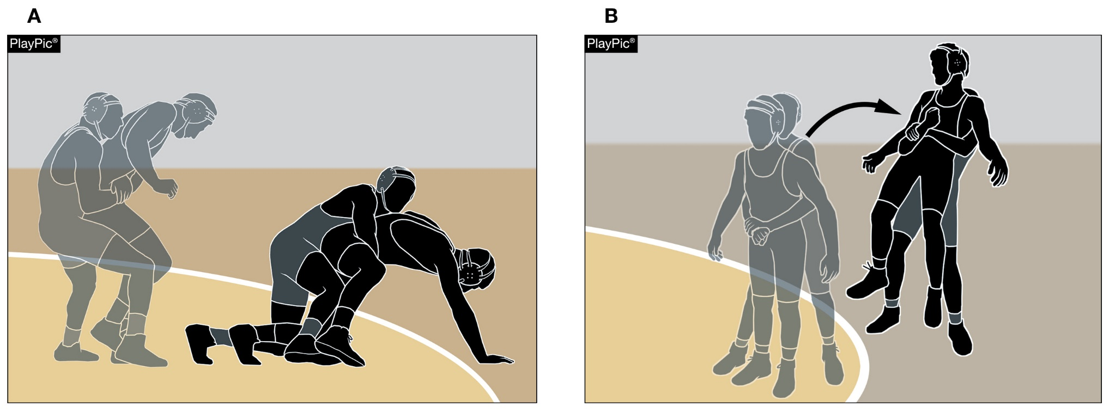
Stalling
Defensive wrestler not wrestling aggressively (A) and pulling the wrestler out of bounds from behind (B) are acts of stalling. Penalizing stalling helps ensure an exciting, competitive match.

Slide 14
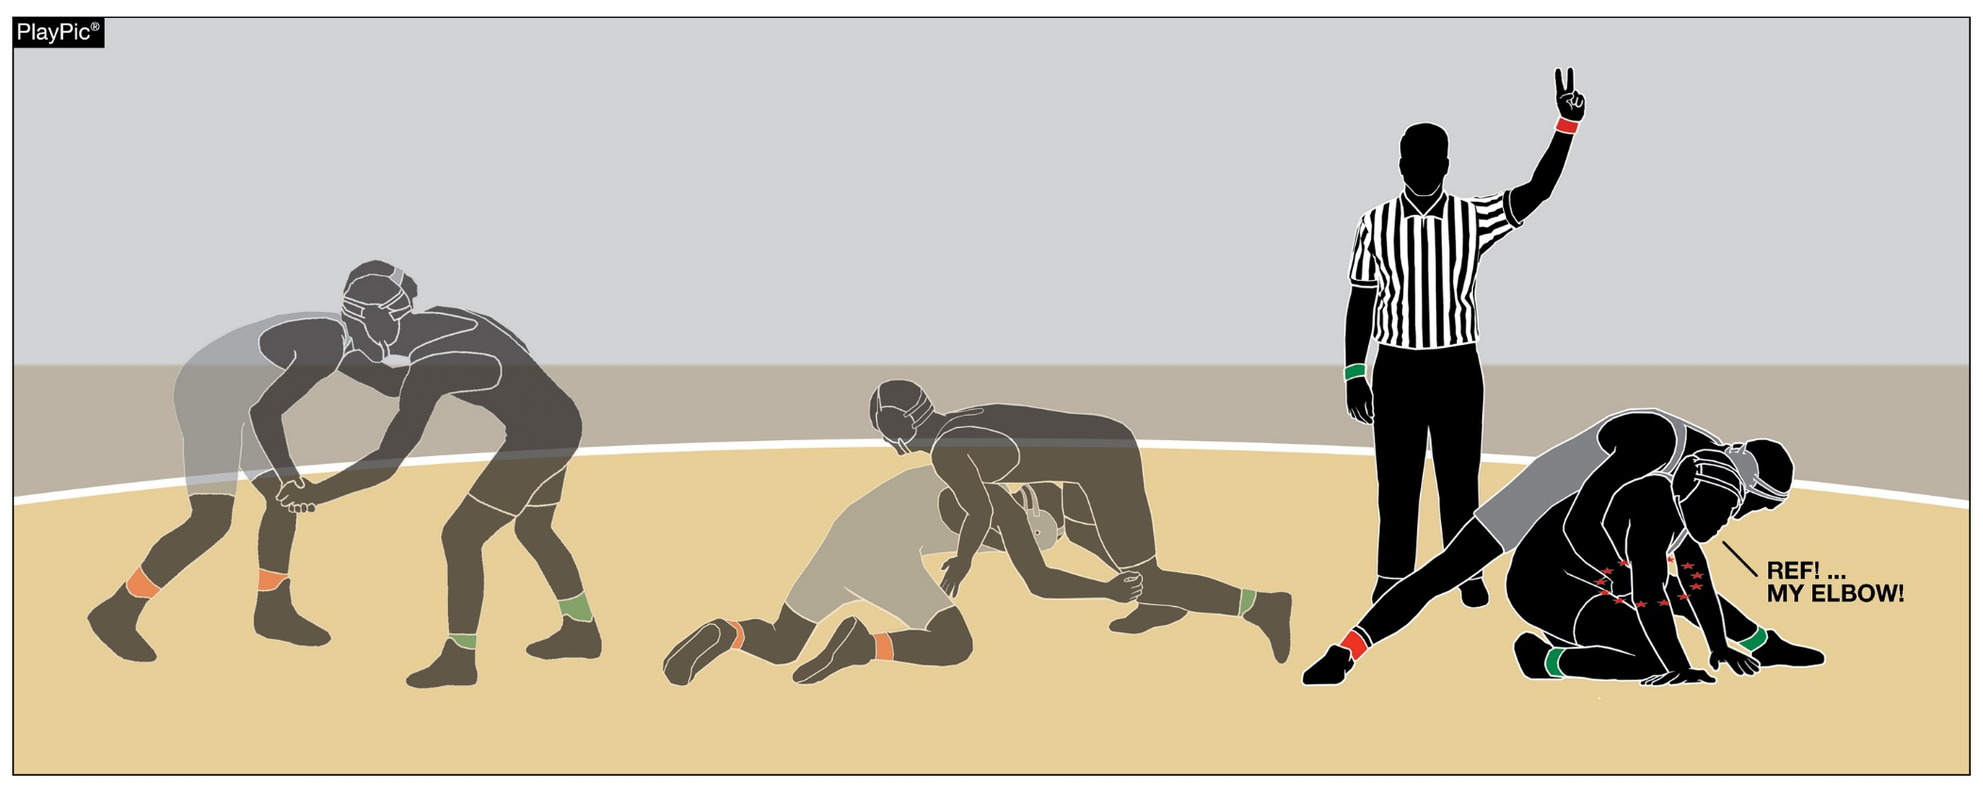
IMMINENT SCORING
Imminent scoring is typically referred to as a situation where one wrestler is on the verge of scoring point(s).

