Slide 1
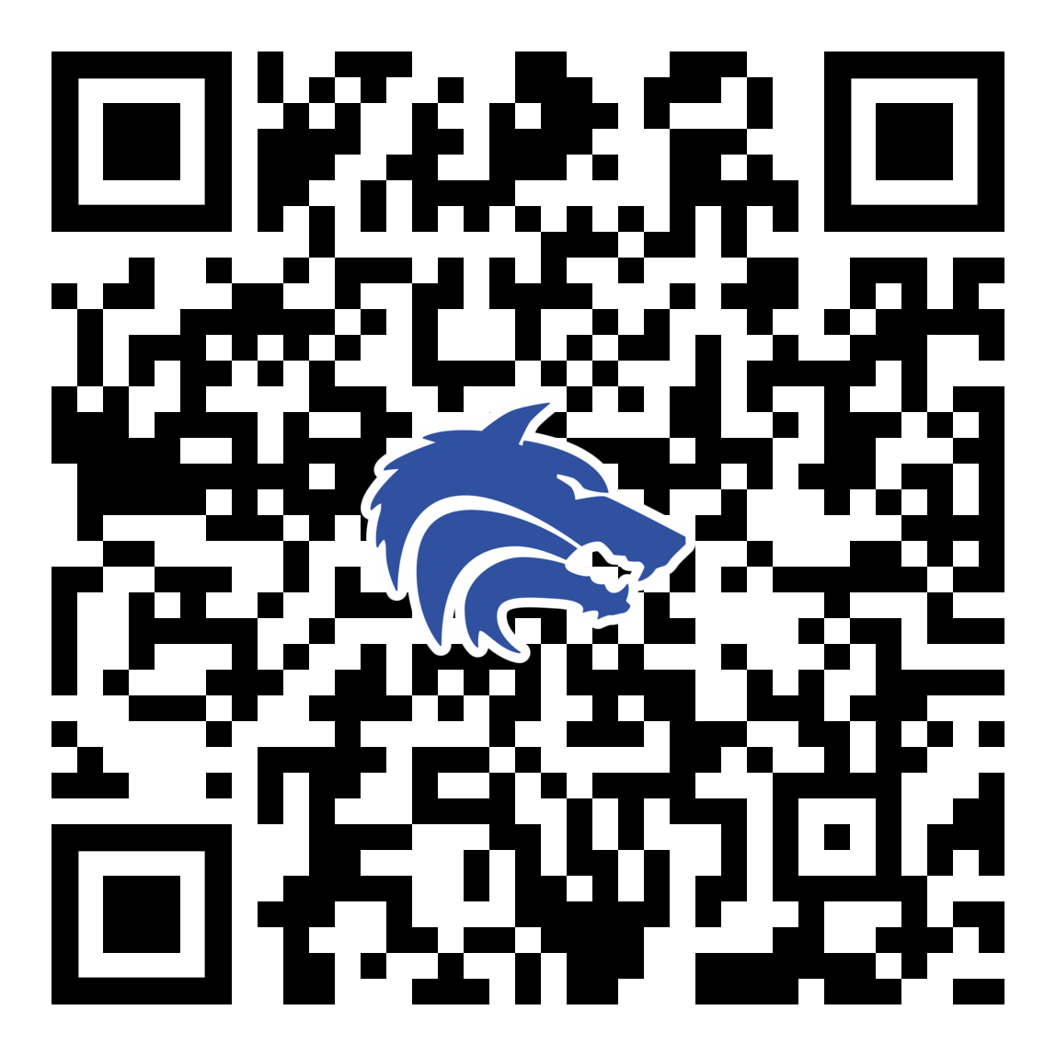
2025-2026 Booster Club Kickoff
August 25, 2025
PLEASE SCAN THIS CODE TO CHECK IN

Slide 2
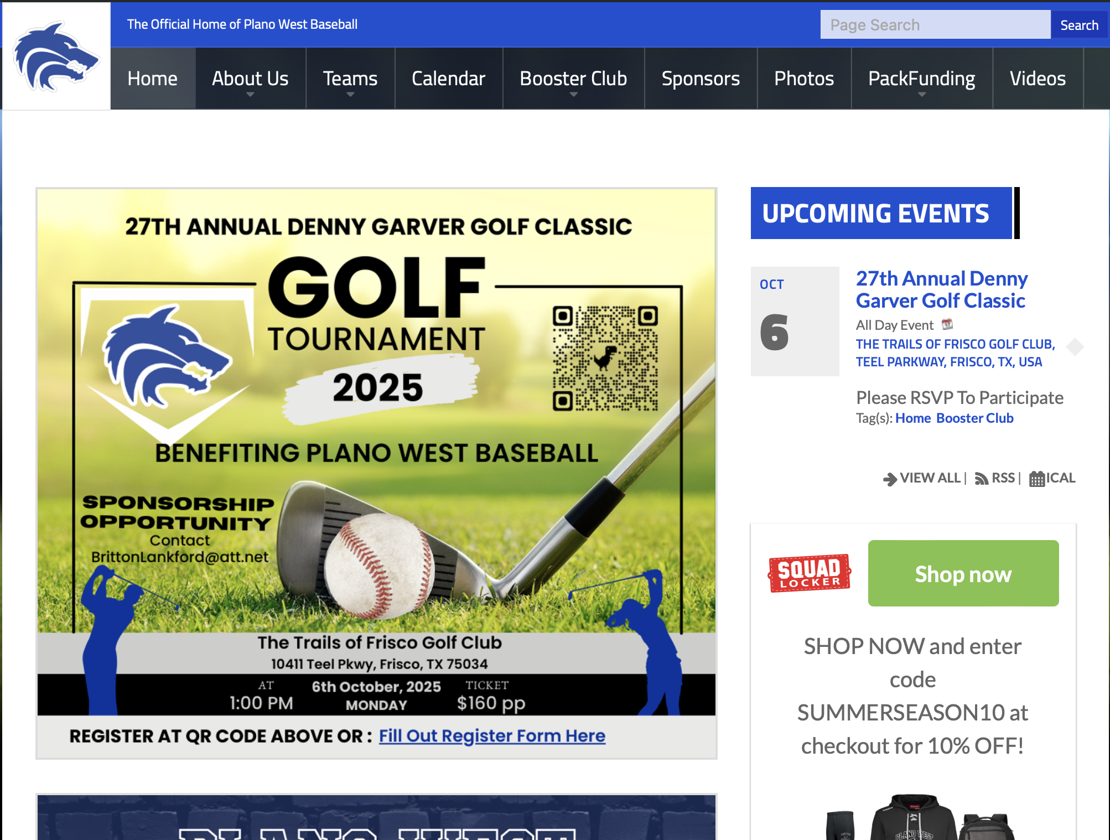
Agenda
•Board Introduction
•Approve May Meeting Minutes
•25/26 Booster Club Kickoff
•Treasurer Report
• 2024 – 2025 Recap
•Fall Calendar & Dues
•Committee Overview
•Fundraising
•Coach’s Corner
Construction Update
SportsYou
•Final Reminders / Spirit Wear
www.planowestbaseball.org

Slide 3
Board Introduction
President: Joe Hattrup Lucas (10)
VP Fundraising: OPEN
VP Marketing: Britton Lankford Miles (11)
Treasurer: Rebecca Howell Caleb (11)
Secretary: Jennie Jones Hunter (10)
*Our contact information is on the Booster Club website
*SportsYou is our primary mode of communication
(www.sportsyou.com enter code DCMN-ZE9D)

Slide 4
Booster Club Votes
Approve May 2025 Meeting Minutes
Meeting Minutes can always be found on the website (https://www.planowestbaseball.org/) under BOOSTER CLUB\FORMS AND MEETING MINUTES
Each meeting we will ask for someone to make a motion to approve the minutes and then we will ask for someone to second that.

Slide 5
What is the “Booster Club”
The PWBB Booster club is a non-profit, parent-run organization dedicated to creating the optimal PWBB player experience
Raises funds to provide the PWBB Team food, equipment, ballpark improvement and events
Works independent of PISD & the coaching staff
Collaborates with coaching staff on priorities & needs

Slide 6
PWBB BOOSTER CLUB 25/26 MISSION
Primary Objective for 25/26 School Year
Bolster & Increase Player Participation, Engagement & Overall Satisfaction in the PWBB Experience
--------------------------------------------------------------------------------------------------------------
Key Priorities
Provide Resources for Game Support (Concessions, Scoreboard, GC, etc.)
Expand Membership & Maximize Revenue
Assure Success of Major Events (Fundraisers/Team Activities)
Support Facilities Repairs & Field Maintenance
Engage Youth Baseball Families & Community
Ideate & Create "Beyond Baseball" Value For Players & Families

Slide 7
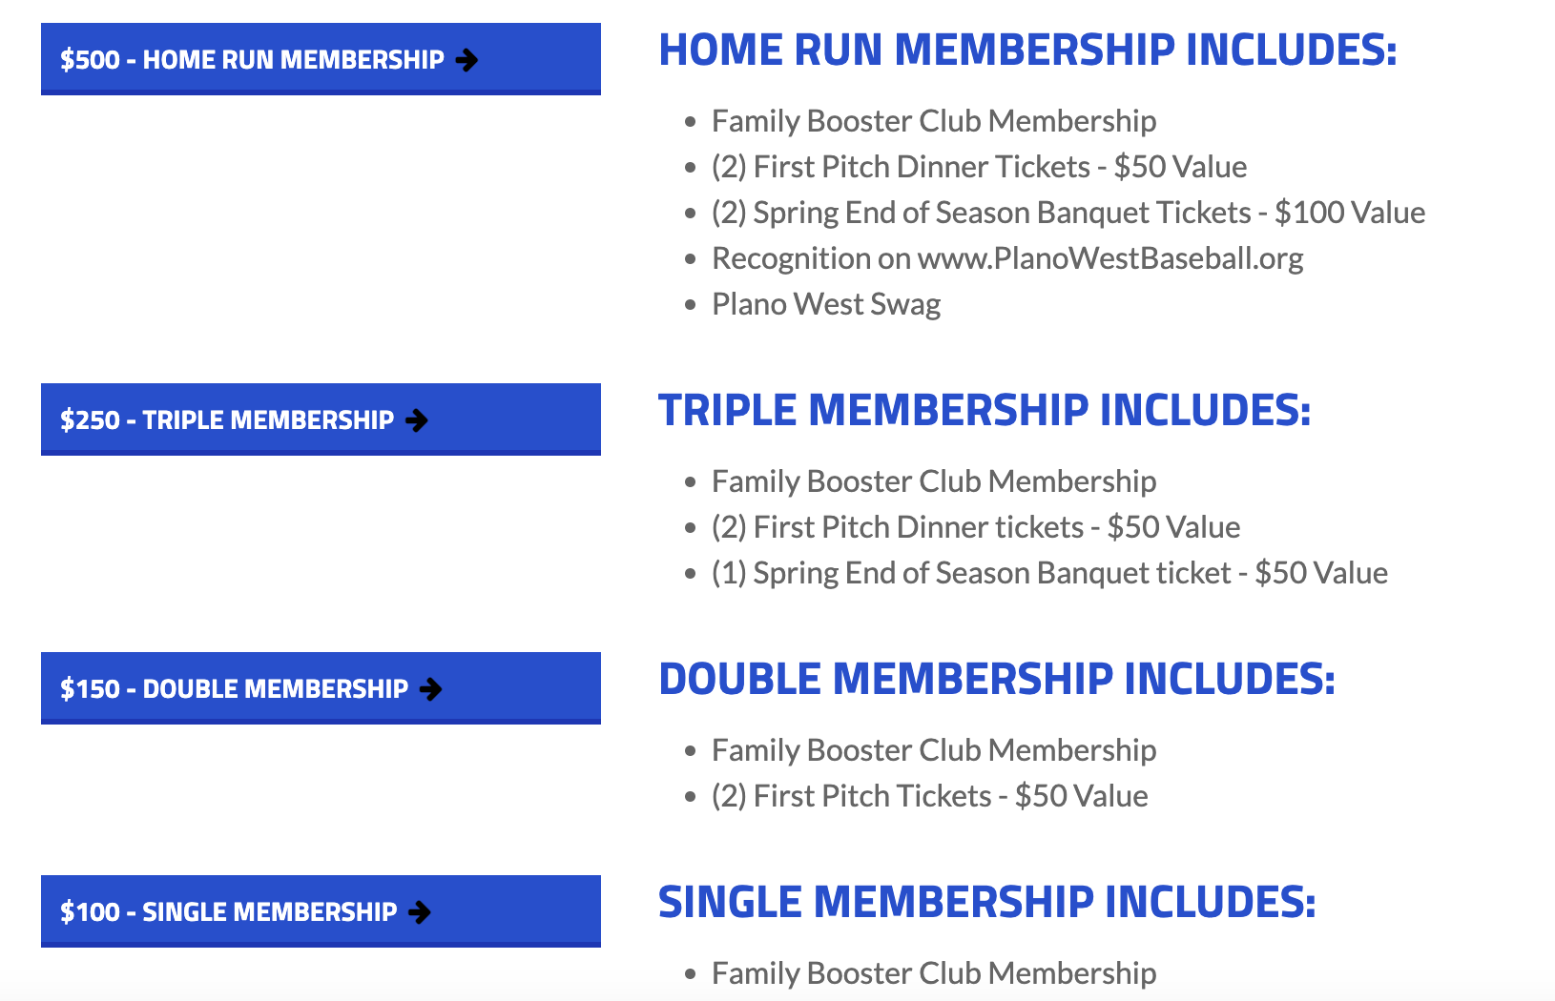
Join The Booster Club
www.planowestbaseball.org/join

Slide 8
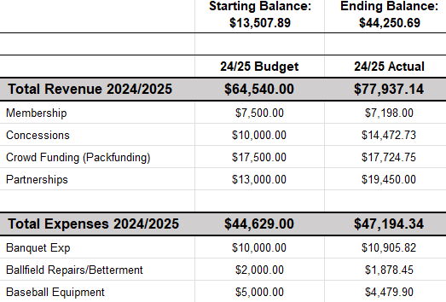
Treasurer’s Report: Recap of 2024-2025

Slide 9
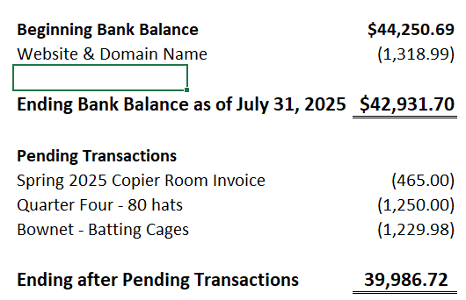
Treasurer’s Report: August 2025

Slide 10
Treasury Information
We will present the 2025/2026 budget in September!
Reimbursable Expenses
Because we are a non-profit, we do not pay taxes; therefore, you cannot be reimbursed for them. Please ask for our Tax Exemption Form before purchasing items.
When requesting a reimbursement, you will need to fill out the Reimbursement Form. I will have these at every meeting or I can email it to you.

Slide 11
Tentative Booster Club Meeting Dates
September 15
October 20
November 10
December 15
January 12
February 9
March 9
April 13
May 11

Slide 12
Fall Baseball Calendar
Booster Club Meetings will be on Website (next meeting 9/15)
HOCO Parade – Wednesday Sept 10
Fundraising
27th Annual Denny Garver Golf Outing - October 6 @ 1pm
Poinsettia Fundraiser Sales – October
Buy A Date - Calendar Fundraiser -November
Sponsor Saturday Fall Edition - September

Slide 13
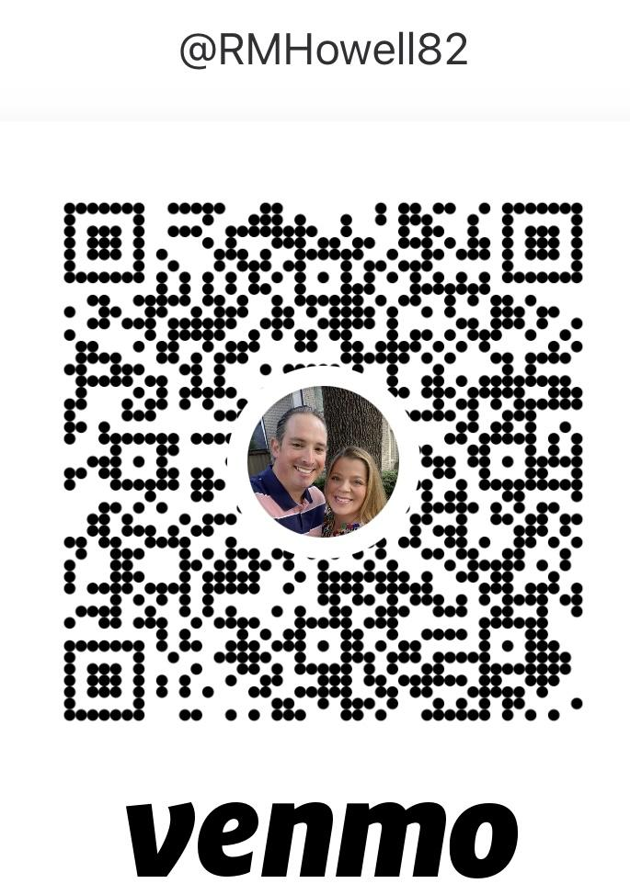
Fall Baseball Dues
Fall Ball Begins
Tuesday, September 2 (Varsity)
Saturday, September 6 (JV & JV2)
Fall Ball Dues $250
These dues cover the uniform and league
payments
Please send your fee to Rebecca Howell as
soon as possible.
Venmo @RMHowell82
Zelle 817-228-1995
Check

Slide 14
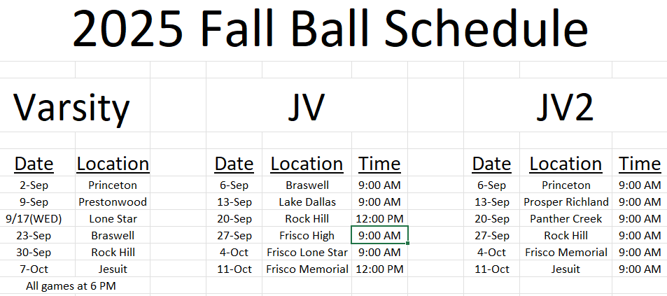
Fall Baseball Schedule

Slide 15
Committees Assembling
Start thinking of where you will want to lend a hand!
Fall committees and volunteer opportunities include:
Homecoming Parade
Golf Outing
Sponsorship & Fundraising
Social Media
Spring will have additional committees.

Slide 16
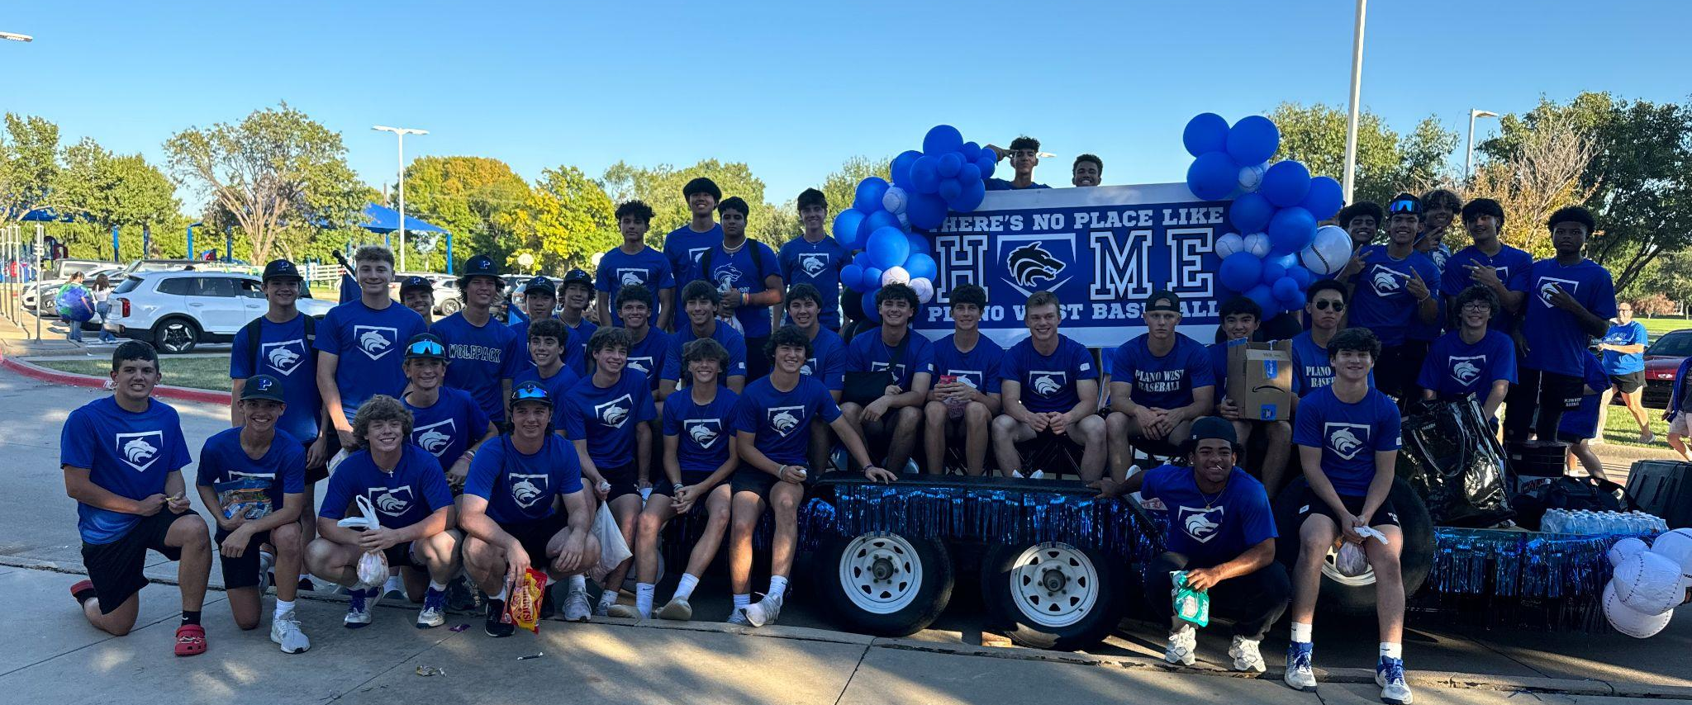
Immediate Needs
HOMECOMING 2025

Slide 17
Immediate Homecoming Needs
Homecoming is early this year:
Homecoming Parade is 9/10/2025
NEED:
trailer and a truck for the boys to ride on during the parade
few parents to help decorate the float
few parents to help coordinate pizza for the boys to eat after practice and before the parade
Everyone to donate 2 halloween sized bags of candy for the boys to hand out during the parade
Drop off at the baseball field and label bags “BASEBALL”

Slide 18

Fundraising
Sign up to play
Share the info
(FB, X, Instagram)
Volunteer to work the event
Employer sponsors or foursomes

Slide 19
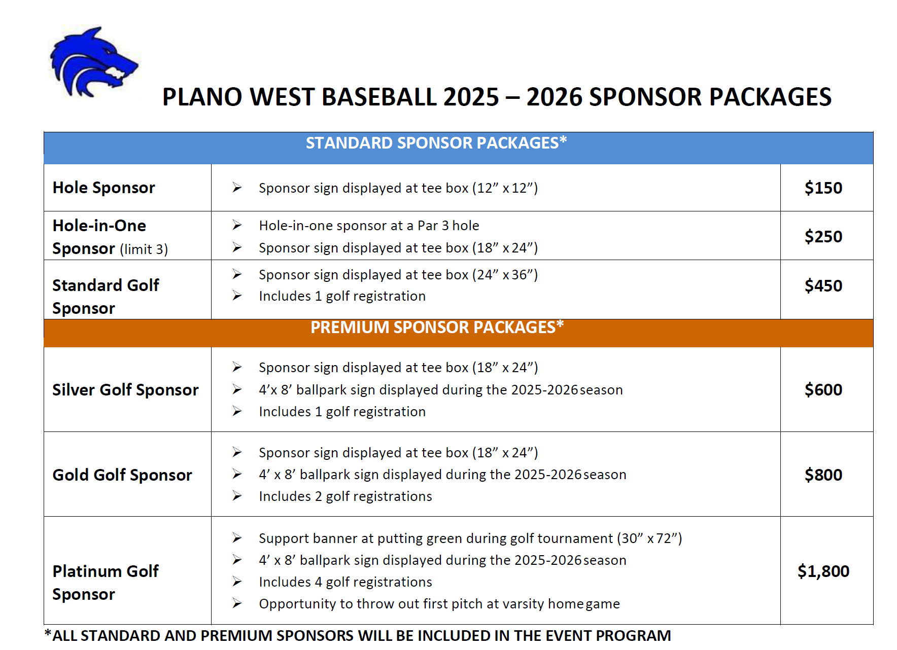
Golf Sponsorships
Reaching out to current sponsors, trying to get them to play in the tournament.
We will still have separate season sponsorship forms.
Won’t be able to add banners until the Spring, with the field work.

Slide 20
Upcoming Marketing/Fundraisers
Poinsettia Sales
Calendar Fundraiser
Pickleball or Cornhole Tournament
Carwash
Concessions
High margin items
Donations
Baked goods
Grillables

Slide 21
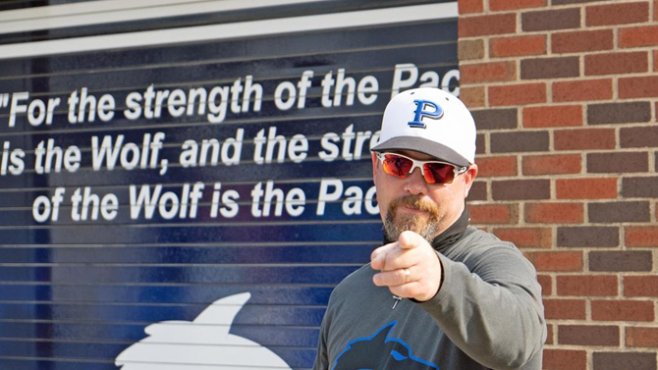
Coach’s Corner
Notes:
Redistricting & Implications (MAKE A SLIDE)
Fall Ball and Process

Slide 22
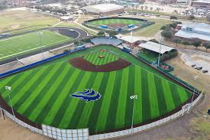
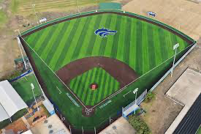
Current 6-6A District Teams
Plano West
Plano Senior
Plano East
Allen
McKinney
McKinney Boyd
Princeton
Prosper
Prosper Rock Hill

Slide 23

SportsYou
DCMN-ZE9D

Slide 24
Checklist
Join the Booster Club
Fundraising Ideas
who do you know - business owners, tax deductions, Plano based firms
what is working with other organizations?
Join a Committee
we welcome all to participate/contribute in any way they can
Thanks for coming!

Slide 25
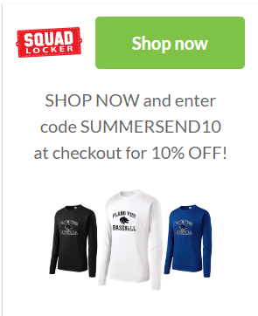
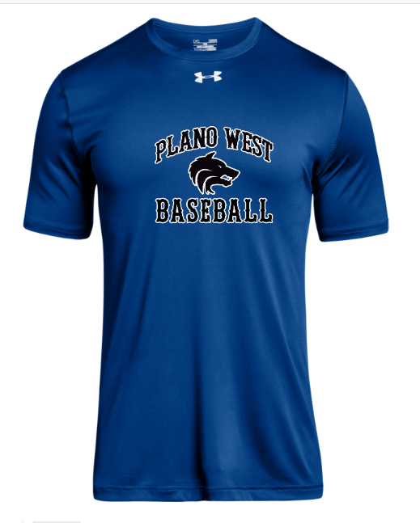
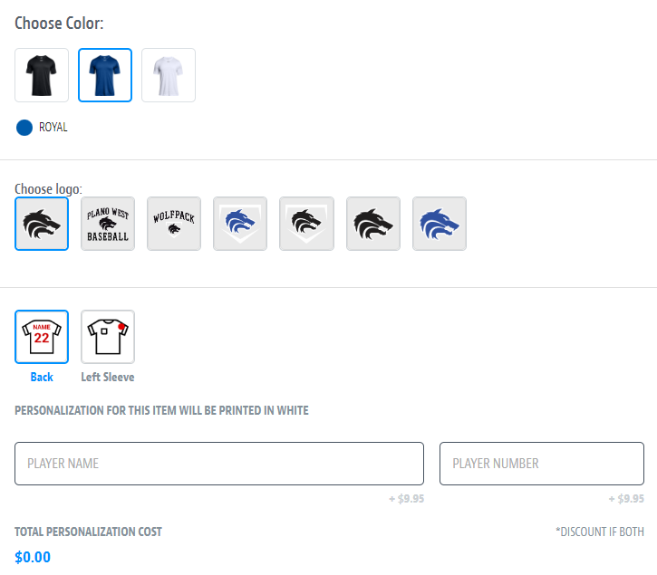
Spirit Wear – powered by SQUADLOCKER
aaaaa
SHOP NOW and enter code SUMMERSAVING10 at checkout for 10% OFF!

Slide 26
Don’t Forget to Check In!

Slide 27
Thank you!

