Slide 1

Omgha Annual Meeting
April 17th, 2023

Slide 2

Agenda
Meeting Called to order
  Announcements by the President
Consent Business
  Approval of 2022 Annual Meeting Minutes
Reports
  2022-2023 Reports
New Business
  Elections
Meeting Adjourned

Slide 3
Consent Business
  Approval of 2022 Annual Minutes

Slide 4
Board Reports
  Treasurer’s Report
  Secretary’s Report
  Boys Traveling Report
  Girls Traveling Report
  House Report
  Skills Report
  Culture & Inclusion
  President’s Report

Slide 5
Treasurer’s Report
Chuck Sawicky

Slide 6

Treasurer Philosophy
OMGHA is a non-profit organization with the financial goals of:
Keeping the cost of hockey low, while investing in our hockey players
Charging current players for the current cost of hockey
Investing in OMGHA assets to ensure viability into future
Providing financial transparency
Creating operational efficiencies where possible
Assistant Treasurers: Brian Pfannenstein, Jason Price
Gambling Manager: Cathy Cheatham
Concessions & Voucher Program: Kelly Edlund / Kristi Meenan

Slide 7
2022 – 2023 Highlights
Strong performance vs budget!
Continued investment in OMGHA Program & Assets
    Skills, Equipment, Coaching, Goalie Discounts, Free Year House Skaters & Equipment Voucher, Financial Aid
    Rink Investments (Flooring, Ceiling, Benches, Alumni Wall, Dryland Areas, Concession Stand)
Strong gambling profits for OMGHA
Strong financial position heading into 2023 – 2024!
Notes:
Skills $130K
Equipment #100K
Coaching $100K
Goalie Discount $50K
New Skaters/Vouchers $50K
Financial Aid $20K

Slide 8
Financial Performance
$’s in thousands
Hockey P&L | 22-23 Budget | 22-23 Forecast | H/(L) | Notes
Revenues | 2,284 | 2,313 | 30 | Short Players, + Gambling
Expenses | 2,284 | 2,263 | 21 | No substantial variances
Net Profit/Loss |  |  | $51
Charitable Gambling Program Gambling Income Gambling Net Profits OMGHA Donations Other Donations |  | YTD $2.7M $797K $500K $28K
End of Year Bank Balance |  | $700K - $800K
Gambling Control
Board Rating = 5 Star
Notes:
Gambling Income = $2.7M
Maple Tavern $1,012K
Malones $873K
Duffys $392K
Max’s on Main $404K
Rock Elm $25K
Donations
$500K – OMGHA
$20K – High School Hockey Booster Clubs
$5K – Osseo
$3K- Grad Parties
Last Year
Gambling Income = $2.3M
Maple Tavern $949K
Malones $832K
Duffys $406K
Max’s on Main $72K
Rock Elm $1.4K
Donations
$500K – OMGHA
$20K – High School Hockey Booster Clubs
$5K – Osseo
$3K – Grad Parties
2 Yrs ago
Gambling Income = $1.5M
Maple Tavern $550K
Malones $563K
Duffys $362K
Donations
$330K – OMGHA
$1500 – Yellow Tree
$1000 – MG Police
$1000 – MG Boys Booster Club
$1000 – Osseo Boys Booster Club
$1000 – Osseo Senior Party

Slide 9
Revenue Breakout
$’s in thousands
Hockey P&L | 22-23 Budget | 22-23 Forecast | H/(L) | Notes
Revenues | $2,284 | $2,313 | $30
Registration | 1,278 | 1,200 | (78) | House -29, Traveling -33
Gambling | 500 | 600 | 100 | Strong business continues
Hosted Tournaments | 105 | 112 | 7 | Hosted 3 tournaments
Other Income | 401 | 401 | - | National Tournament, Hockey Schools

Slide 10
Expense Breakout
$’s in thousands
Hockey P&L | 22-23 Budget | 22-23 Forecast | H/(L) | Notes
Expenses | $2,284 | $2,263 | ($21)
Ice Expense | 817 | 817 | - | Osseo/Maple Grove/Velocity
Rink Loans | 111 | 111 | - | Osseo $111K
Traveling Tournaments | 208 | 208 | -
District/Region/State | 125 | 118 | (7) | Refs $54K, Tourney $28K, R/S $13K
Equipment | 147 | 154 | 7 | Jerseys/Socks $127K, Coaches $24K
Skill Development | 144 | 123 | (21) | N1 $39K, Mega $22K, Vel $36K
Coaching Costs | 124 | 124 | - | Coaches Fees/Reimbursements
Tryouts | 56 | 55 | (1) | Evaluators $35K, Refs/EMT $7K
Projects | 170 | 170 | - | Rink Projects
Other | 383 | 383 | - | Admin, Tourneys, Registration, Misc
Notes:
Hours
BP = $960
MG – 1386 @ $215 per hour = $298K
Osseo – 1508 @ $184 per hour = $278K
Velocity – 687 @ $230 per hour = $158K

Slide 11
Looking to next year
Will start the year in very strong financial position
    Potential for reduced fees or enhanced benefits
Transition in Budget Owners
Understand future financial commitments & projects

Slide 12
Questions?

Slide 13

Secretary Report
Nicole Kustermann

Slide 14

Secretary's Report
Registrars—Deanna Henry (Travel), Kelli Williams (House), Emily Grossman (Coaches)
  657 (672) Travel players registered, 472 (509) House players registered 2022/2023 Season
  408 Travel and House coaches registered and tracked to make sure requirements were met to be on ice with players
  Over 100 Travel and House Managers trained and communicated with throughout the season- Thanks to Lora Lutner and Hannah Carrithurs for oversight and resources
    Excited to welcome Emily McMullin as Manager of Managers for Travel next year
    Thankful to Derek VanHuevlen for help with Gamesheet
  44 Travel, 36 House teams created and rostered with USA Hockey
  48 total waivers processed in and out of OMGHA, 157 vouchers handed out.

Slide 15

Secretary's Report
Volunteer Coordinators—Erika Kreye, Angie Passehl
    These two work with every volunteer aspect of the Association- including tryouts, team pictures, coaches/ managers and tournaments. They managed 10,857 hours this season.
      Pre-season camps, tryouts, Team Personnel, Scholastic Achievement, Blood Drives and 7 tournaments.
      No region tournaments this year. Also down three regular season tournaments – led to families being worried about there being enough hours available to fulfill DIBS
      Big challenge of families not “buying out” until the end of the season. Makes it difficult to plan
    Objective – Insure enough volunteers for OMGHA events. We do not want to cash checks… we want to staff events!
  Policy: 14 hours of volunteer time for one player and 20 hour for two or more players. We re-evaluate and budget at the beginning of each year.

Slide 16
Secretary's Report
Scholastic Achievement— Bridget Erickson and Kristina Kampa
  Awards ceremony on Monday, April 24 at Lord of Life. Event will honor scholar athletes who maintained 3.0 GPA over hockey season. Will also honor Character award recipients. 304 applications for SA award and 41 character awards. 84 4.0 students recognized!
  Terry Gallagher Scholarship – will be awarded to 4 recipients at the ceremony
Pictures - Leah Barber and Evelyn Sluiter
  Individuals and teams photographed by Kemmetmueller over 4 day period
  1200 people and 80 teams
  State Picture
Marketing – Laurel Bot and Becky Thoreson- Sponsorships, Apparel, Mouthguards, Social Media and PR
Player Safety – Adria Hamel- AED/ First Aid / Stop the Bleed Training, Mental Health, Heart Screening
End of Year Survey – administered at season end with 240 respondents

Slide 17
Secretary's Report
Focus for Next year
  Develop roles and responsibilities information for Board roles to encourage greater involvement
  Sit down with Sport Ngin to discuss our needs / create group to explore alternatives
  Enhancing Data Stewardship- taking care of data: knowing where it is and how to share and protect it.
  On-board new VC, succession for Secretary role

Slide 18
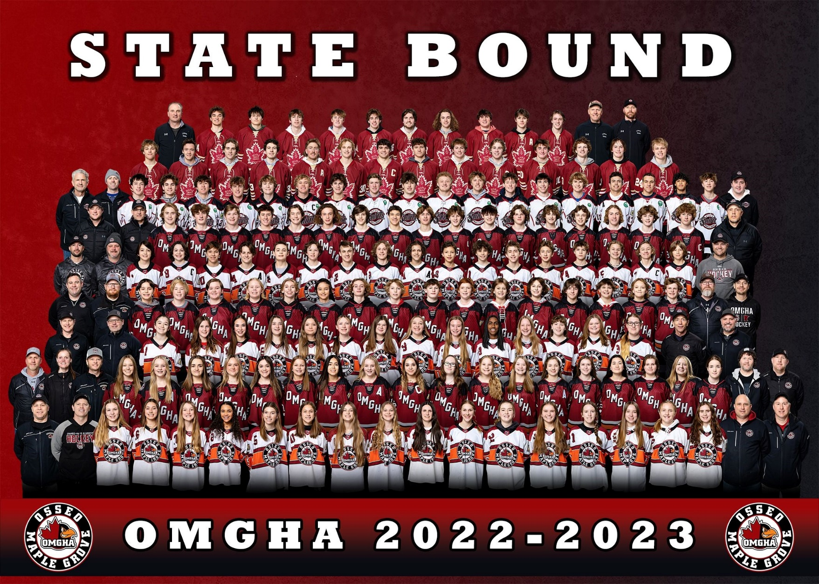
2021 State Teams
MG Crimson, Jr. Gold A, BAA, PWAA, PWB1 Black, U15B White, U15 B Black, U15 A

Slide 19

VP Boys Traveling Report
Jason Rogowski

Slide 20

VP Boys Traveling Report
  Travel Committee
    Level Directors – Lucas Ahlberg/Squirts, Rich Dean/Peewees, PJ Martin/Bantams, Dave Margenau/Jr Gold & Squirt Rec
Goals for 2022-2023
Focus on strong processes starting with tryouts and continuing throughout the season
Code of Conduct compliance with coaches, players and parents
Build on success of Junior Gold Program, launch Squirt Rec
Work closely with the Skills team all year
Level | # of Players | # of Teams
Squirts | 146 (-13) | 11 (-)
PeeWees | 147 (+2) | 9 (-)
Bantams | 124 (-8) | 8 (-)
Junior Gold | 66 (+18) | 4 (+ 1)
Totals | 483 (-1) | 32(+1)

Slide 21
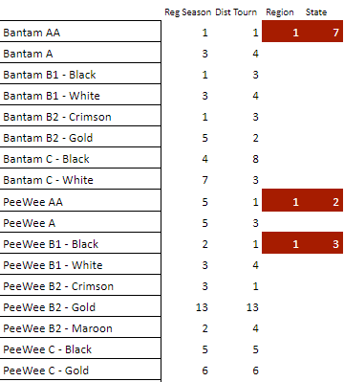
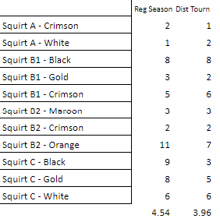
VP Boys Traveling Report
  Strong seasons for majority of teams
  Outperformed season rank in playoffs

Slide 22

VP Boys Traveling Report
  A Look Ahead to the 2023-2024 Season
    Continue to refine tryout process with Team Genius, coach development and team formation
    Improve opportunities for kids to play and have success at all levels
      Build on success of the Squirt Rec league, explore similar programs at older age groups and players who might struggle with contact hockey
      Junior Gold participation for players of all skill levels
      Continue to work on improved retention at all levels
    Coach/Parent/Player Code of Conduct enforcement
      Will be looking for new ways to deliver the same story
      Respect the game, the coaches, teammates, and
      officials will continue to be a core message
Transparency and openness underpins our actions

Slide 23

VP Girls Traveling Report
Chad Wieneke

Slide 24

VP Girls Traveling Report
  Girls Travel Committee
    VP – Chad Wieneke
    Level Directors
      Jeff Allen – U10
      Brandon Erickson – U12
      Tina Reid – U15
      Chris McLeod – Girls Skills Director
    Involved in the following:
      Tournament selection
      Pre-tryout camps/Skills Committee
      Tryouts/team formation
      Communication and oversight throughout the season

Slide 25
VP Girls Traveling Report
2022-2023 Recap
  We had 305 girls playing hockey in OMGHA this past year!
    175 girls in the OMGHA girls traveling program
  Overall, the season went as expected based on our team formation
  We did observe an uptick in both player and parent code of conduct related issues this past season, reducing these issues should be a focus for next season

Slide 26
VP Girls Traveling Report
2022-2023 Recap
State Tournament Appearances
  U15A – 3rd Place
  U15B White – State Champions
  U15B Black – 3rd Place
District 3 Results (Regular Season Finish/Tournament Finish)
  U15A – (1st/2nd)
  U15B White – (1st/1st)
  U15B Black – (3rd /2nd)
  U12A - (4th/tie 6th)
  U12B1– (4th/ 3rd)
  U12B2 Crimson – (1st/2nd)
  U12B2 Black – (3rd /5th)
  U10A – (1st/1st)
  U10B1White – (6th/ 3rd)
  U10B1 Black – (4th/4th)
  U10B2 Crimson – (2nd/ 3rd)
  U10B2 Orange – (3rd/5th)

Slide 27
VP Girls Traveling Report
Looking ahead to 2023-2024
  Projected teams at each level
    U10 – ~4 teams
    U12 – ~4 teams
    U15 – ~3 teams

Slide 28

VP Girls Traveling Report
Priorities for next year
    Continue to grow the girls program!
    Continued focus on recruiting goalies at all levels
      We’ve seen recent improvement in this area
    Focus on reducing and eliminating player & parent code of conduct issues

Slide 29
VP Girls Traveling Report
Notable survey feedback
  Tryout format & team formation
  U15 tryout timing
  Non-parent coaches
OMGHA Decisions
  Decisions are made in what is believed to be the overall best interest of the 45-70 skaters at each traveling level (U10, U12, U15)
    Decisions are not made in the interest of a handful of “bubble players” or players who are unfortunately released from a HS program or the parent who’s certain they would have done a better job of coaching than a non-parent
      Every decision has cost/benefit impact across the association and a decision that presumably benefits one relatively small group of players will likely have a negative impact on another potentially larger group of players

Slide 30

VP House Report
Brian Grant

Slide 31

House Report
House Committee
VP House – Brian Grant Supermite Director – Troy Fodstad
Mite Director – Dustin Fulton Girls House Director – Hailey Fischer
Recruiting – Jennifer Lundquist/ Nikki Stephany Goalie Director – Joe Faust
Skills – Derek Peltier Register – Kelli Williams
House Mission – Hockey Culture
Grow the Game
Grow the Passion
Develop Player Skills
Develop Coaches
Goal of 500 Players!
Retention rates ~89%
Leverage ADM model/provide traveling with skilled players who love hockey
Leverage OMGHA knowledge to grow our Coaching Culture
Growth
Level # Teams
Supermites 12
U8 4
Mite 2 6
Mite 1 6
Girls Mites 4
Mini-Mites 2
Total 32
 | 2016-2017 | 2017-2018 | 2018-2019 | 2019-2020 | 2019-2020 | 2020-2021 | 2021-2022 | 2022-2023
Total Players | 530 | 543 | 542 | 521 | 502 | 470 | 482 | 471

Slide 32

VP House Report
Recruiting
Parade, MG Days Booth, Road Signs, Posters, School Flyers, Open House.
Try Hockey for Free (8 Events) – 200+ Kids Attended
Intro To Hockey Camp (10 Sessions)
SM (145) / U8 (62) / Mite 2 (78) / Mite 1 (71) / Girl Mites (43) / Mini-Mites (69)
-16 -2 +16 -5 -12 +5
Operations
3o3 League (Fall and Spring) –Spring Session started 3/18 (174) +30 from last Spring
Standardized practice plans at each level
Scheduling of 32 teams
  Looking for a new House Scheduler (Compensated Position)
Jamboree – Friday/Saturday/Sunday
Look for the following in 2023-2024:
Mini-Tin Bin, Wayzata crossover 3v3, Small Area Game Days
High School Game Events & OMGHA Girls Hockey Day Event
Skill Development
Total Ice Time: SM/U8 62 Hours, Mite I/II/Girl Mite 50 Hours, Mini-mites 20 Hours
Practice Planning – ADM Model (station based, small area games), standard practice plans
Goalie Training – Continue to build the Goalie Program with MEGA

Slide 33
VP House Report
2023-2024 Initiatives
Grow The Game – Grass Roots Recruiting
  Goal of 500 kids for 2023-2024
  90% Retention
  Equipment Drive
  Starter sets to rent for new players
Goalie Recruitment and Development
  Continue the work to find and train new goalies
  Focused Skill Training - MEGA
Coach Training – Coach the Coaches
  Coach Clinics and Training
House Committee Members
250+ Coaches
50 Managers
Parents!
Thank you for a Great Season!

Slide 34
VP Skills Team
  Mission: Provide the Guidance to Develop Hockey Player to Reach Full Potential
    Player Development On and Off-Ice
    Support Coaches
    Winning Culture
  Skills Travel Committee
    VP – Matt Margenau
    Coaching Director – Andy Hedlund
    Level Directors
      Ryan Campbell – Squirts
      Andy Kampa – Pee Wee
      Tyler Martin - Bantams
      Chris Mcloed – Girls Skills Director
      Aric Stienessen, Brad Albers, Joe Faust – Goalie Directors
      Training Partners (N1 – Rakim Anim / Velocity Joel Klute / Skating Coach – Alex Volpicelli / MEGA – Kent Patterson and Justin Johnson/FHIT)
      On-Ice Skills Team (Fall Camp / In-Season)
    Involved in the following:
      Player and Coach Development
      Coaching Selection
      Team Communications
      Tryouts

Slide 35
VP Skills Traveling Report
2022-2023 Recap
Player Development
    Traveling Skills Programs
      Fall Camp (160 Total Hours)
      Weekly On Ice Training (108 Ice Sessions) – Body Contact, Skating, Position Specific, Small Area Games, Passing and Puck Skills
      N1 (108 sessions) and Velocity (144 sessions)
      Goalie Training Session and Practice Consults (New Partner – MEGA) – Goalie Training Touches – (14 Sessions per Goalie)
      Off Ice Training – Support Dryland Usage
Coaching Development
  Pre and Post-Season Meeting and House Skill Clinics
  Coach Feedback
  Resources – Hockey Share Drill Database, Youtube Channel, Instagram, Hockey Habits, OMGHA Practice Plans, Coaches Handbook
Coach Selection – Parent and Non-Parent

Slide 36

VP Skills Traveling Report
2023-2024 Outlook
  Player Development
    Season Development
      Off Season – Defense Clinics - Pilot
      On and Off Ice Skills Session
        On Ice Goalie Training – MEGA and Sunday Sessions
        Weekly On-Ice Skills Specific Sessions – OMGHA Coaches / Alex V / FHIT
        N1 and Velocity
      Fall Camp
      Off Ice Culture
        Maple Grove Station Training
        Osseo Remodel
Coaching Development
    Coach Meetings (Pre/Post/In Season Meetings(Directors Touchpoint))
    Reinforce Hockey Habit Resource Page
    Expand Practice Plans on OMGHA Website
    Hockey Share
    Coaches Handbook
    Hello Team App
    Video Capability
    Female Coach Skates
Other Items
    Increase Ice Touches for House Teams – Supplemental Program

Slide 37
Diversity Equity & Inclusion Report
Nicole Hurt

Slide 38

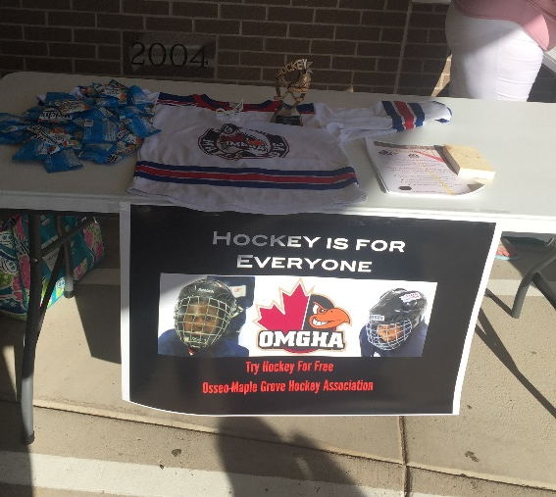
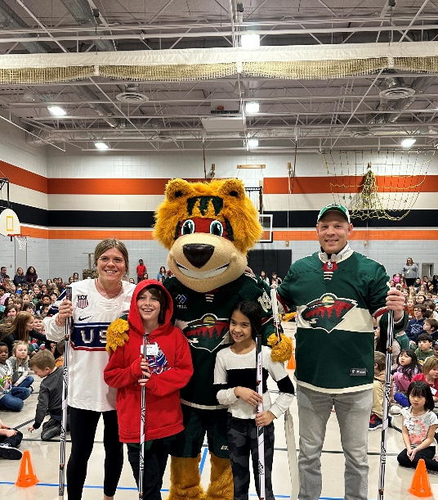

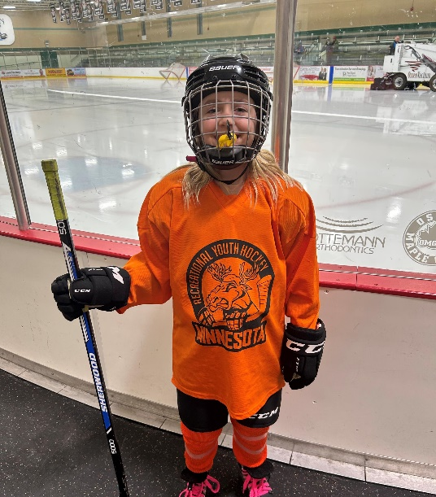
DE and I Initiatives

Slide 39
President’s Report
Colin Steen

Slide 40
President’s Report – Year in review
What a great year for our teams, our association, and our players
Several achievements worth noting:
  U15 B1 State Championship
  Successful hosting of the U18 Tier II USA Hockey National Championship
  Increased focus on player development throughout the year
  Squirt House program launched with 2 teams in 2022-2023
  Maple Grove approved the Community Center project which will bring an additional sheet of ice for our use in 2025 and beyond

Slide 41
President’s Report – Year in review
Strong board governance and financial position
Continued growth in our house and travel programs
Re-vamped skills nights met with positive feedback
Competitive balance of teams across levels
  7 Teams to State; several players playing in National tourneys
Excellent level of volunteer contributions throughout the year
  National Tournament hosting and MGCC Improvement discussions
Focus on connecting into High School programs with both Osseo, OPC, and Maple Grove
Region Winner for PCA Double Impact Coach – Kurt Halstrom

Slide 42
President’s Report – Member Feedback
Coach feedback
  Overall very positive; both from a parent and non-parent perspective
Pride in our association and our OMGHA culture
  Our volunteers have helped make this association what it is today; we are very organized and this helps us put the best possible product on the ice
  While room for improvement we have built a strong culture of focusing on all teams and players
  How do we continue to get players engaged of all skill levels is an annual challenge for our board to address
Junior Gold
  While our number of teams and players is growing; we will need to continue to think about how best to address team formation with a broad range of players’ skills
Team formation and tryouts
DIBS frustration with signing up; finding opportunities

Slide 43
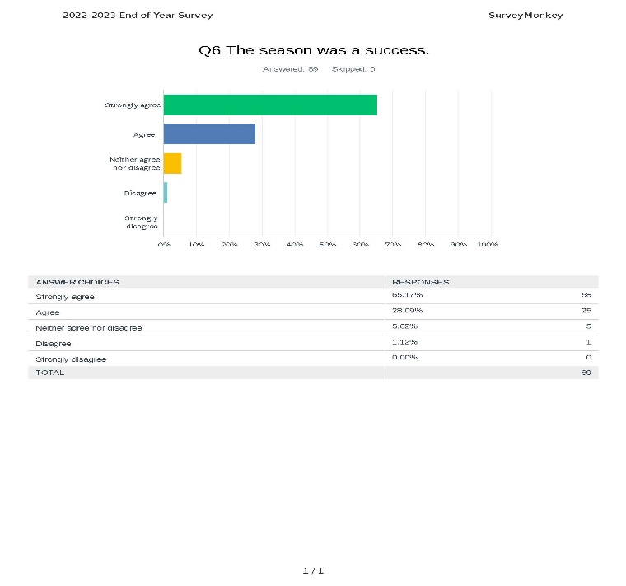
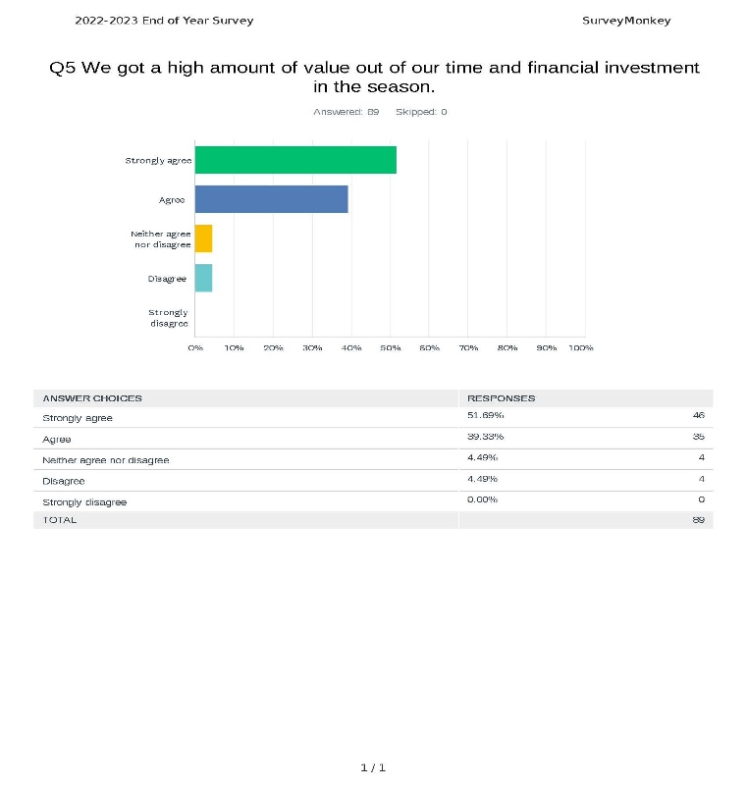
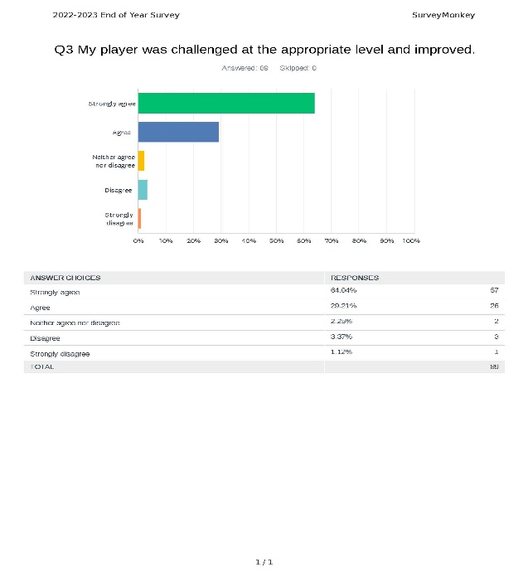
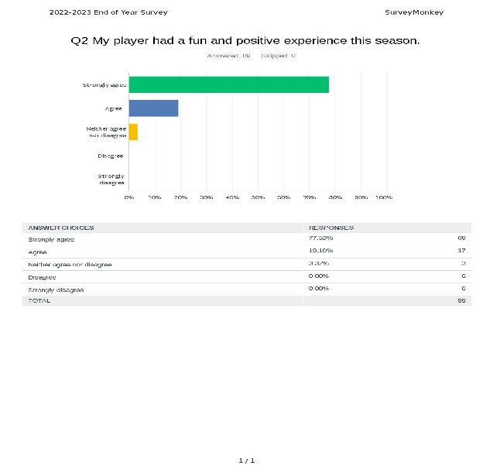
Are we serving our members well?

Slide 44
Looking Ahead to 2023-2024
Our board focuses for 2023-2024 season
  Continue to focus on player development
    Stick with what is working; continue to invest time and training for our coaches and our players
  Volunteer Hours
    Making sure our members continue to be informed on when and where they can volunteer
  Continue to focus on Code of Conduct
    No coach suspensions in 2022-2023; not the same for parents unfortunately
  Tournaments overall
    Two new tournament directors starting in 2023-2024; thanks to Eric and Sara for helping with the transition
  Squirt House Program
    Continue to look to grow this program; someone to lead these efforts will be important
  Maple Grove Community Center planning
    Committee will be working with the city of Maple Grove to help ensure our needs are being considered in the engineering and design

Slide 45
President’s Report – Year in review
Thank you to our long-time volunteers!
  Chad Weineke
  Sara Grant
  Eric Ruska
  Steve Fischer

Slide 46

New Business
Elections

Slide 47
Elections
    Presentation of Election Results – presented by Election Committee
      President – Colin Steen
      VP Girls Traveling – Brandon Erickson
      VP of House – Brian Grant
      Asst. ACE Coordinator / Coaching Director – Andy Hedlund
      Boys Level Directors – (3)- Lucas Ahlberg, Ryan Campbell, Rich Dean
      Mite Director – Dustin Fulton
      Girls Level Directors (1) – Aaron Tofte
      D3 Representative – Nick Rice
    Motion to Approve Election Results
    Board of Directors Vote

Slide 48
Meeting Adjourned
Thanks for attending the 2023 OMGHA Annual Meeting!

