Slide 1

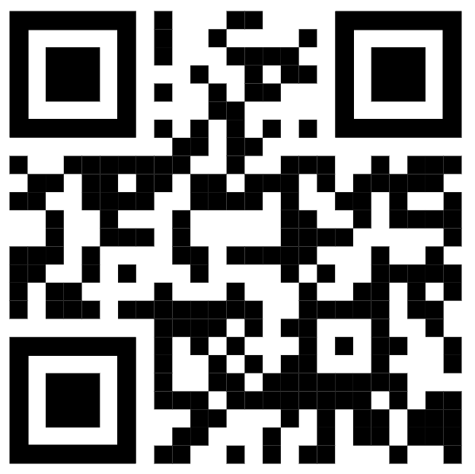
Join the 2026 JAYBA and J-Hawks sponsorship team
The Jackson Area Youth Baseball Association (JAYBA) and Jackson J-Hawks are
Community-driven 501(C)(3) nonprofit organizations. Thanks to volunteers and support from local businesses we’re able to provide a safe and competitive environment for youth baseball players (ages 5-14) to learn baseball while developing personal skills.
Our home diamonds are located at 3146 Division Rd. in Jackson, WI.
JAYBA and J-Hawks teams will host over 175 league games and two (2) annual Jackson Grand Slamboree tournaments.
Games and tournaments draw teams, families and guests from local and regional communities.
For more information, email JAYBA.Chairman@gmail.com or , visit our website at www.jayba-wi.com

Slide 2

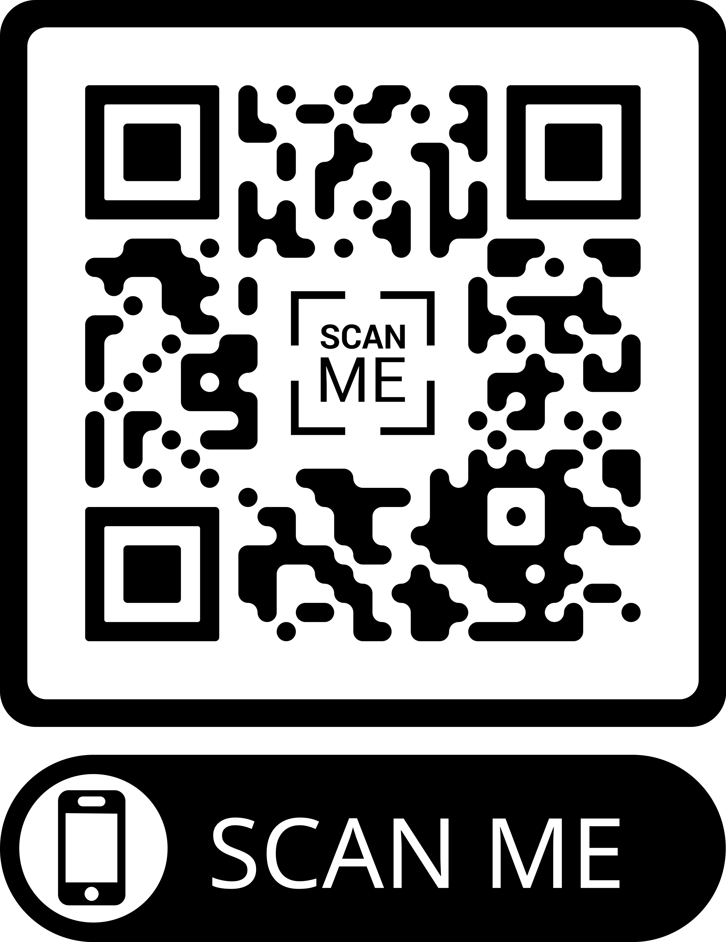


Help us make the 2026 season a home run!
As a 501 (C)(3), 100% of sponsorship funds are used to support our league’s players, facilities and equipment improvements, and special community programs. 2026 sponsor support will help:
JAYBA and J-Hawks Teams | Player uniforms (hats, shirts, bags and socks) Team equipment (helmets, bats, balls, catcher’s gear) Maintains low-cost registration fees and waives them for those in need of financial assistance.
Player and Family Support | JAYBA hosts off-season and in-season events including player camps and tournaments. Sponsor support helps with registration fees and equipment for players in need of financial assistance. Sponsor support helps to offset the costs associated with the JAYBA end-of-season party for players and families.
Facilities/Field Maintenance and Improvements | Fence repairs on all diamonds. Replacing protective netting. Adding new benches and bleachers. Ongoing field and grounds maintenance. Maintaining and replacing field equipment. Scoreboard maintenance. Practice facilities providing players with access and training opportunities during winter months.
For more information, email JAYBA.Chairman@gmail.com or , visit our website at www.jayba-wi.com

Slide 3
2026 Sponsorship Options/Levels
Levels | Investment | Sponsor Receives
Level 1 | $175 | Company name, logo and description on the JAYBA website and social media.
Level 2 | $300 | Team sponsor (company name/logo on team uniform or team banner) Company name, logo and description on the JAYBA website and social media. Team sponsor plaque (delivered post season).
Level 3 | $350 | Custom company banner (company name/logo/info) placed on outfield fence in one field location for the entire 2026 season and Slamboree tournaments. Company name, logo and description on the JAYBA website and social media
Level 4 | $650 | Two (2) custom team banners placed on outfield fences for entire 2026 season and during 2026 Slamboree tournaments. Company name, logo and description on the JAYBA website and social media.
Level 5 | $750 | Team sponsor (company name/logo on team uniform or team banner). One (1) custom team banners placed on outfield fences for entire 2026 season. Company name, logo and description on the JAYBA website and social media. Team sponsor plaque (delivered post-season).
Level 6 | $1,000 | Team sponsor (company name/logo on team uniform or team banner One (1) custom team banners placed on outfield fences for entire 2026 season. Outfield Scoreboard Signage (with company name/logo). Company name, logo and description on the JAYBA website and social media. Team sponsor plaque (delivered post-season).
Level 7 | $1,500 | Team sponsor (company name/logo on team uniform or team banner). Two (2) custom team banners placed on outfield fences for entire 2026 season. Outfield Scoreboard Signage (with company name/logo). Company name, logo and description on the JAYBA website and social media. Team sponsor plaque (delivered post-season).
If you have any additional sponsorship ideas for us to consider, please contact us: JAYBA.Chairman@gmail.com
For more information email, JAYBA.Chairman@gmail.com or , visit our website at www.jayba-wi.com

Slide 4
2026 JAYBA / J-Hawks Sponsorship Form
Thank-You for your support! We look forward to partnering with you this season. Please complete and mail the information below:
Make Checks Payable to: JAYBA
Mail Checks to: JAYBA P.O Box 353 Jackson, WI 53037
Payments due by: March 27, 2026
Please circle a sponsorship level below:
1
$175
2
$300
3
$350
4
$650
5
$750
6
$1,000
7
$1,500
Team/Player Sponsorship:
If there is a specific team and/or player’s team you’d like to sponsor, please note below:
Team:
Player:
Please provide us with your contact information
Business Name
Address
Contact Name
Phone Number
Email
Please email JAYBA.Chairman@gmail.com your company logo by March 27, 2026
Form 23

