Slide 1



Grafton Wrestling Club
2025-2026 Season Information

Slide 2
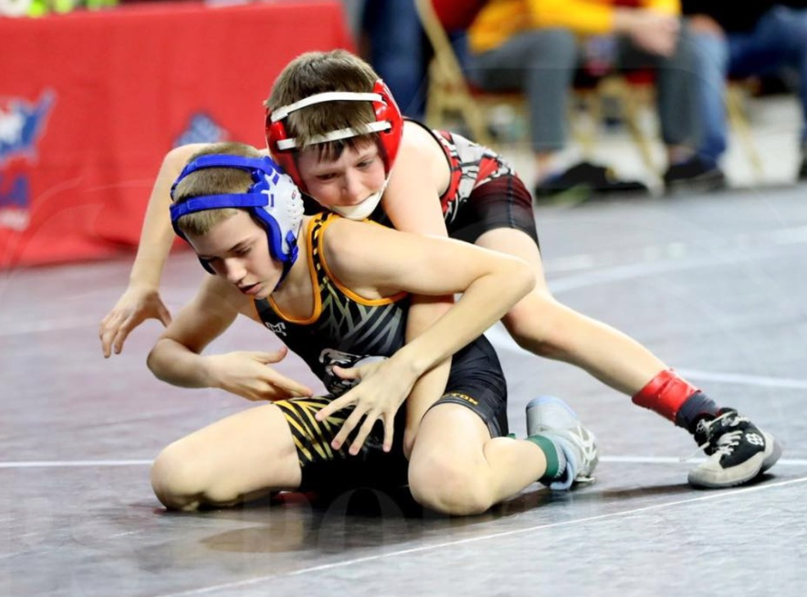
Important Dates:
Monday November 3rd- First Day of Practice for JLMS Wrestling- 6:00pm in GHS Wrestling Room.
Tuesday November 4th- First Day of Raptors Practice in GHS Wrestling Room.
Sunday December 14th: Grafton Raptors Rumble for the Ring Youth Tournament.

Slide 3
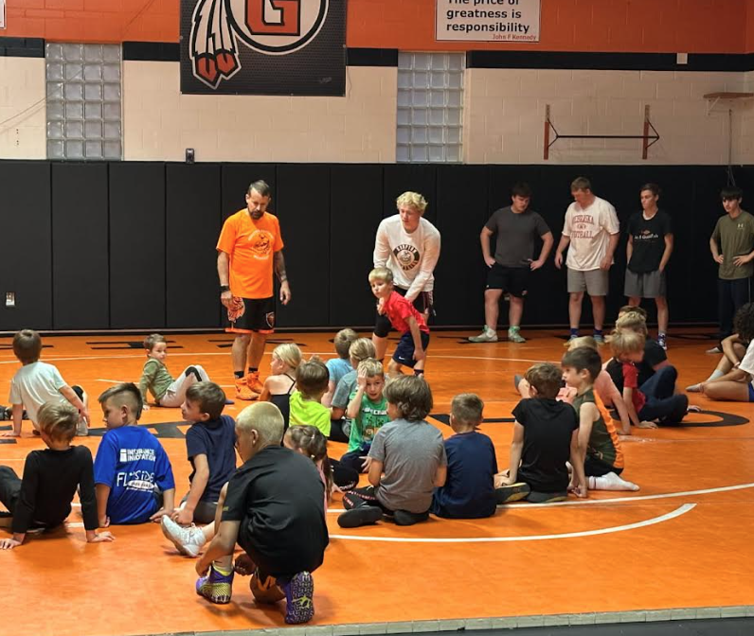
Practice Times for 2025-2026
All Practices are held in the GHS Wrestling room unless notified.
You can enter wrestling room on West side(by football field) using door 10.
Tuesdays:
Beginner: 6-7pm Experienced: 7-8pm.
Thursdays:
Beginner: 5-6pm Experienced: 6-7pm.

Slide 4
Contact Information:
Coach Dodge:
Cell: 262-370-1419
Email: graftonwrestlingclub2021@gmail.com
Grafton Wrestling Club Website: graftonraptors.com
Grafton Wrestling Club Facebook Page

Slide 5
Sports engine:
This will be our primary form of communication.
Register at https://www.graftonraptors.com/
Once registered you will get added to the Grafton Raptors Wrestling Club team for any communication and scheduling items
Contact Luke or Heidi Koele with Questions
lmkoele@gmail.com or 319-651-7504
hakoele@hotmail.com or 563-650-0867

Slide 6
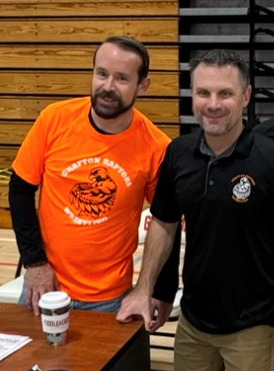
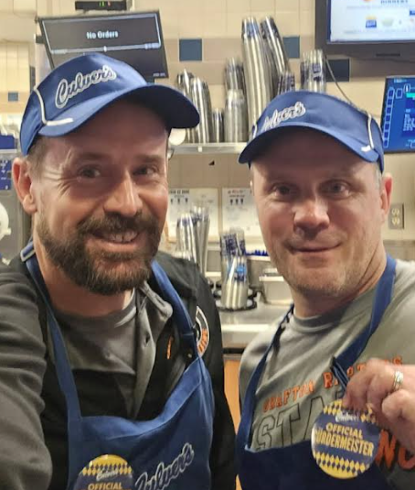
Coaching Staff
Mike Dodge
Matt Gartman
Jonathon Leeson
Frank Mazzari
Steve Melstrand
Erik Imes
TJ Weissinger
Adam Ewald

Slide 7
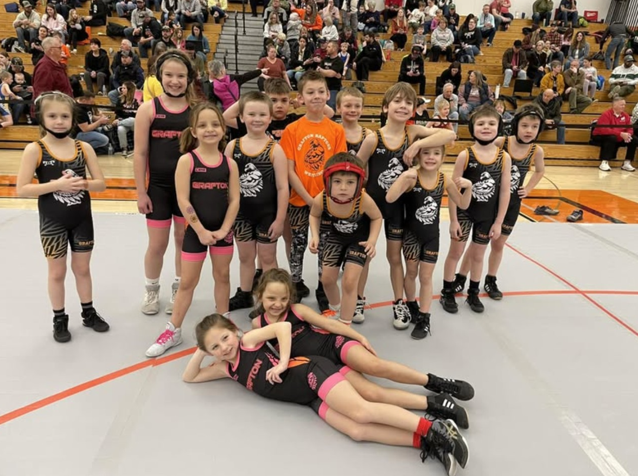
Grafton Raptors Club Board
Luke and Heidi Koele
Mike and Katie Dodge
Matt and Beth Gartman
Jim Brulla
Nick Otis
Eric Pfleger

Slide 8
Parent Volunteer Requirements:
Each Family needs to volunteer for 4 hours at the Grafton Raptors Rumble for the Ring Tournament. This is our biggest fundraiser of the year.
If you volunteer we will pay your wrestler’s registration fee to our home tournament.
We are also going to ask families to sign-up for food/beverage donations for the tournament.

Slide 9
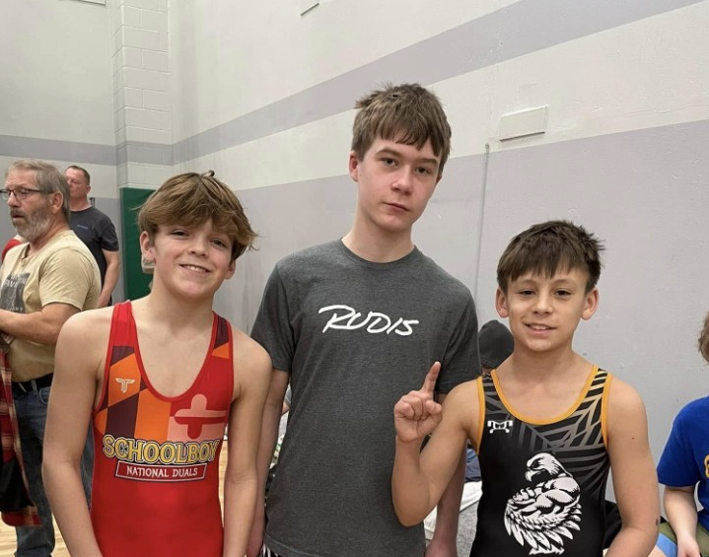
Membership Costs
Individual Membership Fees:
$100 for first wrestler in the family.
$60.00 for each additional wrestler in the family.
USA Wrestling Athlete Membership:
https://www.usawmembership.com/login
Required before you can practice.
All JLMS wrestlers must have a USA Wrestling Membership.
$50.00 to cover insurance at practice and tournaments
How to purchase a membership video: https://www.youtube.com/watch?v=qbvC3oTy6OI

Slide 10
Required Equipment:
Wrestling Shoes:
$50 to buy your own or borrow from the club if we have your size.
Headgear: Buy your own or borrow from the club.
Mouth guard: Optional.
Knee pads: Optional.
$50.00 Equipment deposit if you choose to borrow a singlet for the season. (You will get his back when you return the singlet.)
Contact Heidi Koele with any questions….

Slide 11
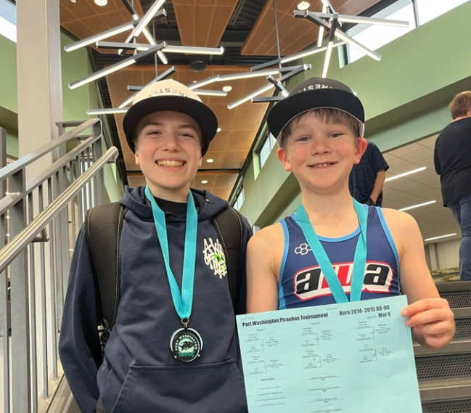
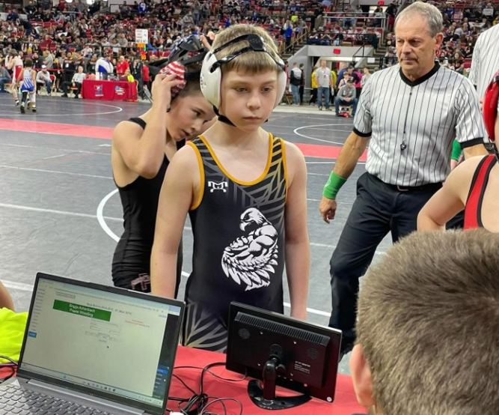
Tournament Schedule- TBD
In the past we have gone to these local tournaments. Coaches will determine a schedule as we get closer to January.
Grafton Raptors Rumble for the Ring: Sunday December 14th, 2025.
West Bend Wildcats:
Hartford Youth Tournament:
Sussex Sabercats “Tear it up!”:
Brawl in the Falls:
Germantown Hornets:
Kewaskum Battle for the Belt:
Cedarburg Grant Schoen (Beginner):

Slide 12
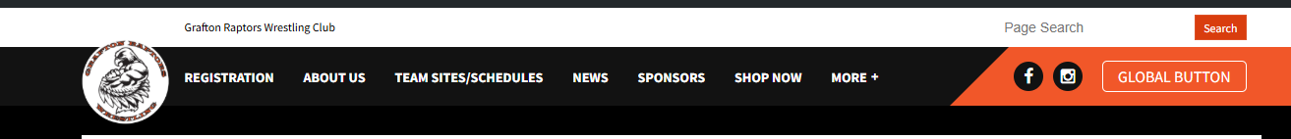
Official Club Gear from MyHouse:
Grafton Wrestling Club MyHouse Store
There will also be a team store through RBS Sportswear.
This link is also on our website.

