Slide 1

All Aboard: A Parent’s
Introduction to Crew
ADMIT ONE
All Aboard
2nd Thursday each month
7:30-8:30 pm
DEPARTURE:
2nd Thursday each month
SEAT ASSIGNMENT:
meet.google.com/yix-nfqb-hib
SEAT CLASS: Parent
Langley Crew Booster Club
Notes:
Thank you for taking time out of your evening to join us
We won’t be recording this evening, but we will post the slide deck, including the Q&A on the All Aboard page, which you can find on the dropdown menu under the Parents tab and under the Info tab
Just like last month, if you have a question, please type it in the Chat. Once we finish the 15-minute presentation, we’ll spend the rest of our time on questions
All the questions are being noted and we’ll add them to the slide deck before we post it on the website.
Please mute yourself during the presentation, but feel free to unmute once we go to Q&A
This evening, we’ll be talking about:
Registration
Interest Meeting
Communication
Parent’s Guide to Crew

Slide 2

Registration
What you need to know:
Registration for the crew team is open now. This is the one and only way you get your kids on the roster.
Registration starts a domino effect. Once we know who/how many are on the roster we can:
Send you info for carpools
Identify the number of boats we need to have for practices and racing
Identify what is needed to make sure we have enough boats
Identify additional coaching needs, if any
Identify how many buses we need for practices
Book the buses for practice
Notify VASRA as to the number of people on our team so they can start planning regattas, including how may volunteers they need from each school (hint: we’ll have a lot of assignments)
What does this mean for you?
Because of the anticipated size of the team, we need you to register ASAP if you think your child will want to participate. The cutoff for a refund is late January, so there is no reason to delay registration.
What does this mean for your kid?
If we can’t get accurate numbers early, we may be unable to:
Rent additional boats/find repair parts for boats
Hire additional coaches
Rent a third bus if needed
Notes:
Registration for the season opens tomorrow. There is a link on the main page of the website, on the Join page of the website, and in every newsletter until registration closes.
If you signed up for Learn to Row, you still need to register for the season. Learn to Row is a completely separate program, and registration for one does not apply to the other
As you can see from the list, the roster is all-important when it comes to logistics. It’s the starting point for almost everything we do to manage the season. The roster tells us
how many coaches we need,
how much equipment we need,
how many buses we need,
how many rowers we report to VASRA for their planning
The sooner you register, the more time we have to prepare. We’re expecting a large team this year and are pretty sure we’ll need additional resources. The sooner we start on that, the better an experience your kids will have.
You do need to pay when you register, but you also have until mid-January to get a refund, minus a small administration fee that we have to pay to the registration site.

Slide 3
If we can’t get even one of these things in time for water practice, we can’t guarantee that everyone can participate.
If we don’t have enough coaches or boats for water practice, we can’t all practice at once
If we don’t have enough ergs for winter conditioning, we can’t all practice at once
If we can’t reliably book a third bus, we can’t all get to water practice without carpools
What do you need to do?
Register as soon as you can. There are roughly four weeks between now and the beginning of Winter Conditioning on November 17. We sincerely hope that all of you will register during those four weeks. If you’re not going to join, please let us know. It will help us estimate our numbers.
There are several steps to registration
Register with the school via Langley Athletics, including a VHSL physical dated after May 1, 2022
Register online with Langley Crew via SportsEngine (like you did for Learn to Row)
Create/renew your US Rowing membership
Have your child complete our swim test prior to February 17, 2023
What does your kid need to do?
Decide on whether to row with us
Get a physical, using the VHSL form
Complete a swim test by February 17, 2023
Make you register them
Notes:
Let’s take a quick look at some numbers, so you have an idea what we’re trying to manage and why early registration is so important to us
We have a little over 100 kids from last year who are still in school. We expect almost all to return
We have 67 LHS students (not counting the 8th graders) in Learn to Row; we normally have well over half our Learn to Row kids join the team – usually, most of them join.
We always have kids who did not go to Learn to Row join during the winter and spring.
We are anticipating anywhere from 100 to 150 kids on the team this year. Logistically, the difference between those numbers is huge.
100 kids is 2 buses; 125 kids is 3 buses
100 kids is 114 chaperone assignments; 125 kids is 171 chaperone assignments
100 kids is workable with our current equipment; 150 kids requires additional equipment
We need to know what we’re looking at as soon as possible, so it’s vitally important that you register as soon as you can
Winter conditioning begins November 17, and we’ll go deep into that next month, but I mention it now because there are about 3 weeks between the end of Learn to Row and winter conditioning and we would LOVE for you to sign up during that time frame. If you’ve decided not to join, please let us know so we can stop counting your child as a potential team member and stop pestering you with emails.
So, how do you register?
You need to go to 3 different websites. Sorry, but we’re not in control of that. We will, however, have instructions and links to all 3 sites on the Join page of the website to walk you through it.
Quick note on the swim test requirement – we will hold another one in February for anyone who needs it.

Slide 4
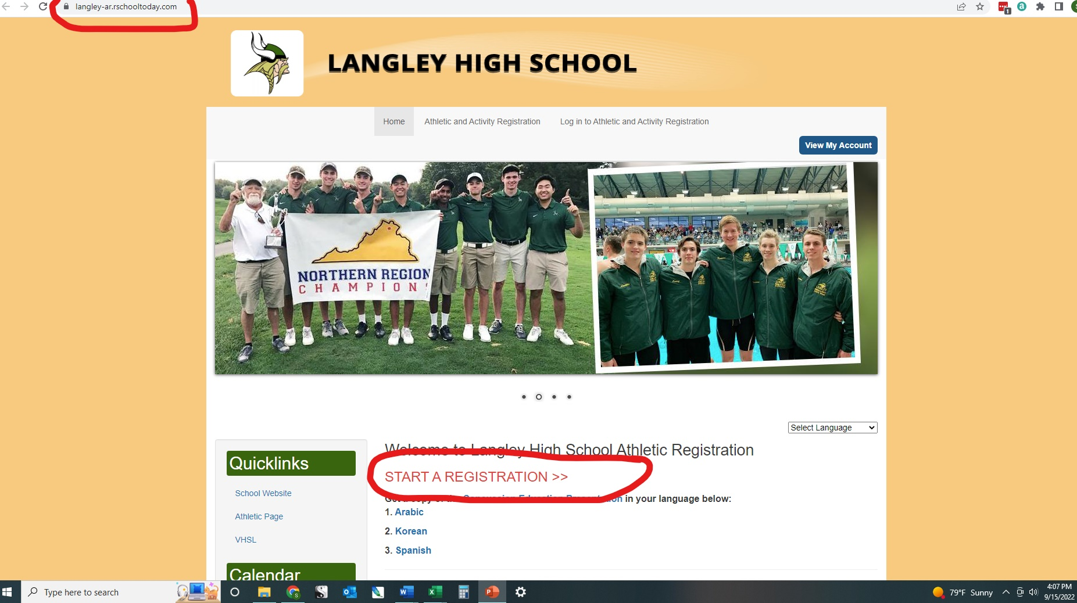
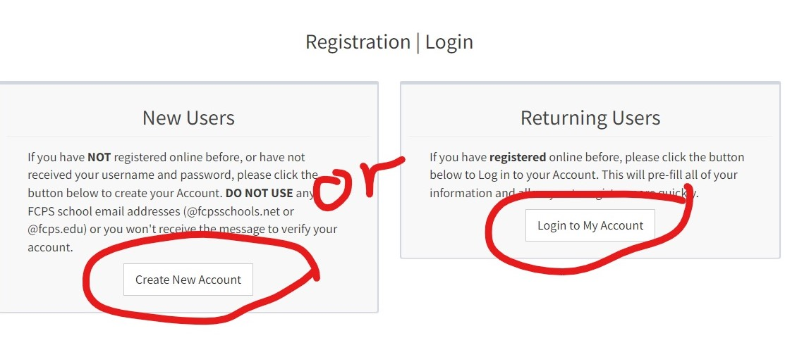
Register with Langley
Notes:
On the Langley Athletics Registration website, go to “Start a Registration”
If you already have an account, log in. If not, create one for your family

Slide 5
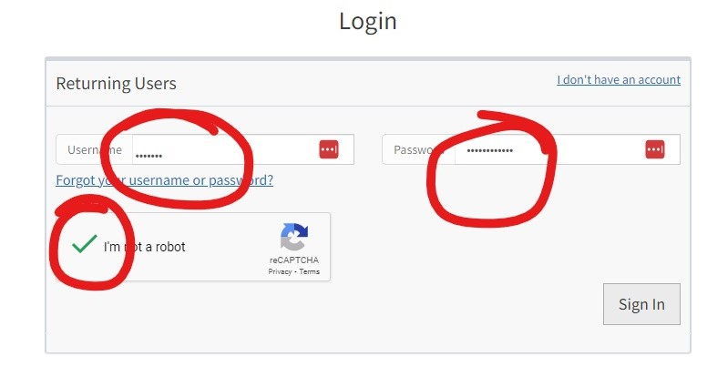
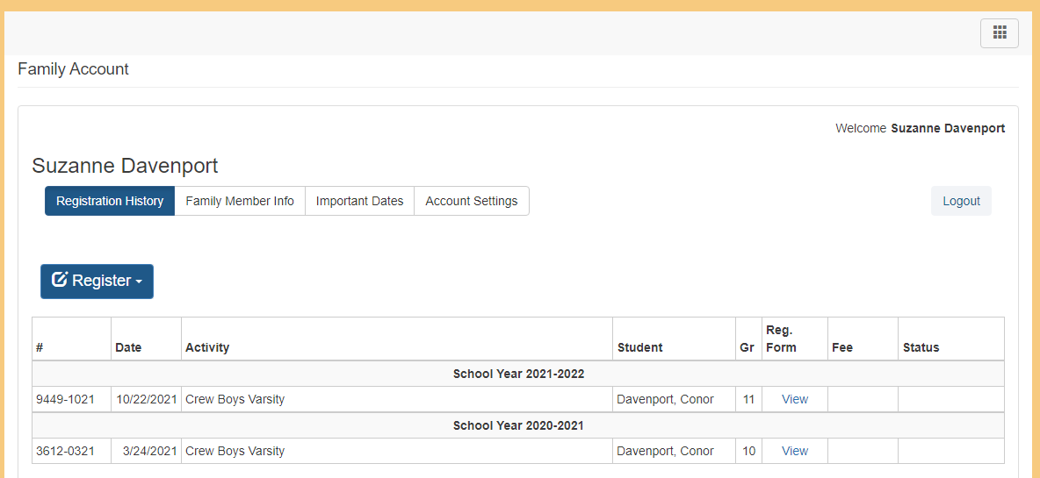
Notes:
Once you’re logged in to the family account, click on the Register button

Slide 6
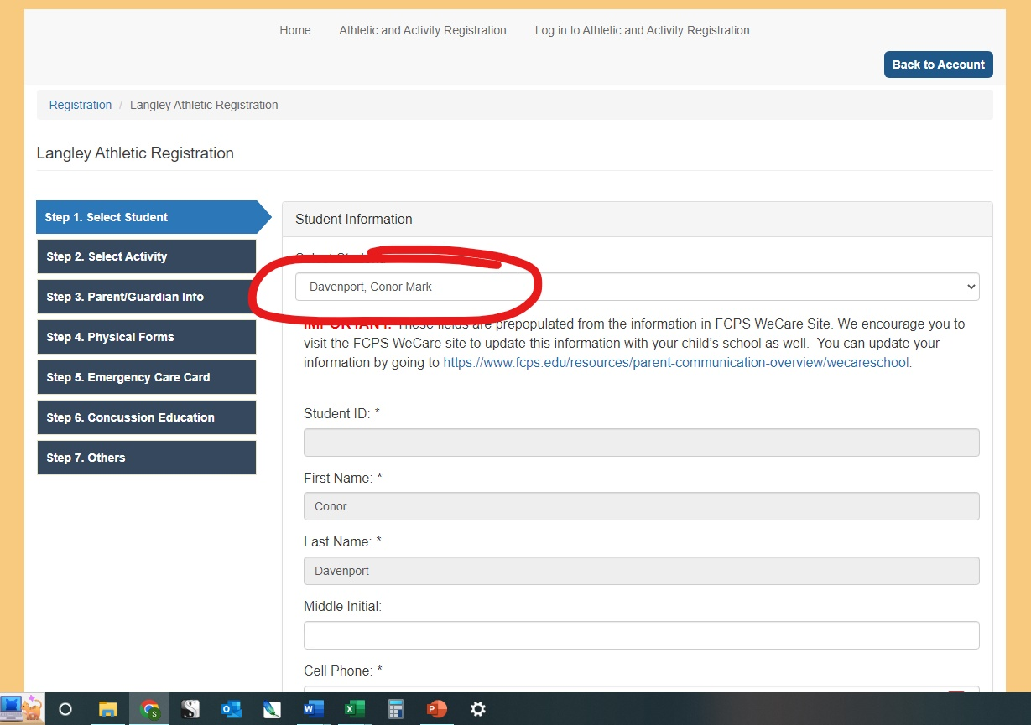
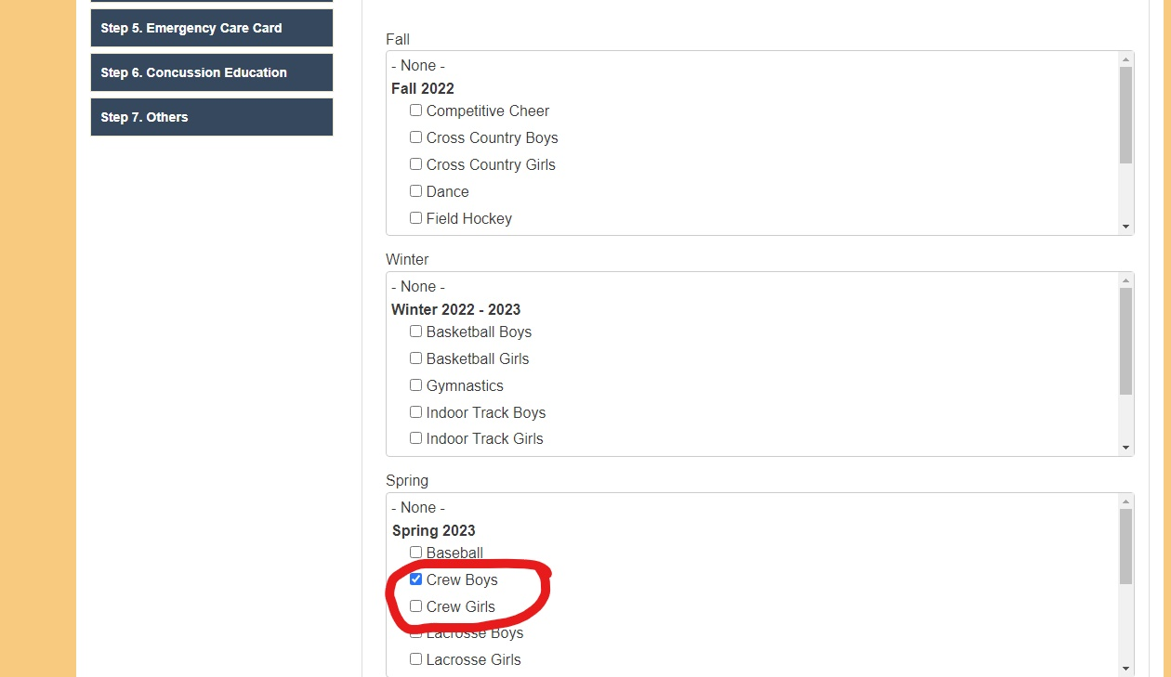
Notes:
From here, you follow the registration steps the website walks you through.
Most importantly, make sure that you select Crew under Spring in Step 2, Student Activity.

Slide 7
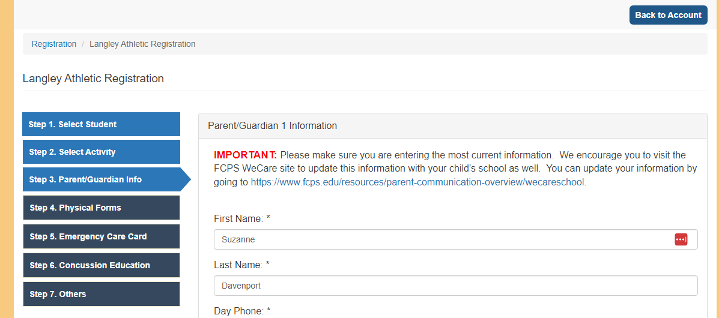
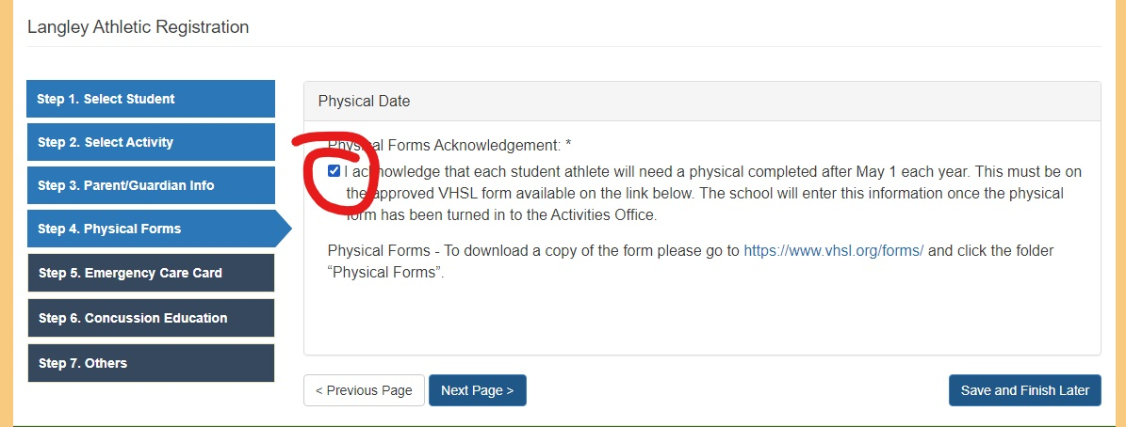
Notes:
In Step 3, you’ll fill out the parent info
There is a little confusion with Step 4. This is where you agree to provide the VHSL Physical. It is not the same thing as actually providing the physical. You will do that separately, as you can’t actually upload the form here.
You can either provide a digital copy to Beth Longo via email or give her a hard copy at the school. If you’re going to give them a hard copy, take it directly to the Athletics Office – don’t drop it off in the main office. Better safe than having to go back to the doctor.

Slide 8
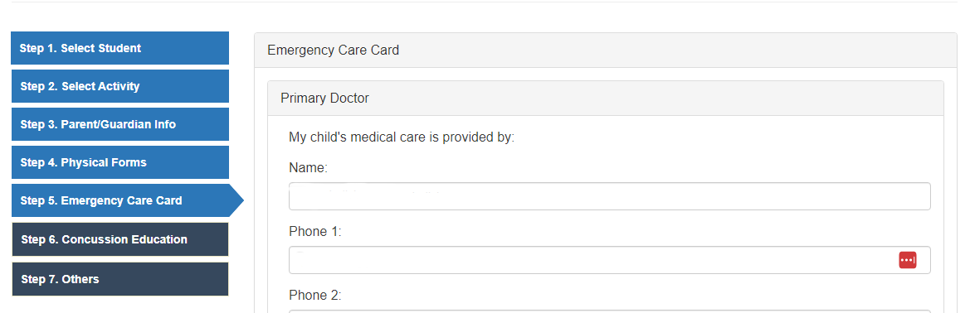
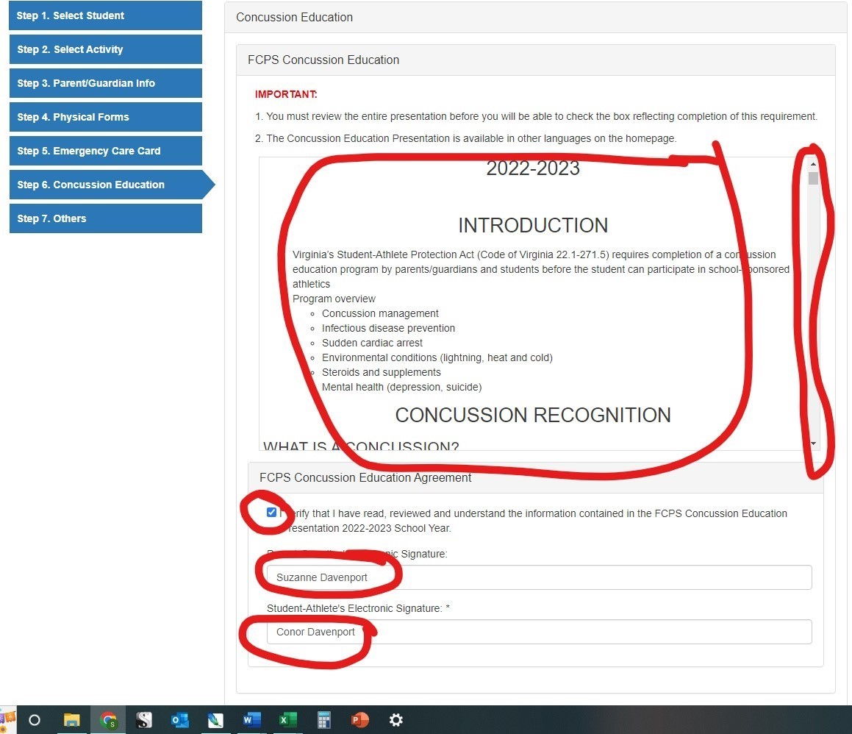
Notes:
Step 5 - PLEASE fill out ALL info on the emergency care information – this is provided to the coaches electronically, so they have it in the event of an incident during practice.
Step 6 - You AND YOUR STUDENT must review the entire concussion protocol information and then BOTH OF YOU e-sign to acknowledge you’ve read it. It should only take a few minutes, but you do need to scroll through the entire presentation

Slide 9
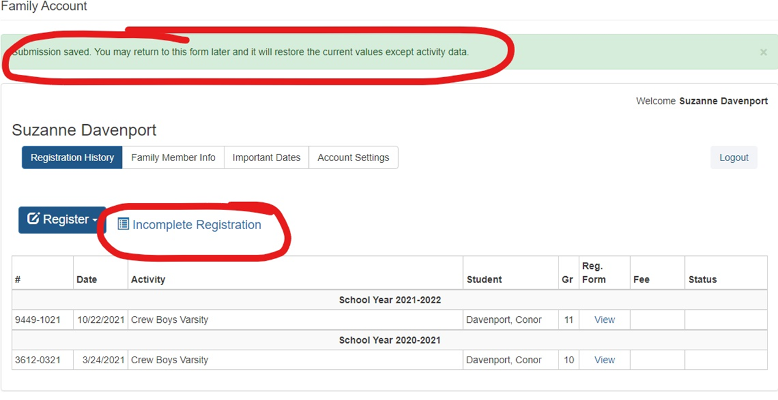
Notes:
Once you’ve gone all the way through the process, you will get a notice that your submission is saved but the registration is incomplete. This is because Langley doesn’t have your physical yet. Your registration will stay incomplete until all items are complete – including the concussion training, emergency care info, and physical.
Incomplete registration with Langley means your child cannot participate in Spring Training.

Slide 10
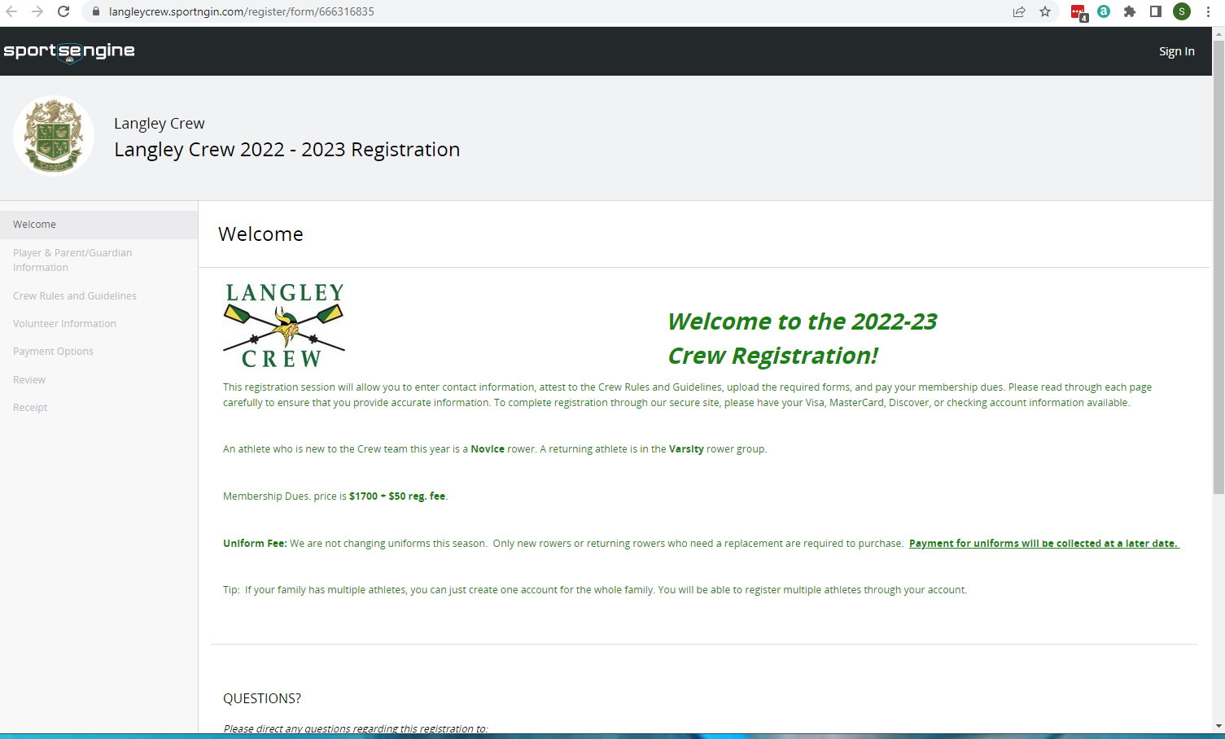
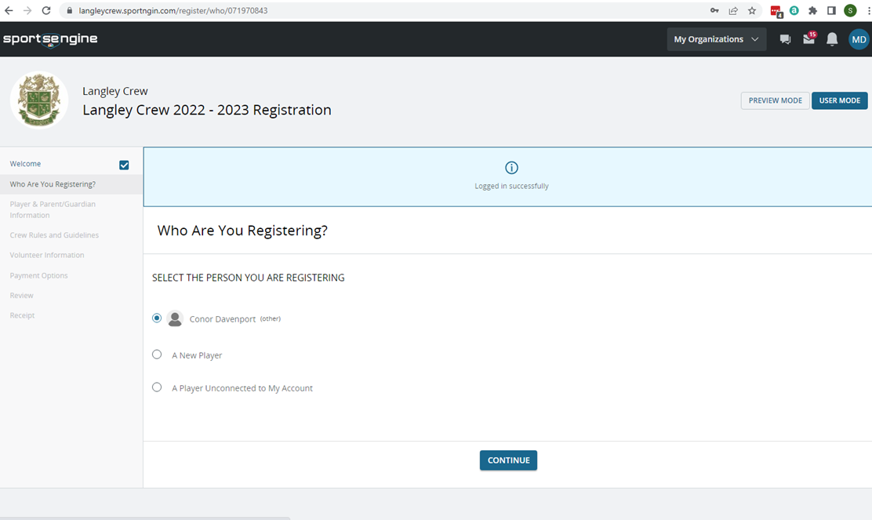
Register with the Crew Booster Club
Notes:
Congratulations – You’ve finished one of your registrations!
Now let’s look at the next one – Registering with the Booster Club, via SportsEngine, our team management platform
This is registering through the crew website, like you did with Learn to Row.
This is where you get on the roster for the team, provide detailed information about you and your student for the database, and pay your fees.
You need to complete this by the time Spring Training starts, or your child will not be able to participate
On this first page, you’ll need to either log in to your account, or create one if you don’t have one yet.
Once you’ve logged in, select which student you are registering. You can use one account for all your children doing crew.

Slide 11
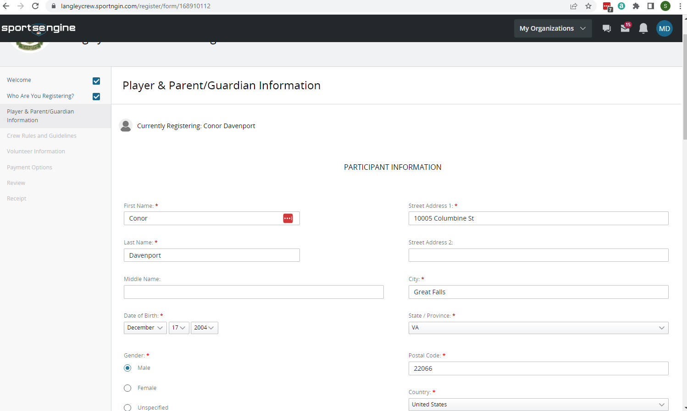
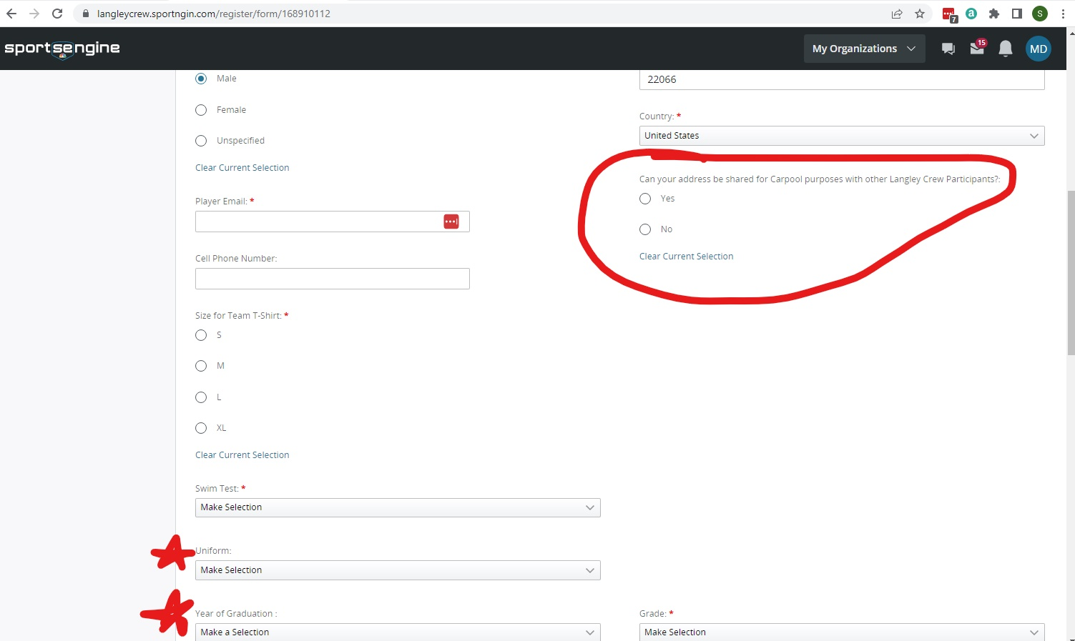
Notes:
On the next page, you’ll add information about you and your student
Towards the bottom of the page are a couple of important optional boxes
The first one is about the uniforms – it helps us plan if we have an idea how many of us will likely need a new uni
The next one is about the year of graduation – again, it helps us identify the different classes
The last one is really important for you – the carpool question. Clicking Yes gets you on the list of people willing to form carpools. Clicking No or not selecting anything keeps you off the list

Slide 12
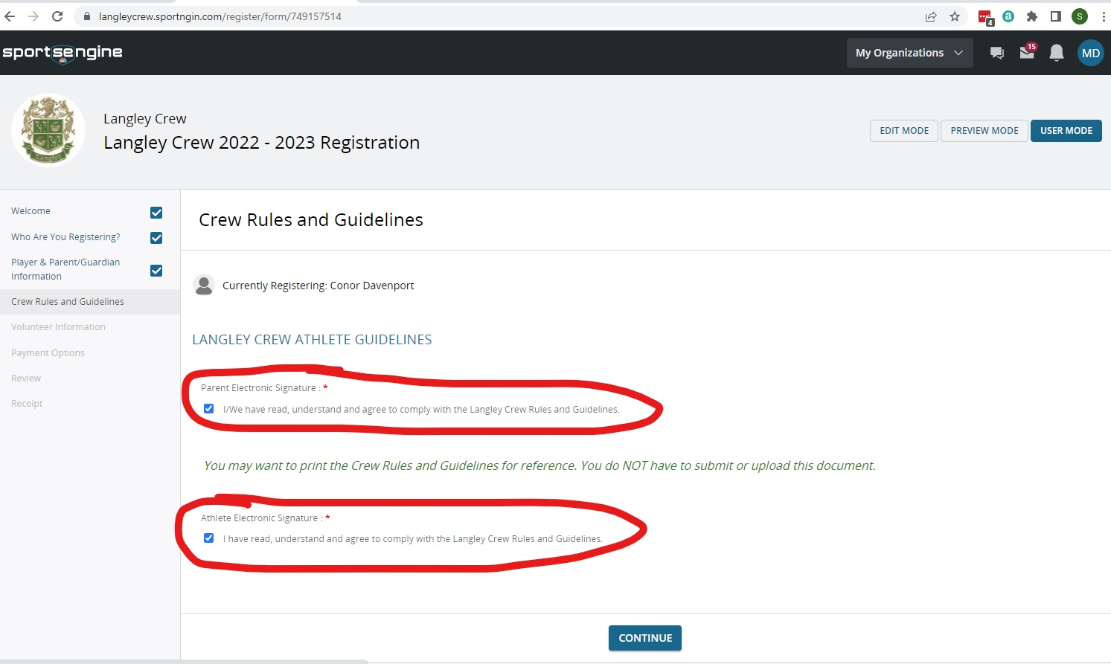
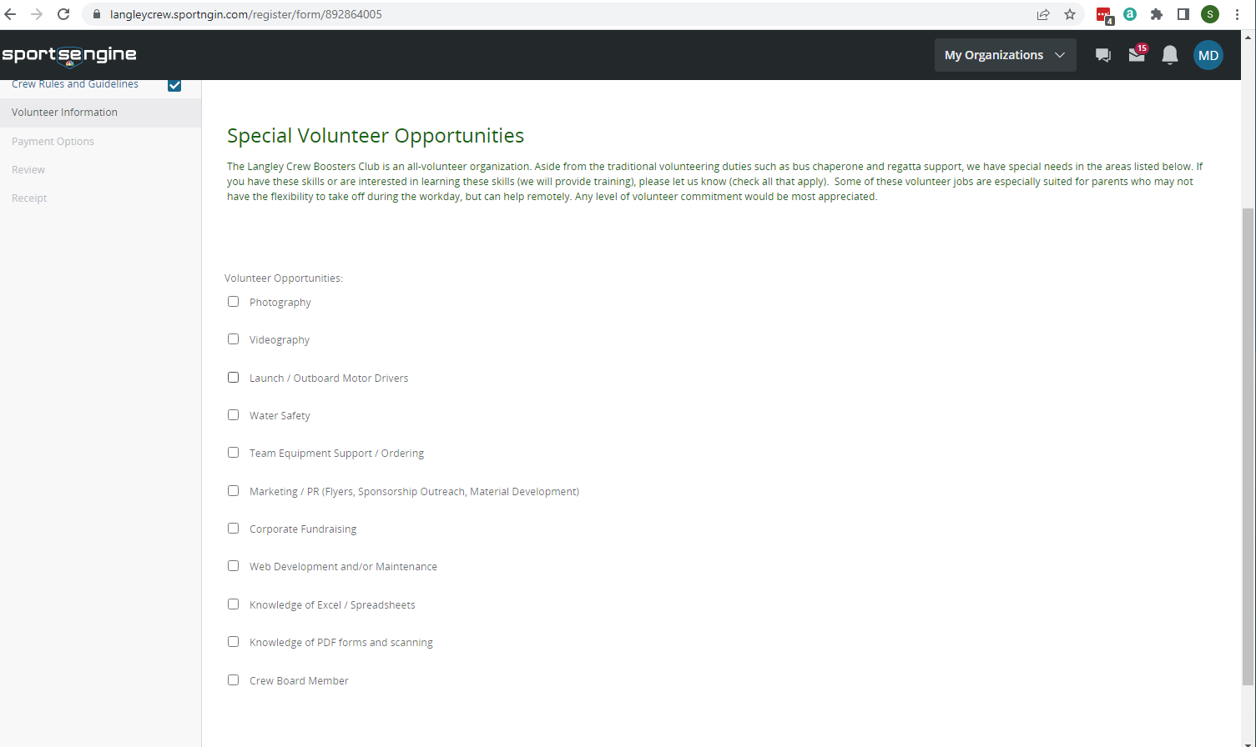
Notes:
On the next page, you and your student will review the Athlete Guidelines, which spell out the behavior, commitment and responsibility requirements
Both you and your student will check the box acknowledging compliance with the guidelines
The next page gives you a chance to tell us where you would like to volunteer
Except for the coaches, we are run 100% by parent volunteers. It’s very important that you participate, but how you participate is up to you. By indicating your interests on this page, we know who might be available for what.

Slide 13
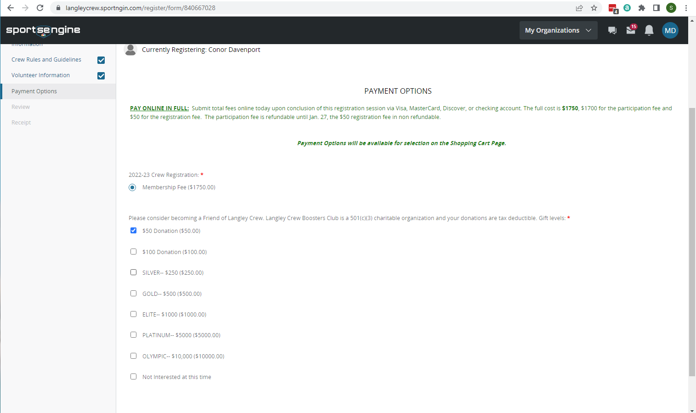
Notes:
Next you’ll go to the payment options
You can pay in one payment or in three payments. You’ll make that selection on another page.
On this page, you’re selecting the registration fee and any additional donation you choose to make, if you choose to do so.
Benefits for the various levels of donation are on the website, on the “Support” tab under the Home Page

Slide 14
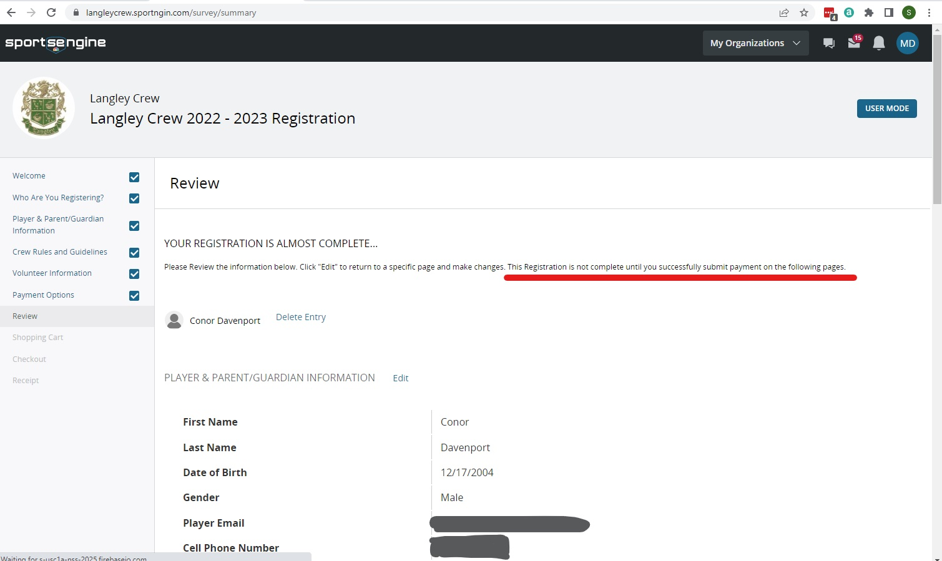
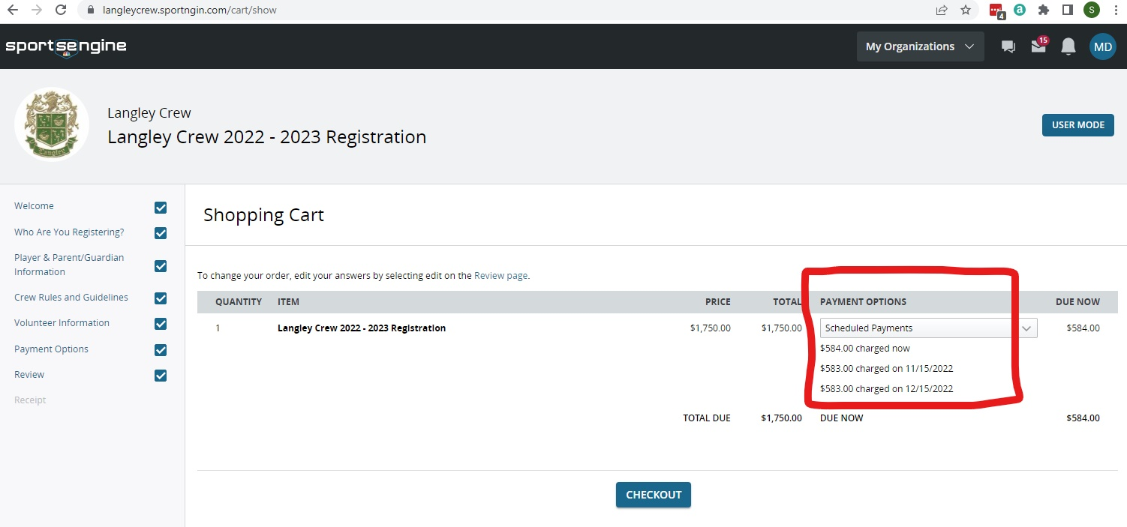
Notes:
The next page gives you a chance to review the information and make edits before you get to actually paying.
The next page is the “shopping cart”, where you will review the payment information
This is where you will indicate one lump sum payment or three monthly payments
The first monthly payment is taken on the day you register, the second payments are charged on November 15 and December 15.
If you register after November 15, both the first and second payments will be charged upon registration
If you register after December 15, all three payments will be charged upon registration
Any donations you’ve chosen will also appear here.

Slide 15
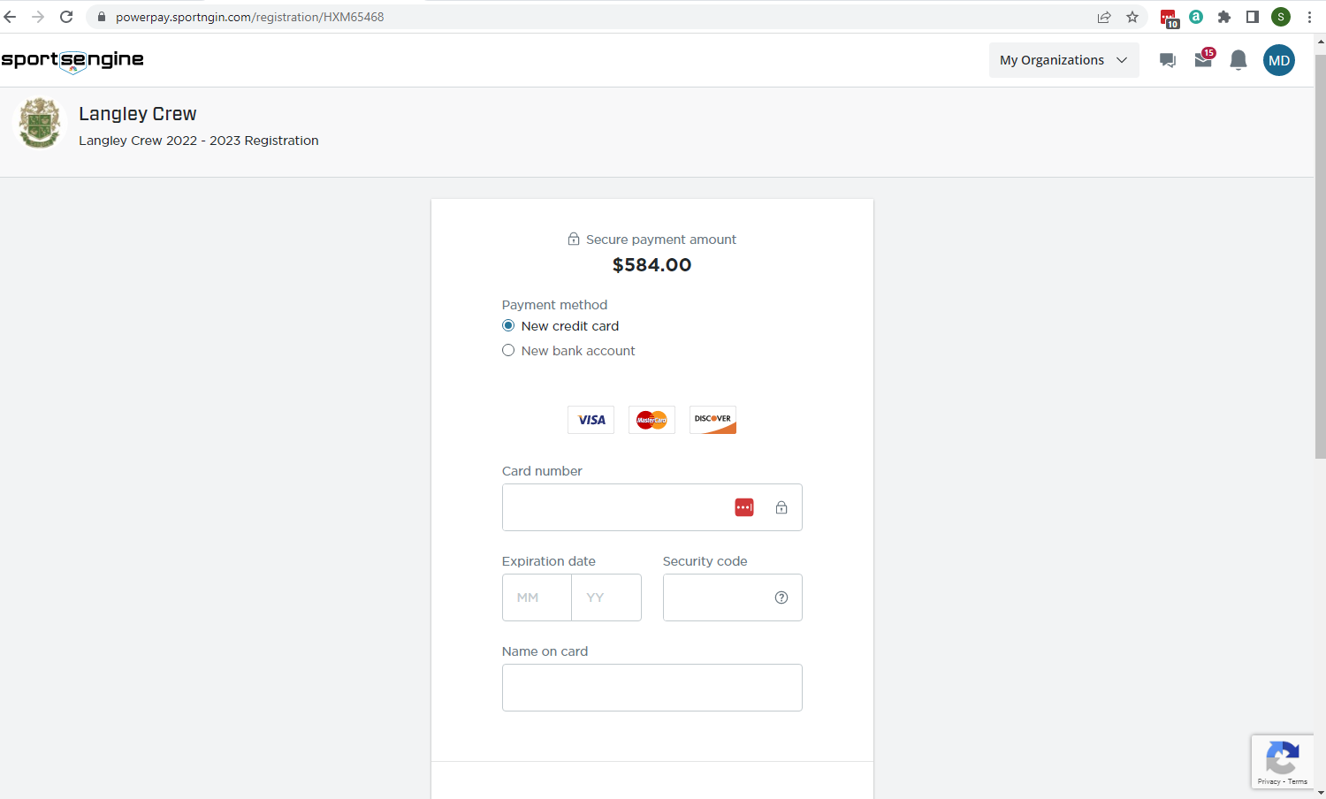
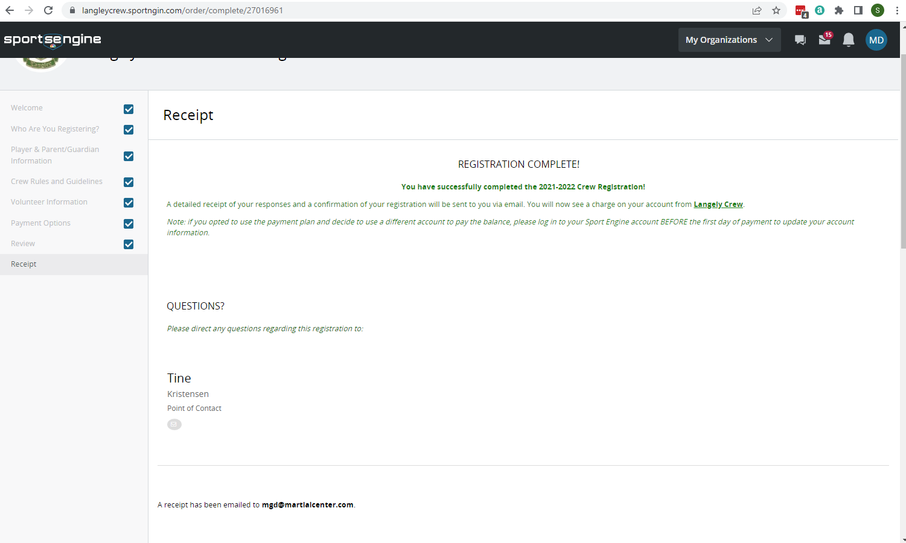
Notes:
The next page allows you to check out, and your credit card is charged according to your choices in the shopping cart
Once the payment has gone through, you will get a receipt page. This receipt will also be emailed to you.
Congratulations! The second registration is complete!!
Two down, one to go!

Slide 16
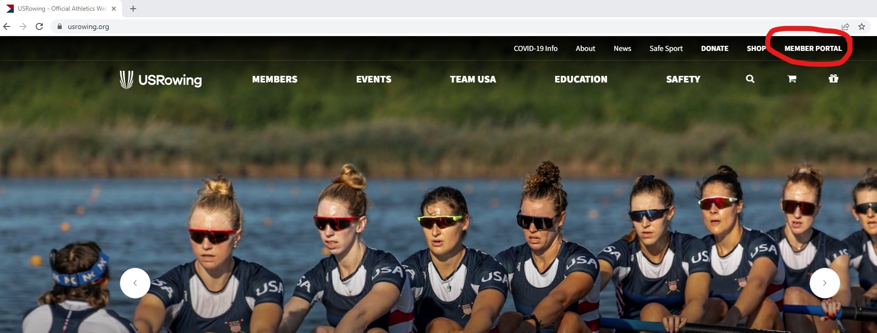
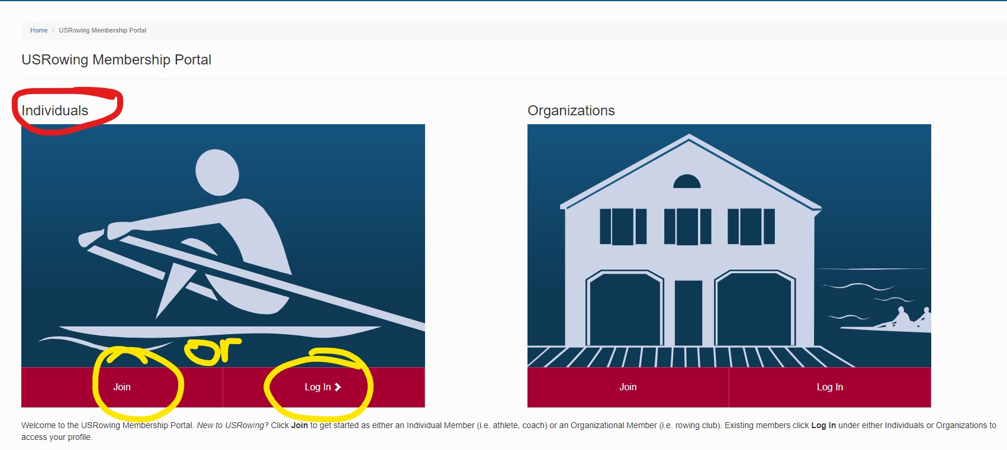
Register with USRowing
Notes:
Our regattas are held under the authority of USRowing Association. All regatta participants must be USRowing members.
You must be a member by the time regattas start, and renew your membership annually
Non-members cannot participate in regattas, regardless of LCBC or LHS registration status
From the USRowing website, go to the Member Portal
Under Individuals, choose either Join if you’re just starting your membership account, or Log In if you’re going to be renewing your membership

Slide 17
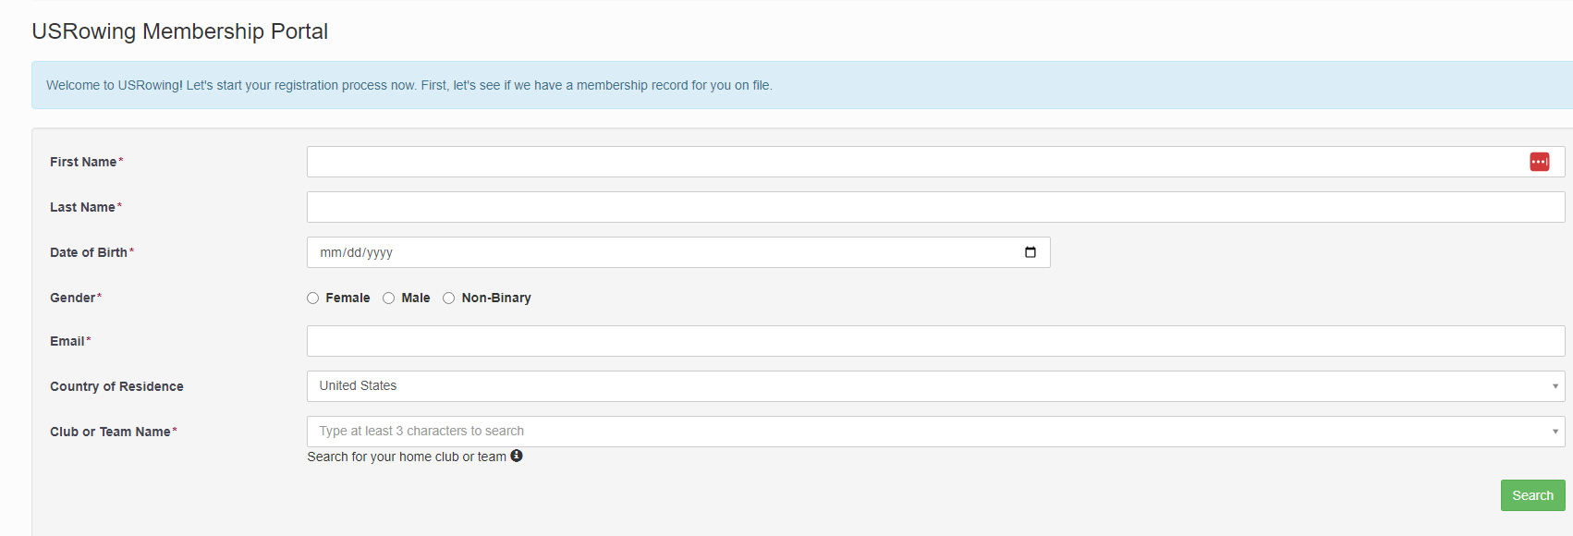
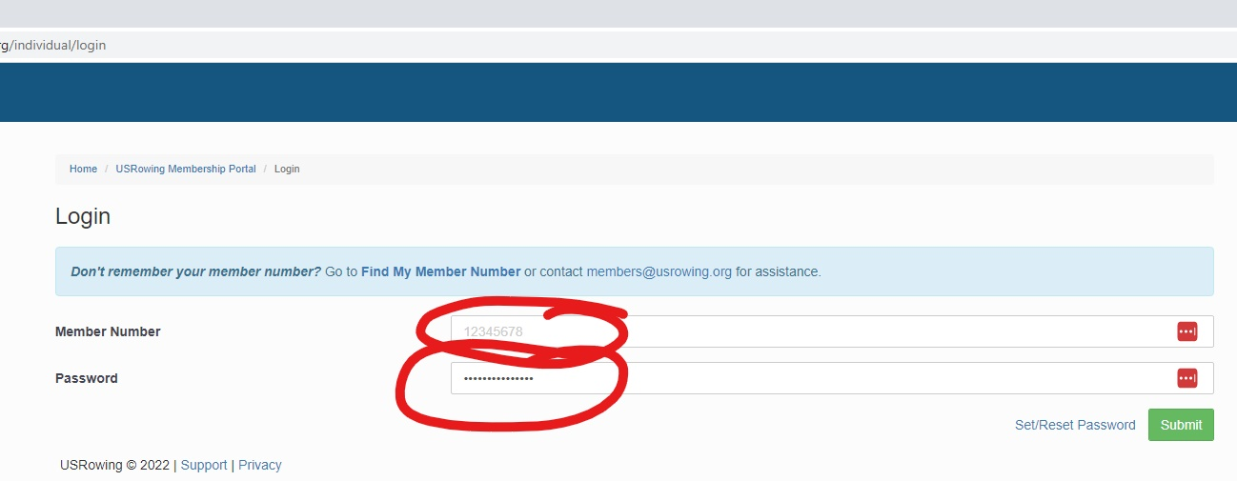
Notes:
If you’re creating your account, you’ll see the top screen. You register using your rower’s information, not yours (except for email, use your email).
If you’re renewing, you’ll see the bottom screen.

Slide 18
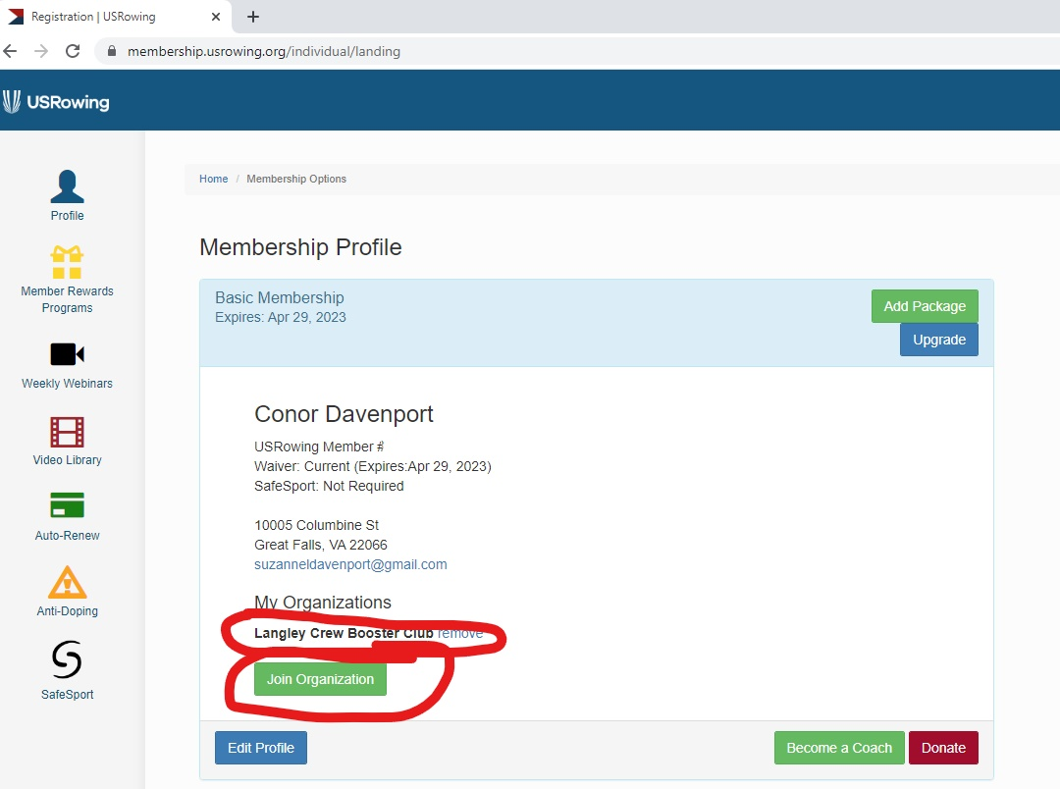
Notes:
Logging in will take ;you to your membership profile.
You will need to associate your student with Langley Crew Booster Club.
For a new profile, there will be nothing under My Organizations. Renewing members should see us there.
If we aren’t there, click on Join Organization

Slide 19
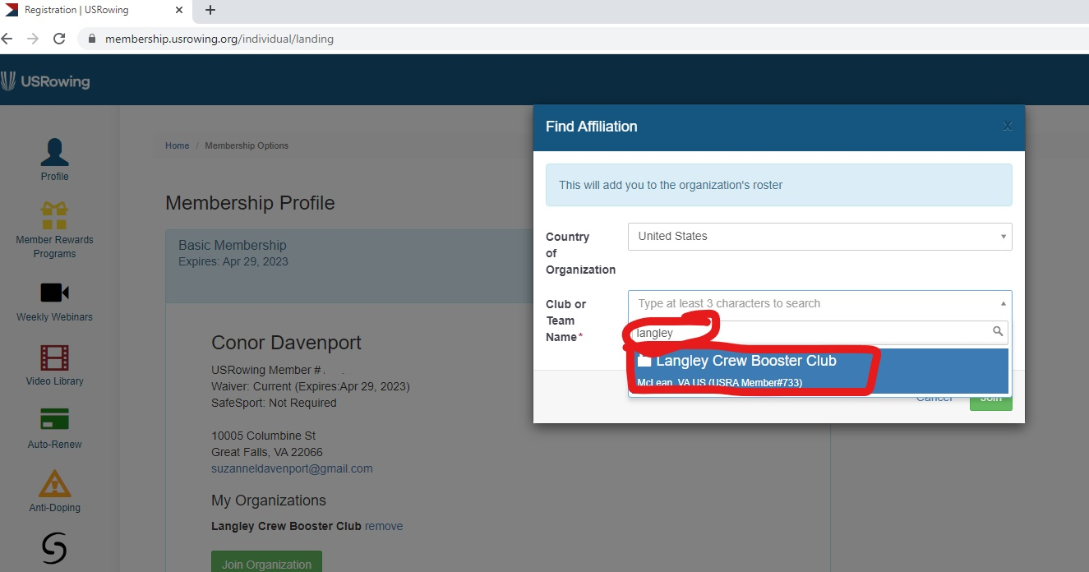
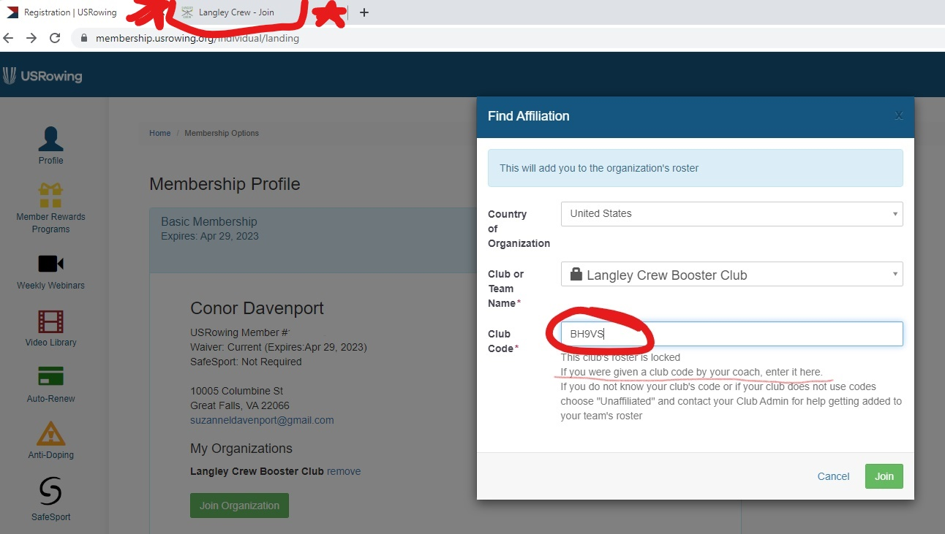
Notes:
You’ll see a popup box. Under Club or Team Name, type in Langley. We will come up. Select us.
You’ll get another popup box, asking for our club code. That code is located on the website’s Join page, under the USRowing header. IT IS CASE SENSITIVE so enter it exactly as it appears on the web page
Click Join
Congratulations! Your child is now a member of USRowing, affiliated with Langley Crew, and can do the fun part of what all the work is for!!

Slide 20
Is that all?????
Jeez!
Almost – don’t forget to email your VHSL physical to Langley!
Notes:
So, you’ve registered with Langley, registered with us, and registered with USRowing. It’s not quite time to pop the champagne just yet though – don’t forget to send in the physical. It has to be dated after May 1, 2022 to count.
We know this is complicated and there are a lot of moving parts.
We work closely with Langley to make sure all the registration boxes are checked before spring training starts, and we work with USRowing to make sure everyone is affiliated with us.
We get lists from both LHS and USRowing to make sure everyone is all signed up.
If there’s a box not checked, you’ll get an email telling you what’s missing. Please pay attention. If you’re not sure what we mean, please ask. We don’t want to have to suspend your student from practice or regattas, but we will have no choice.

Slide 21
Crew Interest Meeting
What you need to know:
We are holding an Interest Meeting on Tuesday, November 1, at 7 pm at the school for any student and parent interested in joining the team. We’ll talk about what’s involved in registration and how to do it, the logistics of winter and spring practices, and what you and your kids need to do to get the most out of crew.
What does this mean for you?
A chance to learn what you need to know to make your decision regarding crew
A chance to meet the Board and coaches
A chance to ask questions about any aspect of the program
What does this mean for your kid?
Another chance to convince you crew is where they want to be
What do you need to do?
Attend the meeting
Ask questions
What does your kid need to do?
Attend the meeting, if they want
Notes:
If you missed the Open House, or don’t remember what we told you, this is a chance to ask us anything you want to know.
If you went to the Open House, and remember it, but now know more about what you don’t know, this is your chance to ask.
We’ll be talking about the registration process, Winter Conditioning, and again hammering you with how important it is to register ASAP
You can meet with Board members, current team parents, coaches, and current team members

Slide 22
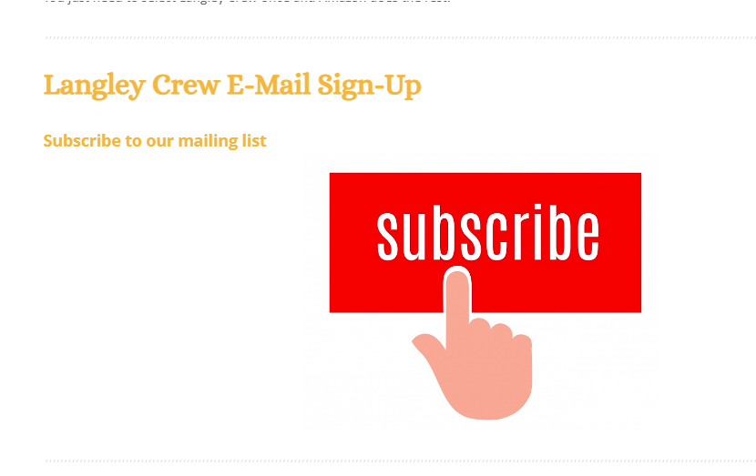
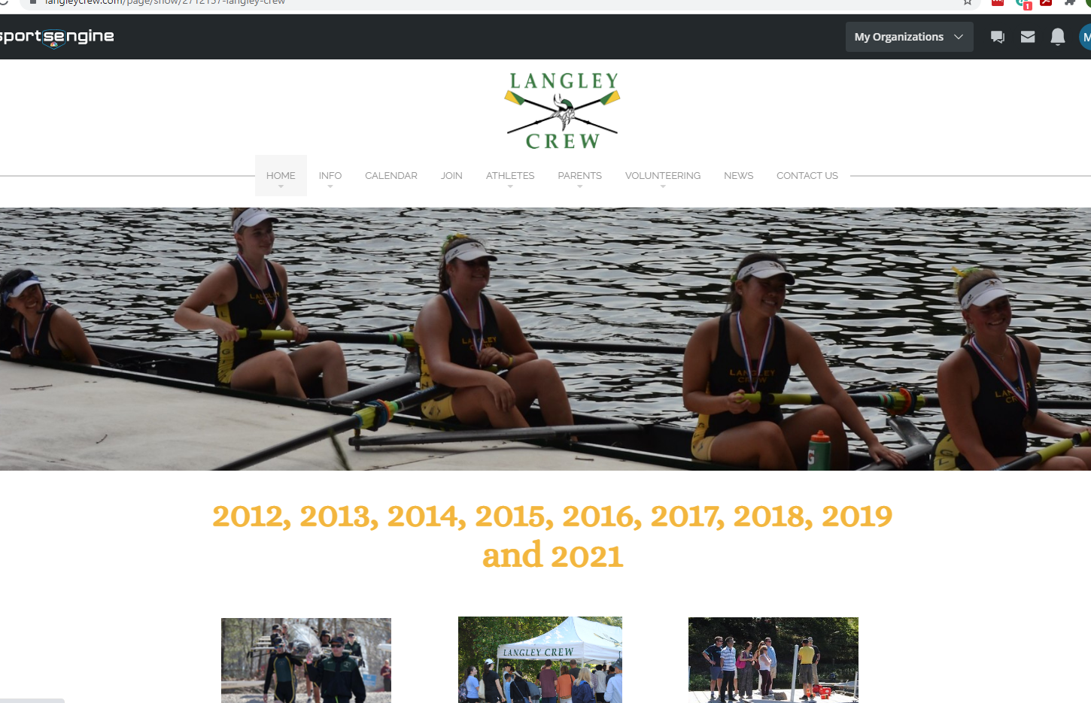
Communication
What you need to know:
We use several methods to communicate with you:
Newsletter – the main means of communication with parents. Number one source of information for what’s going on with the team throughout the season. This is where you’ll find changes to schedules, event news, calls for volunteers, merchandise opportunities, and regatta information.
Emails
  From us – any urgent messages, such as weather-related cancellations, will be sent out via email. The distribution list is generated from registrations.
  To us – reach out to us at langleyrowing@gmail.com. We’ll get back to you usually within the next 24 hours.
Langley Crew website – we post pretty much everything you need to know about Langley Crew here. The main page contains the most updated information, while the other tabs contain information that doesn’t change frequently.
Notes:
The newsletter is the number one way we keep you up to date. Please, please subscribe. If we have something that you need to know, we will tell you through the newsletter. We may add it to other platforms, but it will definitely be in the newsletter.
Our email address is langleyrowing@gmail.com Make sure you add it to your “safe” addresses so our emails don’t go to spam. The newsletters are sent from this address.
The website has been totally updated and restructured to make it easier to find the information you’re looking for. We think it’s pretty user friendly, but we can do a tutorial on navigating the website if you want.

Slide 23




GroupMe – a chat app we use to provide last-minute weather-related changes and regatta results. It’s also a forum for parent discussions and questions.
Facebook – we use this as a forum for parent discussions, share successes, and post photos
Flikr – we post our crew photos here. For our kids’ internet safety, only people we approve are given access. You must join Flickr and then follow us to be approved.
YouTube – we post our crew videos here
What does this mean for you?
You have multiple ways to find out what you need to know without using your teenager.
What does this mean for your kid?
They are not responsible for keeping you informed. We all know how good they are at that.
What do you need to do?
Subscribe to the newsletter, ask to join the GroupMe chat and Facebook group if you want, follow the Flickr and YouTube pages, and explore the website.
What does your kid need to do?
Breathe a sigh of relief and be secretly pleased you’re involved
Notes:
GroupMe has become an important means for the parents to feel connected, get to know each other, and keep up to date on what’s going on. Urgent information will be sent out via a “flash” newsletter then immediately posted on GroupMe. Parents use the GroupMe chat to ask and answer questions, exchange information, post pictures, and post regatta results for those unable to attend. It’s become quite important to the parents, especially the new ones.
Flickr: to see the Flickr photos, you will need to join Flickr and follow Langley Crew so we can provide access.
What this means for you is that you do not have to rely on your teen for information. They are notorious for not providing their parents full, if any, information on what’s happening in their world.

Slide 24
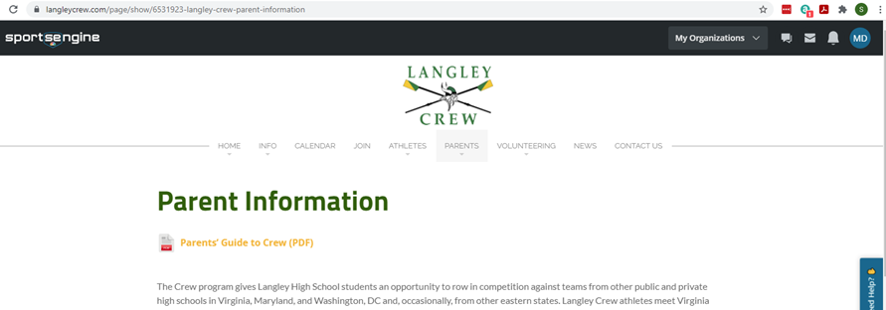
Parent’s Guide to Crew (Crew 101)
What you need to know:
We have consolidated all the information that a crew parent needs to know into one comprehensive PDF. It’s the first thing you see when you go to the Parents page on the website.
Notes:
We’ve put together a one-stop shop of information for parents, called the Parent’s Guide to Crew, lovingly called Crew 101, in a PDF format
To find it, go to the website, click on the Parents tab and it’s right under the headline

Slide 25
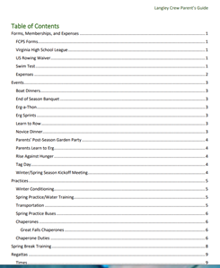
What does this mean for you?
All the information from the PDF is on the website, this just puts it all together in one easily navigated and downloadable document. You can look up pretty much anything you want to know regarding transportation, volunteering, regattas, schedules, and events.
What does this mean for your kid?
They do not have to be your main source of information on how crew works.
What do you need to do?
Check it out and use it as a reference guide.
What does your kid need to do?
Breathe a sigh of relief and be secretly pleased you’re involved.
Notes:
It’s downloadable and easy to navigate. If you click on the page number in the table of contents, you go to that page. You don’t need to scroll through to find what you need.
In the Parent’s Guide, everything on the website that parents need to know, including a guide to the strange new language your student is now speaking, has been compiled into one document.
You can learn things like
What is a boat dinner?
What is tag day?
What do I do on regatta day?

Slide 26
Questions??

Slide 27
Registration:
Langley Athletics Registration
Q: What if you turned in a VHSL physical for a Fall Sport? Do you need to resubmit?
A: No. If you turned in a physical for a fall sport this year, you do not need to resubmit.
Q: We have submitted the physical form in Spring. Do we need to resubmit it?
A: Yes. The expiration date for the physicals is April 30 each year, so a new physical, dated May 1 or after, is required for each year. For this school year, the physical must be dated May 1, 2022 or later.
Pro parent tip: if your child had a physical in April, check with the doctor’s office – they may be willing to provide a VHSL physical form dated after May 1 based on the April physical results. It’s worth a shot.

Slide 28
Langley Crew Booster Club Registration
Q: Who would need a new uniform? All first-time crew members?
A: Yes, all first-time crew members and any returning members who have outgrown last year’s uniform. Have your student try it on to see if it still fits. This is particularly important for the boys, as they grow so much so fast.
Q: What is the timing on the uniforms? When do we do that?
A: We will do that in early December. You’ll be given information on that as we get closer
Q: Is there a sizing guide?
A: Yes, you’ll be given information on how and where to measure your student so we can order the correct size
Q: I have a brand-new uniform from my older daughter from 2020 never used - is it the same - can my 9th grader use it?
A: Yes. We haven’t changed uniforms.

Slide 29
Q: If you answer “yes” for the carpool question, is that for offering a carpool or requesting to be in a carpool?
A: We do not set up the carpools for you. Answering “yes” on that question will get you on the list of people who are interested in being in a carpool. We will pull a list of names, addresses, and contact info for everyone who answered “yes,” sort it by city, and email it to everyone on the list so you can set up your own carpools.
Q: Do we get a full refund in mid-January if there is a change?
A: The cutoff date for refunds is January 27, 2023. At that time, if you withdraw, we will refund you $1700 of the $1750 – the $50 is the administrative fee charged by SportsEngine, but we do refund the $1,700 that is our fee.
Q: What about the swim tests? Do we need to do that again?
A: No, that’s a one-time-only thing. They only need to pass it once in their high-school careers, so if they’ve already done it to join Learn to Row, they’re good.

Slide 30
Miscellaneous
Winter Conditioning
Q: Is there a separate signup for 2022 Winter Conditioning in case you can't make the Nov 1 meeting?
A: No, you don’t need to sign up for winter conditioning. They just attend.
Q: Is Winter Conditioning every day after school?
A: Yes, and every Saturday. Winter conditioning is not mandatory. The purpose is to get the kids in physical shape so we can spend our time on the water working on things like technique, form, and timing – things we can’t do off the water. If your student is doing a winter sport, they are already getting the physical conditioning.
Q: Are Saturday practices morning or afternoon?
A: Mornings
Q: How is it possible to have 150 kids doing winter conditioning at the same time?
A: In shifts. We can’t possibly have all of them working on the same thing at one time, but they will be assigned shifts and each shift will rotate through the various activity stations.
Q: When does winter training end?
A: Friday, February 17

Slide 31
Spring Training:
Q: When does spring crew start?
A: Saturday, February 18. The first official day of spring sports is Tuesday, February 21, but we start on the Saturday before that. The first day is always chaotic, so it’s much easier to do that on a Saturday morning than on a Tuesday afternoon
Q: What is the schedule for Spring Break?
A: We will not know until we get much, much closer. It’s determined by the coaches’ availability. In previous years it’s been 9 am–2 pm, but last year it was 2 pm–7 pm.

