Slide 1

2025 PARENT MEETING
July 18, 2025
Mike Warbel
Commissioner

Slide 2
MISSION
Develop participants as better football players and young men and women in an encouraging and safe environment that focuses on skill development, player safety, sportsmanship and personal growth.

Slide 3
COMMISSIONER’S EXPECTATIONS
LISTEN
HUSTLE
BE NICE

Slide 4
HUSTLE
WORK
WIN!

Slide 5
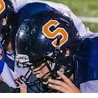
OUR CLUB
PROUD TO BE SYC
Multiple teams, One Club
168 Registrants (as of 7/18)
Coaches
USA Football Certified
Background Checks
NVYFL Code of Conduct
Springfield Fields
RVW
WIMS
SR7

Slide 6

OUR LEAGUE
Northern Virginia Youth Football League
Age Weight Matrix
Official
Designed for development & safety
Divisions
American
Central
National
Fields & Game Scheduling
Rules
Referees

Slide 7


Slide 8


Slide 9
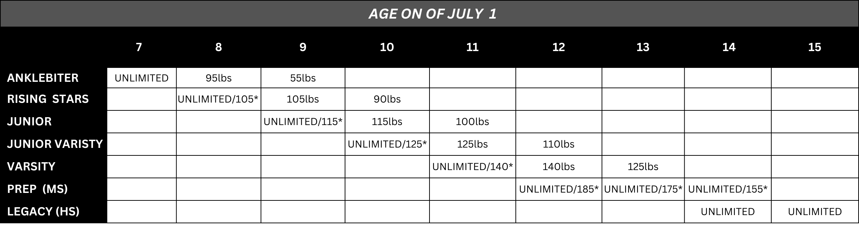
NVYFL AGE/WEIGHT MATRIX

Slide 10
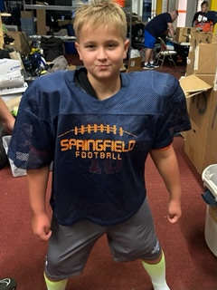

EQUIPMENT DISTRIBUTION
$300 check required at distribution…returned once gear is returned
Dates:
Saturday, 7/19, 9 a.m. – 1 p.m.
Saturday, 7/26, 9 a.m. – 1 p.m.
Makeups TBD
SYC WAREHOUSE
7411 Alban Station Ct, A104
Springfield, VA 22150

Slide 11
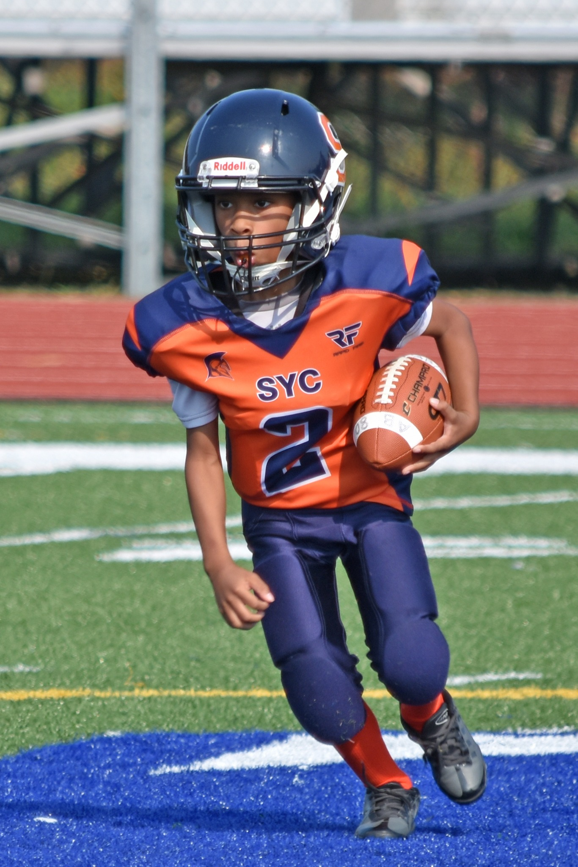
OTHER EQUIPMENT
Mouthpiece w/ strap (no red)
Cleats
Belts for big kids
Water jugs

Slide 12

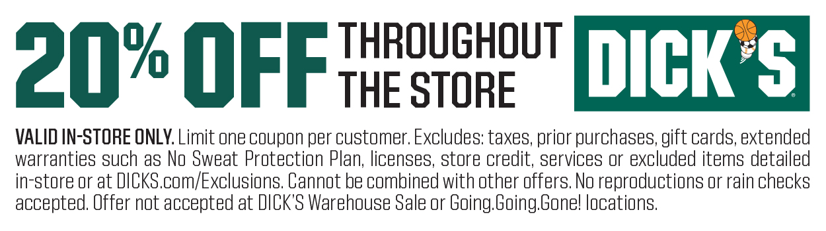
SPRINGFIELD TOWN CENTER 8/2-8/4

Slide 13


DATES: 7/28 – 7/31 REGISTRATION STILL OPEN!
LOCATION: ROLLING VALLEY WEST PARK – 6512 SYDENSTRICKER RD., SPRINGFIELD, 22152
DAILY CHECK IN AT 5:30
HYDRATION
GYM CLOTHES, CLEATS, & WATER JUG

Slide 14
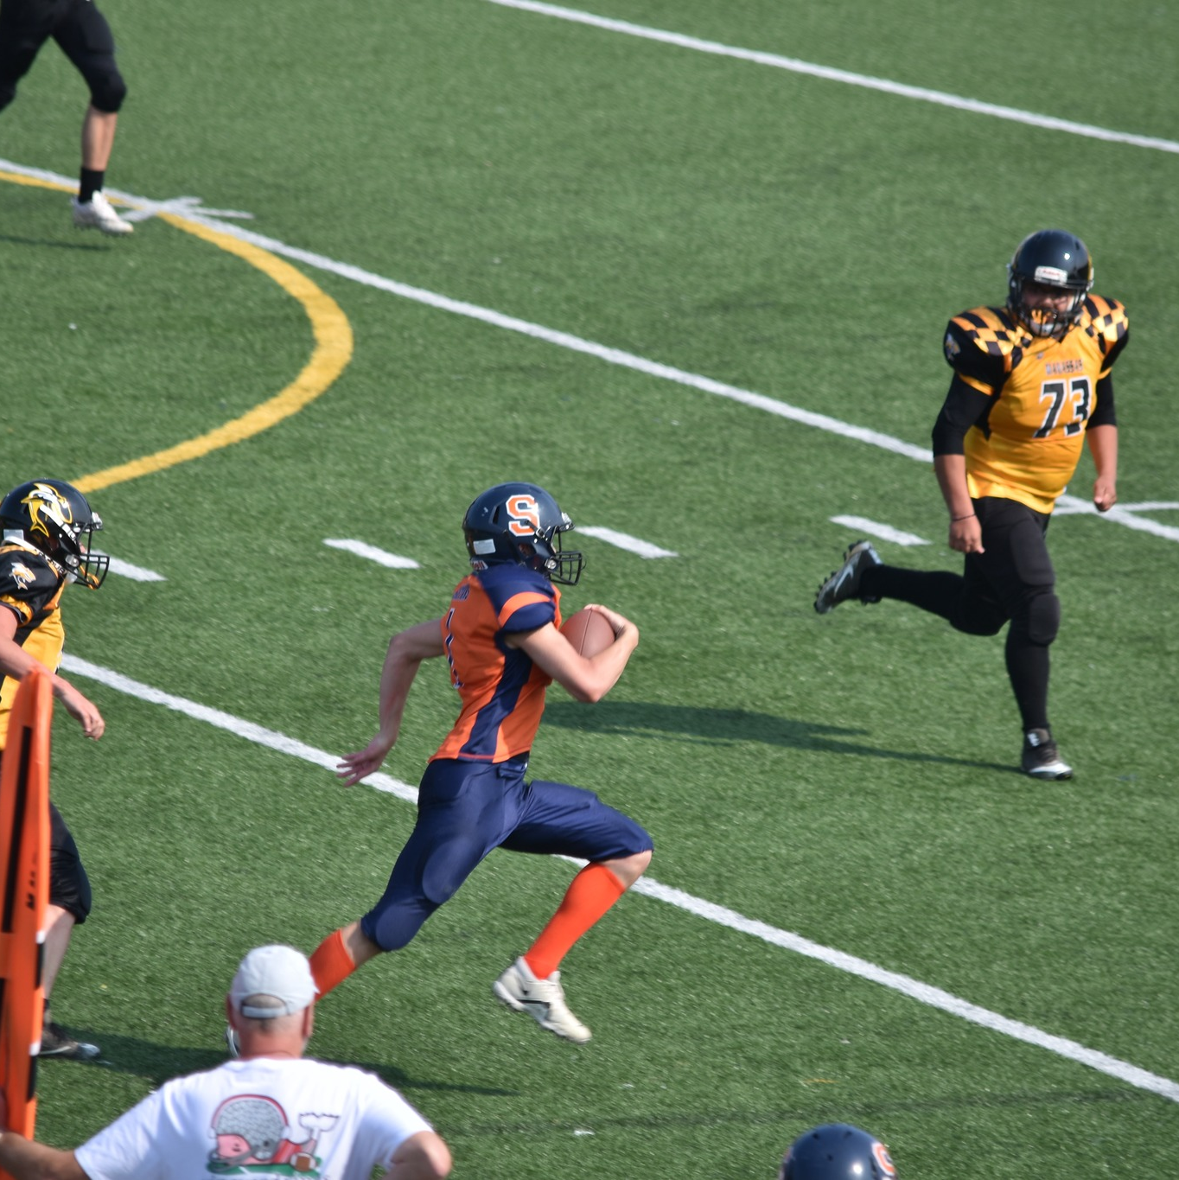
Eval Week / Acclimation
Dates: 8/4 – 8/8
Time: 6 – 8 p.m.
Location: Rolling Valley West Park
Water: Player provides
Uniform: Changes Daily

Slide 15
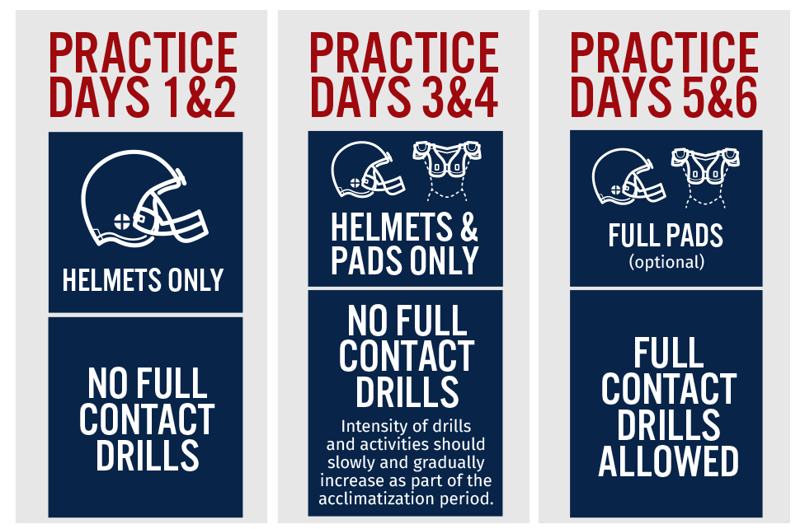

Slide 16
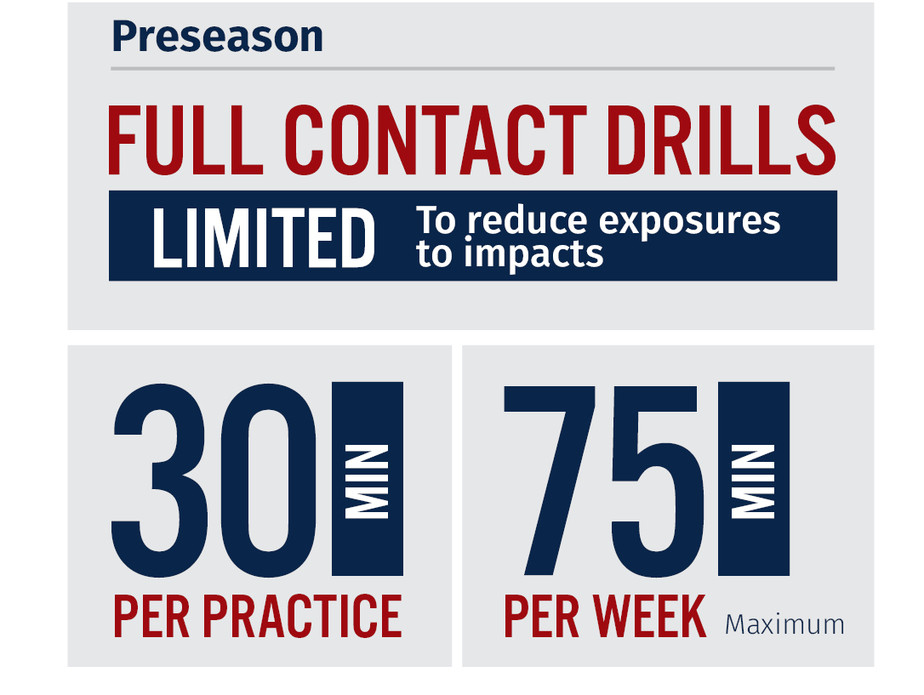

Slide 17
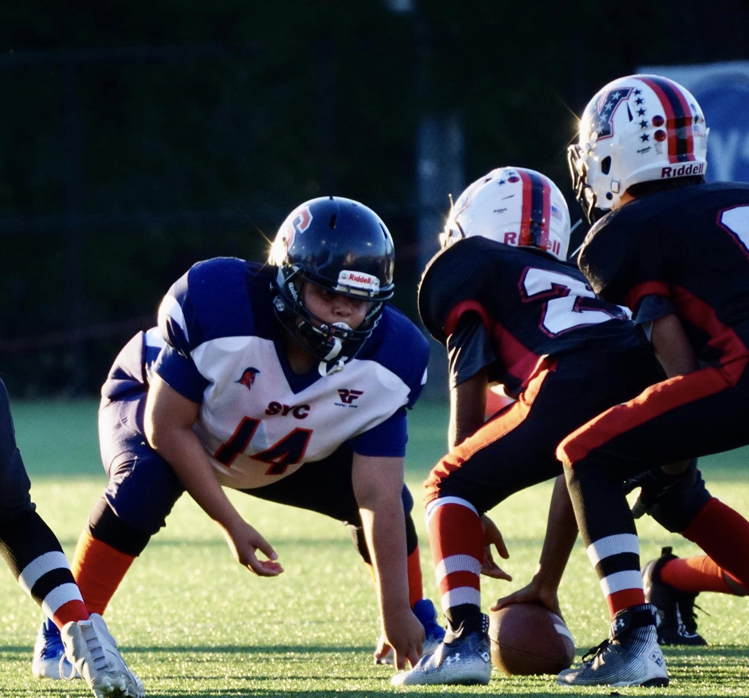
PLAYER PLACEMENT
Age/Weight is key
Waivers
Multiple Teams: Best first
Coaches & Commissioner Decide
Parent Input
Appeals to Commissioner

Slide 18
WEIGH-INS
Marshall High School
Dates
8/9 (FREE)
8/16 ($30)
8/23 ($40)
ID Card!!!
Volunteers Needed
Follow Instructions
Parking
Entry Door

Slide 19
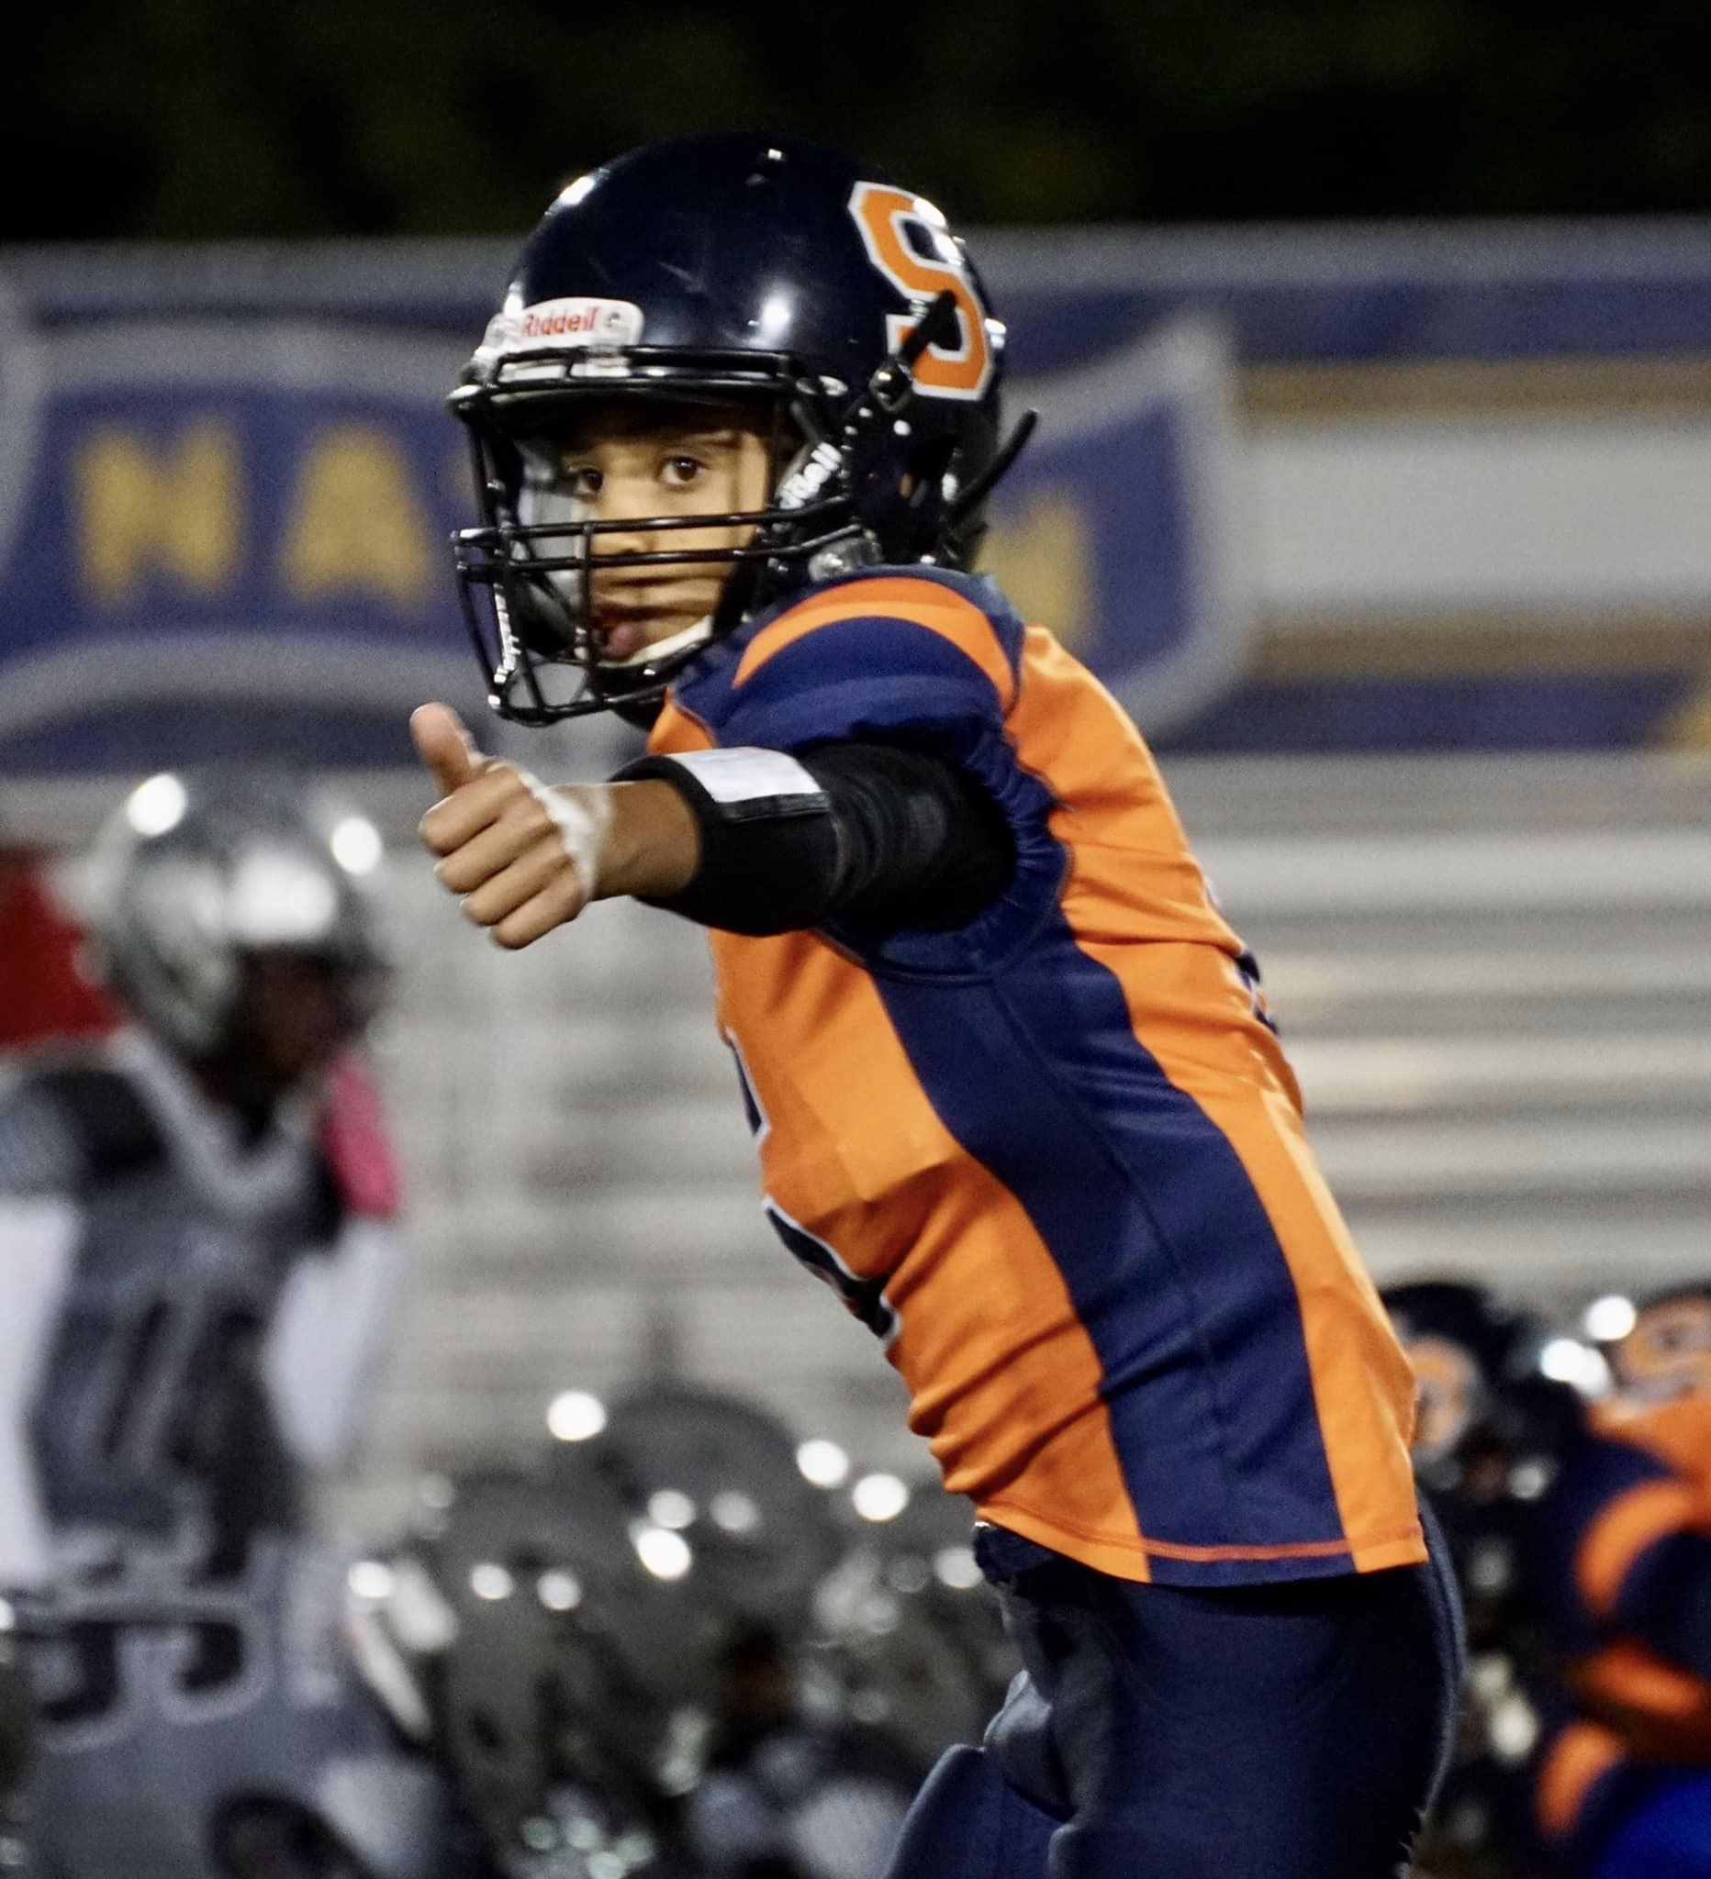
PRACTICES
Pre-Season
RVW Turf & Grass
5 days / week
6 – 8 p.m., generally
In – Season
Multiple locations
3 days / week
Coaches’ Discretion
Expectations
Be on time
Minimum practice rule

Slide 20
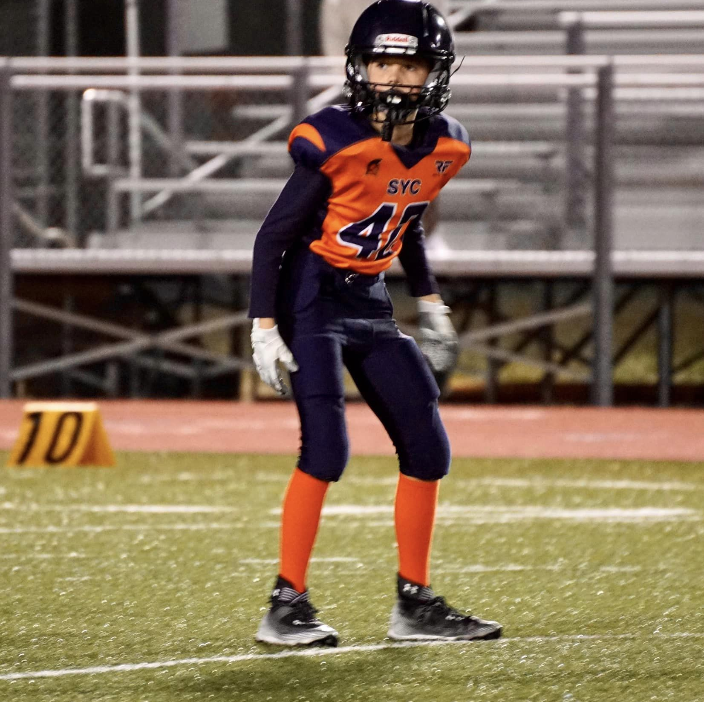
SCRIMMAGES
Multiple Locations
Possible Dates
8/23-24
8/30
9/6

Slide 21
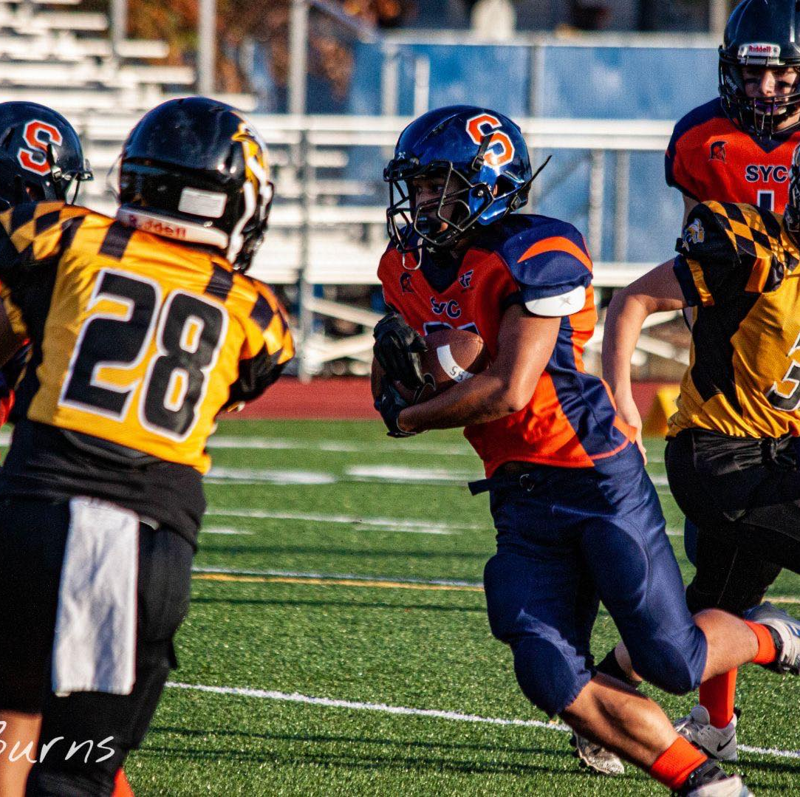
SEASON
Games start 9/13 (or earlier)
7 Regular Season Games
2 Weeks of Playoffs (end 11/8)
10 min. quarters / 5 min. half
Game and play clock and score kept on field
PAT: 1 pt. run/pass; 2 pt. kick

Slide 22
SAFETY
Concussion Awareness
Thunder & Lightning Policy
See, hear, or app
Priority to see/hear
30 mins. Break
Heat Policy
94 and below: Practice
95-104: Limitations
105 and up: No Practice
Game Site Trainers
Safety Officer Brendan Crane

Slide 23
FUNDRAISING
Sponsorships
Need Help
Snap Raise!
Online
August/September
Player Gear and Trainer Fees
Last Year
$28k
Trainers
Helmets
Sleds & Tackle Dummies
Game Balls

Slide 24
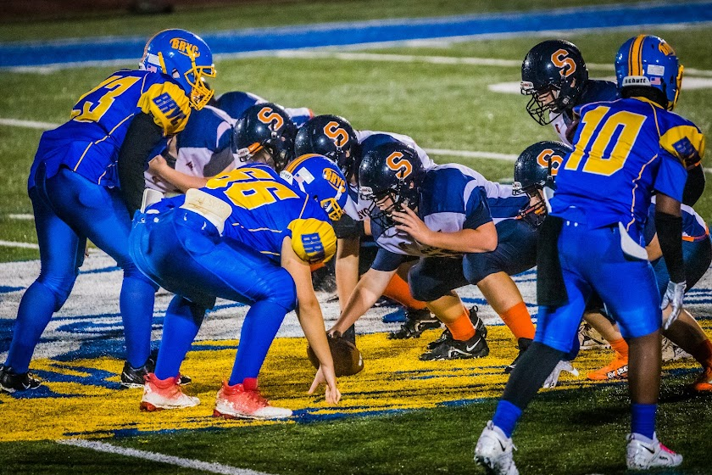
MEET THE TEAMS NIGHT
Friday, 8/29 or 9/5 at 6 p.m.
RVW Park
Events
Food
Dunk Tank & Games
Spirit Wear
Player-Coach Introductions
Volunteers Needed!
Email Commissioner

Slide 25
PARENTS
Thank you
Kids playing a game
Let the coaches coach
Respect the refs
Respect the opponents
VOLUNTEER!!!

Slide 26
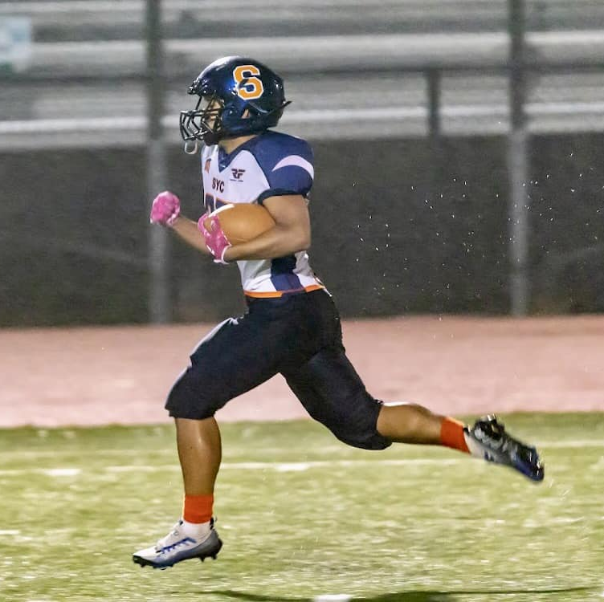
MISSION ACCOMPLISHED
Zero preventable injuries
Better Football Players
Fun
Want to come back for more

Slide 27
Questions?

Slide 28


