Slide 1
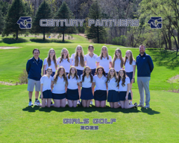



Century Girls Golf
Parent/Athlete/Coach meeting 03/24/26
Notes:
‹#›

Slide 2

CONTACT INFORMATION
Contact Information
Coach Tim O’Neill 507-319-4909 tioneill@rochesterschools.org
Athletic Director David Perkins 507-328-5140 daperkins1@rochesterschools.org
Athletic Office Manager Dee Fritz 507-328-5140 defritz@rochesterschools.org
Head Coach Eric Kartheiser 507-398-9870 erkartheiser@rochesterschools.org

Slide 3
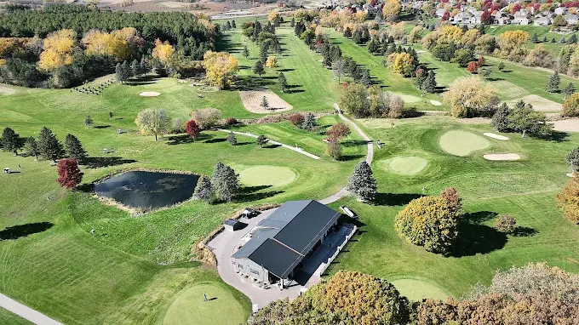
Northern Hills – Our home course
Golf Pro: Mike Manahan (507) 281-6170

Slide 4
Communication
Always via the GroupMe app - the link is on the website
Website:
https://www.centurypanthers.org/page/show/3165980-girls-golf-regular-season-
Event Calendar (on website): 2026 Century Girls Golf Calendar
Athletes not participating in a match, will likely practice at Eastwood with Coach O’Neill and some of the CHS boys team
If practice or a meet is canceled due to weather there will be no events that day

Slide 5

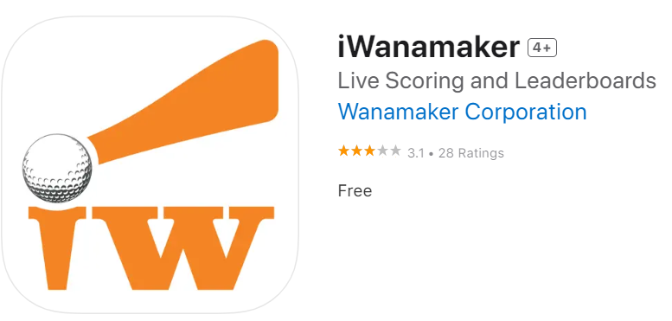


ATHLETE REQUIRED APPS
GroupMe, iWanamaker, MSHSL Golf and USGA Rules
CHECK WITH YOUR DAUGHTER TO MAKE SURE THEY HAVE THESE INSTALLED AND ARE REGISTERED AND ABLE TO ACCESS THEIR ACCOUNT

Slide 6
Fundraising
The team relies on fundraising efforts to pay for invitational meet fees (estimated $1200 per year), practice tee times and range balls for range time at Northern Hills and Hadley Creek (estimated $1200-1800 per season). There are also some miscellaneous items the program purchases less periodically, such as range finders and rules cards to attach to bags.
Raffle ticket sales last winter raised $1,000. Thank you to those who contributed! For those that did not contribute, a straight minimum $100 donation should be made to the 4giving site.
The link is available on the website. Share with your family and friends to raise additional funds!
https://www.4giving.com/donation/7F6D

Slide 7

Acai Bowls + Easy Fundraising!
#1: AWAY MATCHES
Parent volunteers pick the dates of meets that you want the team to order bowls and let Indigo know what time the team is leaving CHS (they need that to know that at least 2 hours before)
A few days before each date Indigo would send a link to their online ordering system with a code word for 10% off. Golfers would order their bowl - they can place their order from 1 day before up to 1 hour before leaving.
#2: Trucks at HOME Golf Matches
Parents would let Indigo know the date, time and location of the golf matches we want trucks at any home matches. If available, they would drive their truck there and sell to anyone who wants to buy. Right now our Spring is mostly open, but they do have a few truck events already scheduled. If have have some dates in mind, we need to let them know ASAP.
#3 Century Golf Day at the Store
We would need to pick a day for this to happen. Indigo would donate a percent of sales to the program after the day was done. They would even stay open later that day depending on what day was picked. As PR, we could have our athletes come to the store to deliver bowls to cars for curbside pick-up.

Slide 8
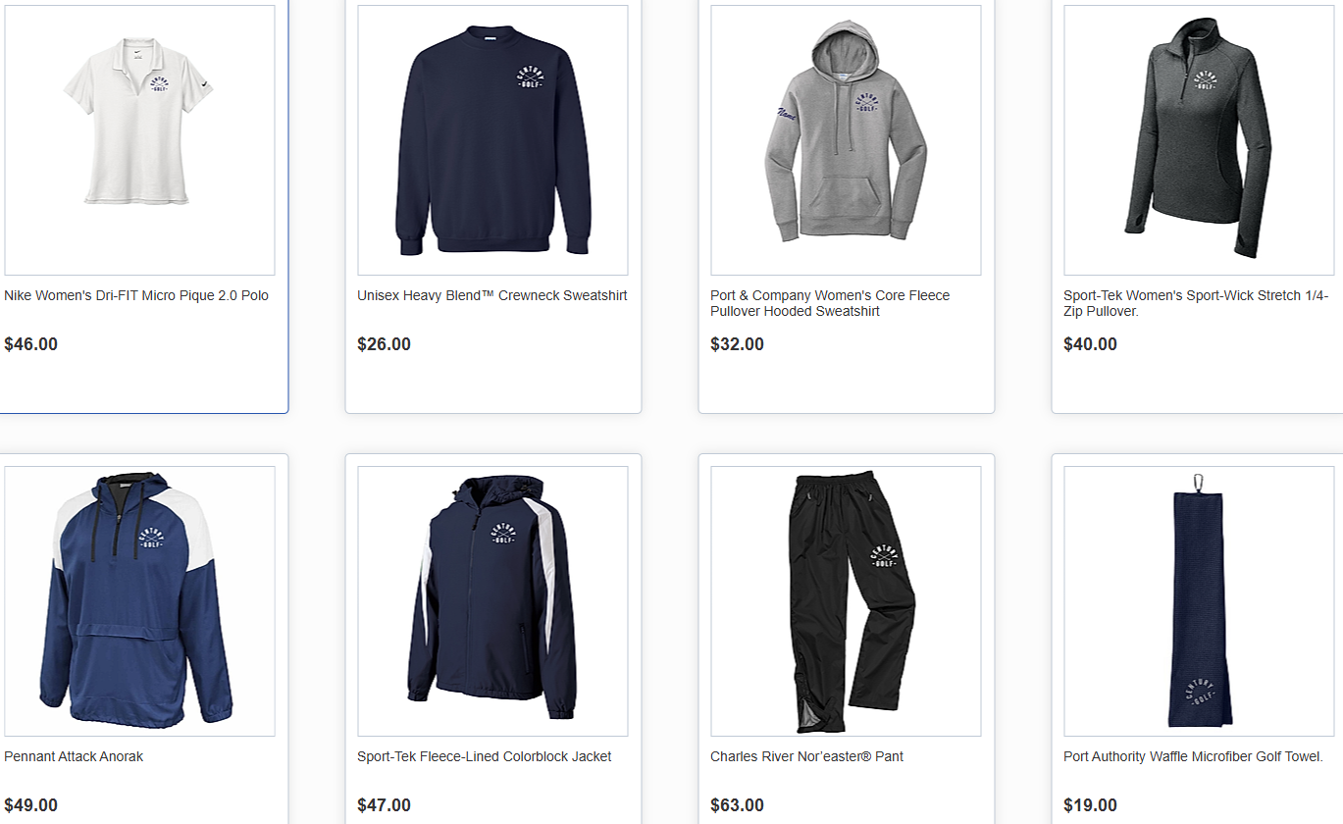
UNIFORMS
Required at Matches
CHS Polo
Pants, leggings or Skirt (black, grey, white or navy)
Long sleeve (a navy or grey long sleeve (either full zip, 1/4 zip, hoodie or crew neck).
Always Recommended
Overdress for the weather, in layers!
Have extra layers and waterproof apparel in golf bag
Team Store OPEN NOW!
All orders need to be complete by April 5th.

Slide 9
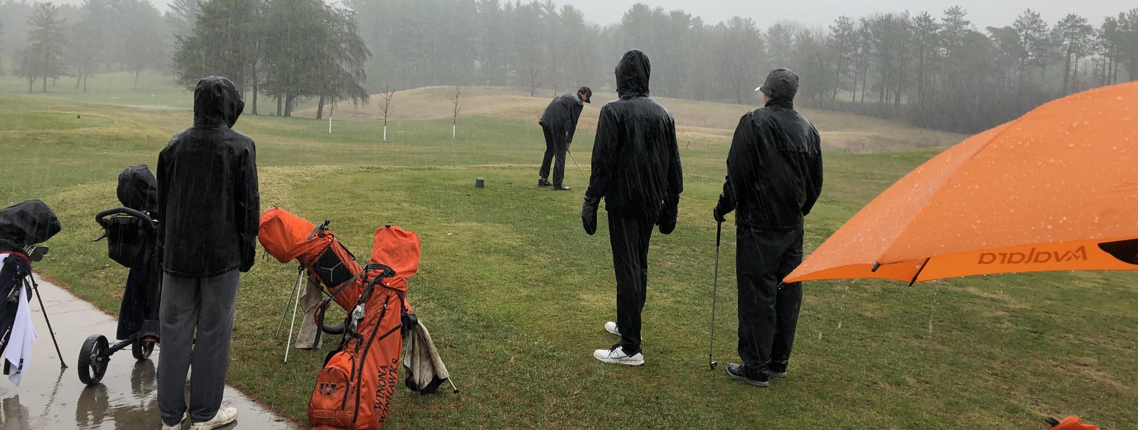
WITB?
Clubs (14 Max)
Golf Balls (Load Up!)
Rain Gear & extra Layers (ALWAYS)
Stocking Hat, Cap, Visor
Extra Socks
Umbrella
Golf gloves / warm mittens
Tees
Golf Shoes - stuff newspaper after a wet round/practice!
Ball Markers/coin & Divot Tool
Towel(s)
Water Bottle / Snacks
100% CHARGED phone (have a portable charger and cord)
Rule Book/Local Rules Sheet
Hand Warmers
Personal Items Bag
Sharpie & Pencil
First Aid Items (Meds, Bandaids, Athletic Tape)
Sunscreen/Bug Spray
Sunglasses
Range Finder (Handheld GPS or Laser with viewfinder)

Slide 10
IMPORTANT INFORMATION
We encourage parents/families to come and watch! Just stay 25 yards back and away from the greens and sand traps – you can help athletes look for a lost ball. No rules talk or swing/course advice is allowed.
iWanamaker – girls will all have an account – Parents can sign up also and track progress!
Practices - Only athletes and coaches are allowed to attend during scheduled practices.
Grades - School first. If behind in school work or need extra help, stay back at school.
Unexcused absences = will leads to missed matches. Be sure they are pre-excused.
Equipment – Ensure your child has proper fitting clubs, dry shoes, cold/rain weather gear, umbrella, etc.
Distance devices - HIGHLY encourage purchasing a range finder (either handheld GPS or laser with viewfinder, depending on preference). Program has a limited supply athletes may borrow
Pull carts - buying a high quality/light cart is good investment. Will save on the legs for the round!
Invitational at Somerby: Varsity only on May 4
Picture Day will be May 6th, at the start of practice
All City Invitational: Varsity and JV at Rochester Country Club on May 11
Big Nine: varsity only on 2 seperate days. Day 1 at Austin on April 21 and Day 2 at Albert Lea on May 19
Sections at Cannon Falls. All six varsity go to day 1, Top qualifiers go to day 2
End of Year Celebration will be at Chip Shots date TBD (pending state qualifiers)

Slide 11
MATCHES & DISMISSAL
6 Varsity athletes will play 18 holes/6 JV athletes will play 9 holes. The lineup is fluid, week to week. No spots are guaranteed! Past performance and potential is considered, as is team chemistry/dynamics. Effort and attitude in practice is always a determining factor. Typically, varsity tees off first and JV goes after. So, families with athletes competing JV can typically expect an hour later start time.
Middle schoolers playing in matches will need to be dismissed by guardian
Bus will pick up students at their school for away meets. Check calendars for dismissal times.
Have food/gear ready, you will NOT be excused any earlier than our dismissal time
Travel Release Forms MUST be completed 48 hours prior to competition to ride home with parents from out of town matches.
Practice
3:45ish-5:15 at Northern Hills GC on Tuesdays and Thursdays (+ tee times - coaches will communicate) or Hadley Creek on Mondays, Wednesdays, and Fridays
Always check GroupMe & the Website Event Calendar for possible changes

Slide 12

Team Picture Day will be May 6th at Hadley! Be sure to text the code panthergolf26 to 90738 ASAP.

Slide 13
HEADING INTO NEXT SEASON… HOW TO IMPROVE!
Consider getting private lessons.
Play a lot of golf (ALL Summer) - consider buying a Junior Pass!
Have an off season practice plan and commit to it! Not all talented players are skilled and not all skilled players are talented!
Join Junior PGA (sign up ends before season ends!) https://www.minnesotajuniorgolf.com/
Fitness: Strength and Mobility Training. MANY golfers neglect this but it’s essential to dramatically improve.
IMPROVING AS A TEAM…..
Keep an eye out for younger Century/Kellogg golfers on the course in the off season and talk up our program!
Play with your teammates in the off season!
Notes:
‹#›

Slide 14
My end of season reflections:
Did I foster relationships where every student-athlete feels secure, seen, safe and supported in all facets of their life?
Did I ensure student-athletes had fun and wanted to be a part of our program?
Did I communicate well and keep the student-athletes and their families informed throughout the season?
Did I help student-athletes get better at the skills of the golf, while maintaining integrity and the respect of their teammates and opponents?

Slide 15
MISCELLANEOUS
Snacks/Drinks Volunteers to organize a SignUp Genius, etc??
Captains: Upperclassmen: Tea McEachern (12)
Cora Erickson (11)
Underclassmen: Stella Link (10)
Any questions?

