Slide 1




WHY COMPETE VIRTUAL
Renae Carlson
Jill Wrobbel
October 24, 2023
6:00 pm

Slide 2
Benefits of Competing Virtually
No regional or state competitions
No limit on number of virtuals you compete in
This does not count toward
1 individual
1 group event
The entries will be judged prior to National Leadership Conference
Cash Prizes

Slide 3

What Virtual Events Can You Compete In?
Multimedia & Promotion
Individual and Team
Software Engineering Team
Web Application Team
Mobile Application
Promotional Photography
Cyber Security/ Digital Forensics
Start-up Enterprise Team
Financial Portfolio Management Team
Virtual Branding Team
2D Animation Team
Social Media Marketing Campaign Team
Esports Team
Ethical Leadership & Decision- Making Team
3

Slide 4
How Do They Prepare
Read the rubric carefully
Meet with someone in the area as an expert
4

Slide 5
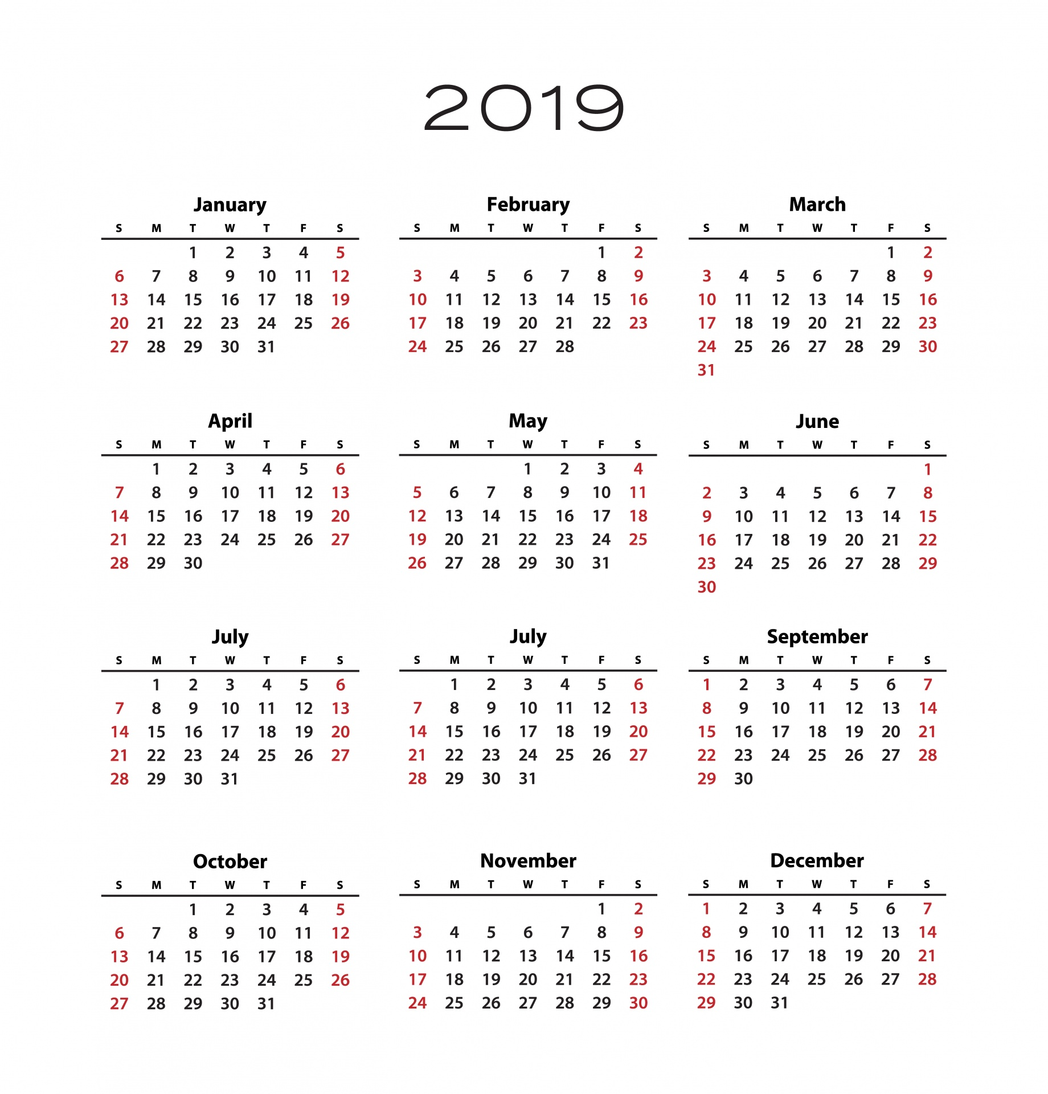

Registration deadline: 5:00 pm Eastern Time on DECEMBER 1, 2023 FEE: $10.00 PER INDIVIDUAL $20.00 PER TEAM Projects due: January 15, 2024 Finalists will be notified by March 1, 2024
Deadlines
&
Fees

Slide 6




Thank you
Renae Carlson
rmcarlson55@gmail.com
Jill Wrobbel
jwrobbel@isd876.org

