Slide 1


LANGDON LITTLE LEAGUE COACHING CLINIC
SAM BUSSWOOD– COACHING COORDINATOR
REGAN TURNER – PRESIDENT
TRISH NORDQUIST – VICE PRESIDENT
Notes:
Curt

Slide 2
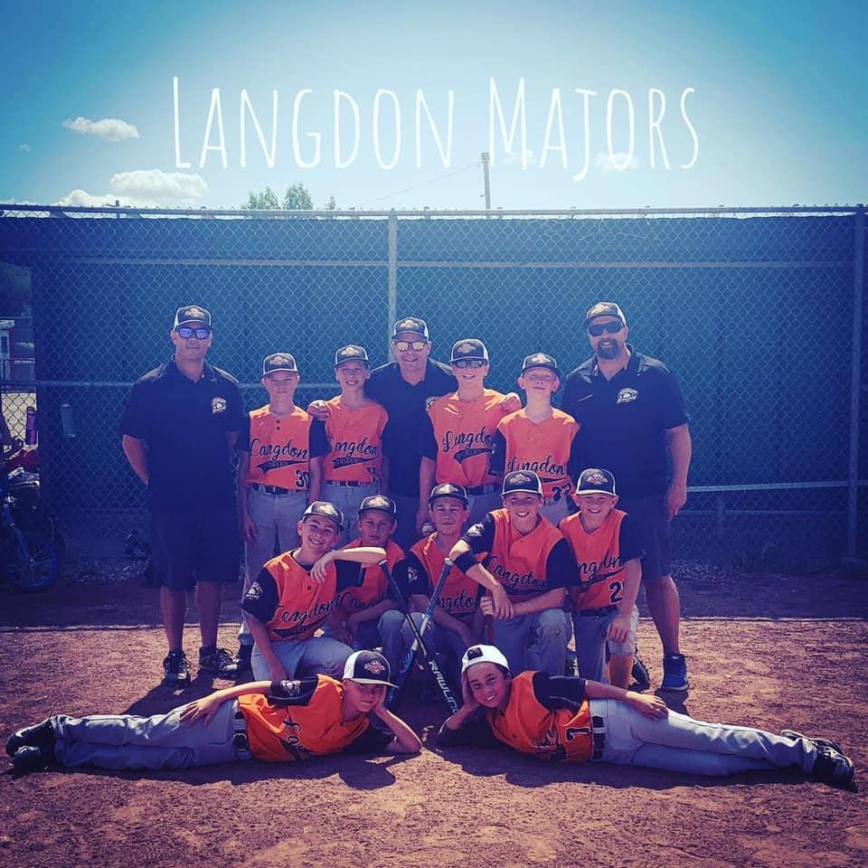
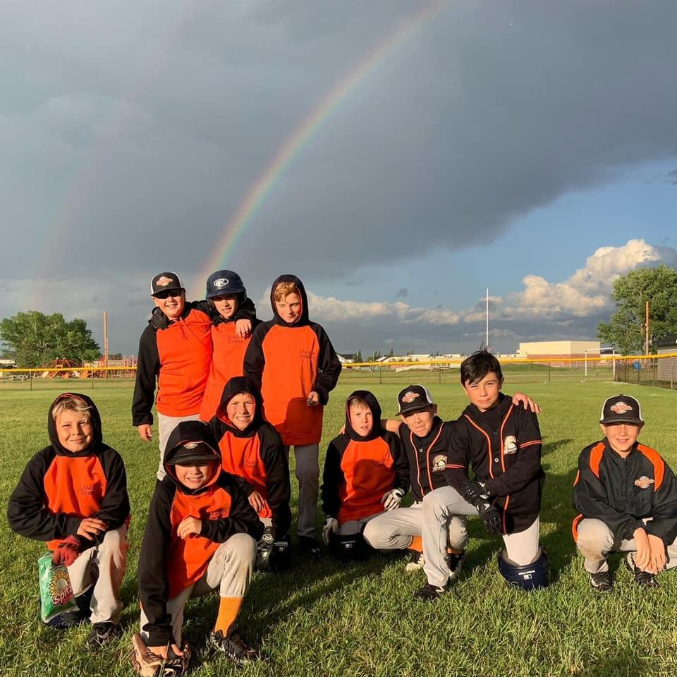
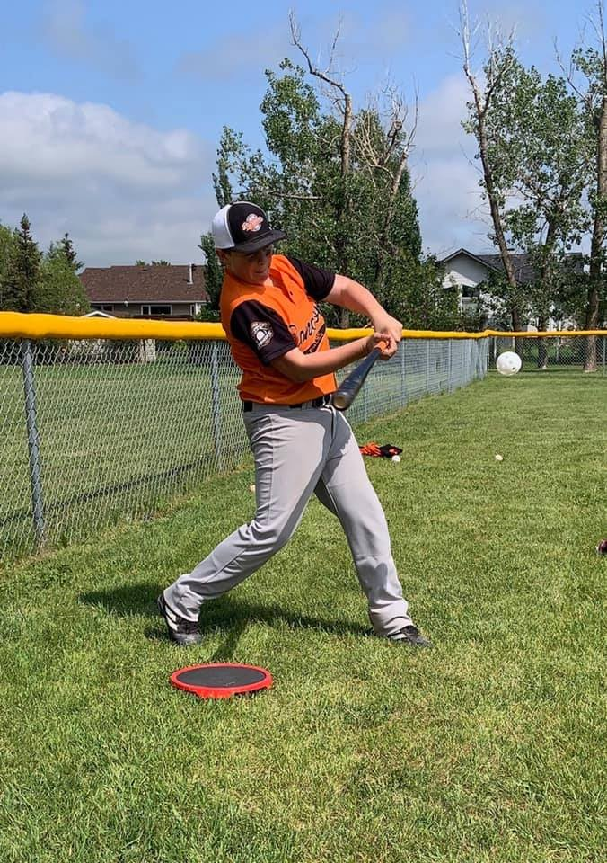
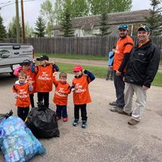
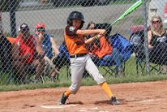
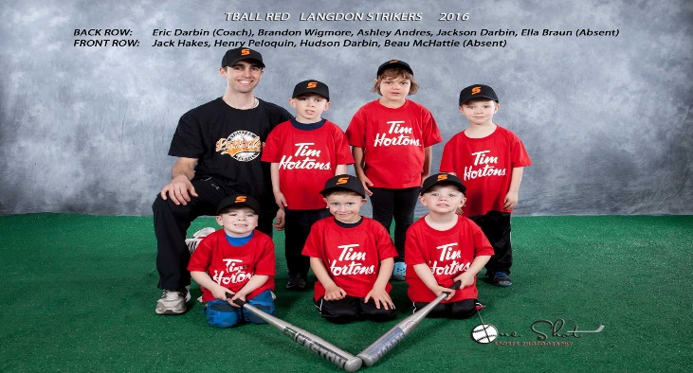
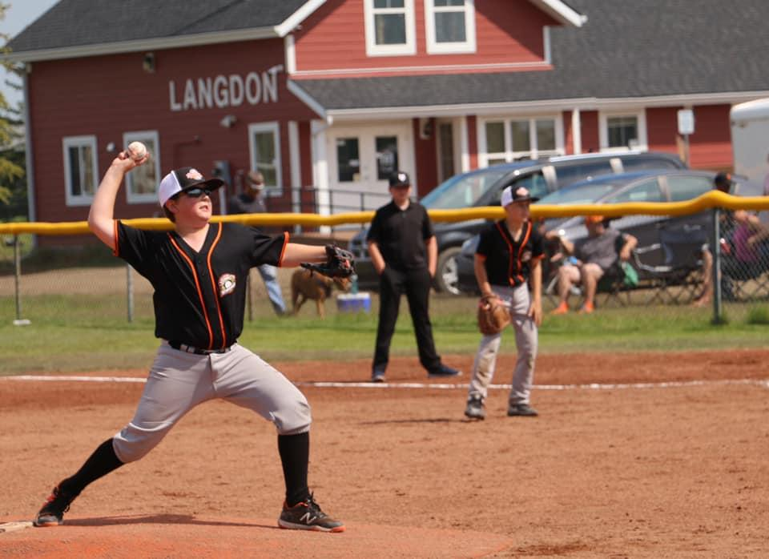
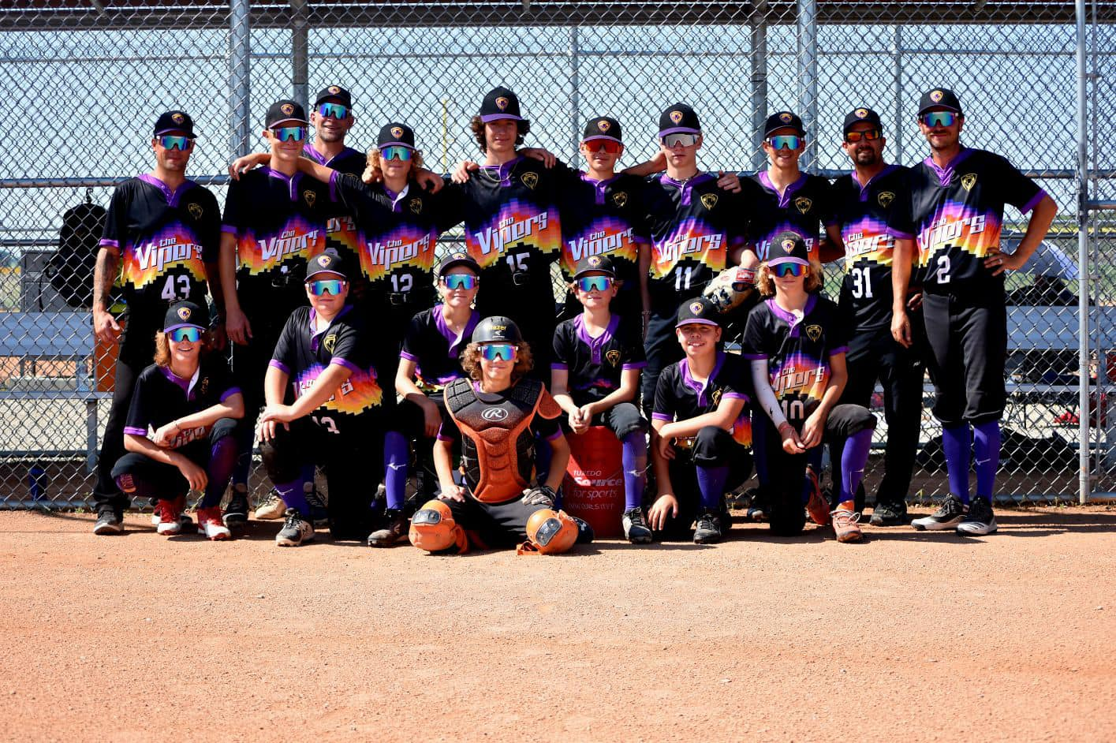
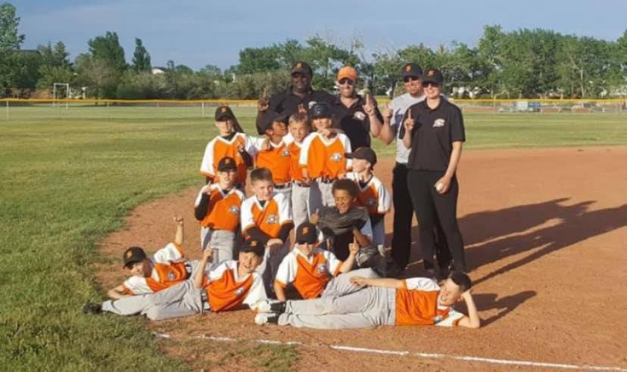
THANK YOU
Notes:
Curt

Slide 3

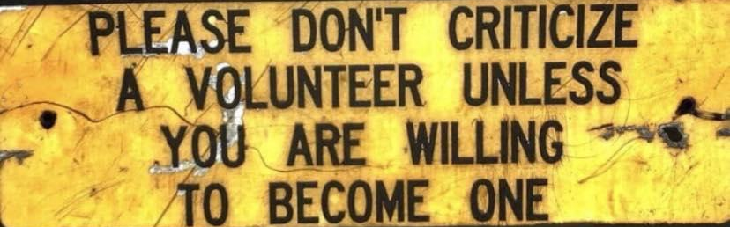
Introductions
ON DECK: Getting Started
1ST BASE: Coach Binder Walkthrough
2ND BASE: Practice & Game Schedule
3RD BASE: Coaching Philosophy
Wrap Up
Notes:
Curt

Slide 4
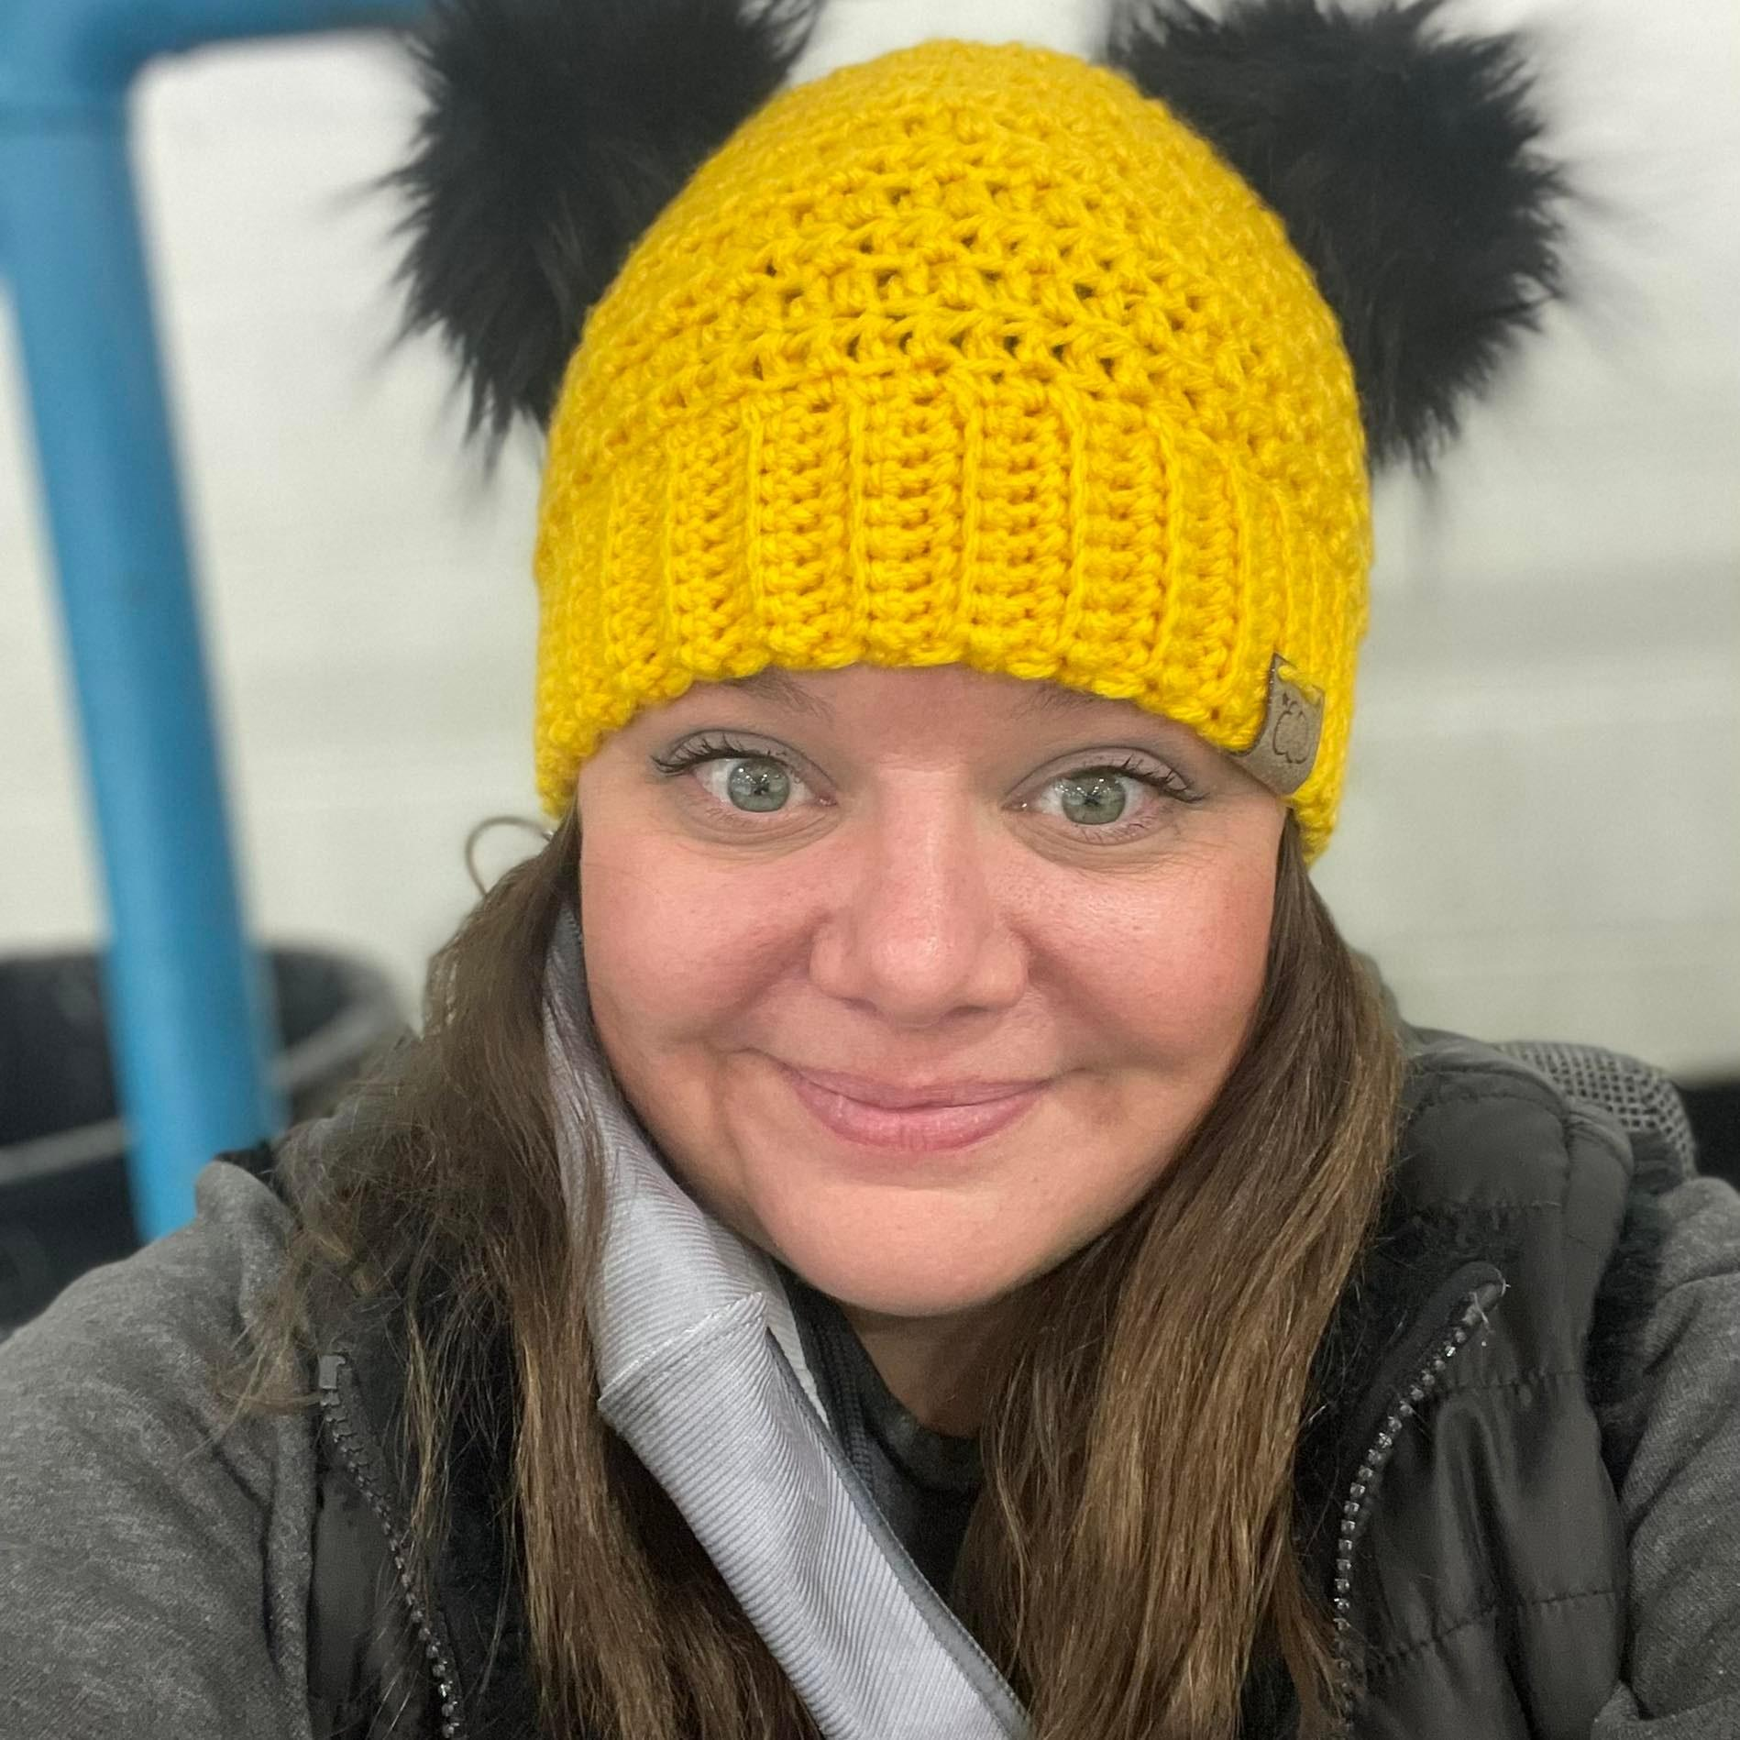
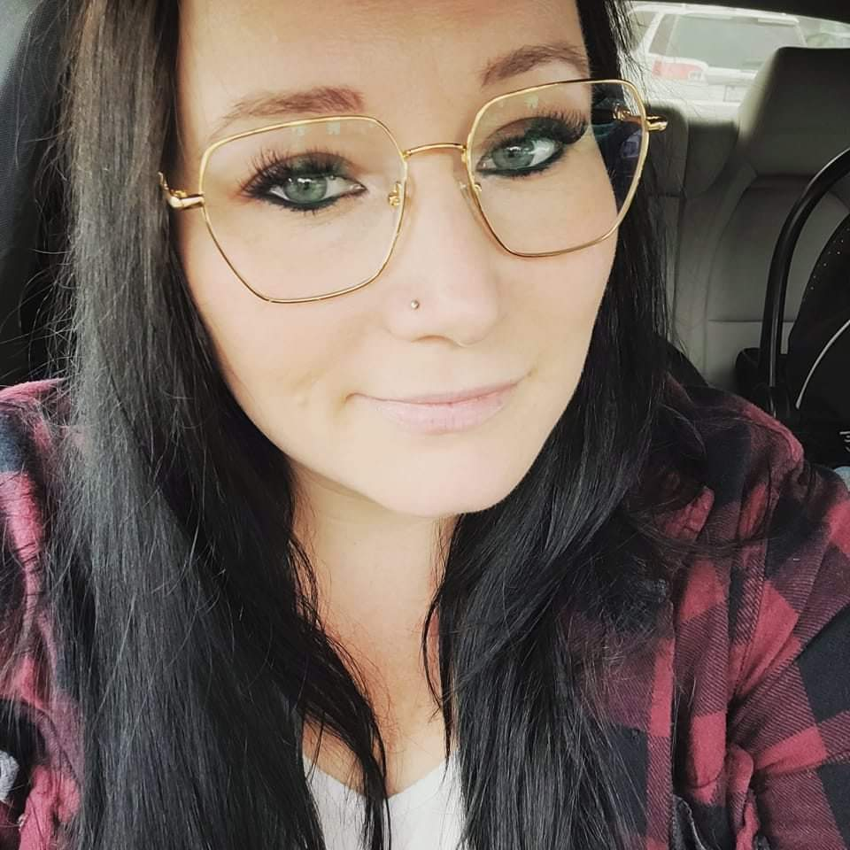
Introductions
Sam Busswood– Coaching Coordinator
Regan Turner – President
Mum of 3 Baseball Tiny Humans
Played Hardball and Fastball from Age of 3
within Calgary / Strathmore Area (Little League)
Play Adult Slow Pitch since 18 with Jaycee &
and Langdon Softball Association
Founding Member of Little League in 2010
Notes:
Everybody

Slide 5
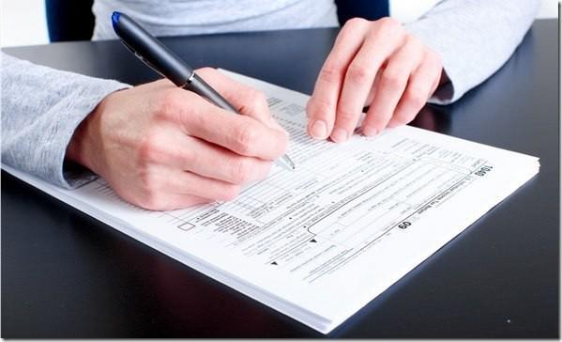



ON DECK – Getting Started
Volunteer Forms Review
Head Coach Welcome Package email
Volunteer Application Form (completed with Coach Registration)
Child Abuse & Prevention Policy Sign off & Course completion
(MANDATORY FOR INSURANCE)
Vulnerable Sector Check Letter (Police Clearance)
Police Checks are ONLY valid for 1 year
Coach’s Safety Code of Conduct (completed with Coach Registration)
Coach Western Canada Code of Conduct(completed with Coach Registration)
Coach’s Code of Conduct – Concussion Awareness (completed with Coach Registration)
Do you have a valid First Aid certificate?
Require at least 1 person on the team (Coach/ assistant coach/ manager/ parent)
If yes, please email a copy to the Coaching Coordinator for tracking purposes
Please submit all documentation to the Coaching Coordinator (strikersbaseball.coaching@gmail.com)
Notes:
Richard

Slide 6
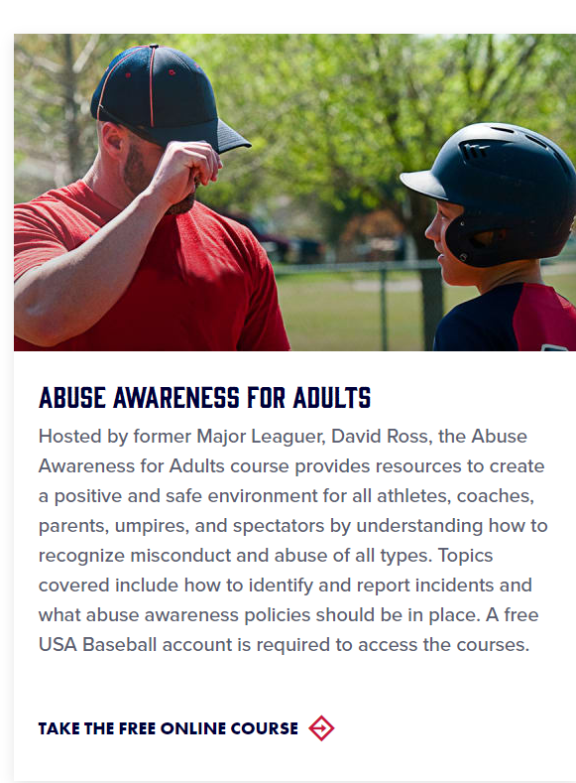


ON DECK – Getting Started
Volunteer Forms Review
You can take one of two courses:
https://www.littleleague.org/player-safety/child-protection-program/safesport-resources-parents/
Once you create an account or login if you already have one you can take the course and it will provide you with a certificate.
You will be able to access the certificate under your online account, a copy of your certificate will be emailed to you – Please email to the Coaching Coordinator @ strikersbaseball.coaching@gmail.com
https://www.littleleague.org/player-safety/ (Choose SafeSport)
Once you create an account or login if you already have one you can take the course. When you complete the course it saves it to the coaching passport, just take a screenshot and send to the Coaching Coordinator @ strikersbaseball.coaching@gmail.com
Notes:
Richard

Slide 7
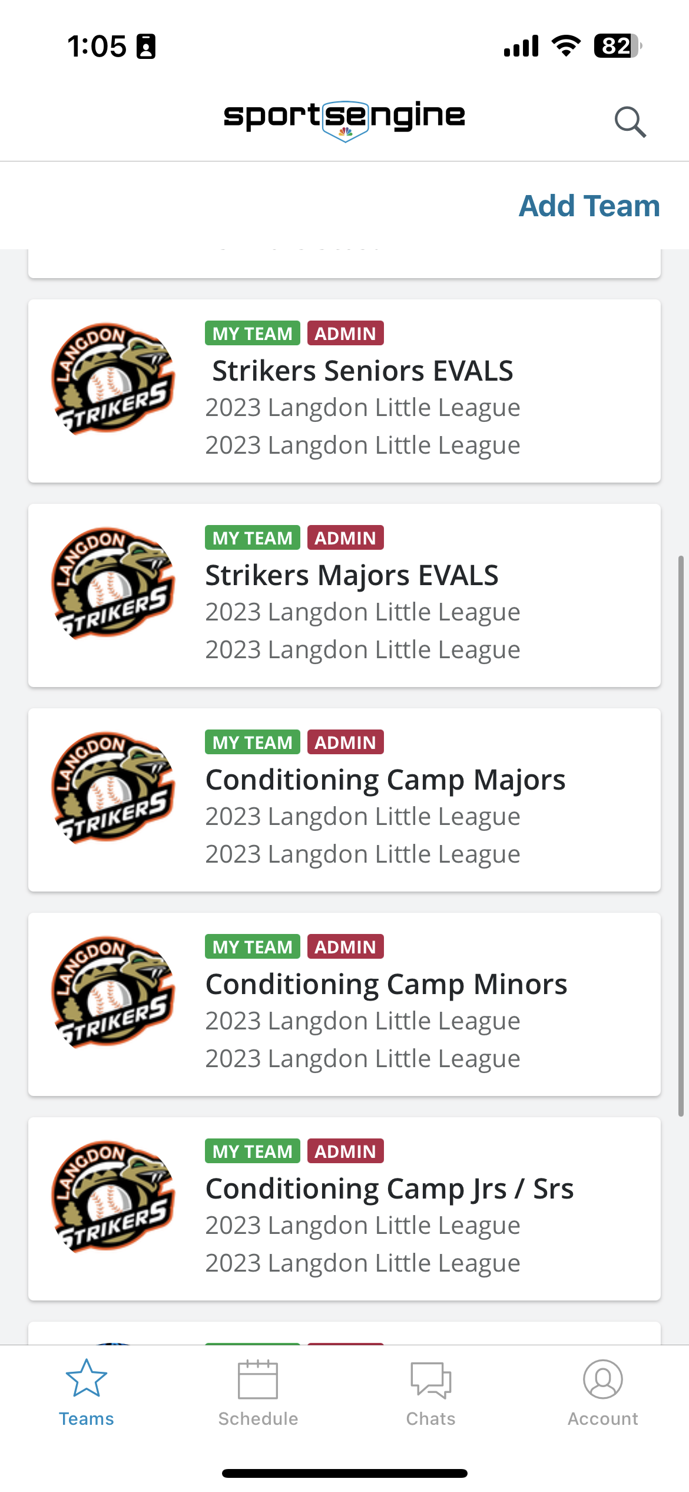
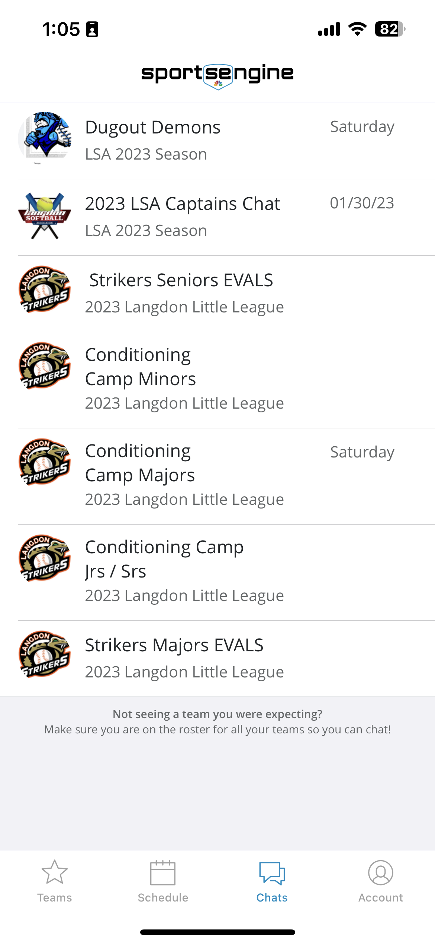
ON DECK – Getting Started
Volunteer Forms Review
Introduce yourself to your new team
Sports Engine APP (email) or in person (1st team practice)
T-Ball / CP Teams will open on April 15th into your Sports Engine App
Minor/ Major / Junior - Will open April 4th AFTER DRAFT NIGHT!
You will view your team under MY TEAM (Roster)
Send out an message under MESSAGES to introduce yourself.
Keep an eye on your APP for Schedule changes
Find volunteers for your team
Team Manager
Team Manager would find the following volunteers (Minors, Majors, Juniors):
Pitch Counter
Score Keeper
PARENT CODE OF CONDUCT - will be found in each coach binder, please hand out and collect on day 1 to all parents
(All Divisions):
Parent Code of Conduct Form (keep in coach binder)
Do any parents have a valid First Aid certificate? (if coaching staff does not…)
Require at least 1 person on the team (Coach/ assistant coach/ manager/ parent)
If yes, please email a copy to the Coaching Coordinator for tracking purposes (Team Name Included)
Please submit all documentation to the Coaching Coordinator (strikersbaseball.coaching@gmail.com)
Notes:
Richard

Slide 8

1st BASE – Coach Binder Walk Thru
T-Ball
Inside your T-Ball HANDBOOK you will find:
-12 Things to know about coaching T-Ball
-General guidelines and practice drills.
-Learning the basics of T-Ball (Positions, Holding a bat, Throwing Ball...etc
-Awards, Incentives and Motivational Helpers!
Safety Program:
-To review the Langdon Little League Safety Plan - Please visit www.strikersbaseball.ca
-Injury Tracking form - any events / injuries a form is filled out and forwarded to the Coaching Coordinator at: strikersbaseball.coaching@gmail.com
Roster:
- Your team roster and parent information will be on your Sports Engine APP under MY TEAMS and select ROSTER and you can select a player and click on the “!” and you will see your players parent contact information, Medical information and a picture of your player that the parent can upload.
Additional Coaching Guidelines and information for Coaches located on Website: www.strikersbaseball.ca under ABOUT US – FOR COACHES
Notes:
Regan

Slide 9


1st BASE – Coach Binder Walk Thru
Coach Pitch Div 1 & Div 2
Inside your Coach Pitch Div 1 & Div 2 HANDBOOK you will find:
-12 Things to know about coaching Coach Pitch Div 1 & Div 2
-General guidelines and practice drills.
-Learning the basics of Coach Pitch (Positions, Holding a bat, Throwing Ball...etc
-Rules to Division - Difference between Coach Pitch Div 1 & Div 2
-Div 1 - Older players -Play Minor Rules - 3 strikes, 4 balls, 3 outs, Steal bases etc.
-Div2 - Younger players- Modified Minor Rules - each player receives 5 pitches from coach and then walk to first base if no hit, If Player hits ball they only run to first base.
-Awards, Incentives and Motivational Helpers!
Safety Program:
-To review the Langdon Little League Safety Plan - Please visit www.strikersbaseball.ca
-Injury Tracking form - any events / injuries a form is filled out and forwarded to the Safety Coordinator at: strikersbaseball.coaching@gmail.com
Roster:
- Your team roster and parent information will be on your Sports Engine APP under MY TEAMS and select ROSTER and you can select a player and click on the “!” and you will see your players parent contact information, Medical information and a picture of your player that the parent can upload..
Additional Coaching Guidelines and information for Coaches located on Website: www.strikersbaseball.ca under ABOUT US – FOR COACHES
Notes:
Regan

Slide 10
1st BASE – Coach Binder Walk Thru
Minors
Inside your Minors Special Playing Rules you will find:
-Pitcher Eligibility Form
-Pitch counter and Score Keeper instructions
- Pitching Rules
-Score book
-Game Time Limit
-Mercy Rule
-Special Playing Rules - Pitching, Batting Order, Base running, etc.
-Submitting your Final Score - Email submission plus entering into SI play App.
Safety Program:
-To review the Langdon Little League Safety Plan - Please visit www.strikersbaseball.ca
-Injury Tracking form - any events / injuries a form is filled out and forwarded to the Safety Coordinator at: strikersbaseball.treasurer@gmail.com
Roster:
- Your team roster and parent information will be on your Sports Engine APP under MY TEAMS and select ROSTER and you can select a player and click on the “!” and you will see your players parent contact information, Medical information and a picture of your player that the parent can upload.
Additional Coaching Guidelines and information for Coaches located on Website: www.strikersbaseball.ca under ABOUT US – FOR COACHES
Notes:
Regan

Slide 11
1st BASE – Coach Binder Walk Thru
Majors
Inside your Majors Special Playing Rules you will find:
-Pitcher Eligibility Form
-Pitch counter and Score Keeper instructions
- Pitching Rules
-Score book
-Game Time Limit
-Mercy Rule
-Special Playing Rules - Pitching, Batting Order, Base running, etc.
-Submitting your Final Score - Email submission plus entering into SI play App.
Safety Program:
-To review the Langdon Little League Safety Plan - Please visit www.strikersbaseball.ca
-Injury Tracking form - any events / injuries a form is filled out and forwarded to the Safety Coordinator at: strikersbaseball.treasurer@gmail.com
Roster:
- Your team roster and parent information will be on your Sports Engine APP under MY TEAMS and select ROSTER and you can select a player and click on the “!” and you will see your players parent contact information, Medical information and a picture of your player that the parent can upload.
Additional Coaching Guidelines and information for Coaches located on Website: www.strikersbaseball.ca under ABOUT US – FOR COACHES
Notes:
Regan

Slide 12
1st BASE – Coach Binder Walk Thru
Juniors / Seniors
Inside your Juniors Special Playing Rules you will find:
-Pitcher Eligibility Form
-Pitch counter and Score Keeper instructions
- Pitching Rules
-Score book
-Game Time Limit
-Mercy Rule
-Special Playing Rules - Pitching, Batting Order, Base running, etc.
-Submitting your Final Score - Email submission plus entering into SI play App.
Safety Program:
-To review the Langdon Little League Safety Plan - Please visit www.strikersbaseball.ca
-Injury Tracking form - any events / injuries a form is filled out and forwarded to the Safety Coordinator at: strikersbaseball.treasurer@gmail.com
Roster:
- Your team roster and parent information will be on your Sports Engine APP under MY TEAMS and select ROSTER and you can select a player and click on the “!” and you will see your players parent contact information, Medical information and a picture of your player that the parent can upload.
Additional Coaching Guidelines and information for Coaches located on Website: www.strikersbaseball.ca under ABOUT US – FOR COACHES
Notes:
Regan

Slide 13
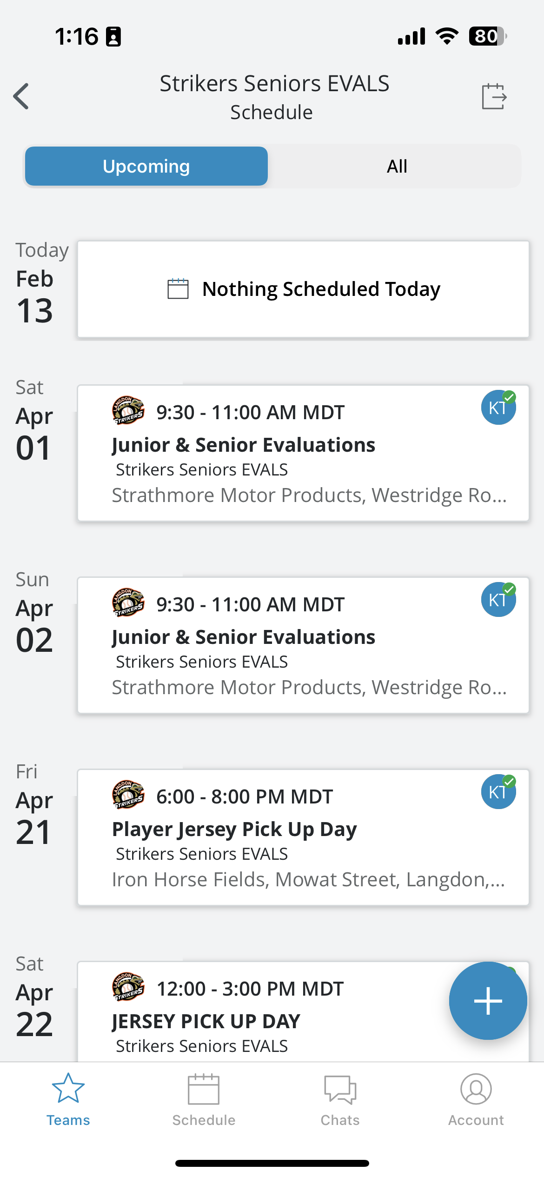
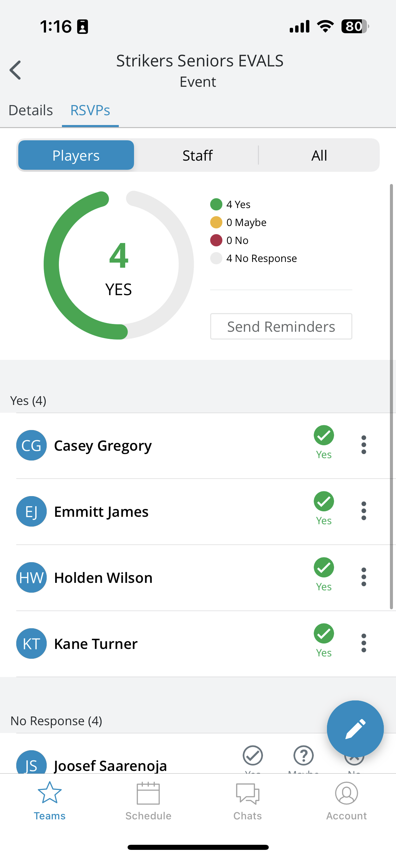
2nd BASE – Practice & Game Schedule
T-Ball
-Practice and Games times are Tuesday & Thursday 6:00 pm - 7:00 pm @ Langdon Park Diamonds.
-Your Practice and Game locations are uploaded into your Sports Engine App under SCHEDULE with location to your playing area.
-You will be able to view which players will be in attendance for each practice and game, please remind your parents thru the MESSAGES section on the app to update their players attendance to attending or not attending.
-Team Equipment and Jersey hand out for coaches has been scheduled on April 21, 2023 (6pm-8pm) & April 22, 2023 (12pm-3pm) (Garage @ Iron Horse Fields)
-Team Picture day is scheduled for May 7, 2022 @ Langdon Field house and your team time slot will be added into your Sports Engine App -please ensure your team arrives 10 minutes prior to time slot for you to hand out jerseys and hats.
-Langdon Little League Bottle Drive Fundraiser has been scheduled for May 27, 2023 @ 9:00am meet @ Langdon Park
-This will be uploaded into your APP Schedule
-Players dress in Hat and Jersey
-Volunteers needed to go with players, collect bottles and drop off @ Langdon Bottle Depot
Notes:
Regan

Slide 14
2nd BASE – Practice & Game Schedule
Coach Pitch Div 1 & Div 2
Practice and Games times are Monday & Wednesday 6:00 pm - 7:00 pm @ Langdon Park Diamonds.
Your Practice and Game locations are uploaded into your Sports Engine App under SCHEDULE with location to your playing area.
-You will be able to view which players will be in attendance for each practice and game, please remind your parents thru the MESSAGES section on the app to update their players attendance to attending or not attending.
-Team Equipment and Jersey hand out for coaches has been scheduled on April 21, 2023 (6pm-8pm) & April 22, 2023 (12pm-3pm) (Garage @ Iron Horse Fields)
-Team Picture day is scheduled for May 7, 2022 @ Langdon Field house and your team time slot will be added into your Sports Engine App -please ensure your team arrives 10 minutes prior to time slot for you to hand out jerseys and hats.
-Langdon Little League Bottle Drive Fundraiser has been scheduled for May 27, 2023 @ 9:00am meet @ Langdon Park
-This will be uploaded into your APP Schedule
-Players dress in Hat and Jersey
-Volunteers needed to go with players, collect bottles and drop off @ Langdon Bottle Depot
Notes:
Regan

Slide 15
2nd BASE – Practice & Game Schedule
Minors
-Games times are Tuesday & Thursday 6:00 pm - 8:00 pm @ Langdon Park Diamonds, Indus Diamonds, Chestermere Diamonds (No new inning to be started after 2 hours of play)
-Your Practice and Game locations are uploaded into your Sports Engine App under SCHEDULE with location to your playing area.
-You will be able to view which players will be in attendance for each practice and game, please remind your parents thru the MESSAGES section on the app to update their players attendance to attending or not attending.
If you have less than 9 players for a game, you are able to “call up” a player from Coach Pitch Division 1 team to play
-Additional Practices can be arranged for your team with the Scheduler Coordinator at: strikersbaseball.president@gmail.com will be able to advise what diamond locations and times are available and upload into your APP.
- Player Jersey, Pants, Belt, Long Sleeve Shirt sign out – April 21, 2023 – 6:00-8:00pm & April 22. 2023 – 12:00pm – 3:00pm – PLAYERS TO COME PICK UP JERSEYS!!!
-Team Equipment bag and coach binder pick up for coaches has been scheduled on APRIL 7, 2023 – 6:30pm-8:00pm
-Team Picture day is scheduled for May 7, 2022 @ Langdon Field house and your team time slot will be added into your Sports Engine App -please ensure your team arrives 10 minutes prior to time slot for you to hand out jerseys and hats -Langdon Little League Bottle Drive Fundraiser has been scheduled for May 27, 2023 @ 9:00am meet @ Langdon Park
-This will be uploaded into your APP Schedule
-Players dress in Hat and Jersey
-Volunteers needed to go with players, collect bottles and drop off @ Langdon Bottle Depot
Notes:
Regan

Slide 16
2nd BASE – Practice & Game Schedule
Majors
-Games times are Monday & Wednesday 6:30 pm - 8:30 pm @ Langdon Park Diamonds, Indus Diamonds,
Chestermere Diamonds (No new inning to be started after 2 hours of play)
-Your Practice and Game locations are uploaded into your Sports Engine App under SCHEDULE with location to your playing area.
-You will be able to view which players will be in attendance for each practice and game, please remind your parents thru the MESSAGES section on the app to update their players attendance to attending or not attending.
If you have less than 9 players for a game, you are able to “call up” a player from Coach Pitch Division 1 team to play
-Additional Practices can be arranged for your team with the Scheduler Coordinator at: strikersbaseball.president@gmail.com will be able to advise what diamond locations and times are available and upload into your APP.
- Player Jersey, Pants, Belt, Long Sleeve Shirt sign out – April 21, 2023 – 6:00-8:00pm & April 22. 2023 – 12:00pm – 3:00pm – PLAYERS TO COME PICK UP JERSEYS!!!
-Team Equipment bag and coach binder pick up for coaches has been scheduled on APRIL 7, 2023 – 6:30pm-8:00pm
-Team Picture day is scheduled for May 7, 2022 @ Langdon Field house and your team time slot will be added into your Sports Engine App -please ensure your team arrives 10 minutes prior to time slot for you to hand out jerseys and hats -Langdon Little League Bottle Drive Fundraiser has been scheduled for May 27, 2023 @ 9:00am meet @ Langdon Park
-This will be uploaded into your APP Schedule
-Players dress in Hat and Jersey
-Volunteers needed to go with players, collect bottles and drop off @ Langdon Bottle Depot
Notes:
Regan

Slide 17
2nd BASE – Practice & Game Schedule
Juniors/ Seniors
-Games times are any day of the week 6:30 pm - 8:30 pm @ Langdon Park Diamonds, Indus Diamonds,
Chestermere Diamonds (No new inning to be started after 2 hours of play)
-Your Practice and Game locations are uploaded into your Sports Engine App under SCHEDULE with location to your playing area.
-You will be able to view which players will be in attendance for each practice and game, please remind your parents thru the MESSAGES section on the app to update their players attendance to attending or not attending.
If you have less than 9 players for a game, you are able to “call up” a player from Coach Pitch Division 1 team to play
-Additional Practices can be arranged for your team with the Scheduler Coordinator at: strikersbaseball.president@gmail.com will be able to advise what diamond locations and times are available and upload into your APP.
- Player Jersey, Pants, Belt, Long Sleeve Shirt sign out – April 21, 2023 – 6:00-8:00pm & April 22. 2023 – 12:00pm – 3:00pm – PLAYERS TO COME PICK UP JERSEYS!!!
-Team Equipment bag and coach binder pick up for coaches has been scheduled on APRIL 7, 2023 – 6:30pm-8:00pm
-Team Picture day is scheduled for May 7, 2022 @ Langdon Field house and your team time slot will be added into your Sports Engine App -please ensure your team arrives 10 minutes prior to time slot for you to hand out jerseys and hats -Langdon Little League Bottle Drive Fundraiser has been scheduled for May 27, 2023 @ 9:00am meet @ Langdon Park
-This will be uploaded into your APP Schedule
-Players dress in Hat and Jersey
-Volunteers needed to go with players, collect bottles and drop off @ Langdon Bottle Depot
Notes:
Regan

Slide 18

PLAYER JERSEY PICK UP DAY
APRIL 21 2023 – 6:00pm – 8:00pm
Red Barn – Iron Horse Diamonds
APRIL 22 2023– 12:00pm – 3:00pm
Red Barn – Iron Horse Diamonds
PLEASE HAVE ALL PLAYERS COME PICK UP THEIR JERSEYS, PANTS, BELTS, SPRING TRAINING SHIRTS
$100.00 DEPOSIT HAS BEEN ADDED TO ALL INVOICES FOR JERSEYS - THIS $100.00 WILL BE RETURNED AT END OF SEASON ON JERSEY RETURN DAY!!

Slide 19
3rd BASE – Coaching Philosophy
T-Ball
T-ball is all about having fun and creating a love for the game. We believe that loving the game happens when the people around you love it as well. The goal in coaching these budding stars is to have energy and an understanding of the basics. Our job is to give you these tools. You will learn some fundamentals as well as fun games to play to keep the players engaged and learning.
Coach Pitch Div 1 & Div 2
At this age my kids started calling this ‘real baseball’. As a coach, fun and development is still key but we will be getting into more real life baseball plays. How do they stand in the batters box? How do they hold their bat? How do they safely catch a fly ball or a grounder? These and many other skills will be taught at this age. We see players really grow in this age group as it is fun and exciting.START DEVELOPING YOUR PITCHERS!!
Minors
For some, this is a hard year of ball. Players are dealing with the potential of getting hit by a pitch and there is more pressure to perform. Gaining skills in pitching is put to the forefront as without pitching the games are not as fun. We teach the job of the pitcher is to get the ball in play. They don’t need to strike out the opponent (even if its fun) but to throw strikes that will get hit and have the team behind them field the ball. As this happens the players see their individual skills improve and the love of the game goes up.
Majors
By majors most players will know what they are good at and want to strengthen these skills. Although the goal in little league is about being inclusive and always learning players will start to identify their positions. Some may want to catch, pitch or play outfield. It is our goal to help them grow these skills and still explore other positions at the same time. This is a great age to coach the small details that create big wins in things such as base running, fielding tricks and hitting mindset. A great Ball Player can play ALL positions, so move them around to find the position they LOVE!
Juniors
At the Jr age most players have picked a position or 2 that they love to play. As a coach we are really dialing in these skills with specific drills and routines. These kids are getting stronger and can handle so much when it comes to atheism. We coach them more than at any other level that all the little wins create big wins. This would be things such as exercise, diet, mental strength, etc. There is a lot of growth in this age group.
Seniors
Let them RIP! By this point a great foundation has been formed and kids not how to hit and throw without thinking about it. Their skills and body have caught up to each other and as a coach or parent we see the fruit of all the hard work. We continue to work on ball skills and life skills as well. Its a great age to pour into the lives of these young people that are going to be moving on.
Notes:
Curt

Slide 20

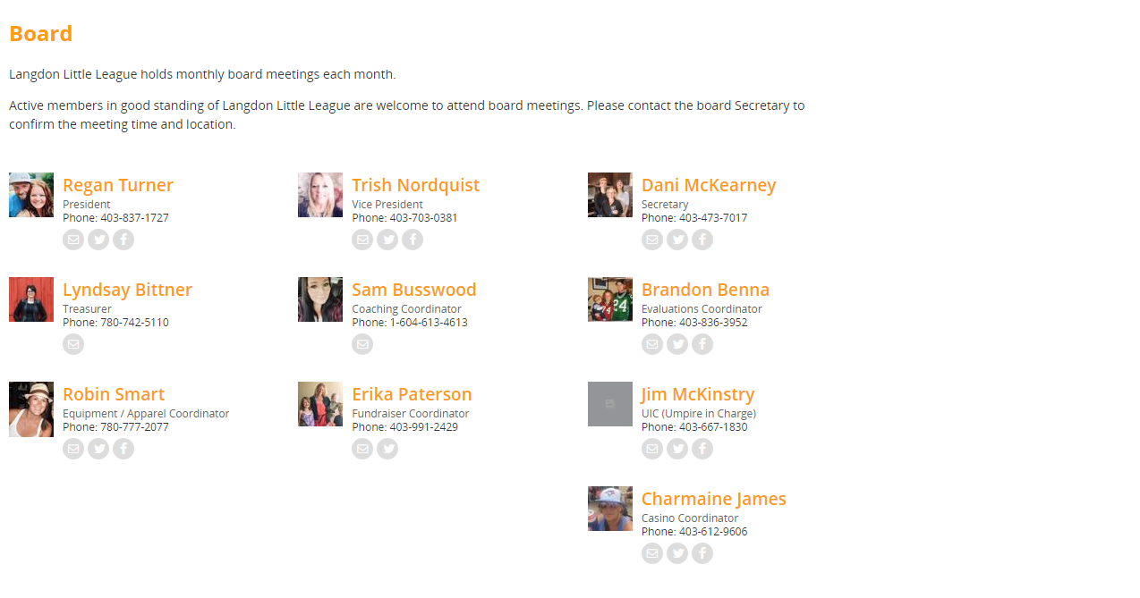

WRAP UP
Notes:
Richard

