Slide 1
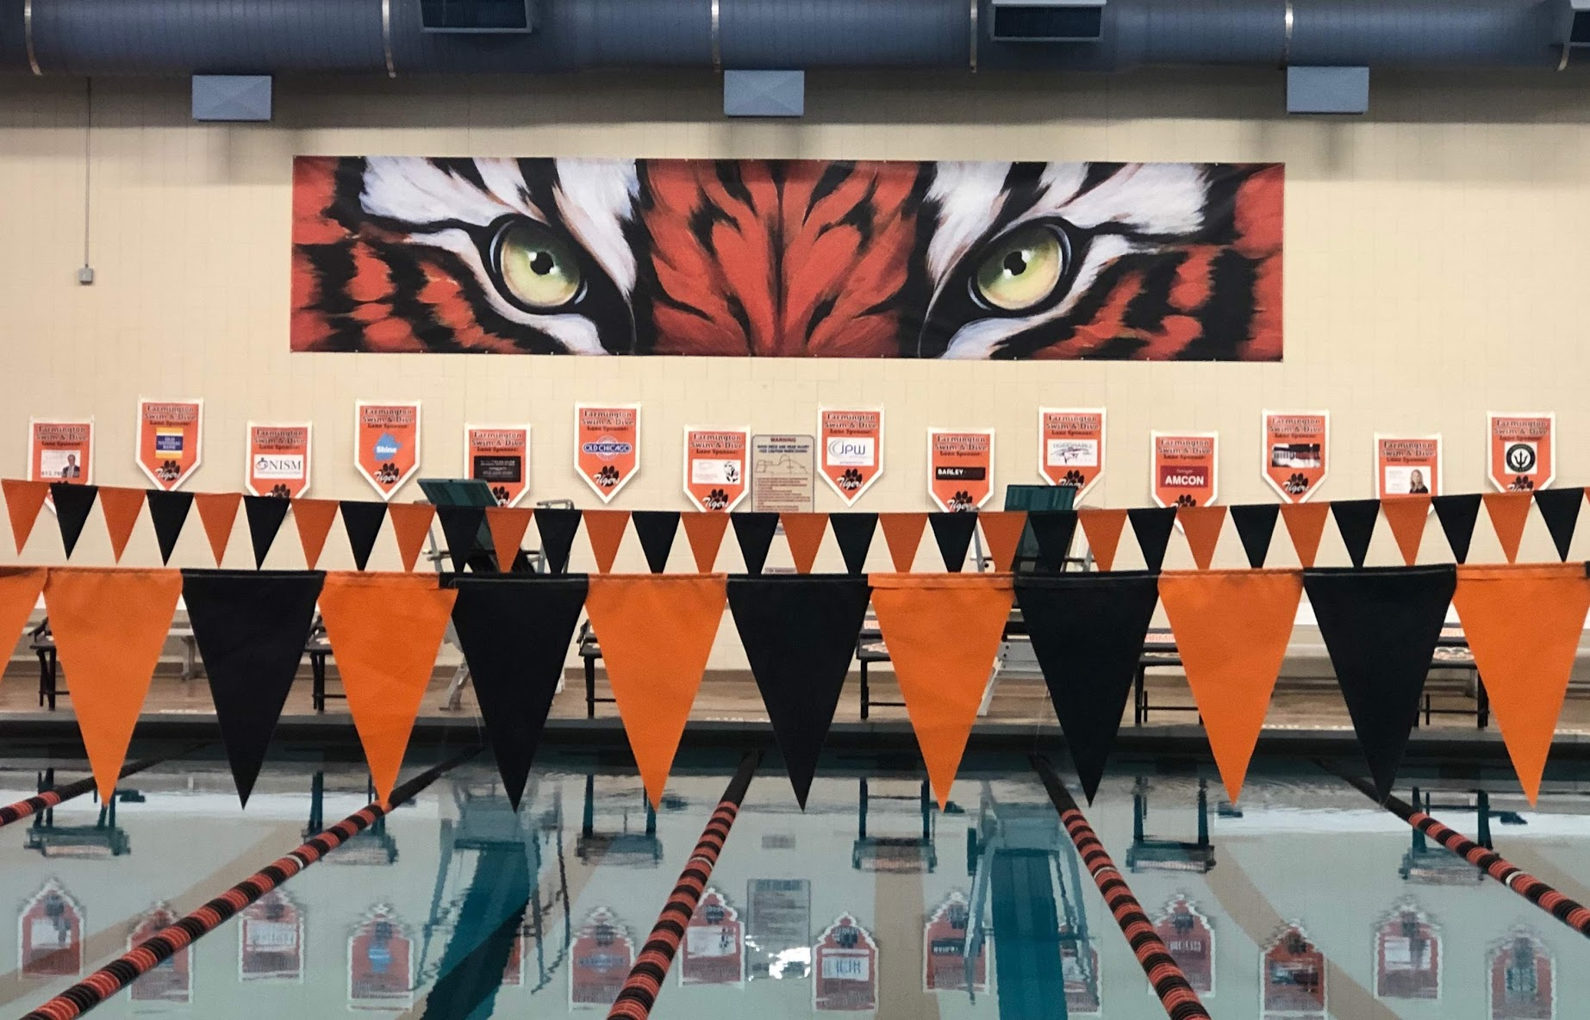
FHS Boys Swim and Dive
2025-2026
https://poweredtemplate.com/03464/0/index.html

Slide 2

Coaches
Max Hubbard - Head Coach
Brock Vestrum - Assistant Coach
Seth Krause - Assistant & Diving Coach

Slide 3

Captains
Daniel Budde
Eli Montgomery
Hantruy Nguyen
Justin Raymond

Slide 4
Booster Club
Jill Hawkins - President
Rachel Gobar - Vice President
Lisa Christensen - Treasurer
Stacey Montgomery - Secretary
Kris Ziegler - Communications
Jessica Boelman - Fundraising
Lee West & Kelsey Roth - Members at Large

Slide 5

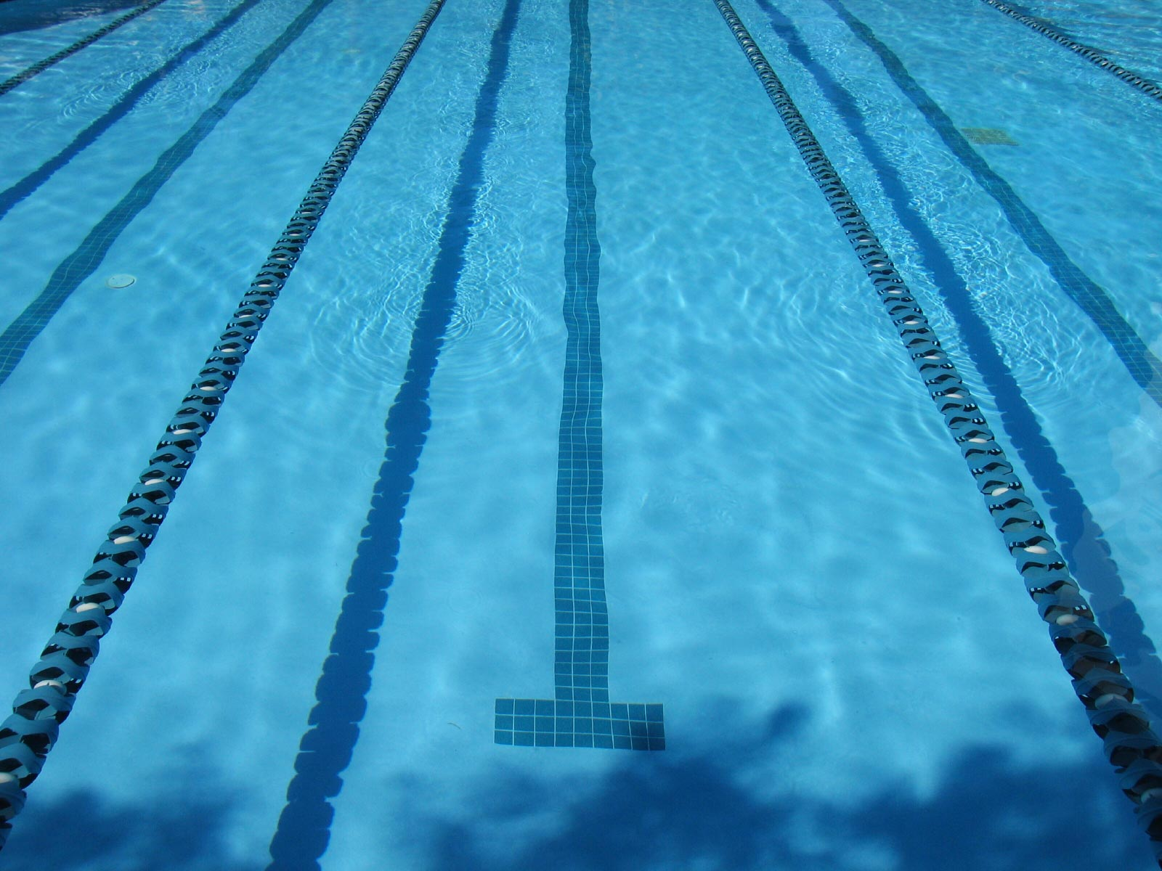
Team Website
https://www.tigerfanclub.org/boysswimdive
Calendar - Click link to subscribe
Meet schedule
Pool addresses
FAQ about swim meets
Volunteer sign-ups
Lettering Policy
Athlete Handbook
Sponsors
Meet results

Slide 6

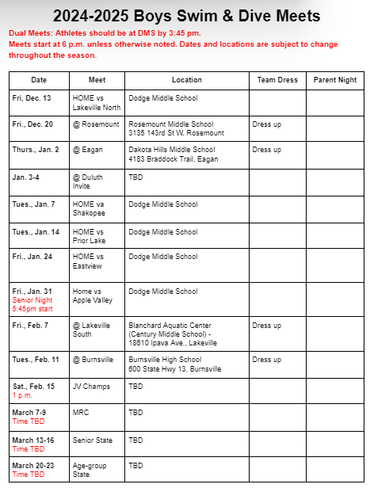
Meets at a Glance

Slide 7
Meet Day Dress Themes
Home Meets
Info coming from captains once season starts
Away Meets
fancy, such as shirt and tie
Invites/True Team/Sections
Tiger pride

Slide 8
Social Media Accounts
Facebook
Farmington Boys’ Swim and Dive
Twitter
@FHS_Swim_Dive
Instagram
@fhs_boys_swim_dive

Slide 9
Requirements & Fees
7th-12th grade
Valid sports physical on file with FHS Athletics Office prior to athletic registration
FHS Athletic Registration on RevTrak $300 (Open now) https://farmington-k12.revtrak.net/
Booster Package $180
* If cost is keeping your son from joining, please contact Max or Jill.

Slide 10
Booster Package $180
Team suit (jammer or brief)
2 swim caps with last name
Team t-shirt
Food: snacks, breakfast, team meals
End of season gifts
This amount is collected on apparel site.

Slide 11

JP Wilder Apparel Website
Warm-up jacket and pants
  purchase only required for new athletes
  booster funds jacket and pants
  athlete funds logo and last name embroidery
  can be tried on at Elsmore for sizing
Optional apparel
Online store will be open Oct. 10
Booster Package Link

Slide 13
Important Dates
Now- RevTrak open for athletic registration
Oct. 10-Nov. 2: Apparel store with Booster package open
Now-Dec. 2: Hy-Vee coupon card fundraiser
Cub grocery bagging 10am-6pm
Nov. 27: Lunds & Byerlys grocery assistance 12:30-6:00pm
Dec. 2: Season begins
  Afternoon practices Mon-Fri 3:30-6 pm
  Weights Mon, Wed & Fri for HS 3-3:30pm
    Begins the week of Dec. 2
  Morning practices Mon & Thur 6-7:15am
    Begins the Thurs. Dec. 5
    Required for HS, optional for MS
  Saturday practices 7-9 am
Dec. 3: Pictures (3:30 pm)
Dec. 5: Parents Meeting (6:16 pm)
Cub grocery bagging
Dec. 23-Jan. 3: Practices over winter break except Christmas Day and New Year’s Day (7 am-10 am)
Year end banquet @Brackett’s, Lakeville 6-9pm

Slide 14
Important Dates
Now-Nov. 2: RevTrak open for athletic registration
Oct. 10-Nov. 2: Apparel store with Booster package open
Now-Dec. 2: Hy-Vee coupon card fundraiser
Nov 24: Season begins
  Afternoon practices Mon-Fri 3:30-6 p.m.
  Weights Mon, Wed & Fri for HS 3-3:30 p.m.
    Begins the week of November 24
  Morning practices Mon & Thur 6-7:15 a.m.
    Begins the Monday, December 1
    Required for HS, optional for MS
  Saturday practices 7-9 a.m.
Dec. 2: Parents Meeting 6:15 p.m.
Dec. 4: Pictures 3:45 p.m.
Dec. 22-Jan. 2: Practices over winter break except Christmas Day & New Year’s Day - Time TBD

Slide 15
Contact Information
Coach Hubbard - maxahubbard@gmail.com
Booster email -
farmingtonboysswimanddive@gmail.com

Slide 16
Thank you for coming!
We are excited for
a great 25-26 season!
https://poweredtemplate.com/03464/0/index.html

