Slide 1

2026
DeWitt Junior PantherS
Football
Parent Meeting

Slide 2
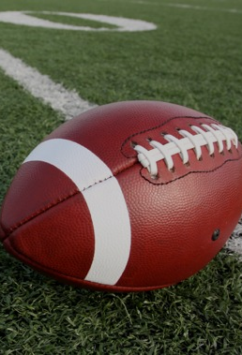
Introductions
President – Corey Feldpausch
Vice President – Bruce gallagher
Treasurer – Tara miller
Secretary – Kristen Hampton
Board Members
Heidi Lenneman April Babb Krista Cornell
kristi coe leah clark Tyler Thelen
Whitney cichocki Jafi Roskey Stephanie elliott
Amber shoemaker

Slide 3

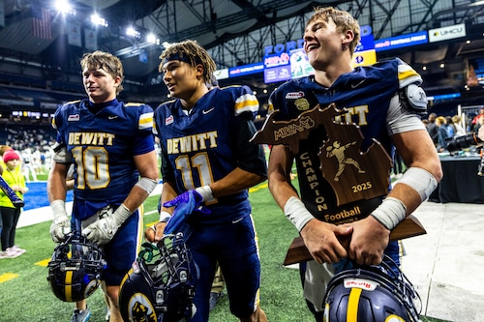
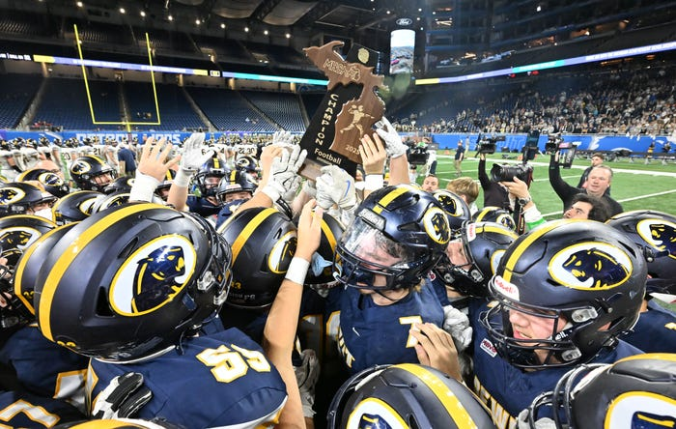
Championship Programs all start somewhere...
"It's just great. We've been talking about it since fourth grade…This team is special, man. This senior class, I love every single one of those guys. This coaching staff, I love all of them. It feels so great to get this win.“
- DeWitt Senior Jadon Bender, Lansing State Journal (November 2025)
Congratulating the 2025 Football State Champs!

Slide 4
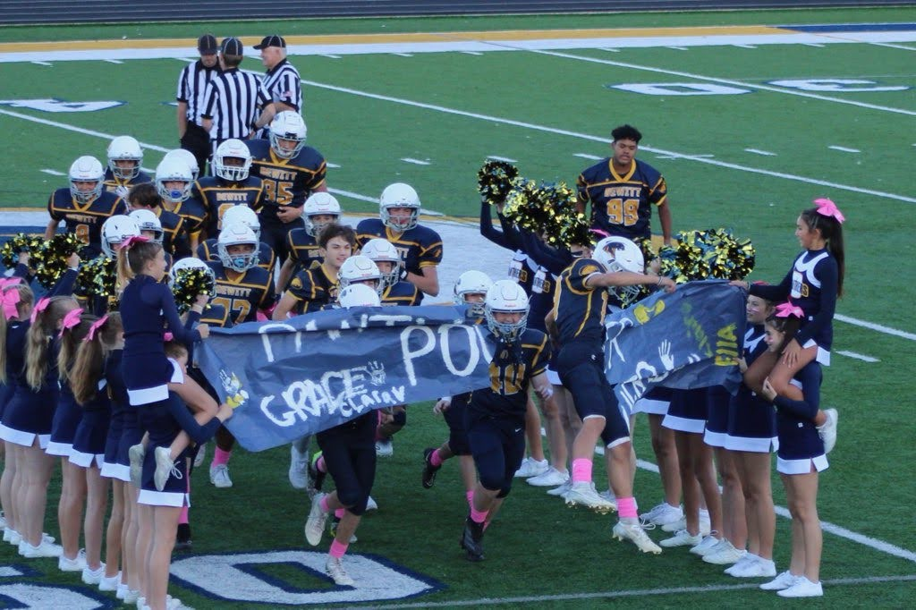
Overview of DJP
Established in 1995 to promote organized and structured football and cheerleading within the community of DeWitt.
A feeder program to prepare athletes for the DeWitt High School Football and Cheer teams.
Encourage all those who desire and are able to participate.

Slide 5
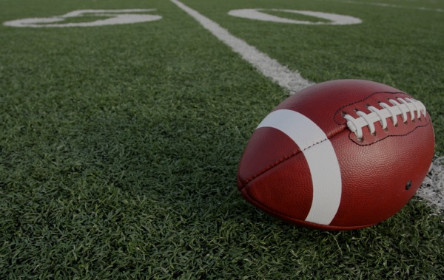
Football Parent Expectations - practices
Parents should refrain from staying at football practices. Parents should expect to drop their players off at practice and pick them up afterward.
DJP’s primary focus during practice is to provide players an opportunity to develop their skills, focus on the game, and work together as a team in an environment free from distractions.
Allowing players to engage fully in practice fosters independence, responsibility, and concentration, while also ensuring that our coaching staff gives their full attention to player development without external interruptions.

Slide 6
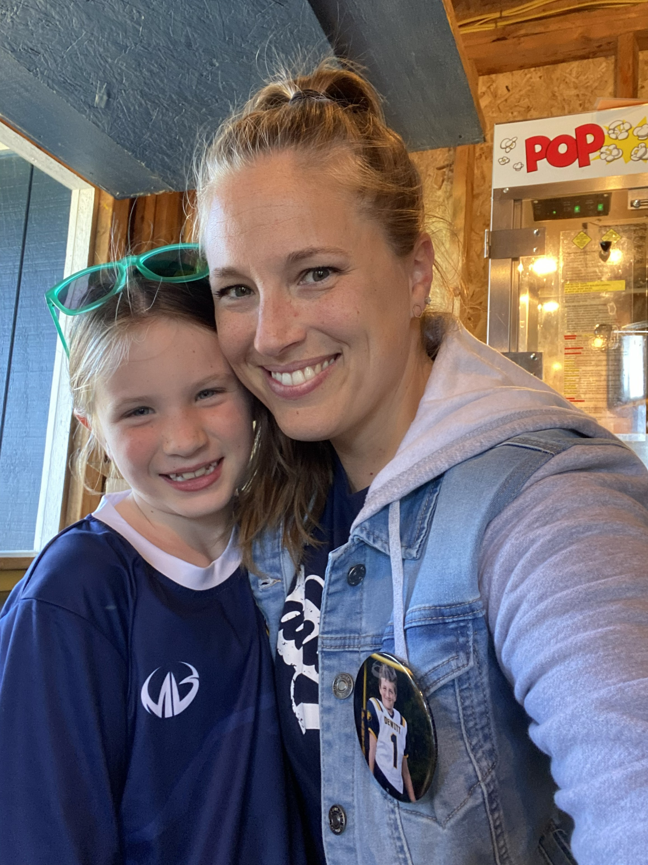
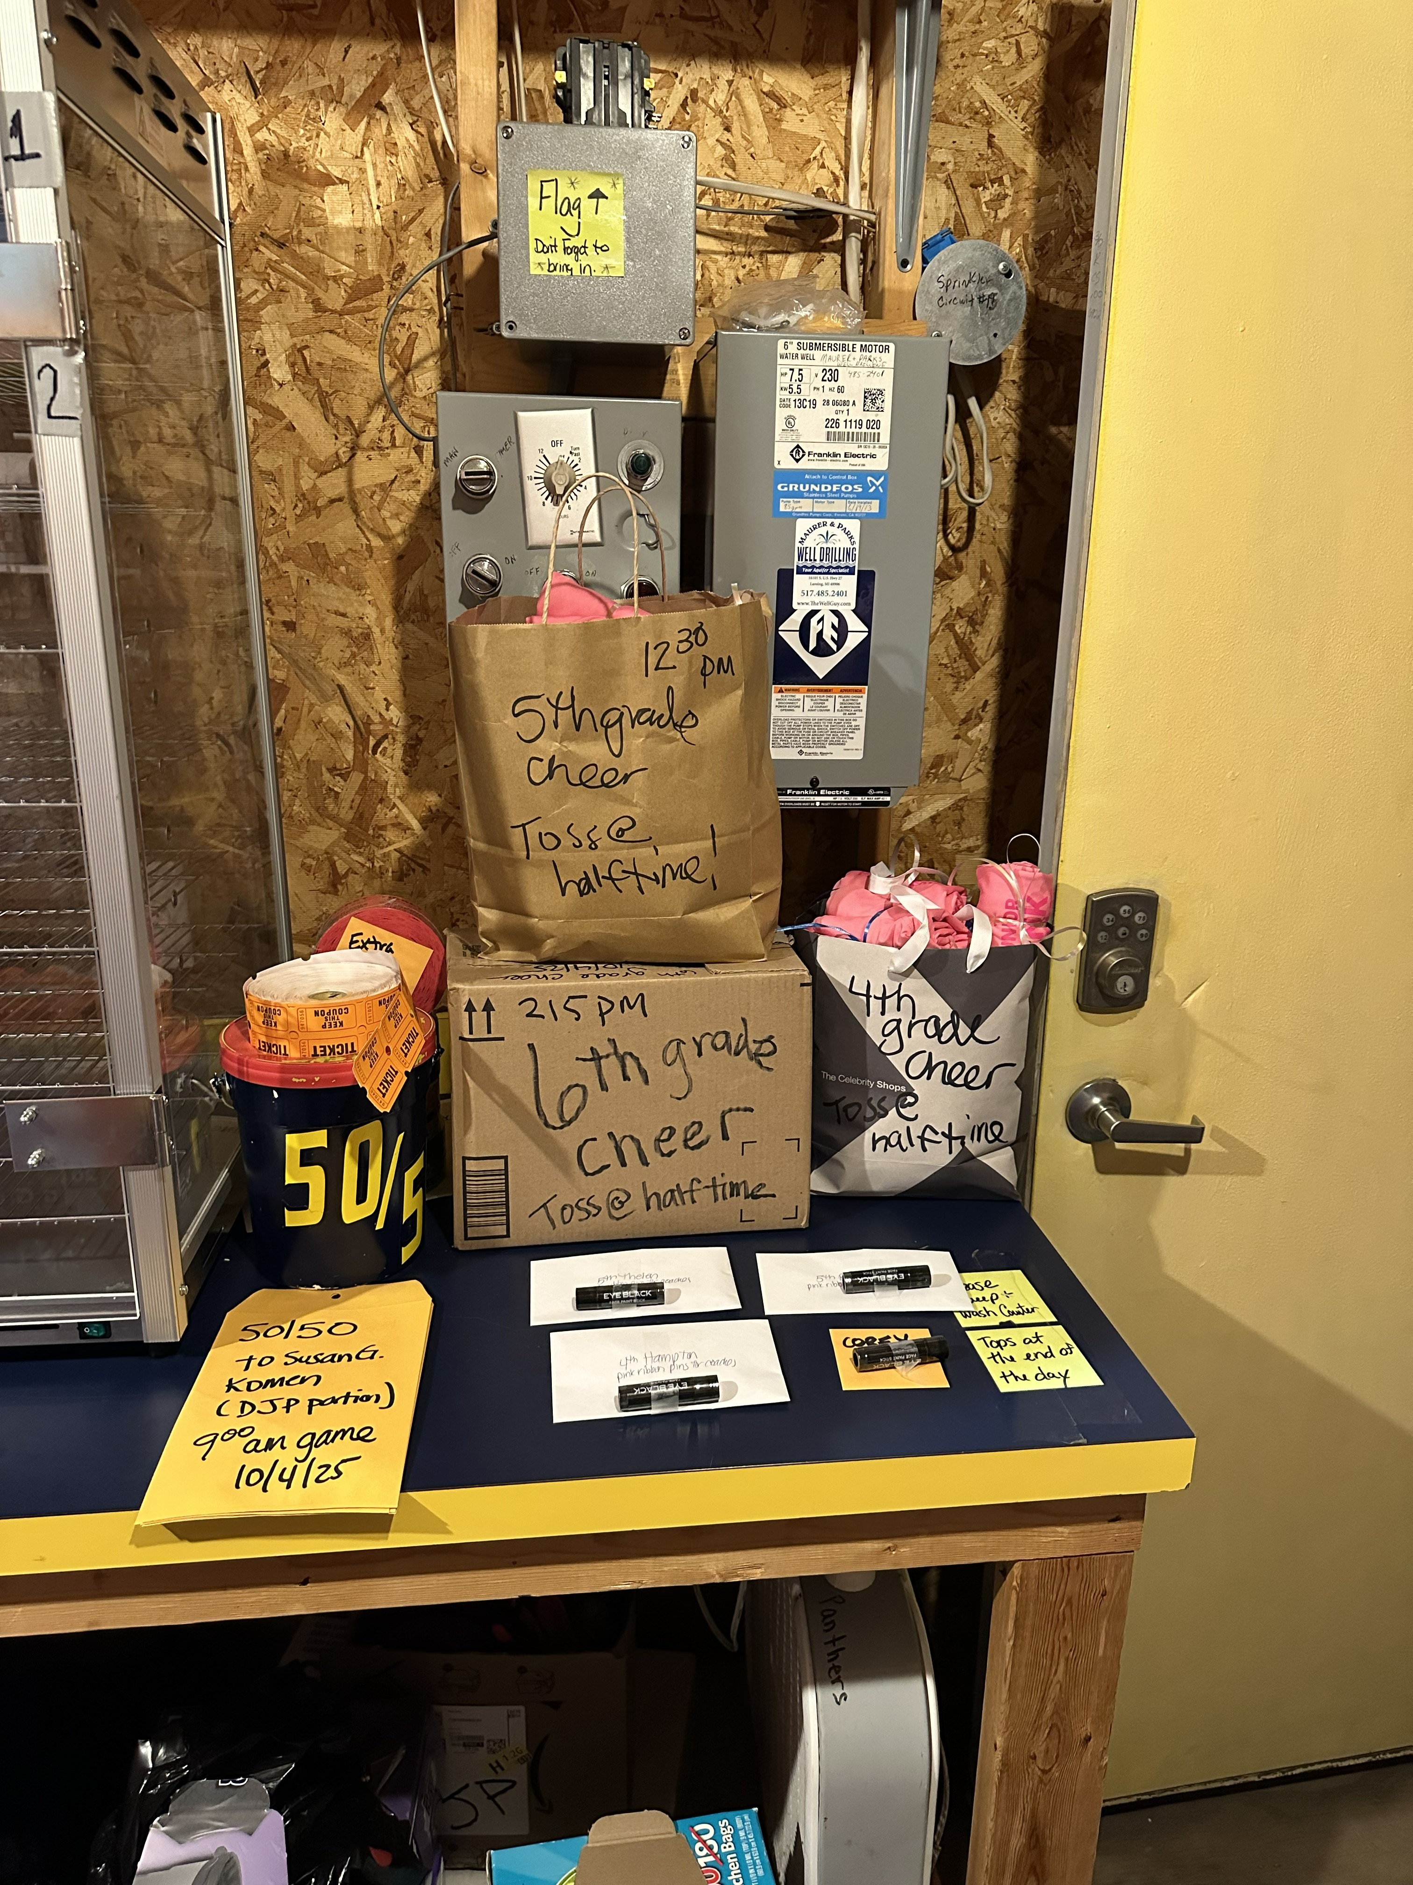
Football Parent Volunteer Expectations
**Football games cannot happen without game day parent volunteers**
Parents are expected to volunteer a minimum of
6 hours each season
Typical Game Day volunteer needs
Concessions (2-3)
Announcer (1)
Game Clock (1)
Spotter (1)
Chain Gang (2)
Parent representative (Team Manager)
Assist with Fundraising

Slide 7
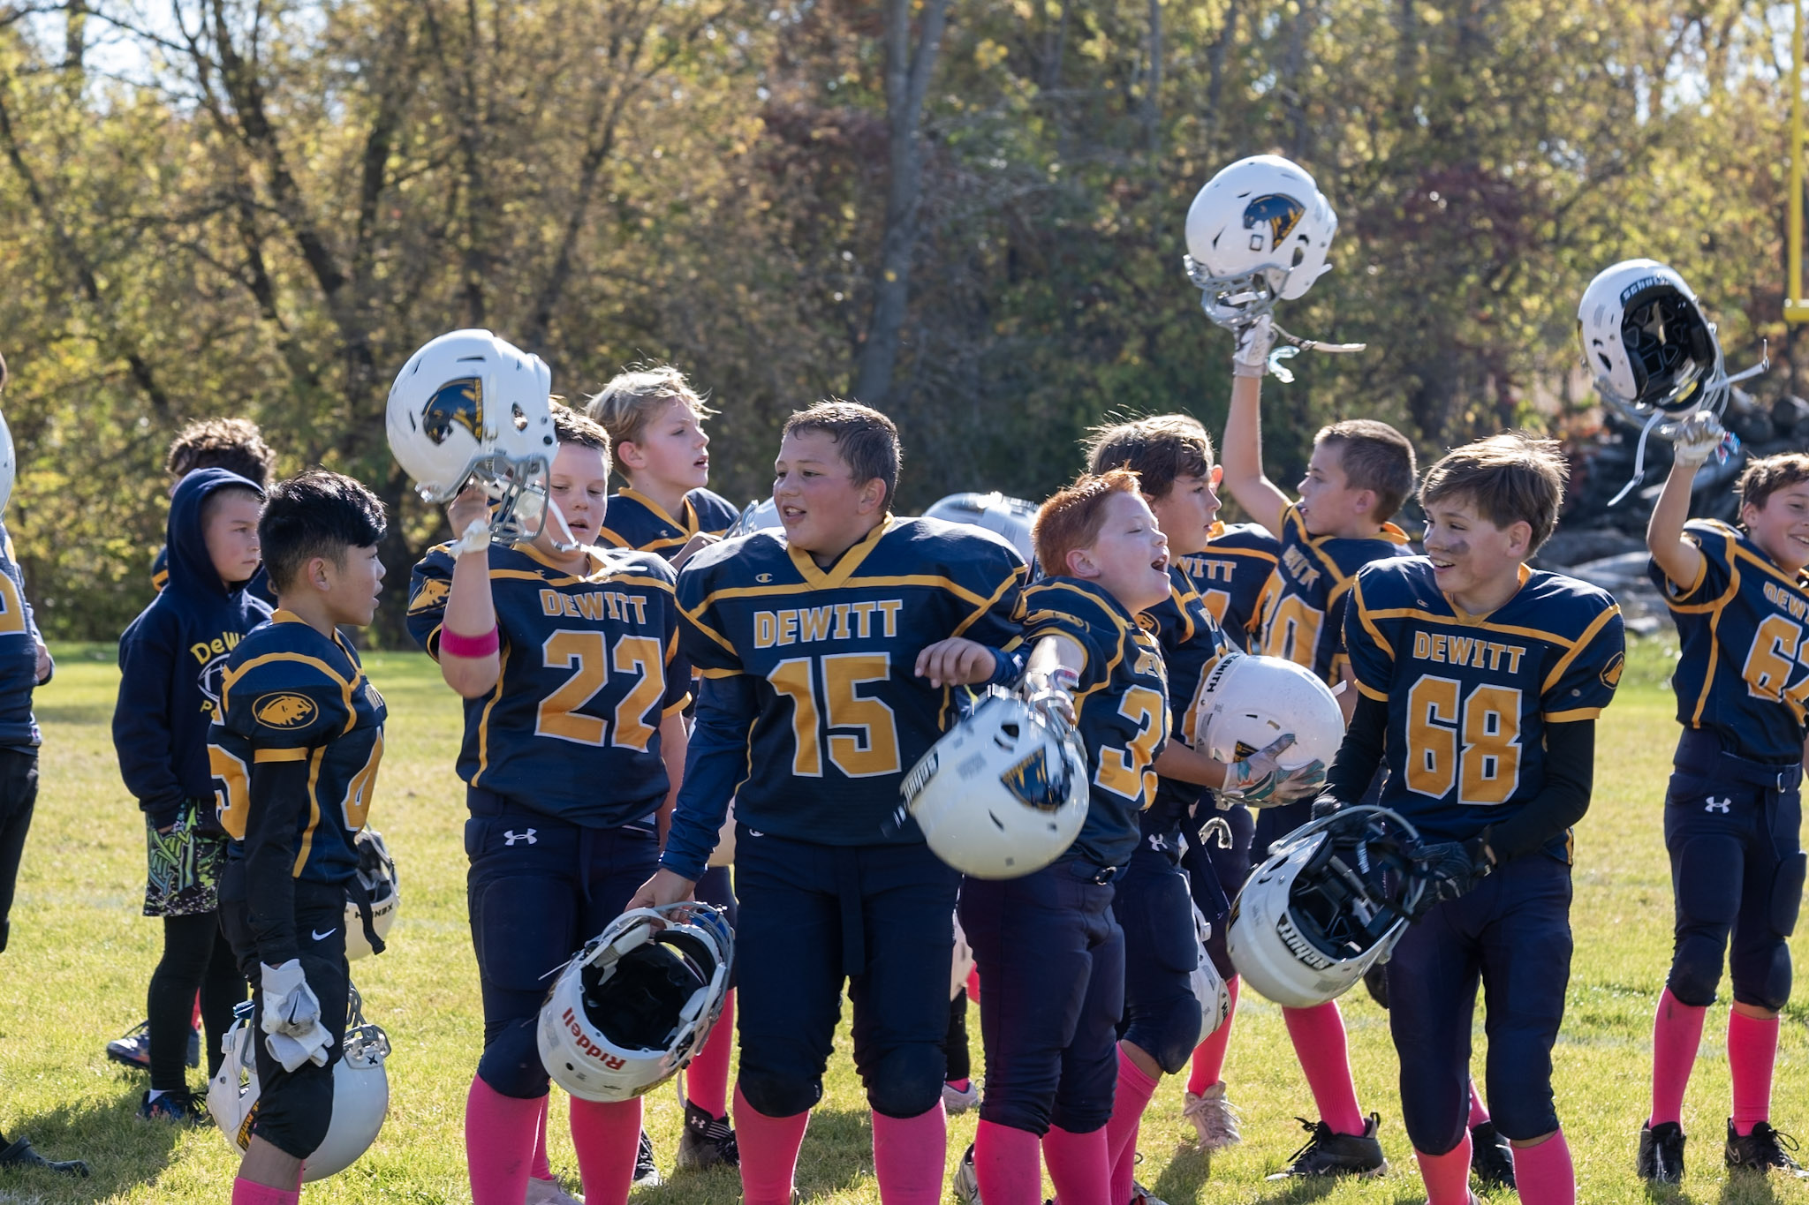
What’s djp’s structure & how does it function?
DJP is Independently supported and is 100% Self-Funded
DJP is not financially supported by DeWitt Public Schools (DPS)
DJP pays an annual player fee to DPS *AND* pays DPS for indoor and outdoor space usage

Slide 8
2025 DJP Budget Expenditures

Slide 9
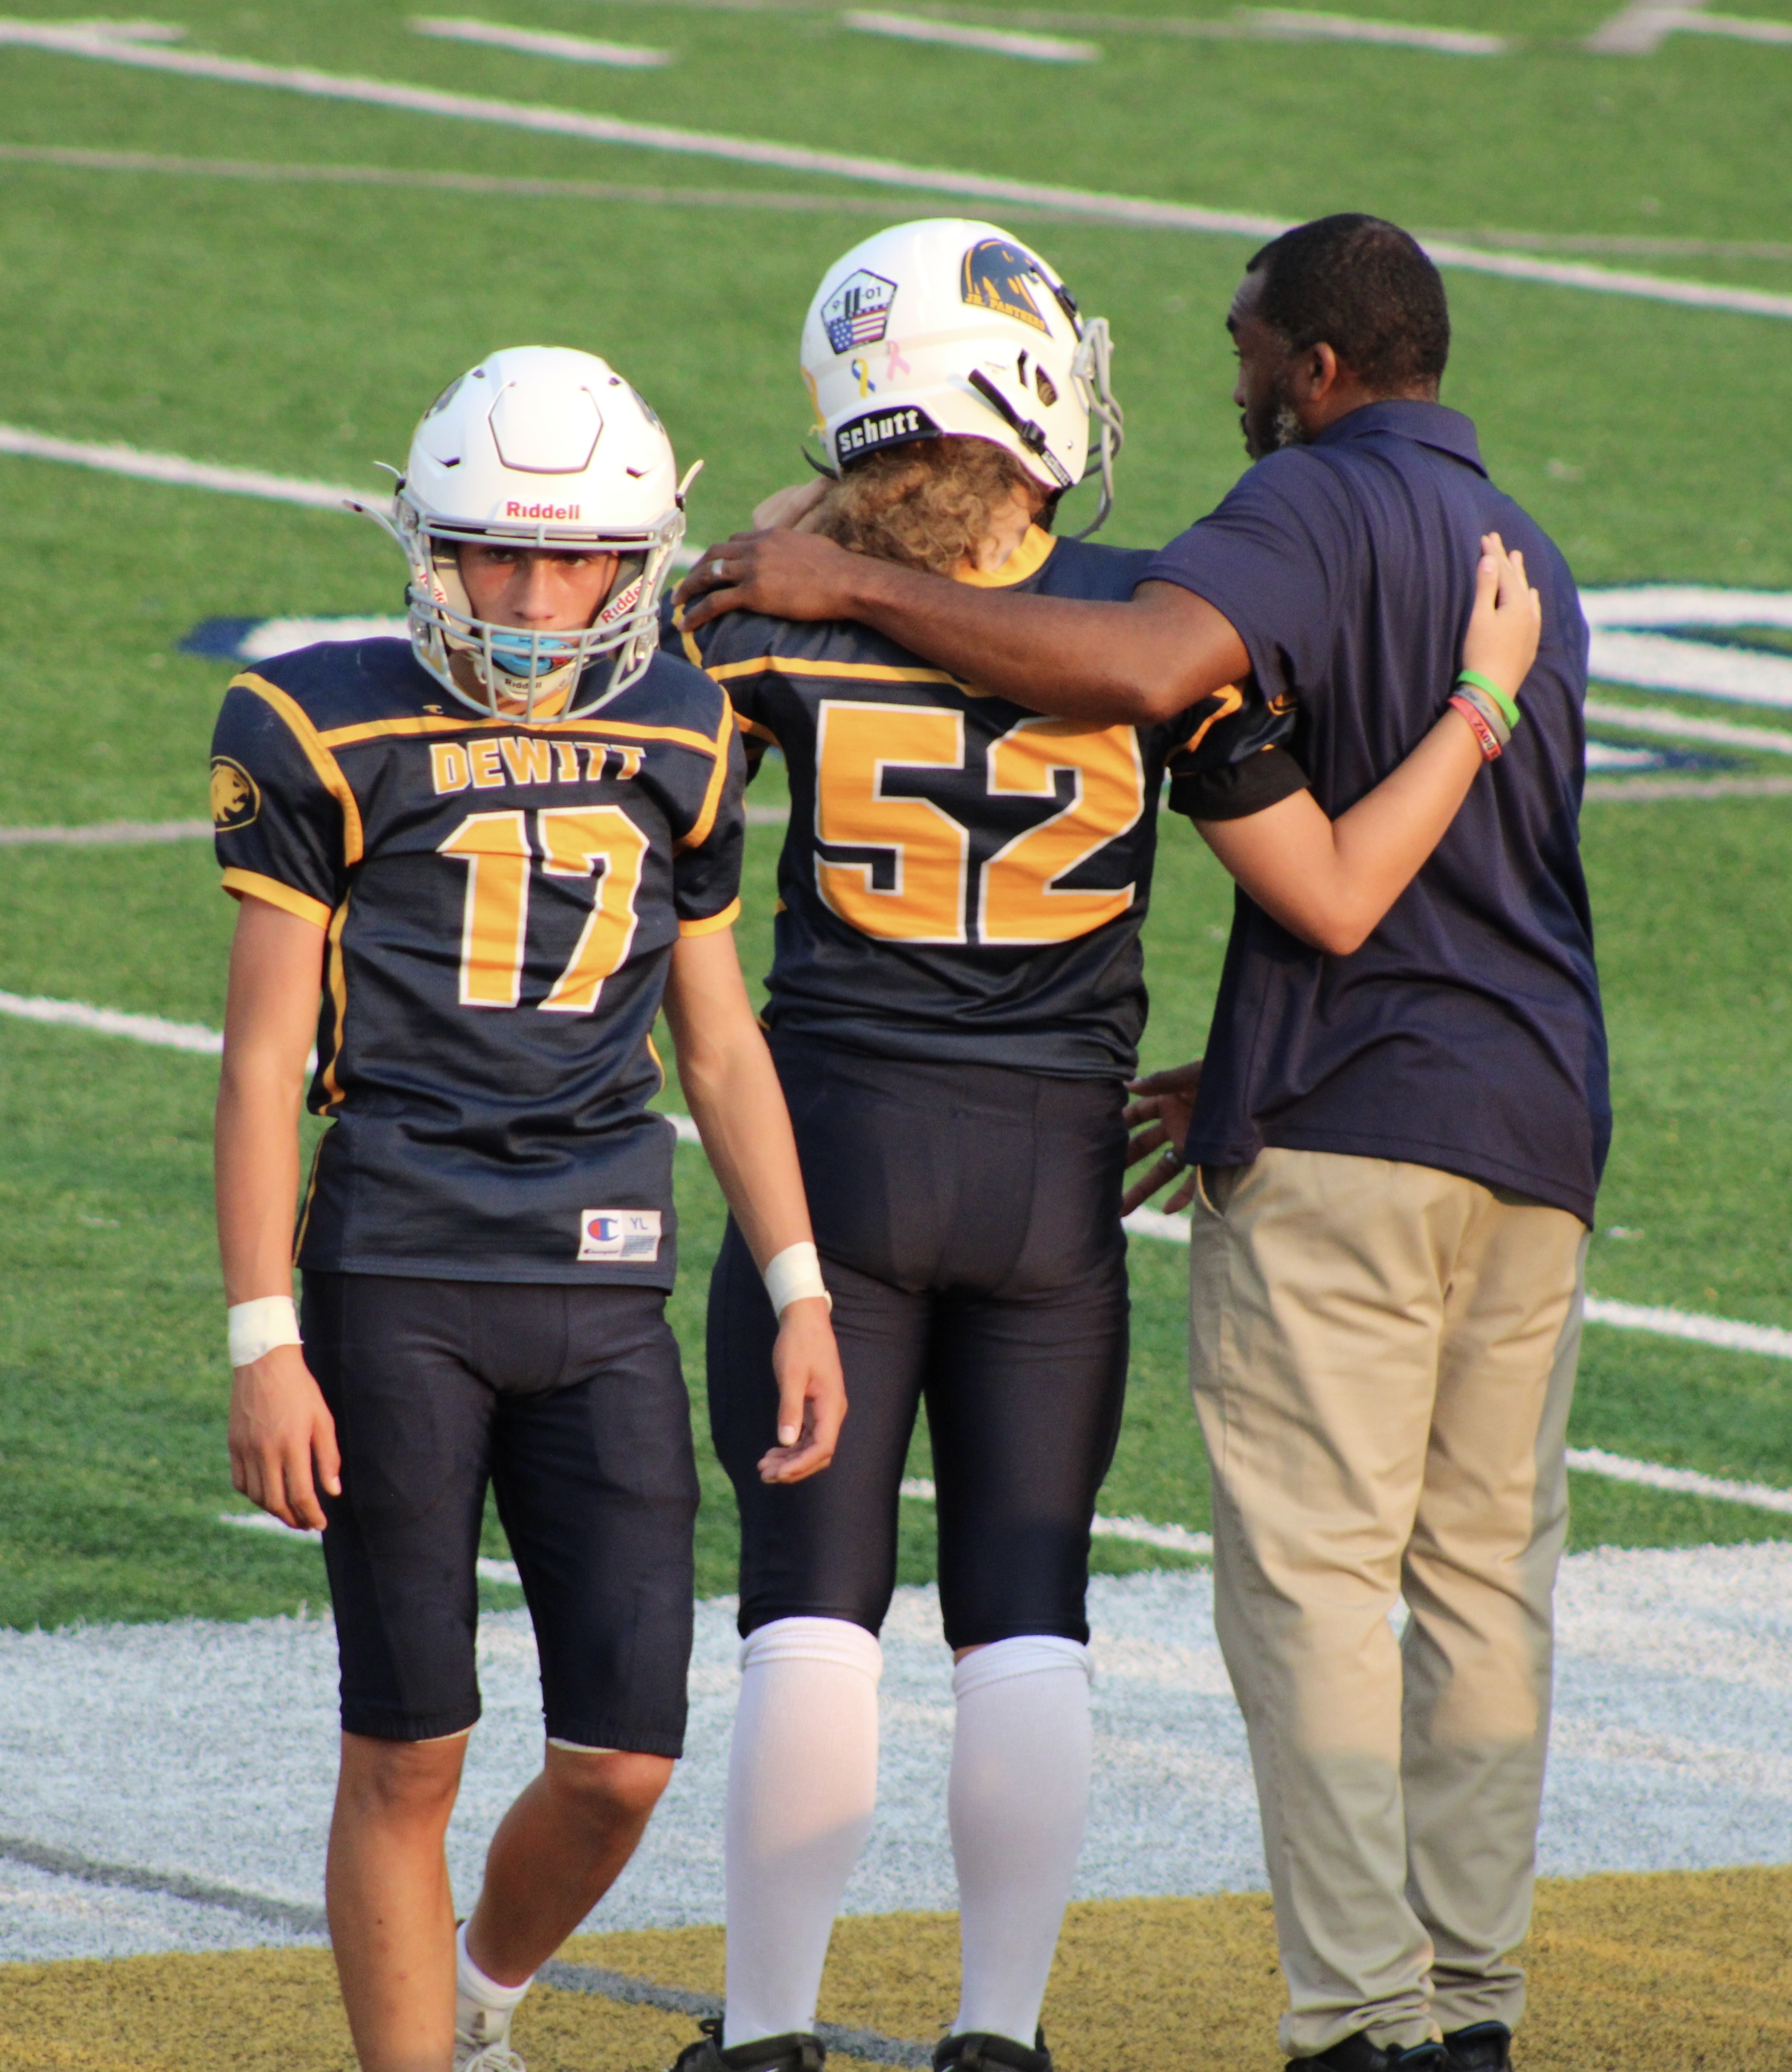
How does djp generate income?
Athlete Registration
Personal Donations
Corporate Sponsorships
Fundraising
Concession Stand Sales
50/50 Raffles (when we have the volunteers!)
** NEW for 2026 ** Spirit Wear & Vintage Uniform Sales

Slide 10
How does djp generate income?

Slide 11
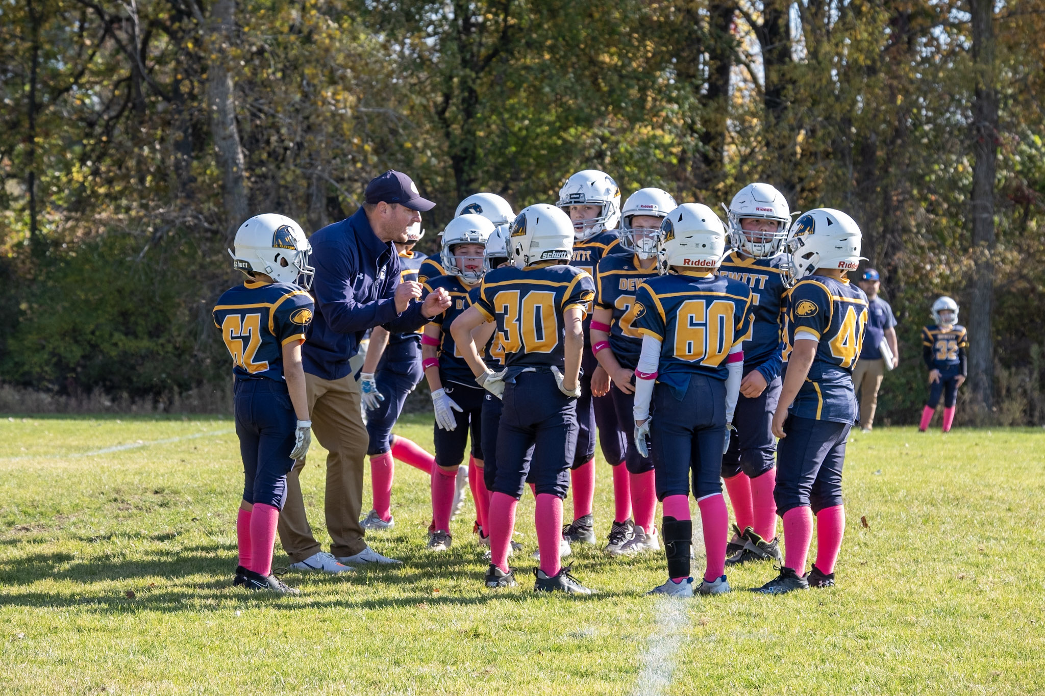
2026 DJP Fundraising
** NEW for 2026 **
Mrs. Fields Cookie Dough Sales
** NEW for 2026 **
Team-Fi Calendar Fundraiser

Slide 12
2026 – 2028 DJP fundraising plan
2-Year Phase In Approach for New Athlete Uniforms
Football Jerseys – 2-Year Phase-in Approach
2026 – 7th & 8th Grade
2027 – 4th – 6th Grade
Estimated Total for New Football Jerseys = $17,500
New Cheer Uniforms – 3-Year Phase-in Approach
2026 – Replenishment of 4th-6th Grade
2027 – Remainder of 4th-6th Grade + Replenishment of 7th-8th Grade
2028 – Remainder of 7th-8th Grade
Estimated Total for New Cheer Uniforms = $35,000
2026 Fundraising NEED = $17,500; GOAL = $20,000
2027 Fundraising NEED = $20,000; GOAL = $22,500
2028 Fundraising NEED = $15,000; GOAL = $17,500

Slide 13
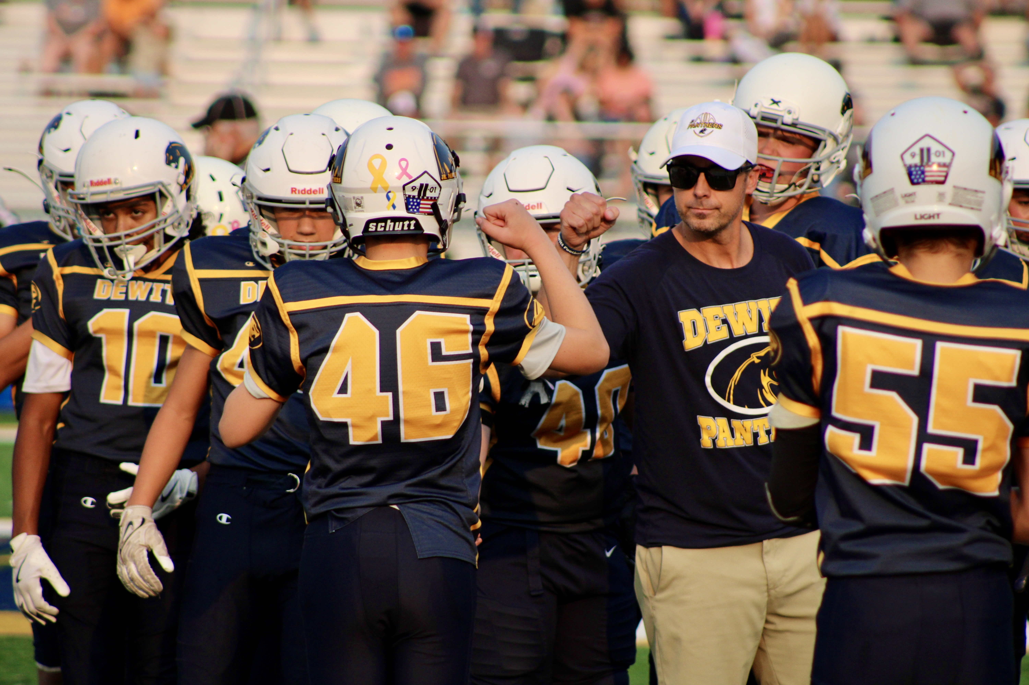
How does djp
use its funds?
2026 – Concession Stand Repair & Maintenance
2027 – Press Box Roof Repair & Maintenance
Football Practice Pads, Sleds, footballs, & other equipment
Accessibility Plan (with DPS?)

Slide 14
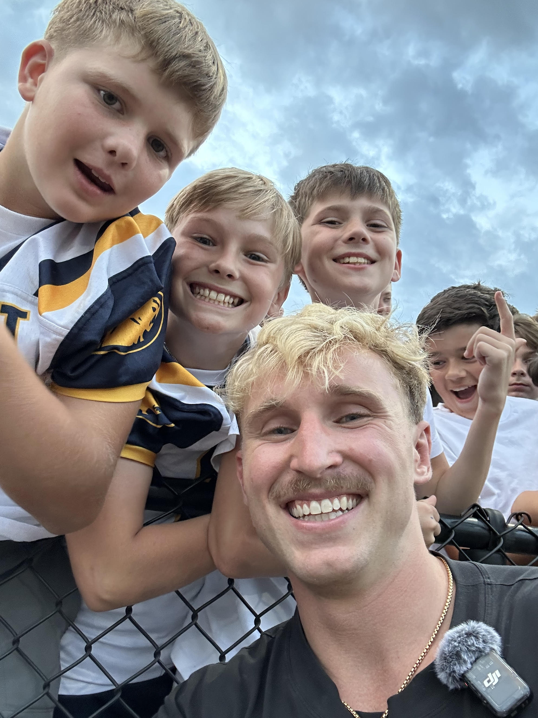
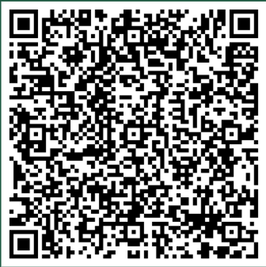
DJP Registration
Early Bird Registration (NOW- April 30) Cost = $175
Registration (May 1 - May 31) Cost = $200
Late Registration (June 1 – June 30) Cost = $250
Payment is due in full at time of registration OR via payment plan with a down payment. Monthly payments are made in 3 installments, paid in full 3 months from registration date.
Scholarship assistance – Please contact us at:
dewittjuniorpanthers@gmail.com
Subject: Scholarship Assistance
Attn: Tara Miller - Treasurer
Register Here!

Slide 15
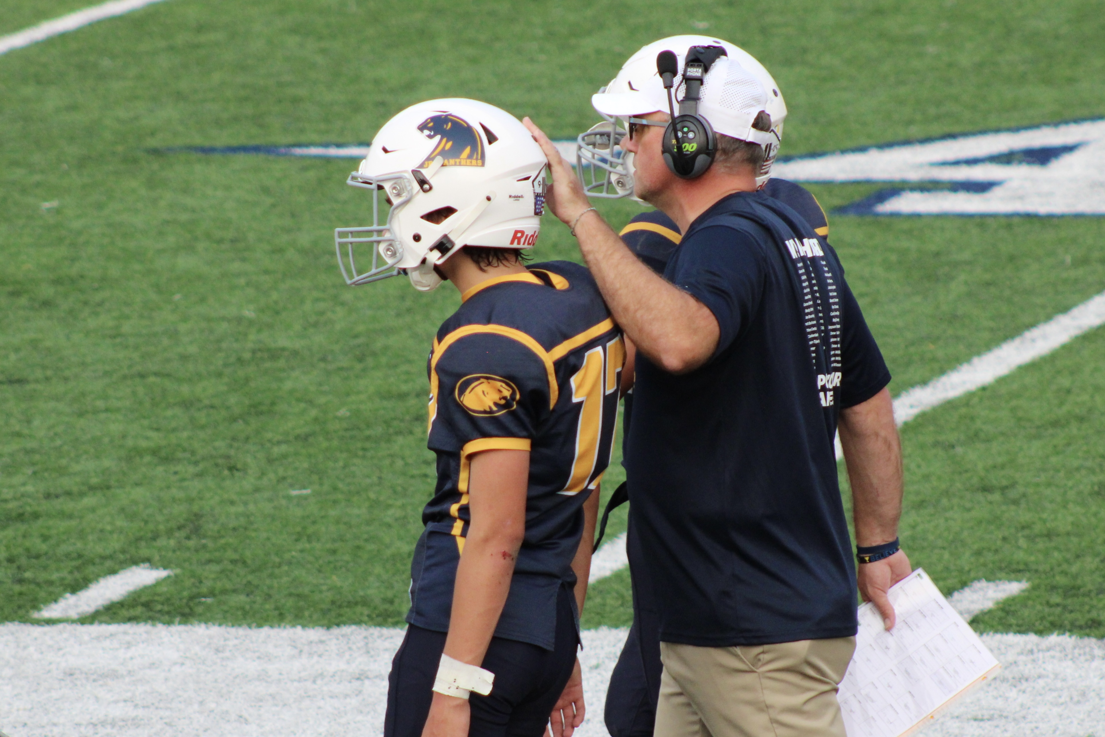
Football
Required Equipment
Player Provided Required Equipment
Helmet
Shoulder pads
Practice pants OR Girdle; Integrated pants may include girdle and knee pads all-in-one
Football Cleats
Mouth guard
Athletic Supporter - suggested

Slide 16
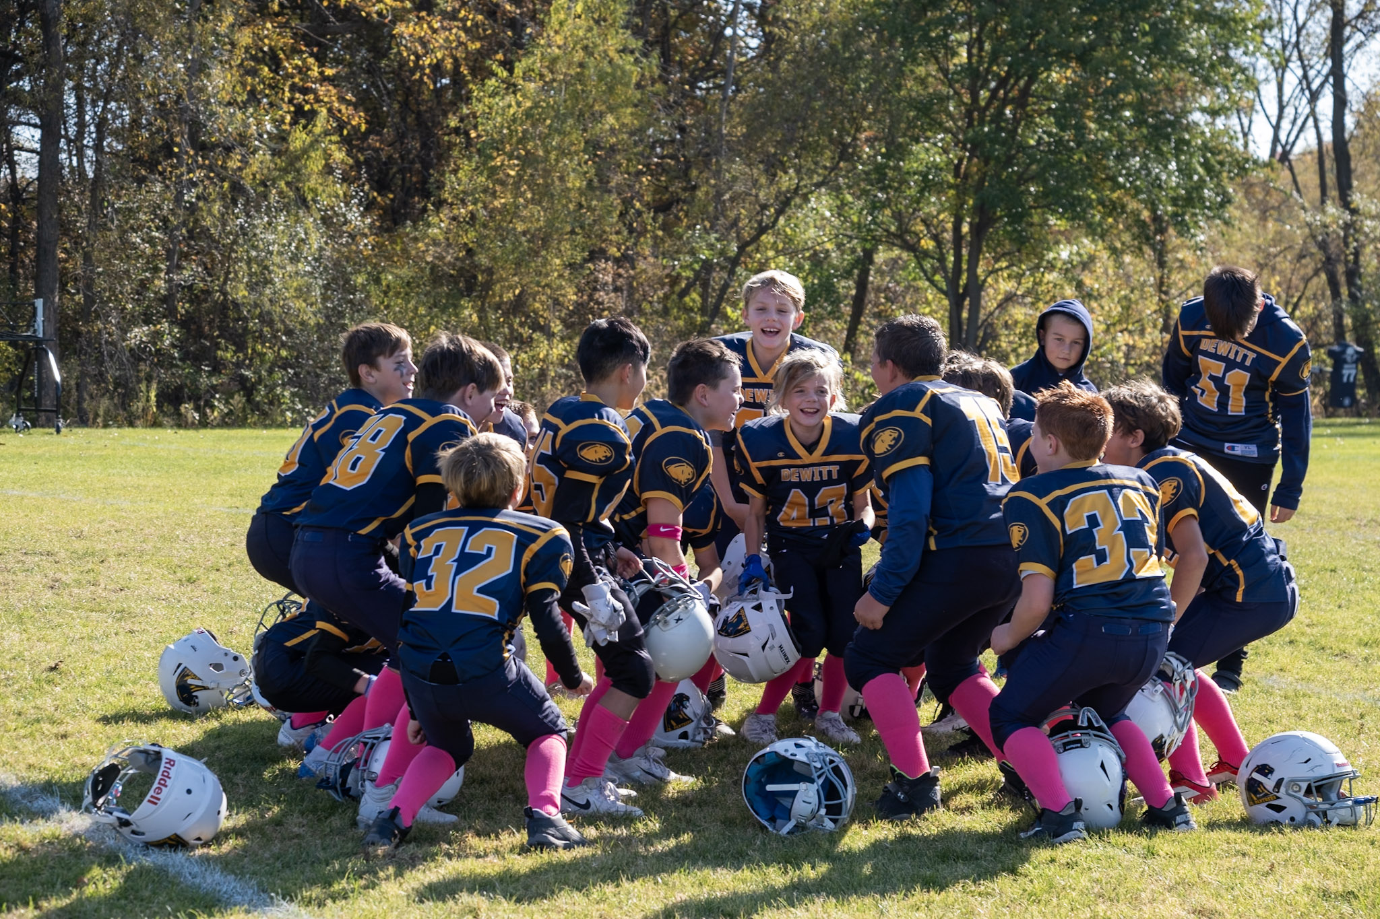
FOOTBALL UNIFORMS
DJP Provided – Players KEEP Post-Season
Practice Jersey
Gold Socks (September Games)
Pink Socks (October Games)
DJP Provided – Returned to DJP Post-Season
** NEW in 2026 ** Game Day Jerseys
Game Pants
Belt

Slide 17
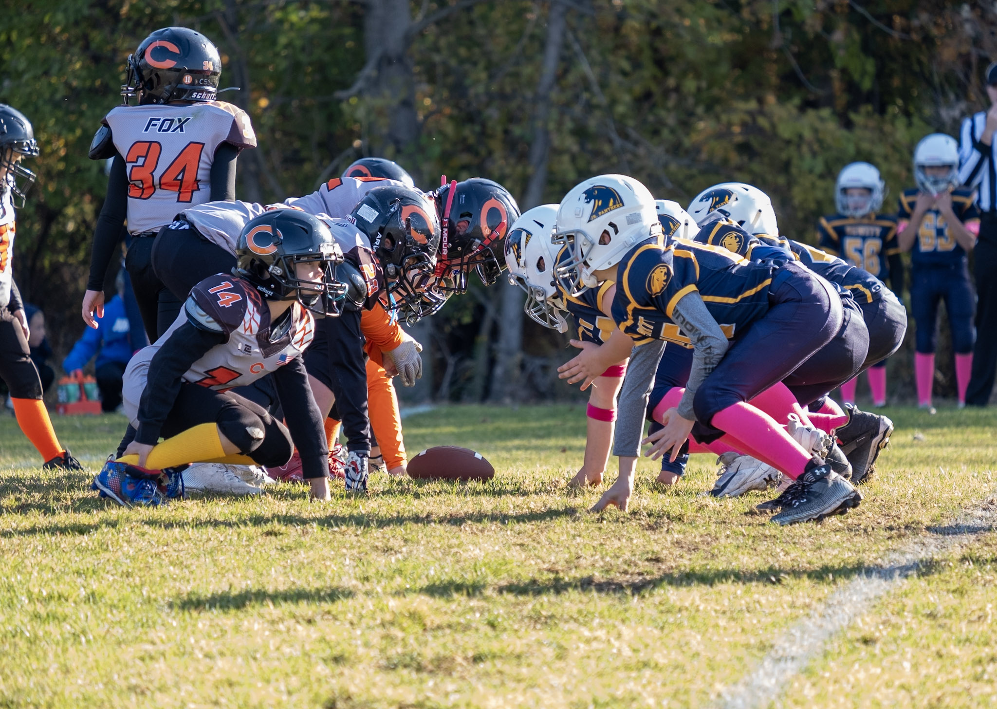
Sports Physicals & Conditioning
SPORTS PHYSICALS
DJP will follow the MHSAA policy dates for 2026-27 season.
Must have a recent physical dated on or after 4/15/2026
DJP will need a COPY of both sides of your Child’s physical form.
Players will not be allowed to start conditioning if a COPY of their physical is not turned in.
CONDITIONING
Mandatory 8 hours with helmets, cleats, mouth guards prior to practicing with pads
** NO pads until after the 8 mandatory conditioning hours are met for each player. Physicals must be on file before players can begin conditioning.

Slide 18
Grade Checks for 7th & 8th Grade:
We are required to check grades for eligibility for our 7th & 8th grade players.
Grades will be reported on Fridays. If a student is failing one class they will be ineligible to play for the next week’s game.
They can attend practice. They are expected to attend the game, but they are not allowed to be in uniform.

Slide 19

Football – Important Dates
Dead Periods (No coach/player contact)
Grades 4th – 6th
June 29 – July 5
August 1 – August 9
Grades 7th – 8th
June 29 – July 5
August 10 – August 23
First week of practice(s)
Grades 4th – 6th : Week of August 10th
Grades 7th – 8th : Week of August 24th
First Games
Grades 4th – 6th (MMPFL): Saturday, September 5th
Grades 7th – 8th (MMMSFL): Wednesday, September 9th

Slide 20

Important Dates – Summer Football Camps
The DeWitt High School Football Program is offering football camps this summer for our Junior Panthers!
These camps are hosted by DeWitt High School Football Coaches, Current DeWitt Varsity Football Players and some Alumni DeWitt Varsity Football Stars.
REGISTRATION IS LIVE!
You can register your athlete at www.pantherfootballcamps.com
Football Camp - Grades 4th – 6th
$91 - June 15th – 17th (8:30am – 10:00am)
Football Camp - Grades 7th – 8th
$101 - June 15th & 16th (10:15am – 12:15pm);
June 17th (1:00pm – 3:00pm)
** MUST REGISTER BY 6/8 TO RECEIVE A CAMP TSHIRT

Slide 21
Equipment swap & vintage uniform sale
DJP will be selling old Football & Cheer uniforms during the summer months.
Will be available for purchase during respective uniform fitting
Football
$30 - Home & Away Jersey Kit
$20 per Individual Piece
Cheer
$30 - Shell and Skirt Kit
$20 per Individual Piece

Slide 22

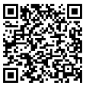
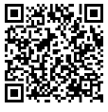

DJP Communication
DJP website – www.dewittjrpanthers.org
Join our Facebook Page!
** NEW for 2026 ** Join our Instagram Page!
Join our Facebook DJP Equipment Buy and Sell Page
Coach or Team Parent Representatives
If you have a concern:
24-hour rule
Contact the coach
A formal complaint form is available on the DJP website. These will be reviewed by the Board.
DJP Facebook Page
DJP Buy and Sell Facebook Page
DewittjrPanthers.org

Slide 23
QUESTIONS?

