Slide 1
Wisconsin High School Track & Field Coaches Annual Track & Field Clinic
Lance Brauman
PURE Athletics

Slide 2


Slide 3
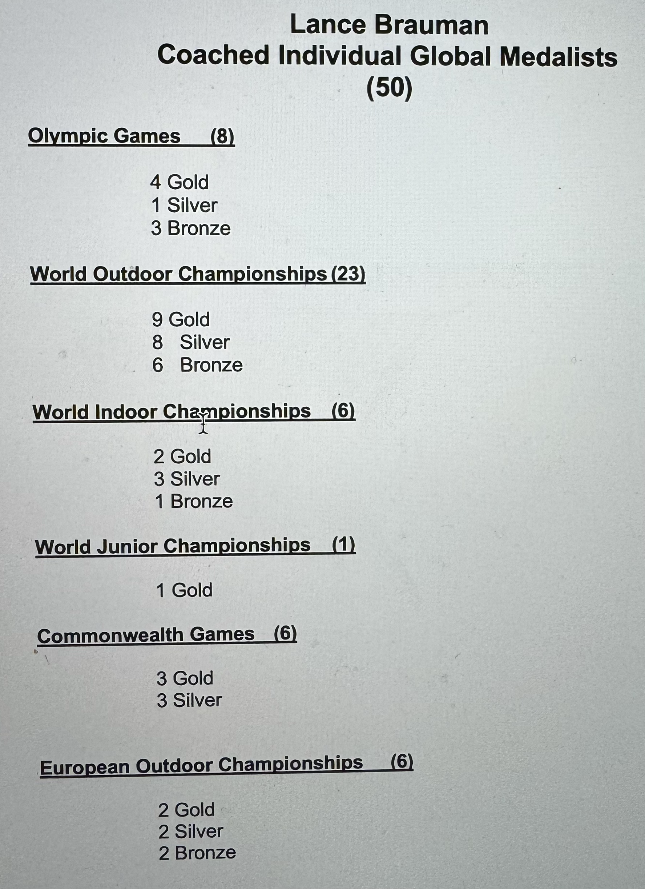

Slide 4
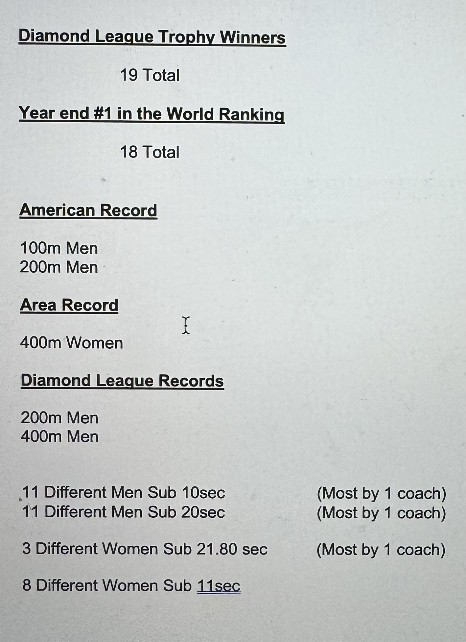

Slide 5
The Science of Coaching
Compared to the Art of Coaching

Slide 6
Physiology
Biomechanics
Strength and power
Fuel

Slide 7
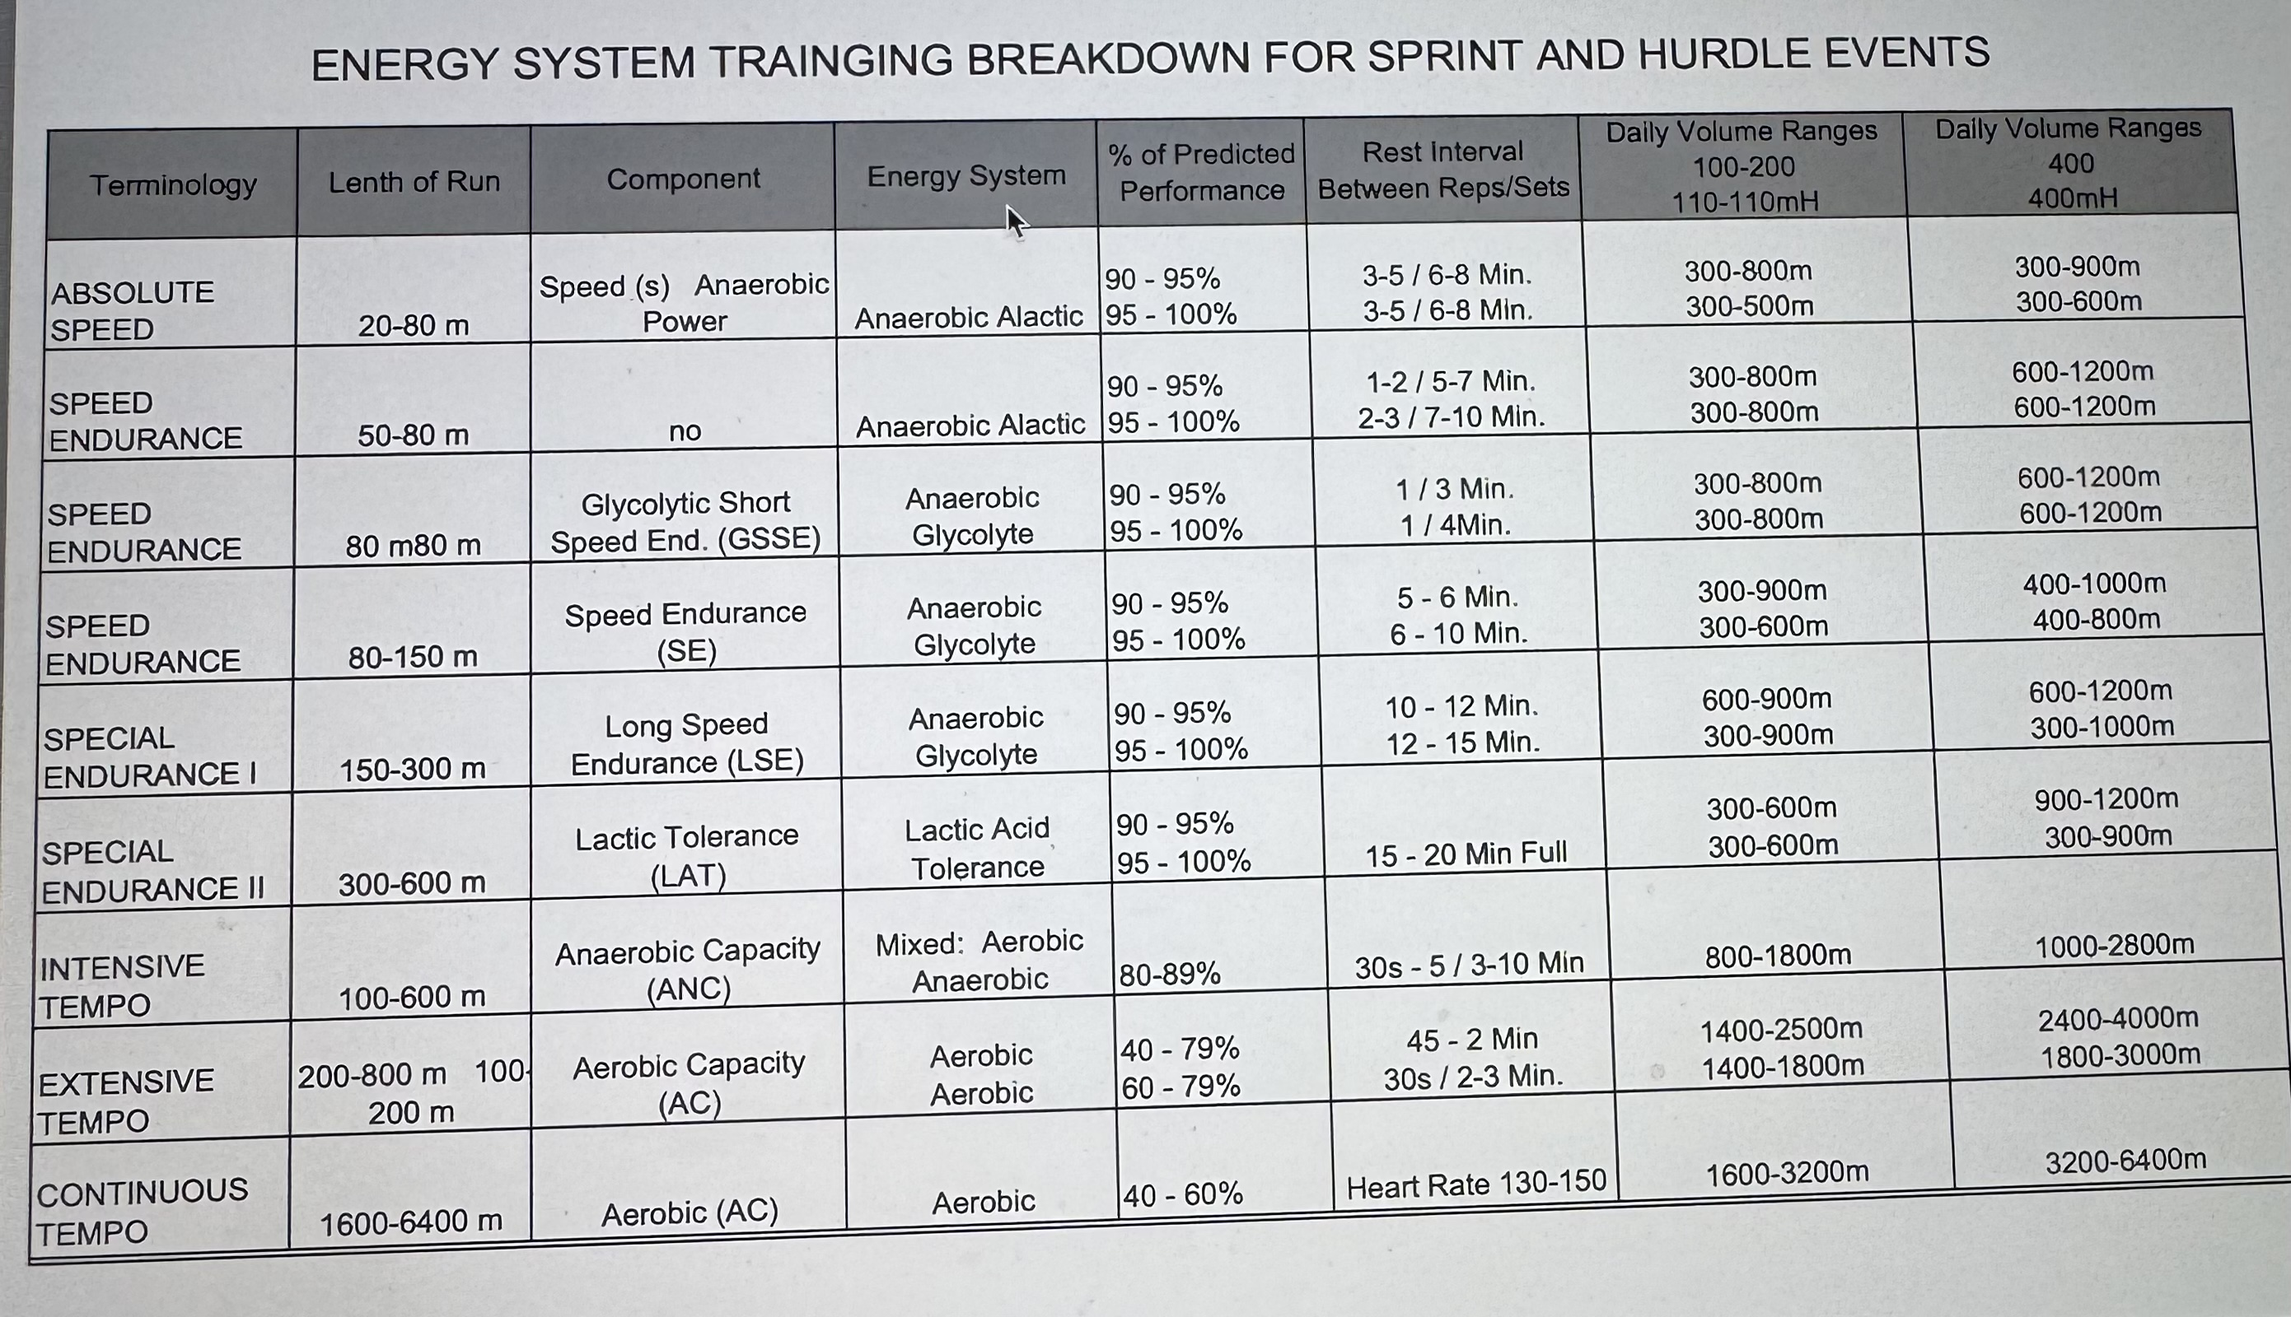

Slide 10
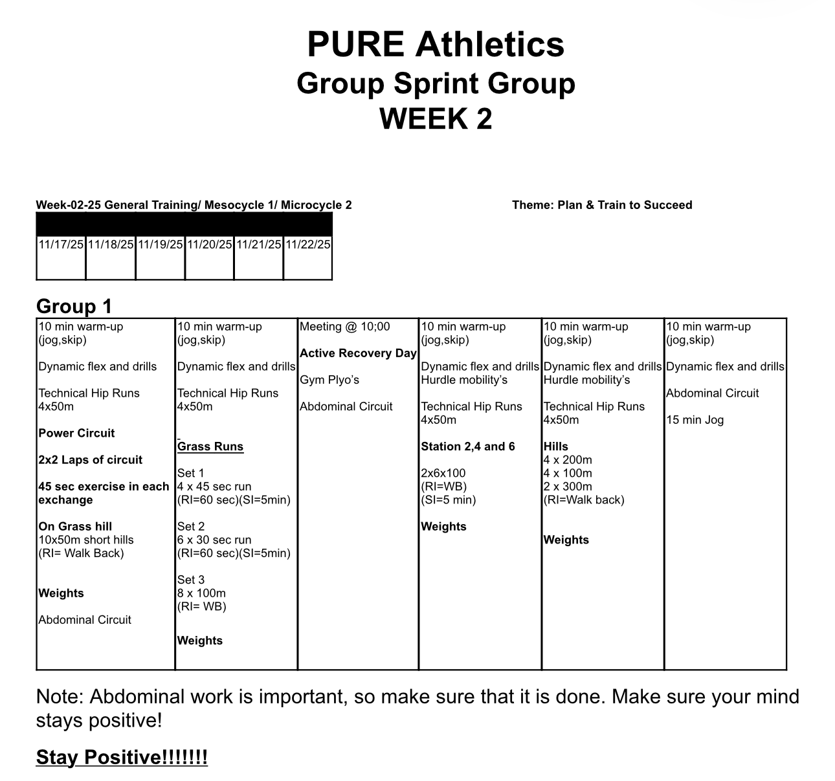

Slide 11
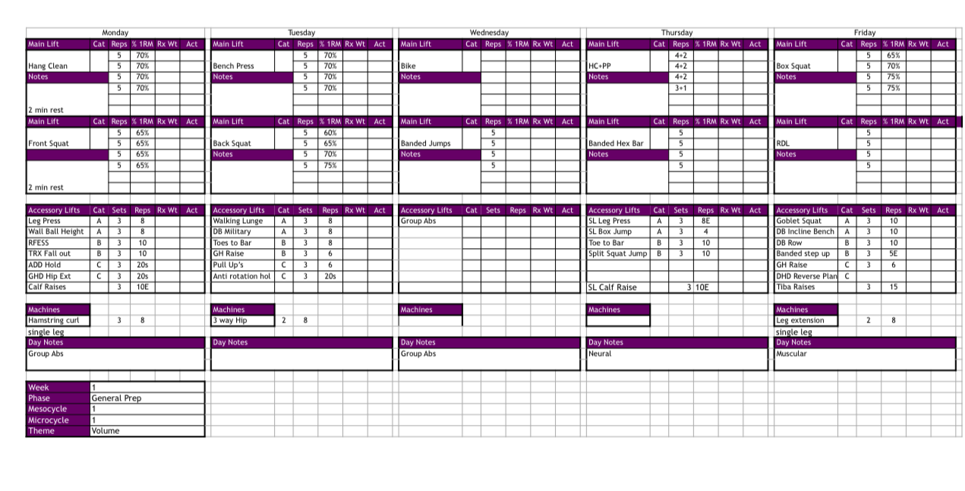

Slide 14
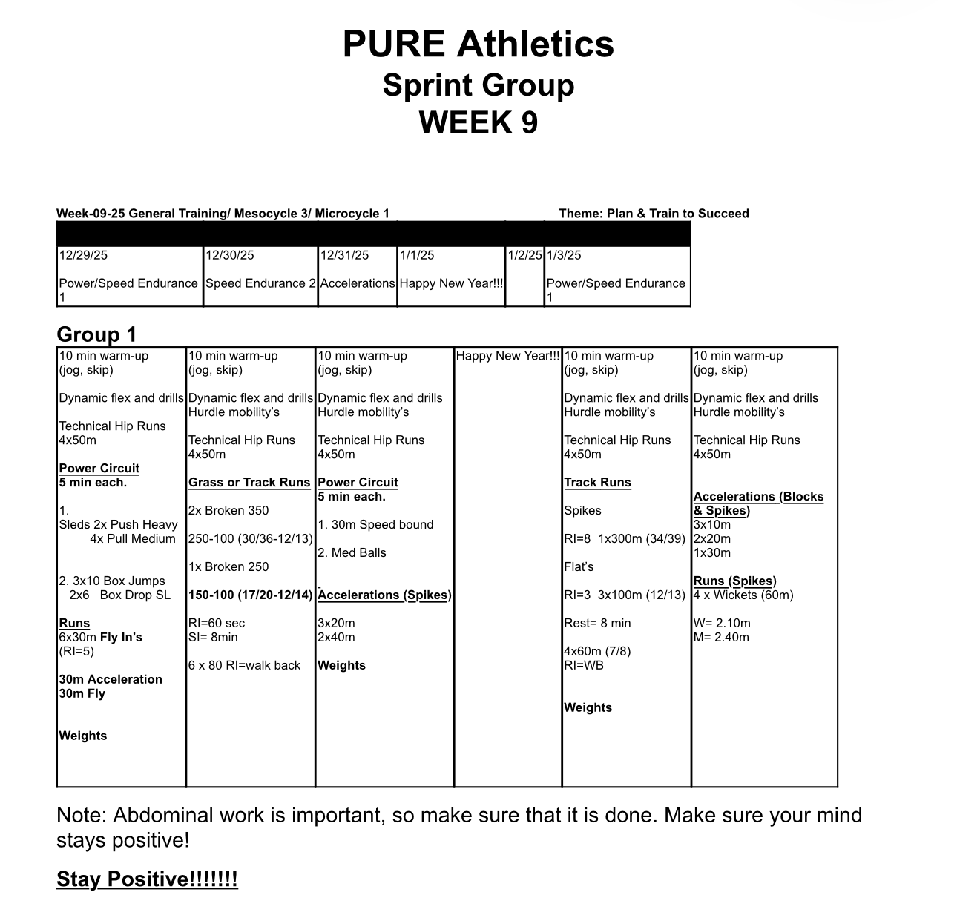

Slide 15
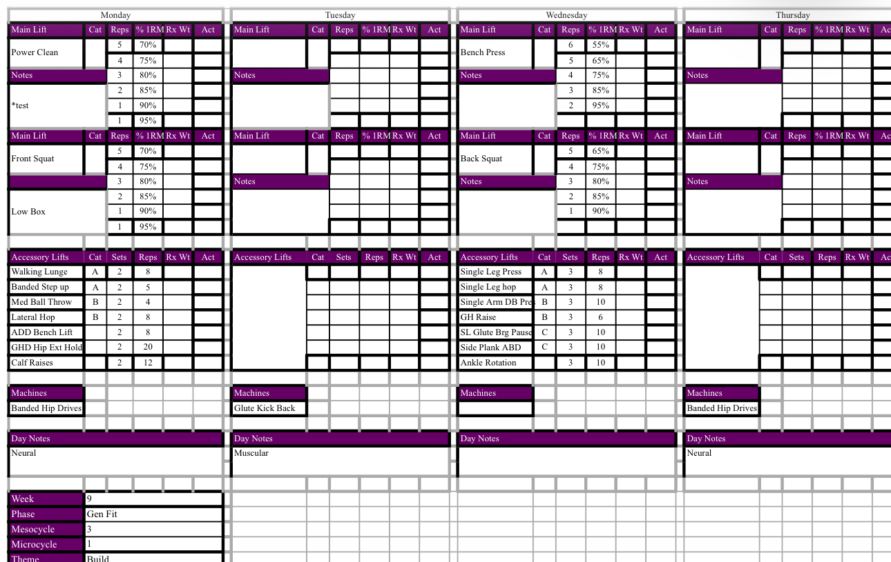

Slide 18
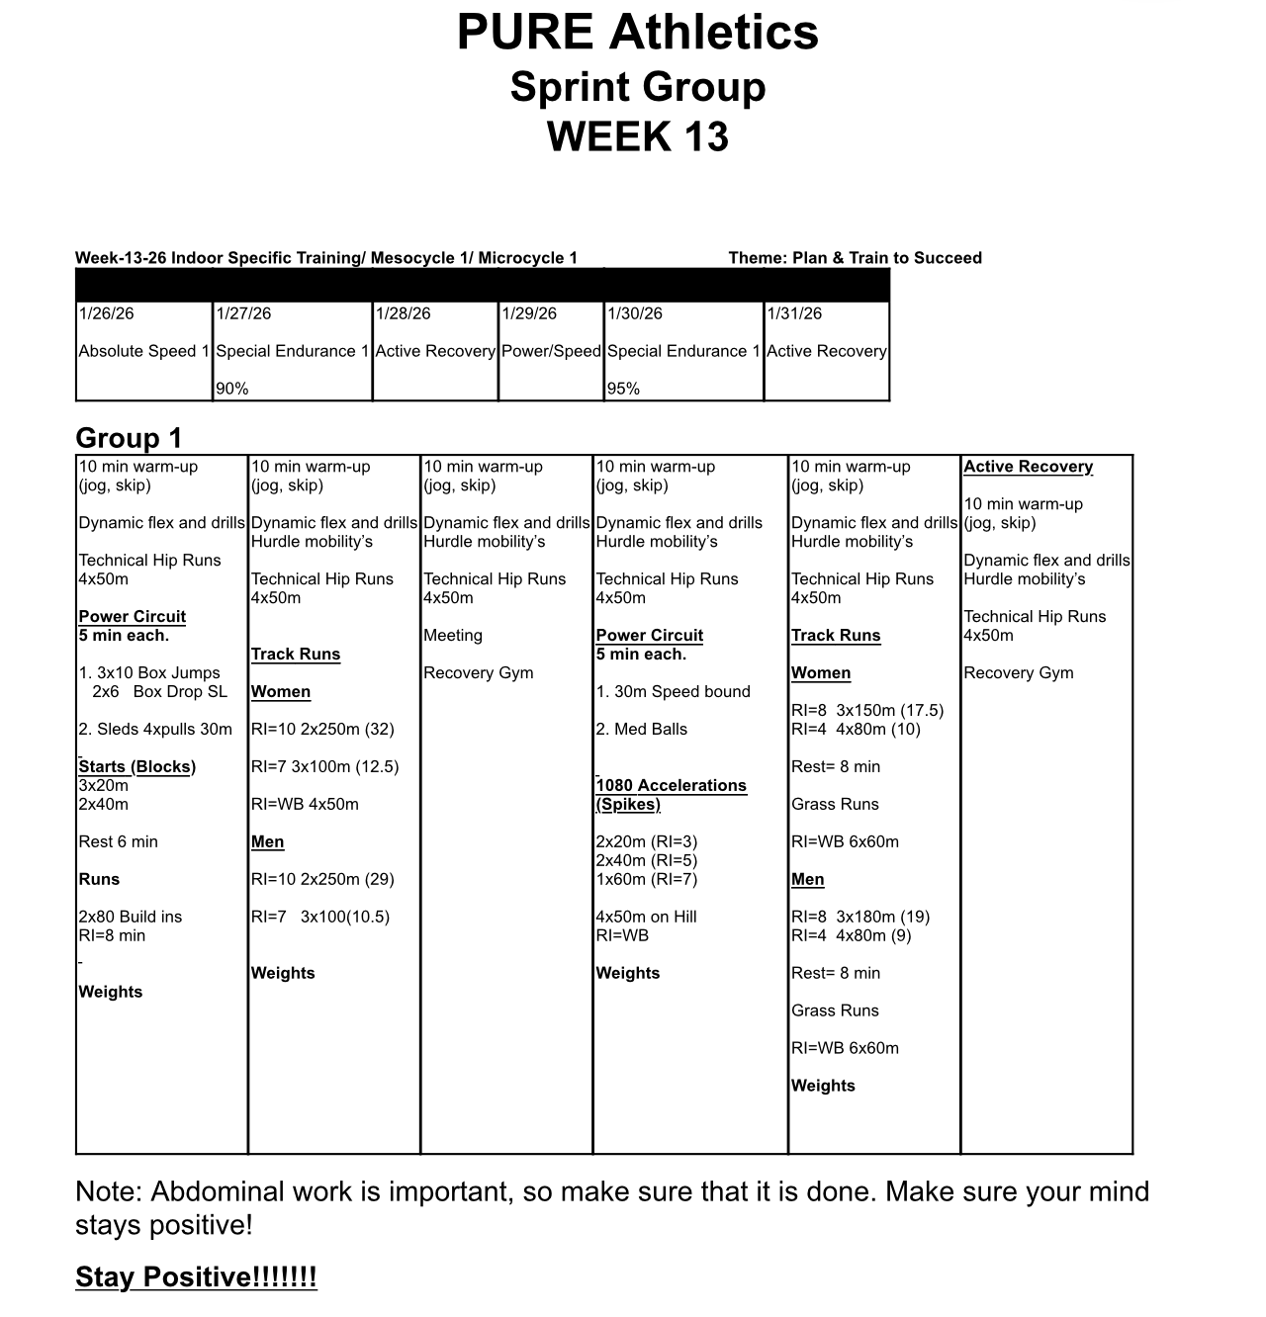

Slide 19
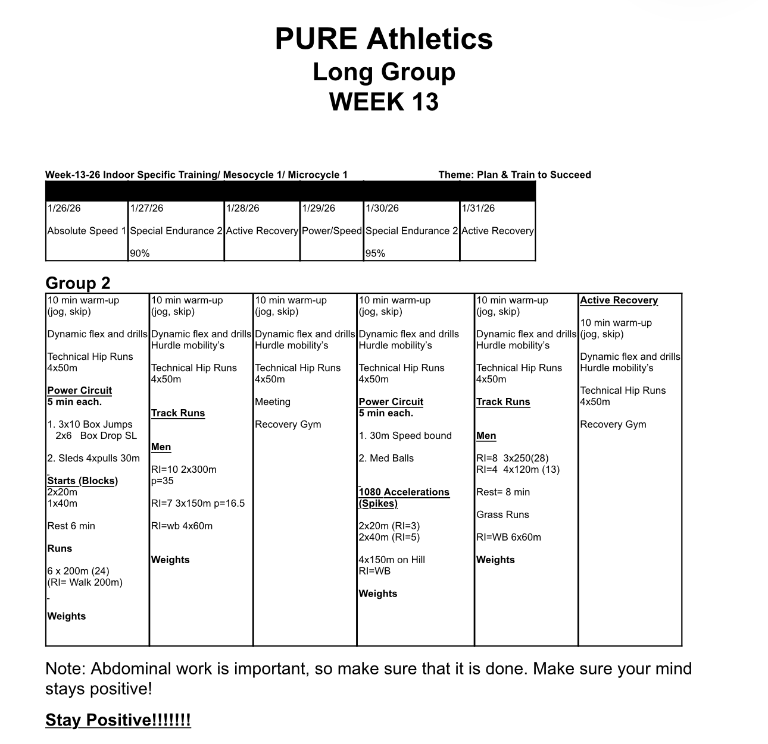

Slide 20
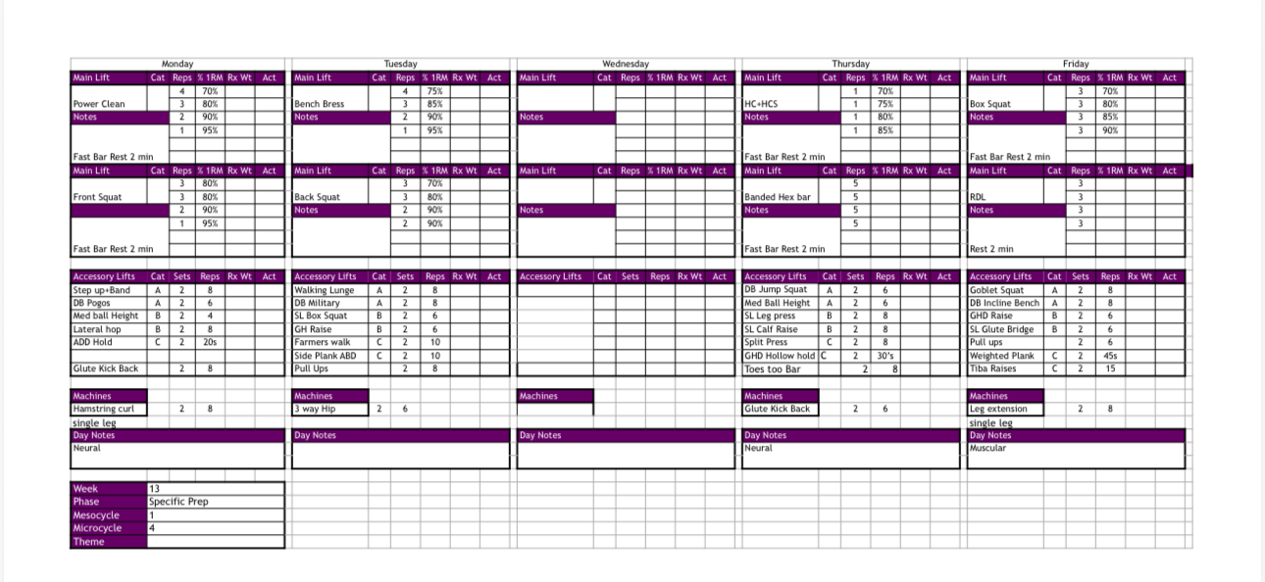

Slide 23
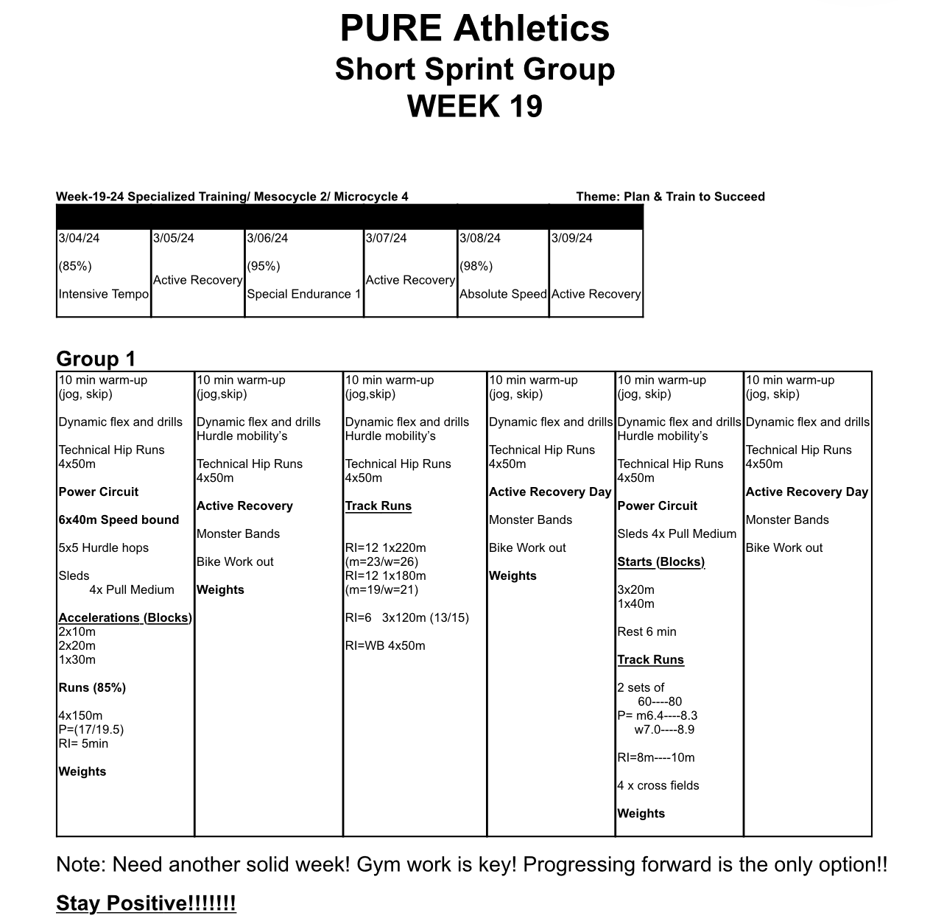

Slide 24
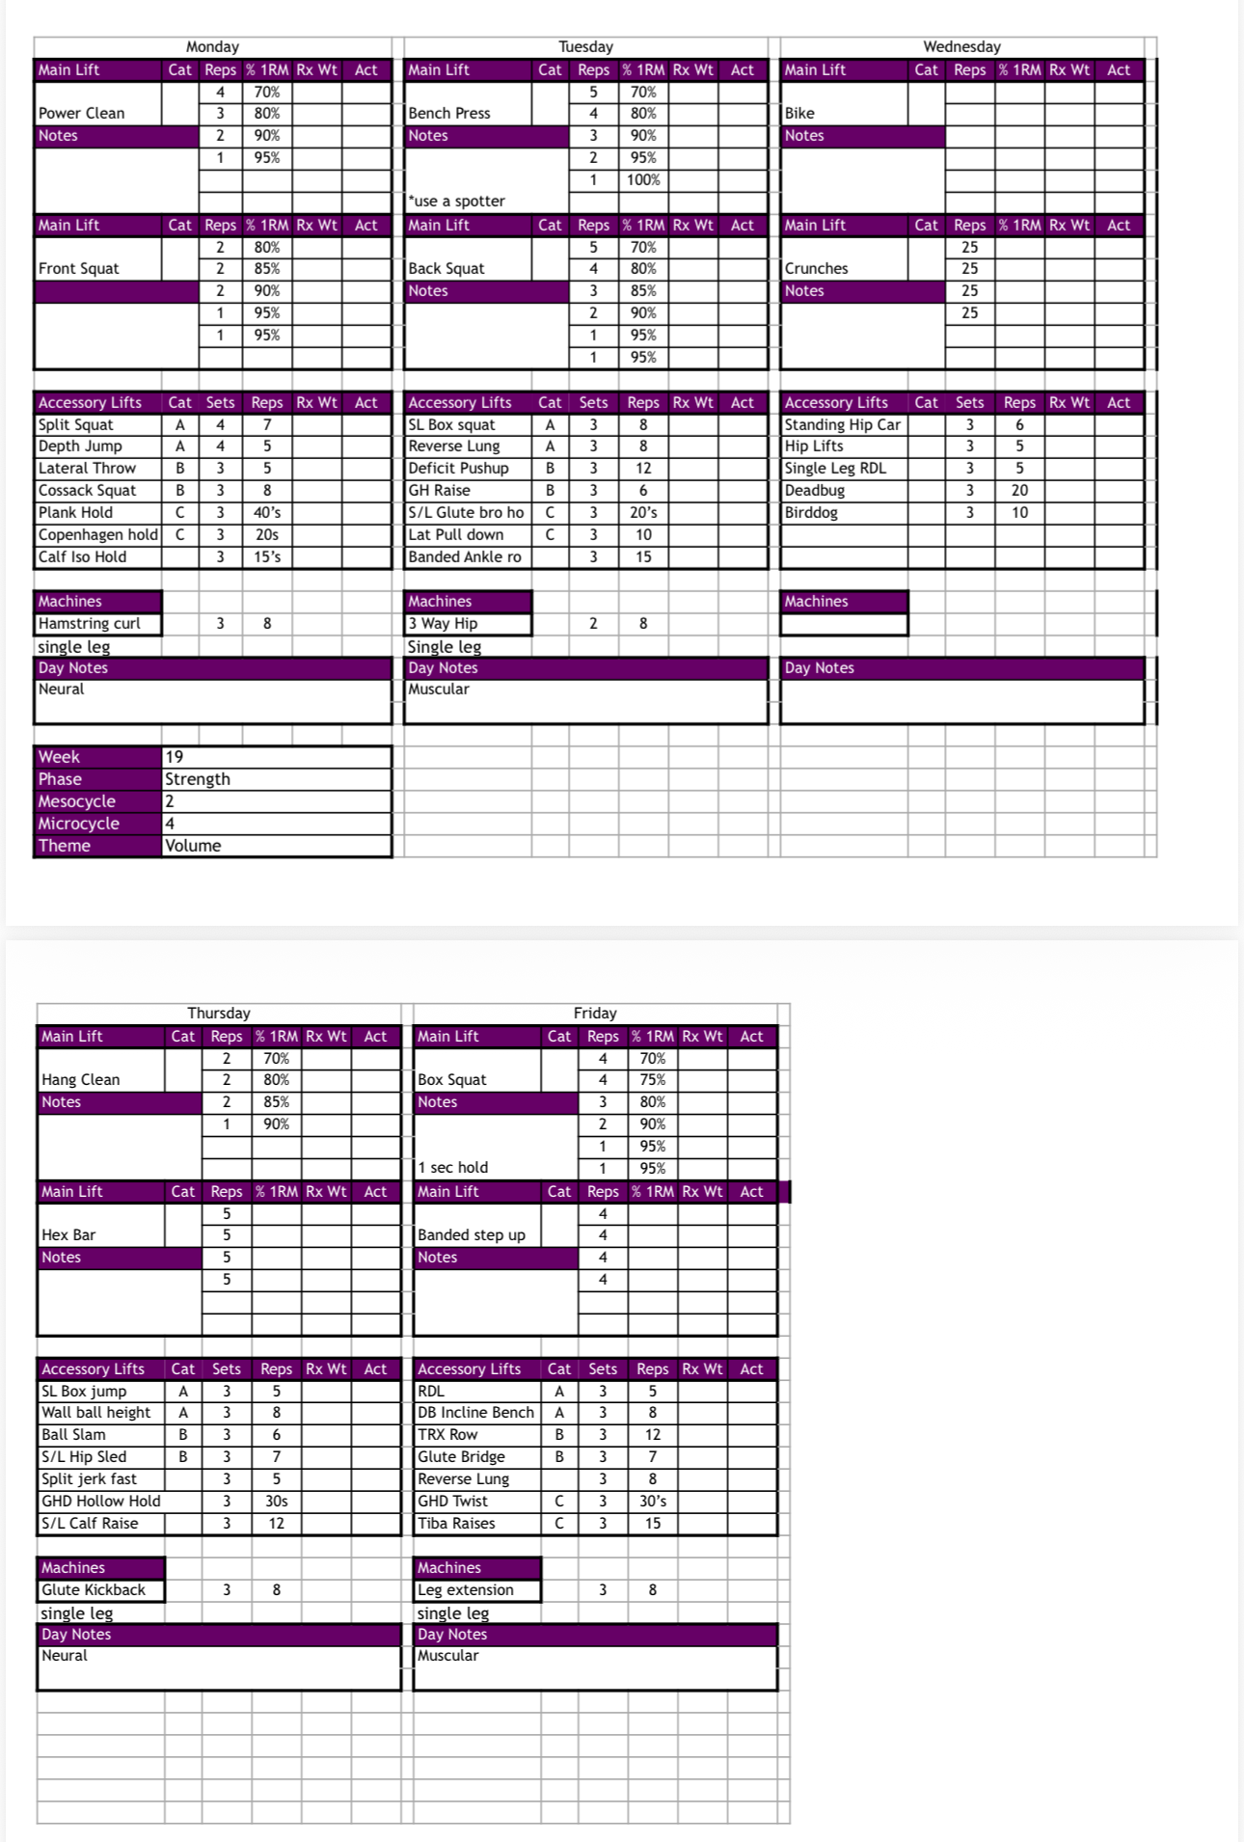

Slide 27
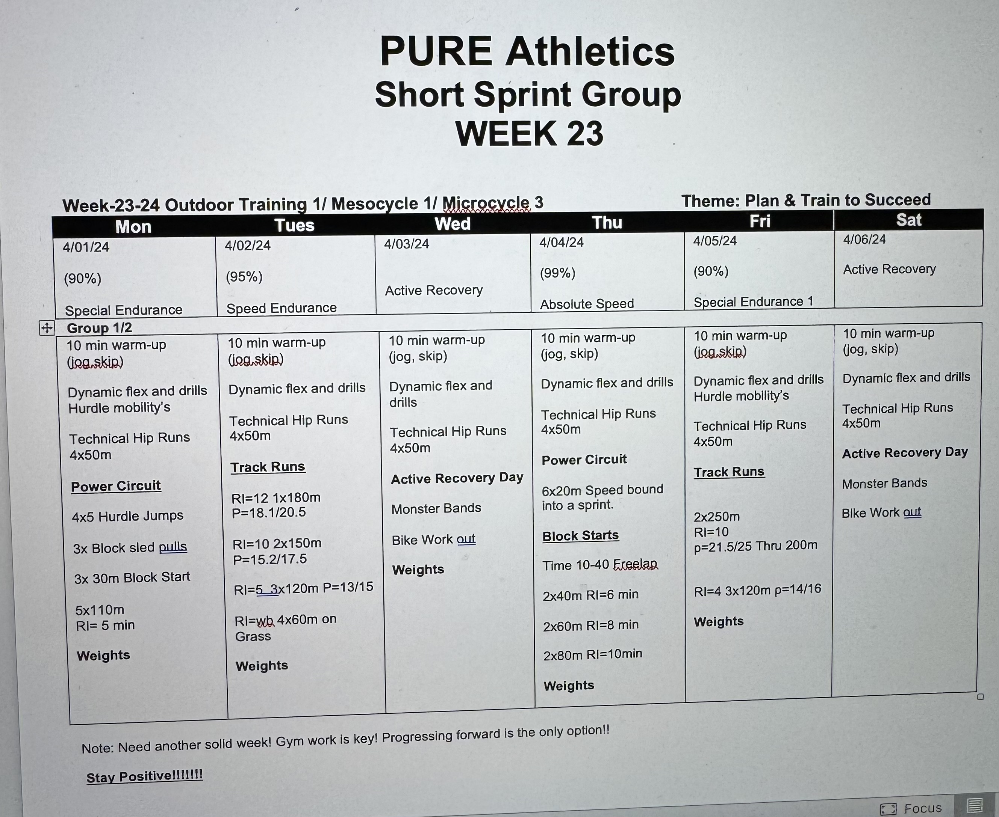

Slide 31
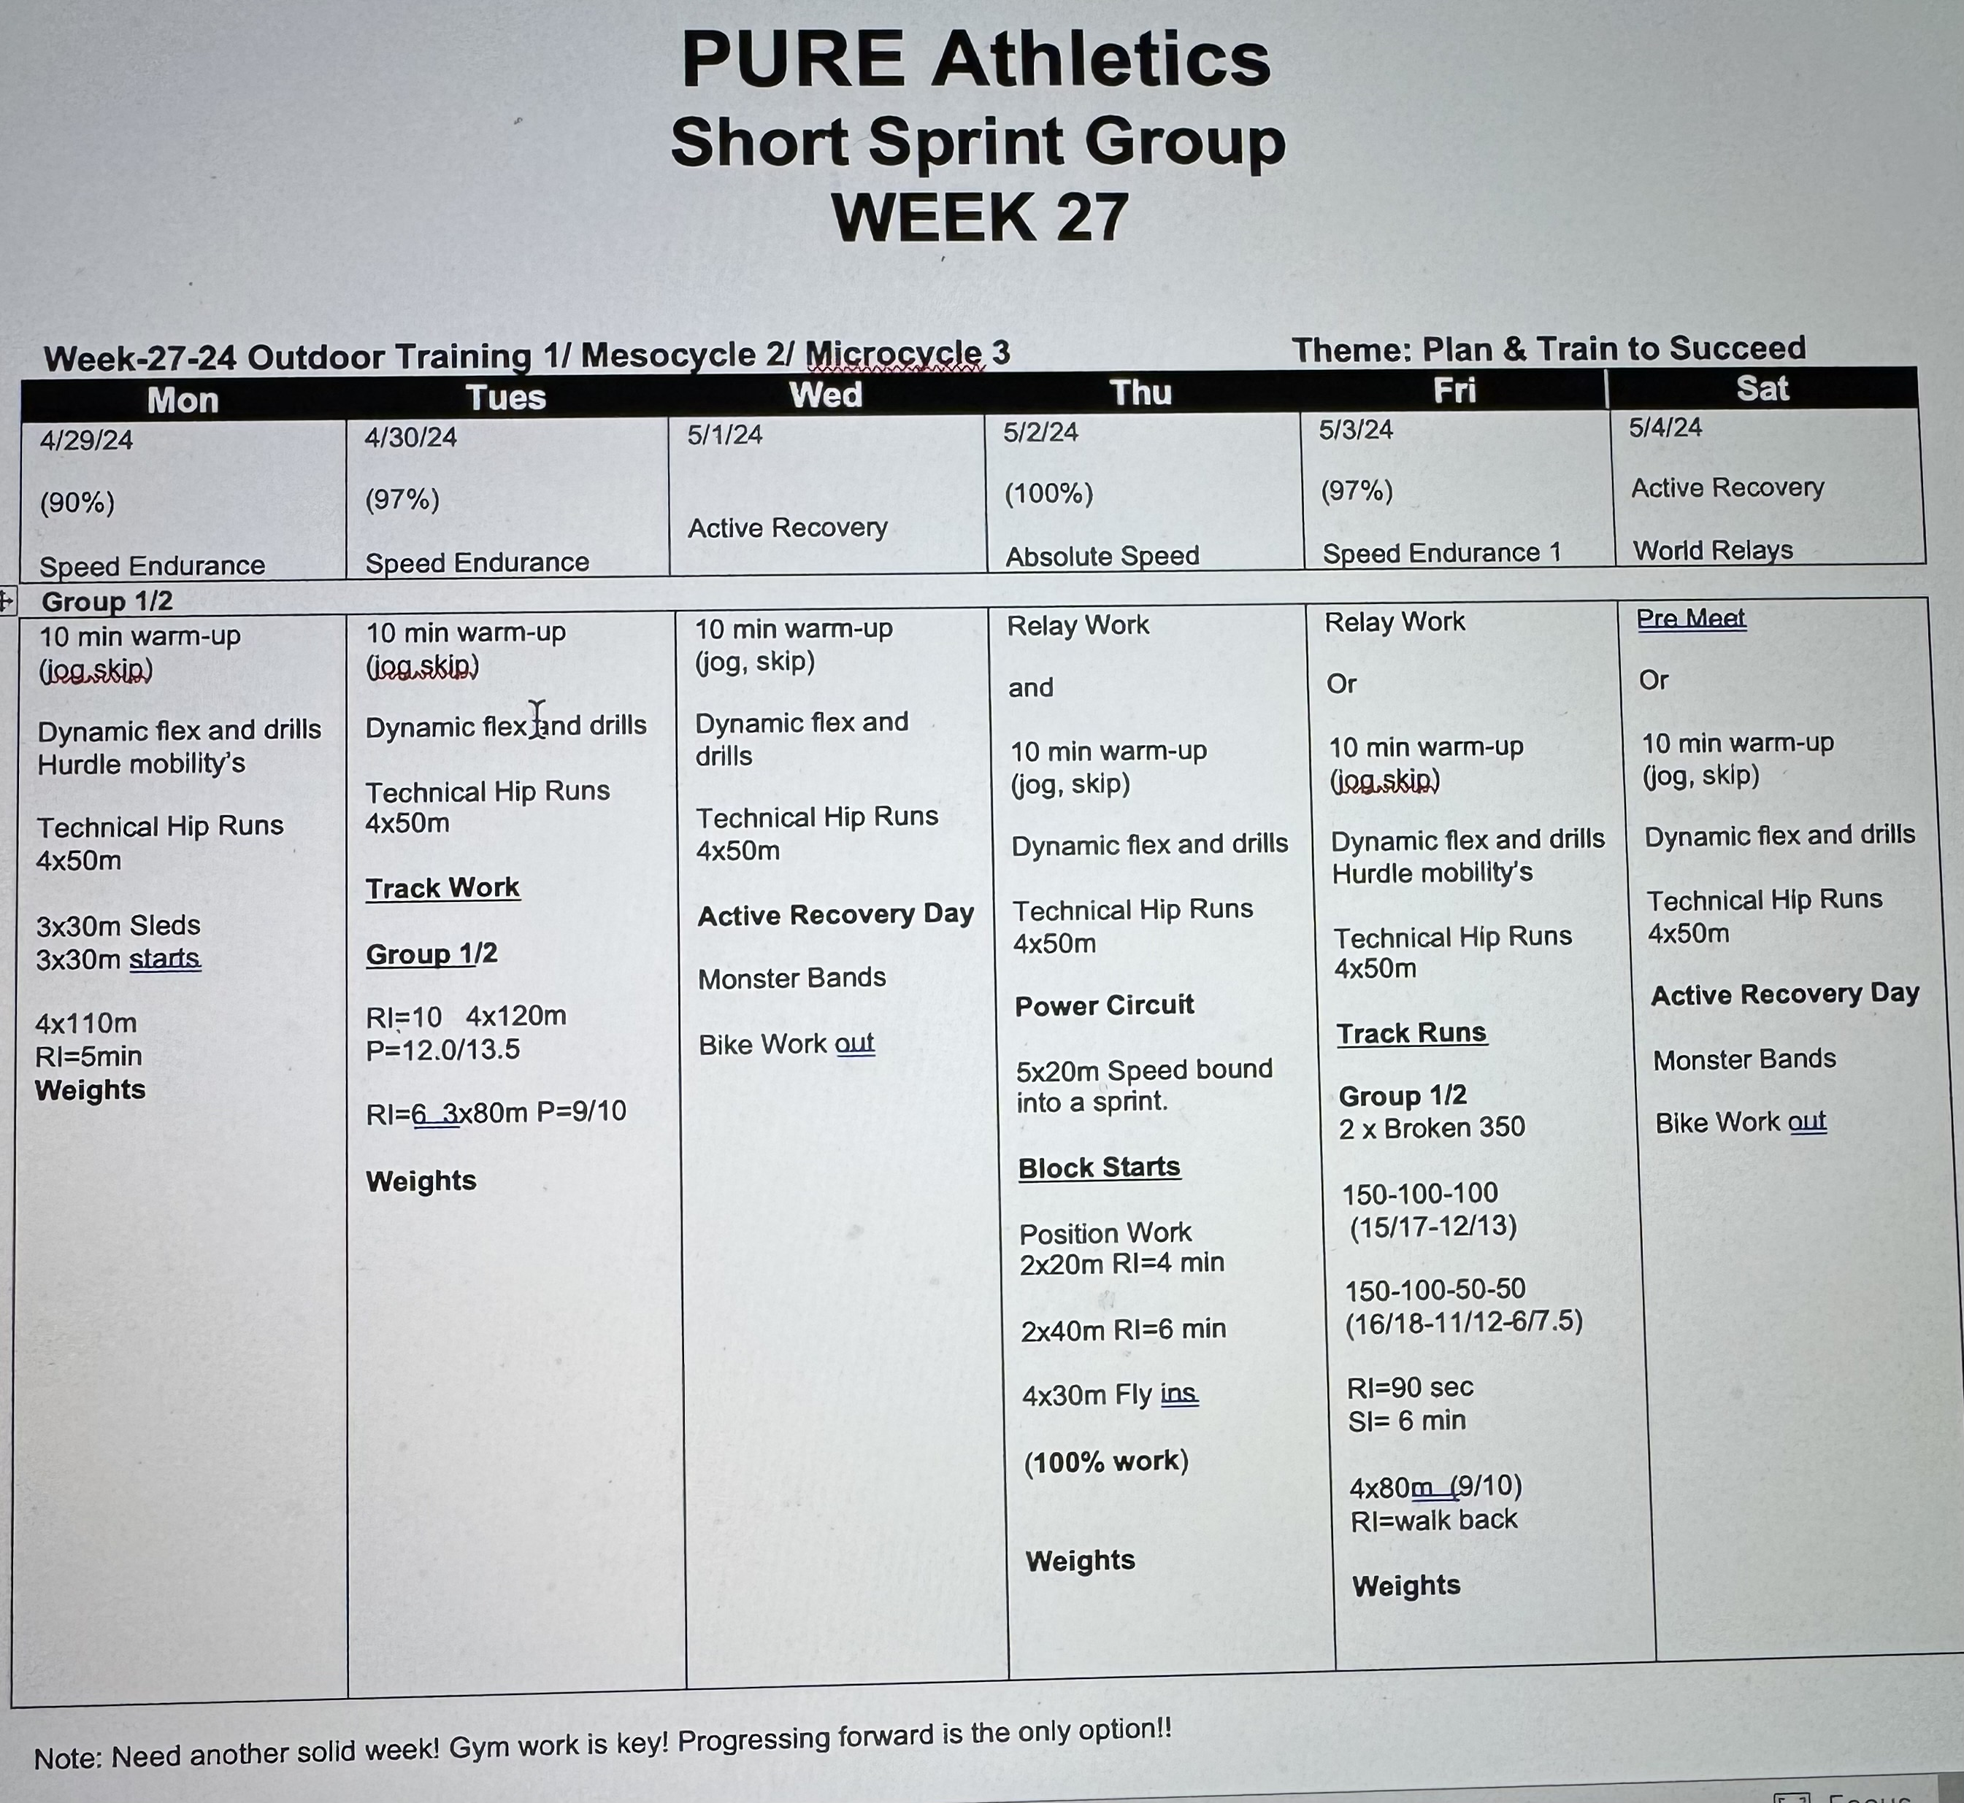

Slide 35
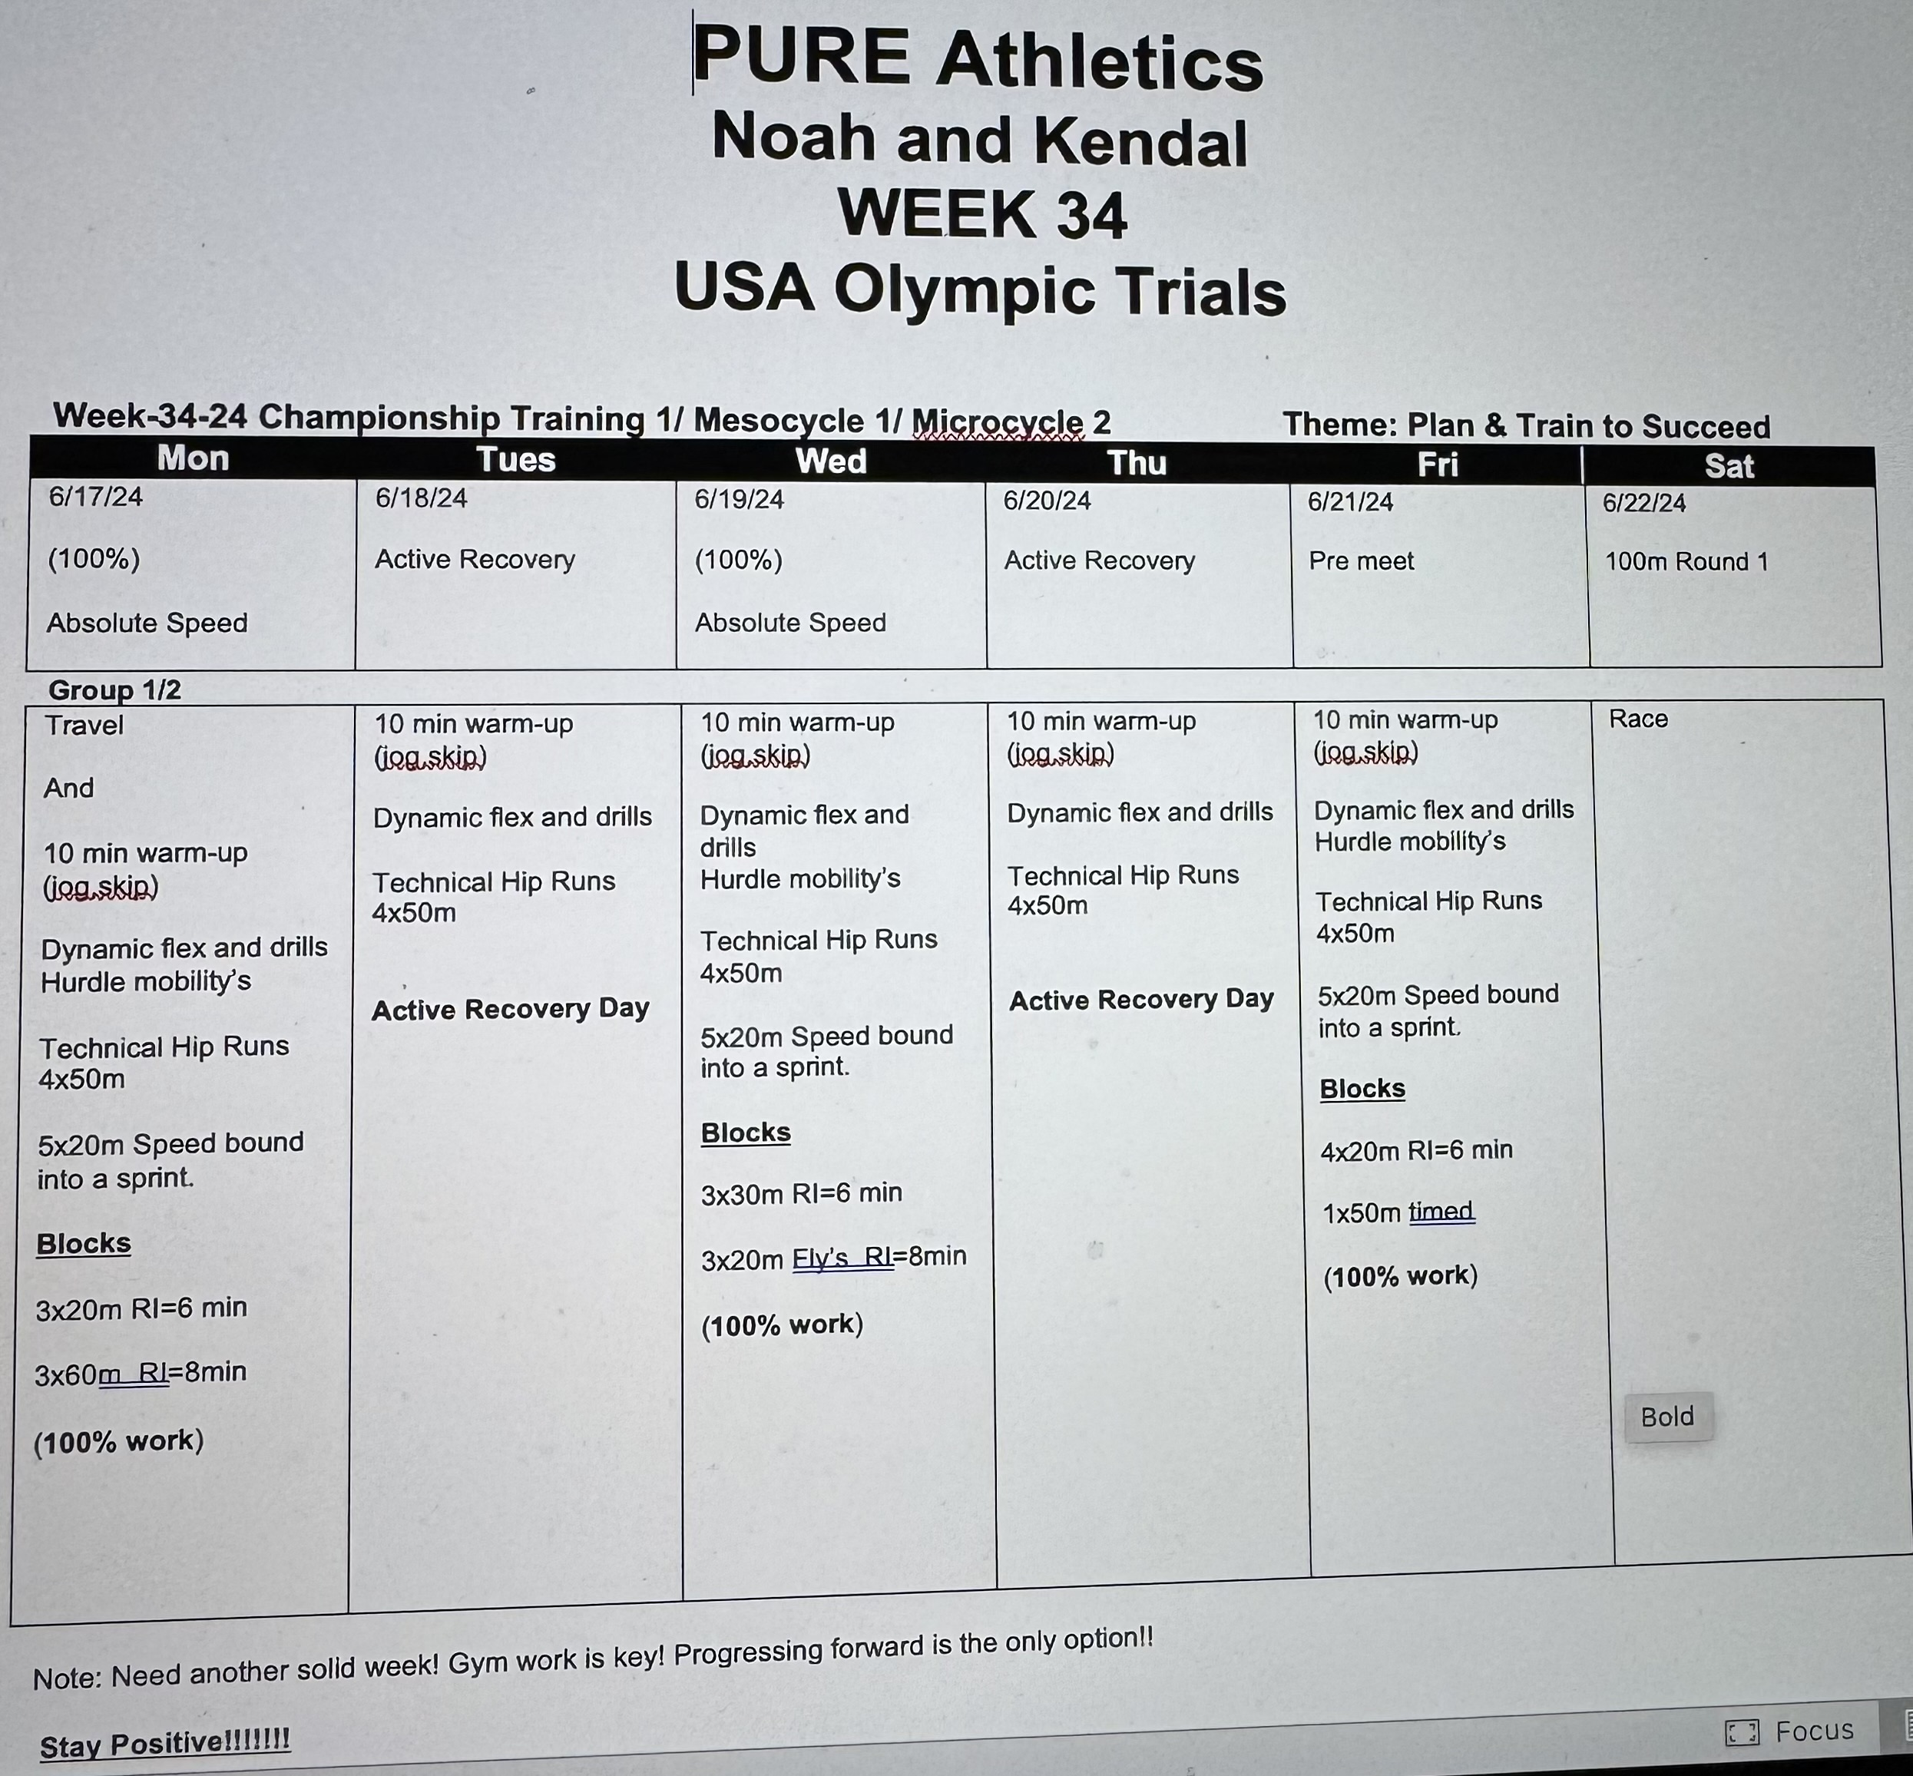

Slide 37
100/200m Training Examples
Weeks (1-3) General Training/Pre-Season
Monday | Tuesday | Wednesday | thursday | Friday | SAturday
10 min warm-up (jog,skip) Dynamic flex and drills Accleration’s 4x10 3x20m 2x30 8x120m (RI=2 min) Abs x 300 Cool Down (jog,skip) | 10 min warm-up (jog,skip) Dynamic flex and drills Hurdle Mobility’s 2 x 5 x 200m P=70% (RI=2min(SI=5min) Grass if possible Cool Down (jog,skip) | 10 min warm-up (jog,skip) Dynamic flex and drills Power Circuit 1) Alternate leg Bounds 2) Straight leg Bounds 3) Sleds 4) Box Jumps 5) Med ball throws 6) 6 x 60m Technical runs | 10 min warm-up (jog,skip) Dynamic flex and drills Blocks = 4 x 20 m Acceleration Sets 2 sets 4x60m Wickets Cool Down | Warm-up and Drills Dynamic flex and drills Hurdle Mobility's 300m 200m 100m 200m 100m RI=3 min P=75% Abs x300 Cool Down | 10 min warm-up (jog,skip) Dynamic flex and drills 10 min run Abs x 300

Slide 38
100/200m Training Examples
Weeks (4-6) Competition Training/Early Season
Monday | Tuesday | Wednesday | thursday | Friday | SAturday
Warm-up and drill Accelerations 3 Point Drive outs 4 x 50m RI=6 2x220m p=85% RI=4 3x120m p=80% RI=WB 4x80m p=PF Abs x 300 | Warm-up and drills Hurdle mobilities 4 x 100m exchange work RI=3 6 x 150m P=70% 10 min cooldown | Mid week Meet Or Warm-up and drills Hurdle mobilities 2x60m in and outs Ladders = P= 15—14—13—12- 300-200-100-100 RI=5 min, 4 x 100m p= 13 Abs x 300 | Warm-up and Drills Blocks = 2 x 20m 2 x 40m 2 x 60m RI=6 4 x 110m p=85% Abs x300 | Warm-up and drills Hurdle mobilities 4 x 100m exchange work 1 x 400 The Hard way Cool down 10min | Weekend Meet

Slide 39
100/200m Training Examples
Weeks (7-9) Competition Training/Mid Season
Monday | Tuesday | Wednesday | thursday | Friday | SAturday
Warm-up and drill Accelerations Blocks 4 x 30m 2 x 50m RI= 5 min RI=8 2x180m p=90% RI=4 3x100m p=80% RI=WB 4x60m p=PF | Warm-up and drills Hurdle mobility's 4 x 100m exchange work RI=5 5 x 110m P=80% 10 min cool down Abs x 300 | Mid week Meet or Warm-up and Drills Blocks 3x30m form starts RI=8 1x220m p=90% RI=4 4x120m p=75% RI=WB 4x80m p=PF | Warm-up and Drills Acceleration Sets 2 sets 20-40-60m 4x150 RI=5 min P=75% Abs x300 | Warm-up and drills Hurdle mobilities 4 x 100m exchange work 1 x 400 The Hard way Cool down 10min | Weekend Meet

Slide 40
100/200m Training Examples
Weeks (10-12) Competition Training/Late Season
Monday | Tuesday | Wednesday | thursday | Friday | SAturday
Warm-up and drills Hurdle mobilities Acceleration Sets 2 sets 20-40-60m p=90% RI=6 4 x 110m p=80% Cool down 10 min | Warm-up and drills Accelerations 3 x 30m fly ins Event run blocks RI=10 1x180 p= 95% RI=8 2x120 p= 95% RI=4 4 x 60m p= pr Abs x 300 5 min cool down and easy flex | Warm-up and drills Hurdle mobilities 4 x 100 exchange work RI=5 2 x 3 x 60m SI=10 P=80-90% Med balls and Abs Cool down and flex | Warm-up and Drills Accelerations Blocks 4 x 30 m Blocks RI=10 1x120m p=95% RI=10 1x80m p=90% RI= WB4x60m p= pr Abs x 300 5 min cool down and easy flex | Warm-up and drills Hurdle mobilities 4 x 100 exchange work And Pre meet shake out | Weekend Meet

Slide 41
100/200m Training Examples
Weeks (13-16) Competition Training/
Championship Season
Monday | Tuesday | Wednesday | thursday | Friday | SAturday
Warm-up and drill Accelerations Blocks 4 x 30m 2 x 50m RI= 5 min 4 x 80m p= 85% Cool down 10 min | Warm-up and drills Hurdle mobilities Accelerations 3 x 30m RI= Full Event run RI=10 1x120 p= 95% RI=10 2x80 p= 90% RI=4 4 x 60m p= pr Abs x 300 5 min cool down | Warm-up and drills Hurdle mobilities 4 x 100m exchange work 1 x 400 The Hard way Cool down 10min | Warm-up and Drills Hurdle mobilities Blocks 3 x 30m RI= Full RI= 8 2 x 60 p= 90% Abs x 300 5 min cool down and easy flex | Pre meet Shake out | Championship Week

Slide 42
400m Training Examples
Weeks (1-3) General Training/Pre-Season
Monday | Tuesday | Wednesday | thursday | Friday | SAturday
10 min warm-up (jog,skip) Dynamic flex and drills Power Circuit Accelerations 4x10m 3x20m 2x30m 10x200m (RI=2min) P=75% Abs x 300 15 min Cool down (jog,skip) | 10 min warm-up (jog,skip) Dynamic flex and drills Hurdle mobility’s Technical Hip Runs 4x50m On Grass 4 x 45 sec run 4 x 60 sec run 4 x 45 sec run (RI=90sec)(SI=4min) Grass | 10 min warm-up (jog,skip) Dynamic flex and drills Hurdle mobility's Power Circuit Alternate leg Bounds 2) Sleds 3) Box Jumps 4) Med ball throws 5) 6 x 60m Group 2 add 6x150 RI= 4 min Pace= 70% | 10 min warm-up (jog,skip) Dynamic flex and drills Blocks = 4 x 20 m Acceleration Sets 2 sets 4x60m Wickets Cool Down 2 x 3 x 300m P=70% (RI=2min)(SI=5min) Grass if possible | 10 min warm-up (jog,skip) Dynamic flex and drills Hurdle mobility’s Technical Hip Runs 4x50m Grass Runs Set 1 3 x 45 sec run (RI=90 sec)(SI=4min) Set 2 3 x 30 sec run (RI=90 sec)(SI=4min) Set 3 6 x 150m (RI= 60 sec) 15 min Cool down (jog,skip) | 10 min warm-up (jog,skip) Dynamic flex and drills 15 min run

Slide 43
400m Training Examples
Weeks (4-6) Competition Training/Early Season
Monday | Tuesday | Wednesday | thursday | Friday | SAturday
Warm-up and drill Accelerations 2x60m Build ins 3 Point Drive outs 4 x 50m RI=6 2x350m p=85% RI=4 3x220m p=80% RI=WB 4x100m p=PF Abs x 300 | Warm-up and drills Hurdle mobilities 4 x 100m exchange work RI=3 6 x 200m P=70% 10 min cooldown | Mid week Meet or Warm-up and Drills Blocks = 2 x 20 m 2 x 40m RI=6 4 x 150m p=80% Abs x300 | Warm-up and Drills 4x60m in and outs Ladders = P= 85% 400-300-200-100 RI=5 min 4 x 100m p= 13 Abs x 300 | Warm-up and drills Hurdle mobilities 4 x 100m exchange work 1 x 400 The Hard way Cool down 10min | Weekend Meet

Slide 44
400m Training Examples
Weeks (7-9) Competition Training/Mid Season
Monday | Tuesday | Wednesday | thursday | Friday | SAturday
Warm-up and drill Accelerations Blocks 4 x 30m 2 x 50m RI= 5 min RI=8 1x420m p=90% RI=8 1x350m p=90% RI=4 3x180m p=80% RI=WB 4x100m p=PF | Warm-up and drills Hurdle mobility's 4 x 100m exchange work RI=5 6 x 150m P=80% 10 min cool down Abs x 300 | Mid week Meet or Warm-up and Drills Blocks 3x30m form starts RI=8 1x380m p=90% RI=4 4x120m p=75% RI=WB 4x80m p=PF | Warm-up and Drills Acceleration Sets 2 sets 20-40-60m 4x250 RI=5 min P=75% Abs x300 | Warm-up and drills Hurdle mobilities 4 x 100m exchange work 1 x 400 The Hard way Cool down 10min | Weekend Meet

Slide 45
400m Training Examples
Weeks (10-12) Competition Training/Late Season
Monday | Tuesday | Wednesday | thursday | Friday | SAturday
Warm-up and drills Hurdle mobilities Acceleration Sets 2 sets 20-40-60m p=90% RI=6 4 x 150m p=80% Cool down 10 min | Warm-up and drills Accelerations 3 x 30m fly ins Event run blocks RI=10 1x320 p= 95% RI=8 2x180 p= 95% RI=4 4 x 80m p= pr Abs x 300 5 min cool down and easy flex | Warm-up and drills Hurdle mobilities 4 x 100 exchange work RI=5 1 x 3 x 60m SI=10 P=80-90% RI=4 4 x 200 P=80% Med balls and Abs Cool down and flex | Warm-up and Drills Accelerations Blocks 4 x 30 m Blocks RI=10 1x220m p=95% RI=10 1x120m p=90% RI= WB4x60m p= pr Abs x 300 5 min cool down and easy flex | Warm-up and drills Hurdle mobilities 4 x 100 exchange work And Pre meet shake out | Weekend Meet

Slide 46
400m Training Examples
Weeks (13-16) Competition Training/
Championship Season
Monday | Tuesday | Wednesday | thursday | Friday | SAturday
Warm-up and drill Accelerations Blocks 4 x 30m 2 x 50m RI= 5 min 5 x 150m p= 85% Cool down 10 min | Warm-up and drills Hurdle mobilities Accelerations 3 x 30m RI= Full Event run RI=10 1x220 p= 95% RI=10 2x120 p= 90% RI=4 4 x 60m p= pr Abs x 300 5 min cool down | Warm-up and drills Hurdle mobilities 4 x 100m exchange work 1 x 400 The Hard way Cool down 10min | Warm-up and Drills Hurdle mobilities Blocks 2 x 30m RI= Full RI= 8 3 x 90 p= 90% Abs x 300 5 min cool down and easy flex | Pre meet Shake out | Championship Week

Slide 51
Thank You!

