Slide 1

Omgha Annual Meeting
April 18th, 2018

Slide 2
Agenda
Meeting Called to order
  Announcements by the President
Consent Business
  Approval of 2017Annual Minutes
Reports
  2017-2018 Reports
New Business
  Elections
Meeting Adjourned

Slide 3
Consent Business
  Approval of 2017 Annual Minutes
  2017-2018 Reports
    Treasurer’s Report
    Secretary’s Report
    VP House Report
    VP Girls Report
    VP Boys Travel Report
    ACE/Skills Report
    President’s Report

Slide 4
Treasurer’s Report
Tim Jacobs

Slide 5
Agenda
Philosophy
Highlights
Income Statement
Fundraising
Gambling
Gambling fund usage
The Future

Slide 6
Philosophy
We are a non-profit organization with a financial goal to charge current players for the current costs of hockey.

Slide 7
2017-2018
Highlights
Able to use an internal ice rate of $130/hour.
Integrated Schechter Dokken Kanter into the OMGHA financial process.
Implemented new iPad into the Osseo concession stand.

Slide 8
Financial Trends

Slide 9
Fundraising

Slide 10
Charitable Gambling
Cathy Cheatham– Gambling Mgr
Approximately $375K of profits expected this year
Gross Revenue over $10 million .
Five star rating with the Gambling Control Board
Addition of Maple Tavern site
Expect to continue to use these profits to offset OMGHA’s cost of hockey

Slide 11
OMGHA Usage Lawful Gambling Profits

Slide 12
Areas of Focus for 2018/2019
Continue to use the gambling proceeds to offset the cost of hockey for OMGHA families.
Osseo rink updates
Continue to develop a long term financial strategy for the association

Slide 13
Questions?

Slide 14
Secretary Report
Amy Lee Olson

Slide 15
Secretary's Report
Registrar’s—Kristy Gourley, Sunny Hamman & Michelle LaBorde
  Had a total of 1155 players registered for the 2017/2018 season,
  These three work with over 200 coaches and managers and are key to making sure everyone is able to step on the ice.
Ultimate Safety Meeting —Stacie Klitz & Tiffany Giese
  Ultimate Safety Meeting/Send off to State—held at Whirly Ball, had a decent turnout, but great comments on the location and the moved up date. Will work to give more notice next year, had location challenges.
Pictures—Jill Wente
  Reviewed other potential picture partners with small committee and decided to stick with Clix!
  Moved to on-line ordering this year. Although there were less orders, those who ordered spent more.
  Clix does a lot of extras for OMGHA—Santa Skate, Coaches pictures, State Pictures
  Clix! made a $600.00 donation to the scholarship fund

Slide 16
Secretary's Report
Volunteer Coordinators—Rochelle Giuliani & Tricia Leafblad
  These two work with every part of the Association—from pictures to coaches and tournaments to parades, they manage over 10, 700 volunteer hours!
  Please remember that our association operates solely on a volunteer basis. In order to provide quality programs and to create a positive, fun and a quality environment for our players, we need help from every participating family. Our policy is for every family to commit to at least 14 hours/credits of volunteer time for one player and 20 hours/credits for two or more players. Note: No Volunteer Hours required for Mini-Mite or Jr. Gold/U16 players.
  Remember to “like” OMGHA on Facebook and “follow” on Twitter for DIBs updates
Scholastic Achievement—Larysa Karkoc
  This years event will be held on Monday, April 23rd at 7pm at Lord of Life Church.
  Will be giving away 4 Scholarships this year. OMGHA continues to support the Terry Gallagher Memorial Scholarship program
SportsEngine
  Please remember to keep your email updated in your NGIN profile, important to receive communications
  Merge your accounts if you have more than one, very easy to do!
  On line payments—can view in profile if you do not receive emails
Thank you!
  It has been a privilege to serve as the OMGHA Secretary
  Will continue to “see you at the rink!”

Slide 17
VP House Report
Chuck Sawicky

Slide 18

VP House Report
House Committee
VP House – Chuck Sawicky Supermite Director – Vic Nelson
Mite Director – Dan Eveland Girls House Director – Brian Grant
Mini-Mite Directors – Nick Pederson Goalie Director – Aric Stienenson
Recruiting – Jason Bauerly Scheduler – Dani/Matt Margenau
Register – Sunny Hamman and Michelle Laborde
Supermite Director – Vic Nelson
Register – Sunny Hamman and Michelle Laborde
House Mission – Hockey Culture
Grow the Game
Grow the Passion
Develop Hockey Players
Promote Safety
Maintain current numbers
Retention rates of over 90%
Leverage ADM model/provide traveling with skilled players who love hockey
Included in all aspects of program
Growth
Level # Teams
Supermites 12
U8 6
Mite 2 6
Mite 1 6
Girls Mites 4
Mini-Mites 2
Total 36
 | 2011-2012 | 2012-2013 | 2013-2014 | 2014-2015 | 2015-2016 | 2016-2017 | 2017-2018
Total Players | 392 | 402 | 451 | 499 | 530 | 543 | 542

Slide 19
VP House Report
Recruiting
Maple Grove and Osseo Parade
Marketing Road Signs, Rink Posters and School Flyers
Try Hockey for Free (6 Events) and New Player Clinics (8 Events)
Letterman Promotions and Early Registration T-shirts
Free Hockey for Girls
SM (173) / U8 (69) / Mite 2 (97) / Mite 1 (83) / Girl (53) / Mini-Mites (67)
Operations
Team Designations and Jerseys
3 on 3 League (Fall and Spring)
HEP (200+ players in 5 hours)
Communication Meetings (Coaches and Managers)
Coach Selection
Outdoor Ice – Rink Rats and Practice
Jamboree – Friday/Saturday/Sunday
Olympic Event, Mini-Tin Bin, The “Show”, Wayzata crossover 3v3
High School Game Events
Skill Development
Total Ice Time: SM/U8 50 Hours, Mite I/II/Girl Mite 40 Hours, Mini-mites 20 Hours
On-Ice Coach Training (Director)
Practice Planning – ADM Model (station based, small area games), standard practice plans
Goalie Training (6 sessions)
Individual Skills Training
3o3 Ice

Slide 20
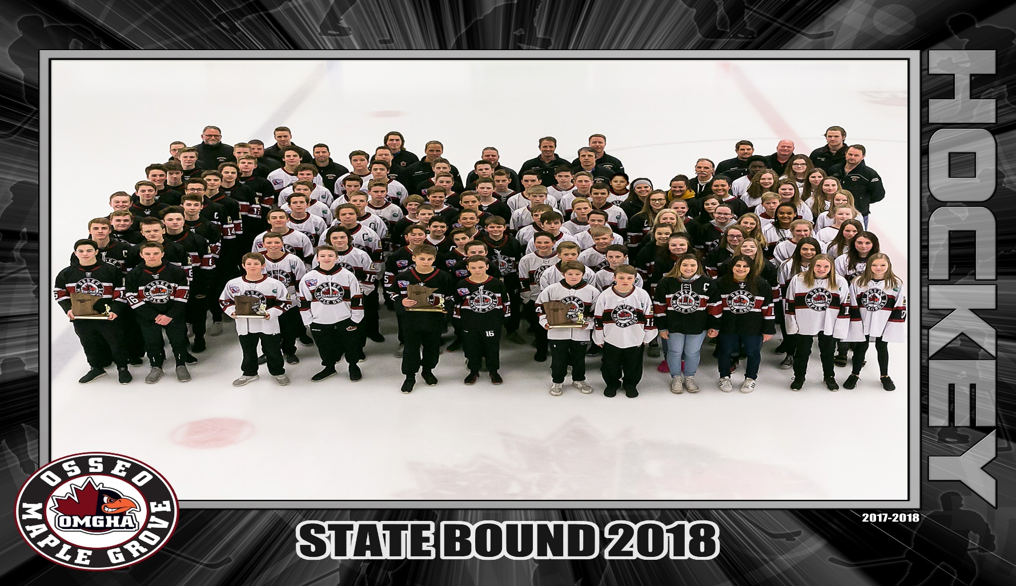
2018 OMGHA State Teams
BAA, BB1, PWAA, PWA, U19, U15B

Slide 21
VP Girls Traveling Report
Chad Wieneke

Slide 22
VP Girls Traveling Report
  Girls Travel Committee
    VP – Chad Wieneke
    Level Directors
      Lisa Albers – U10
      Jeff Allen/Jeremy Lewis– U12
      Bethany Winter – U15/U19
    Involved in the following:
      Tournament selection
      Pre-tryout camps
      Tryouts/team formation
      Communication and oversight throughout the season

Slide 23

VP Girls Traveling Report
2017/18 Recap
  Major accomplishments for this year
    We had 314 girls playing hockey in OMGHA this past year!
    “Hockey Day Minnesota Event” at MG/OPC high school game
    Overall the season went well with very few significant issues, which is a credit to our coaches, players and parents
  Region/State Tournaments
    U19–State Runner-up
    U15A – Participated in Regions
    U15B – State 4th Place
    U12A– Participated in Regions

Slide 24
VP Girls Traveling Report
Looking forward
  Priorities for next year
    Continue to grow the girls program
    Fine-tune tournament selection
    Continue to partner with D3 with focus on team formation

Slide 25
VP Boys Traveling Report
Adam Reiter

Slide 26
VP Boys Traveling Report
  Travel Committee (VP – Adam Reiter and Level Directors – Bret Caywood/Squirts, Colin Steen/Peewees, Kurt Halstrom/Bantams, Richard Dean/Jr Gold)
    Clear mission and goals
    Competitive Team Formation
    Continued tryout process improvement
    Parent/Player Code of Conduct
    Coach investment/Resource development
    Ice Time Needs
    Tournament selection
    Parent Communication/Transparency
    Junior Gold
    Association culture and investment in the future

Slide 27
VP Boys Traveling Report
  Teams
    Squirts
    Peewee
    Bantam
    JrGold
  Region/State Tournaments
    Bantam AA – State Champion
    Bantam A – Region 3rd place
    Bantam B1 – State Runner Up
    Peewee AA – State Consolation
    Peewee A – State 4th place
    Peewee B1 – Region 3rd place

Slide 28
VP Boys Traveling Report
  A Look Ahead
    Building our culture – Coaches, Players, Parents
    Competitive Team Formation
    Ice Needs/Scoping the future
    Modernizing OMGHA
    Investing in our assets
    Junior Gold
    Tryouts
    Tournament Selection
    Parent/Player Code of Conduct enforcement
    Coaching Resources/Investment
    Communication/Transparency

Slide 29
ACE Report
Luke Johnson (presented by Jay Picconatto)

Slide 30
ACE – Skills Development Mission
OMG’s mission is to provide our young athletes with world class training instruction, instructors, and facilities, that allow our athletes to fulfill their potential, while making the game of hockey challenging, safe, and fun for each individual player!

Slide 31
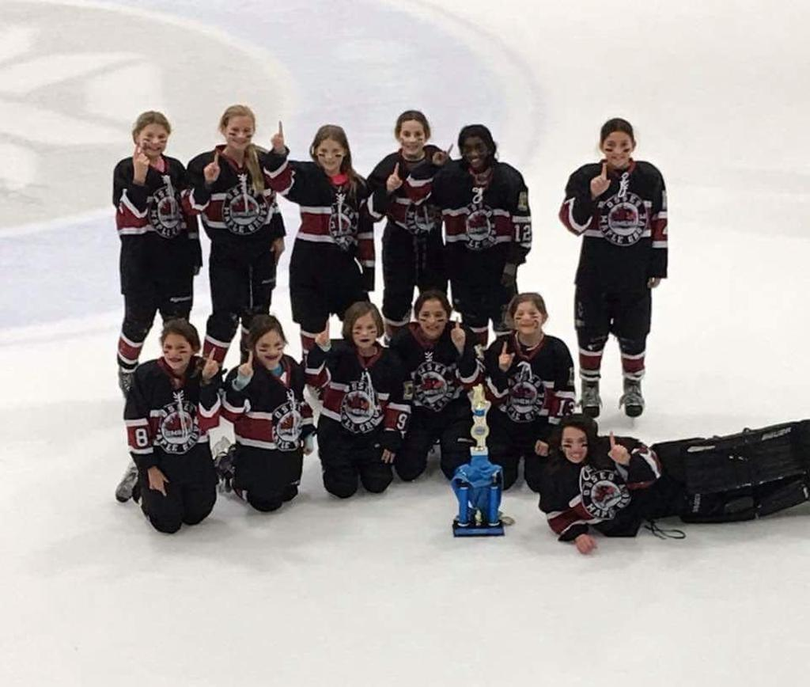
ACE – Areas of Focus
Player Development
  On-Ice Skill Development
  Off-Ice Skill Development/Injury Prevention
  Hockey IQ
  Leadership Skills
Coach Selection and Development
  Coach Selection:
    Coaching Director position
    Early identification of coaching candidates
    Annual survey for feedback and improvement
  Coach Development:
    Pre-season coaches meeting & instruction
    Coach resources and tools: Practice plans, Hockeyshare, Drill videos

Slide 32
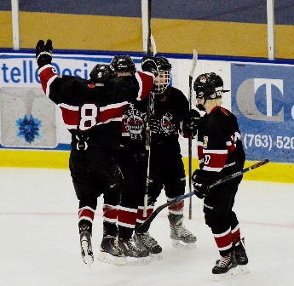
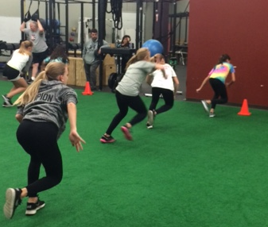
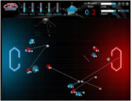
ACE – Player Development
Four Key Areas of Player Skill Development:
On-Ice Skill Development
  Focus: ADM Model, Skill nights, Coach Resources & Development, Outside Instructors
Off-Ice Athletic Development/Injury Prevention
  Focus: Facilities, External Instruction, Education
Hockey IQ Development
  Focus: Small Area Games, tech. investments (Hudl, Intelligym)
Leadership Skill Development
  Focus: Positive Coach Alliance, Community Involvement

Slide 33

Thank You! – For a Successful Season
Skill Development Directors
  Erik Kukkonen - Squirts, Jay Picconatto - Peewees, Mike Kernan - Bantams
  Jeff Allen - Girls
Travel Coaches
  Curtis Janicke - Coaching Director
  104 Coaches for 26 Boys Travel Teams
  45 Coaches for 10 Girls Travel Teams
Managers & Registrars
  50 Managers for 36 Boys and Girls Travel Teams
  Christy Gourley, Sunny Hamman, Michelle LaBorde
On and Off-Ice Trainers
  David Prokop - EuroAmerican, Casey Rooney - ReadReact, Zach Sikich - Pro-Hybrid, Ally Altman – Devenir, Josh Hutton - BE-FIT, Matt Kelley - 3O3

Slide 34
President’s Report
Rob Borsch

Slide 35
President’s Report – Year in review
Long-time volunteers
  Curtis Janicke (10 year board member)
  Kurt Halstrom (6 year board member)
  Tom Adolph (25 year coach)
  Amy Olson (6 year board member)
  Vic Nelson (4 year board member)
  Jeremy Lewis (6 year board member)
Survey Results
  Highest scores
    Coaches and Managers
    Player safety/conduct
    OMGHA is a strong hockey organization
  Lowest scores
    Goalie skills
    Follow OMGHA on Social Media, Website
    Tryout/Team Formation Communication
  Areas of change from Last Year
    Adequate ice time improved
    Pictures

Slide 36
President’s Report – Year in review
OMGHA’s most significant successes
  6 Teams to State – 3 in Championship games
  Balance of teams across levels
  Continued growth of participants
  Partnership and connection to all 4 HS programs
  Continued investment in coaching and skills
  5 U10 Girls teams!
Rink Work
  MGCC West Ice Improvements
  MGCC Branding
  Osseo Arena Branding

Slide 37
President’s Report – Looking ahead
Arenas
  Osseo Arena required work – OMGHA contribution
  Conversations with Maple Grove on looking at 3rd sheet
North Metro situation
Jr Gold Program
  Goal → Top 3 program in state within 3 years
Conduct, Safe Sport
  Locker Room policies firmed up (monitors, cell phones, etc)
Health and Safety
New Jersey’s
Team Formation Planning
Sponsorships/Marketing

Slide 38
New Business
Elections

Slide 39
Elections
    Review of Candidates
      Secretary
      VP Boys Traveling
      VP House
      ACE Coordinator
      Girls Director
      Boy Directors
      Girls House Director
    Collection of Ballots
    Results of elections announced

Slide 40
Meeting Adjourned
Thanks for attending
the 2018 OMGHA Annual Meeting

