Slide 1



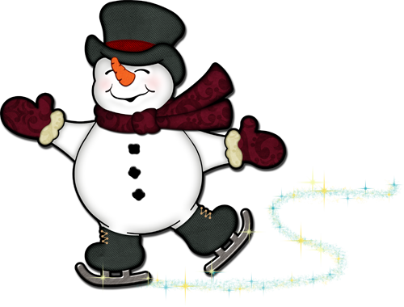
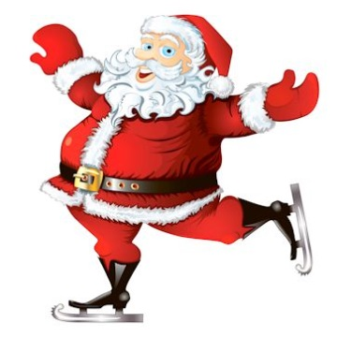
SKANEATELES LAKERS HOLIDAY SKATING CELEBRATION
Skate with the Lakers Girls and Boys Varsity Teams
~ and some special guests!
Wednesday, December 20th at 6:00 pm
Duke Arena, Skaneateles YMCA
Bring your skates and your helmet and skate with the
Laker Girls and Boys Teams!
And bring a non-perishable food item for the Skaneateles Ecumenical Food Pantry (cereal, crackers, canned pasta, soups are ideal)
There will be cocoa and treats, face-painting, games
and lots of skating!
Questions: Contact Karen Dunphy kdunphy257@gmail.com

