Slide 1
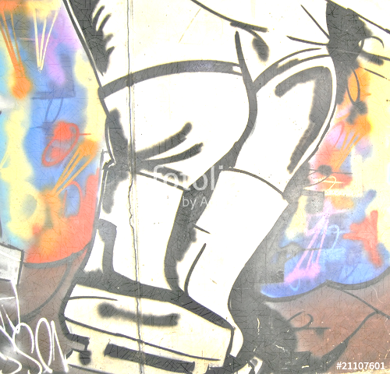

B Bantam Anthem
Now, this is a story all about how our lives got flipped-turned upside down And I'd like to take a timeout Just chill right there we'll tell you how these boys became PolarDevils. In St Paul, North St Paul born and raised On the ice and in rink is where they spent most of their days skatin, and passin, and deekin, all cool shootin some pucks off the line of blue When some coaches showed up and the boys got scared They Started teaching skillz and makin them do drills
They all got jerseys and all the mom’s cheered You're movin' down the ice with speed and no fear I whistled for the boys, to get movin faster Skates gotta get sharpened, raffles gotta be sold. The boys are shootin stronger and their checks are getting harder,
we thought, Hey D8, ‘We're movin' up the standings faster than last year

