Slide 1

NWBA Annual
Campaign Kit

Slide 2
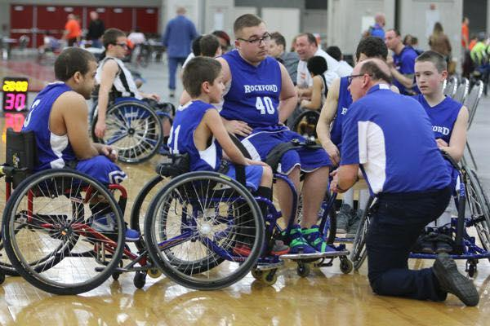
Introduction
The NWBA Annual Campaign is an opportunity for grassroots programs within the NWBA to raise funds to support their team/organization. The NWBA Annual Campaign will launch on October 13th, the start of National Wheelchair Basketball Week, and conclude November 22nd.
The National Wheelchair Basketball Week is a celebration of wheelchair basketball and the contribution the sport makes to local communities and our nation.

Slide 3
Overview
Participating teams will be supported by the NWBA with the NWBA Annual Campaign Kit. The kit outlines essential information for teams to successfully fundraise for their local program during National Wheelchair Basketball Week.
The NWBA Annual Campaign Kit will be shared with all teams registered for the 2017-18 NWBA season.
All funds raised during the NWBA Annual Campaign are retained by the teams.
Prizes will be awarded to top four performing programs during the campaign. Only funds raised during the NWBA Annual Campaign should reported.

Slide 4
Campaign Strategies
Set Goals
        Identify financial need for team and organization
        Goals should be both individual and team/program
Create Prospect List
  Family and Friends
  Local Business and Community Partners
  Identify team member with best rapport with prospect
Ensure Proper Accounting
  Identify a Campaign Chair
  Establish a system for processing funds collected. Ensure checks and balances.
  Use third party if necessary
    Rally Me page can sync to NWBA team page, contact Brandon McBeain at brandonmcbeain@nwab.org for more information.
Identify events or activities to boost support
  Select 3-4 activities from this kit to have the team participant in to ensure quality campaign.
Develop a Campaign Plan
  Assign lead contacts for each activity
Have Fun!

Slide 5
Prize Packages
Platinum Program Package
Six Molten Basketballs
Molten Ball Bag
Practice Jerseys
T-shirts
Gold Program Package
Four Molten Basketballs
Molten Ball Bag
Practice Jerseys
Silver Program Package
Four Molten Basketballs
Bronze Program Package
Two Molten Basketballs
To be eligible for prize packages you must first complete a 2017 NWBA Annual Campaign Report, click here to complete or more info is on slide 36.

Slide 6
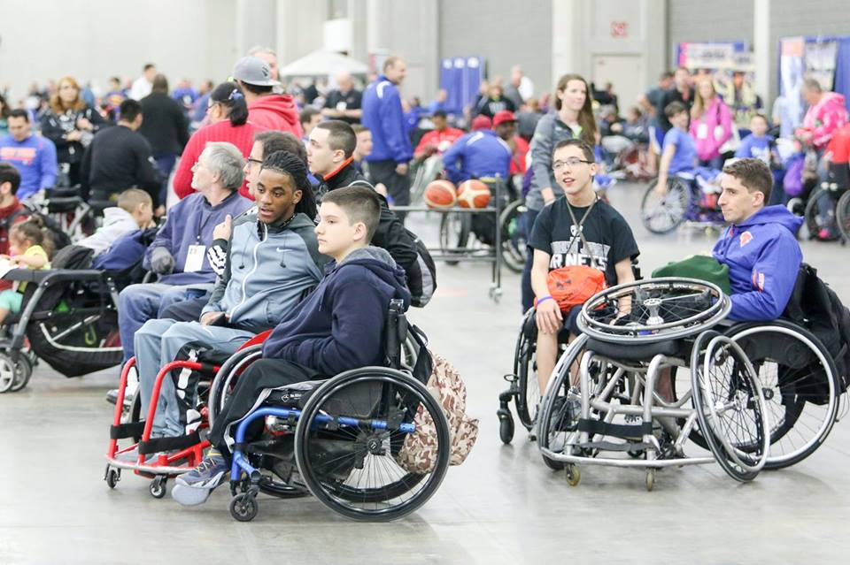
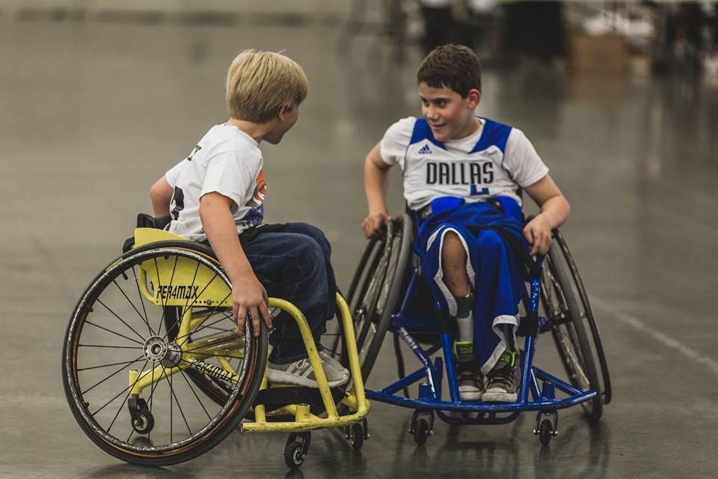
Activity Packages

Slide 7
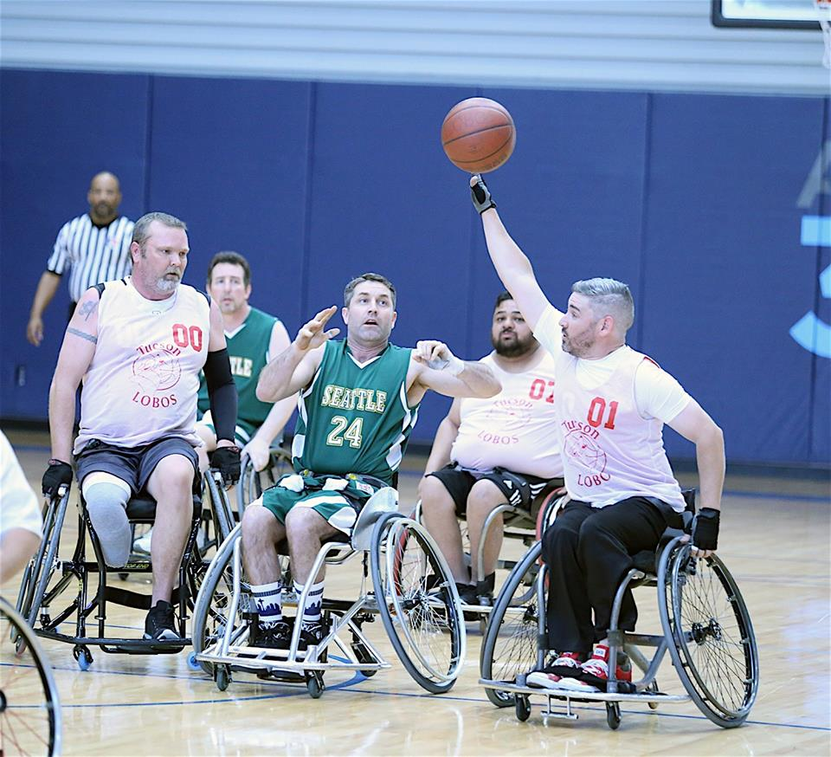
Shoot-A-Thon
Each player will shoot free throws (50-100 recommended), counting each made toward their individual total. As a sponsor of one athlete, you may pledge an amount per shot made (i.e. $1.00 per shot) or a lump-sum (i.e. $100 donation).

Slide 8
Shoot-A-Thon
Instructions
Each player will shoot free throws (50-100 recommended), counting each made shot toward their individual total. As a sponsor of one athlete, you may pledge an amount per shot made (i.e. $1.00 per shot) or a lump-sum ($100 donation).
One player will shoot at a time per basket. It will take approximately 15-20 minutes per basket for 100 shots.
For a group of 12-15 players with two baskets, it could take between 2-3 hours.
Additional baskets, if needed, may be used to speed up the process.
Have volunteers or other players rebound for shooting athlete.
Shots will be taken from the standard free throw line (15 ft.) and basket height (10ft.).
Prep Division players should use 8.5’ basket and 13.5’ free throw line.

Slide 9
Shoot-A-Thon Timeline
Planning & Prep Work
Inform team and participants
Secure a facility for event
Secure equipment and resources for event
Contact local partners to co-brand as event sponsors
Invite local media
Invite donors, program supporters or stakeholders to event
Day of Event
Welcome and Intro Event
Provide Rules to Participants
Conduct Shoot-A-Thon
Recap Presentation; announce results and total funds raised
Distribute Awards; distribute copies of Outstanding Performer Certificate to top three participants for each team
Following the Event
Send thank you notes to volunteers and participants
Send contribution letter to supporters who requested a letter.
Deposit funds to team banking account.
Report results to NWBA, by completing an NWBA Annual Campaign Recap Report on www.NWBA.org.

Slide 10
2017 (Organization) Shoot-A-Thon
In partnership with the NWBA Annual Campaign
When:
Where:
How To Support:
Sponsor a Player
Cheer on the Team
Attend the Event
How it Works:
Each player will shoot free throws counting each
made shot toward their individual total.
As a sponsor of one athlete, you may pledge an amount per shot
made (i.e. $1.00 per shot) or a lump-sum (i.e. $100 donation).
Contact Info:
Insert Team
Logo Here

Slide 11

2017-2018 NWBA Outstanding Performer
Presented to:
For participating and excelling in the
2017 (Organization Here) SHOOT-A-THON
in partnership with the NWBA Annual Campaign.
______________________
Event Director
Anthony Bartkowski
Executive Director of NWBA

Slide 12
Pledge Form
Shoot-A-Thon
Insert Team
Logo Here
(Insert Participant’s Name)
Name/Phone | Pledge Per Shot Made (ex. $1.00 per shot) | Lump-Sum Donation (ex. $100 donation)

Slide 13
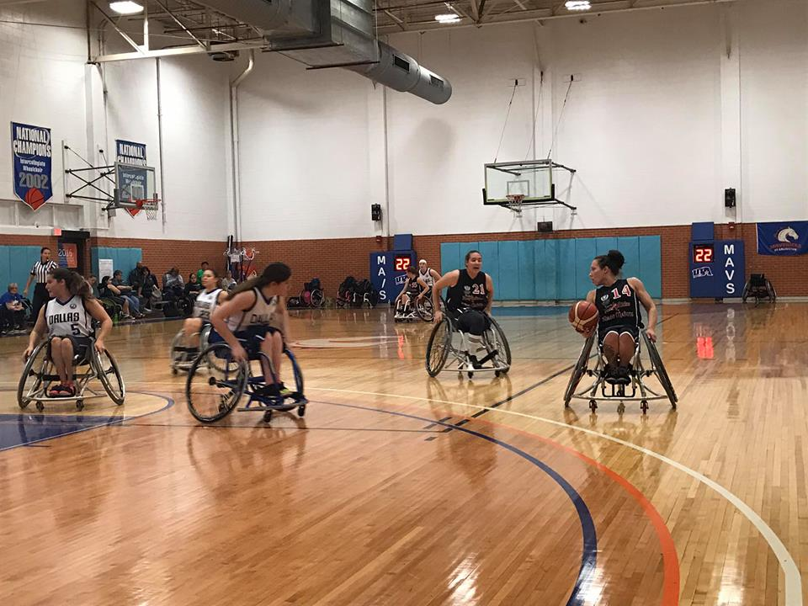
Push-A-Thon
Each player will push in their sports wheelchair continuously conducting down-n-backs for as long as possible. As a sponsor of one athlete, you may pledge an amount per minute pushing (i.e. $1.00 per minute) or a lump-sum (i.e. $100 donation).

Slide 14
Push-A-Thon
Instructions
Each player will push in their sports wheelchair continuously conducting down-n-backs for as long as possible. As a sponsor of one athlete, you may pledge an amount per minute pushing (i.e. $1.00 per minute) or a lump-sum ($100 donation).
Depending on how many players you have, the distance of how many down-n-backs may change to have more players participate at one time. Possible distances could be baseline to baseline, sideline to sideline, or baseline to half court.
Players may extend to open space off the court to fit more participants.
Adequate space is required for safe turning.
Players will push in a straight line to the decided distance, through the line, turn in place, and push back in a straight line.

Slide 15
Push-A-Thon Timeline
Planning & Prep Work
Inform team and participants
Secure a facility for event
Secure equipment and resources for event
Contact local partners to co-brand as event sponsors
Invite local media
Invite donors, program supporters or stakeholders to event
Day of Event
Welcome and Intro Event
Provide Rules to Participants
Conduct Push-A-Thon
Recap Presentation; announce results and total funds raised
Distribute Awards; distribute copies of Outstanding Performer Certificate to top three participants for each team
Following the Event
Send thank you notes to volunteers and participants
Send contribution letter to supporters who requested a letter.
Deposit funds to team banking account.
Report results to NWBA, by completing an NWBA Annual Campaign Recap Report on www.NWBA.org.

Slide 16
2017 (Organization) Push-A-Thon
In partnership with the NWBA Annual Campaign
When:
Where:
How To Support:
Sponsor a Player
Cheer on the Team
Attend the Event
How it Works:
Each player will push in their sports wheelchair continuously
conducting down-n-backs for as long as possible.
As a sponsor of one athlete, you may pledge an amount per minute pushing (i.e. $0.50 per minute) or a
lump-sum (i.e. $20 donation).
Contact Info:
Insert Team
Logo Here

Slide 17
2017-2018 NWBA Outstanding Performer
Presented to:
For participating and excelling in the
2017 (Organization Here) PUSH-A-THON
in partnership with the NWBA Annual Campaign.
______________________
Event Director
Anthony Bartkowski
Executive Director of NWBA

Slide 18
Pledge Form
Push-A-Thon
Insert Team
Logo Here
(Insert Participant’s Name)
Name/Phone | Pledge Per Minute (ex. $1.00 per minute) | Lump-Sum Donation (ex. $100 donation)

Slide 19
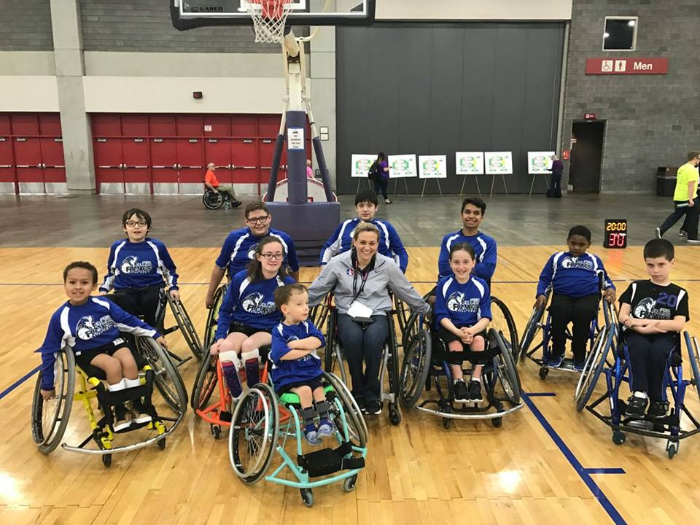
Dribble-A-Thon
Good alternative to Shoot-A-Thon for Prep athletes unable to make basket
Each player will dribble a ball continuously for as long as possible. As a sponsor of one athlete, you may pledge an amount per minute dribbling (i.e. $0.50 per minute) or a lump-sum (i.e. $20.00 donation).

Slide 20
Dribble-A-Thon
Instructions
Good alternative to Shoot-A-Thon for Prep athletes unable to make basket.
Each player will dribble a ball continuously for as long as possible. As a sponsor of one athlete, you may pledge an amount per minute dribbling (i.e. $1.00 per minute) or a lump-sum ($100 donation).
Players will be stationary to avoid collisions with other players.
If a player messes up dribbling, they may chase after the ball, but must start dribbling immediately.
As many players can participate as space allows comfortably. As a stationary activity, any on court or off court space in the gym facility may be utilized.

Slide 21
2017 (Organization) Dribble-A-Thon
In partnership with the NWBA Annual Campaign
When:
Where:
How To Support:
Sponsor a Player
Cheer on the Team
Attend the Event
How it Works:
Each player will dribble a ball continuously for as long as possible.
As a sponsor of one athlete, you may pledge an amount per minute dribbling (i.e. $1.00 per minute) or a
lump-sum (i.e. $100 donation).
Contact Info:
Insert Team
Logo Here

Slide 22
2017-2018 NWBA Outstanding Performer
Presented to:
For participating and excelling in the
2017 (Organization Here) DRIBBLE-A-THON
in partnership with the NWBA Annual Campaign.
______________________
Event Director
Anthony Bartkowski
Executive Director of NWBA

Slide 23
Pledge Form
Dribble-A-Thon
Insert Team
Logo Here
(Insert Participant’s Name)
Name/Phone | Pledge Per Minute (ex. $1.00 per minute) | Lump-Sum Donation (ex. $100 donation)

Slide 24
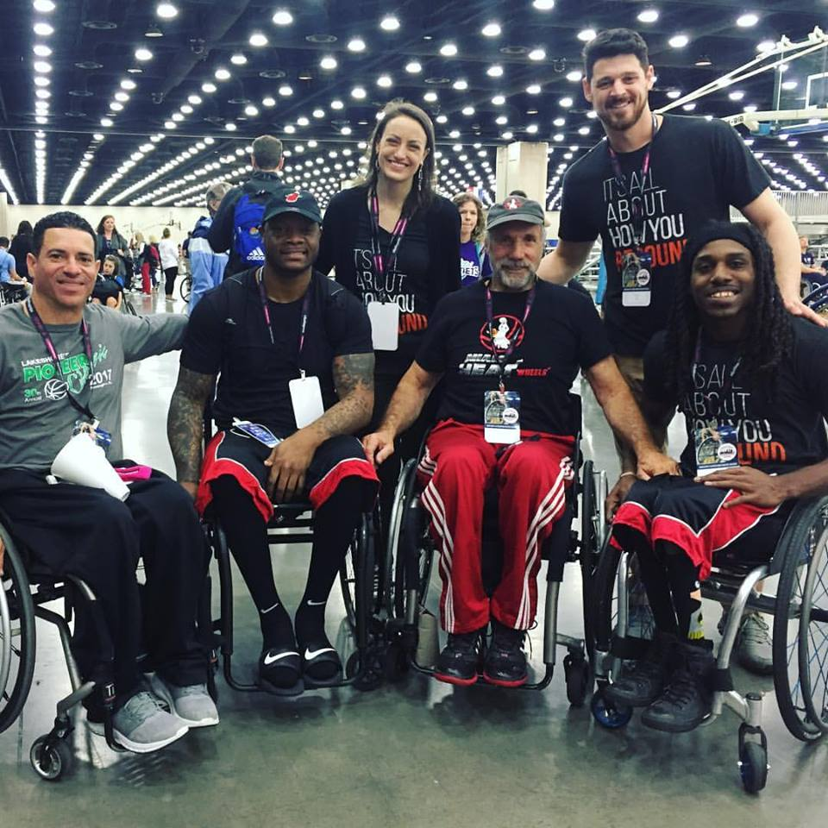
Group Wheelchair
Basketball Experience
Invite a local businesses or groups for a fun, active, educational and team-building opportunity. The event includes a brief introduction to the sport, skills and drills stations and a scrimmage game. This event can help to further engage with current partnerships or an event to purpose to prospective corporate partners.

Slide 25
Group Experience
Instructions
Solicit Group Experience
Contact individuals, business, partners and groups from your Prospect List.
Suggested donation for experience would be $250 to $1,000 based on event details and logistics.
Utlize group’s on-site facility if possible or host at your teams practice facility.
Experience Instructions
A provide group a brief overview of the sport and organization. Basic, surface level, rules should be talked about. Involve program players and coaches to provide instruction.
Depending on the size of the group, you can split into two smaller groups on each half of the court. One small group can work on one skill while the other group works on another. Switch sides after a given length of time. Introduction to the following skills should included: pushing, dribble, shooting, passing and basic rules.
Bring the group back together to break into teams for a 5 vs. 5 full court scrimmage. Use half court for lower skill levels. Limit infractions called to decrease stoppages in gameplay; instruction should be provided instead.
Suggested donation for experience would be $250 to $1,000 based on event details and logistics.

Slide 26
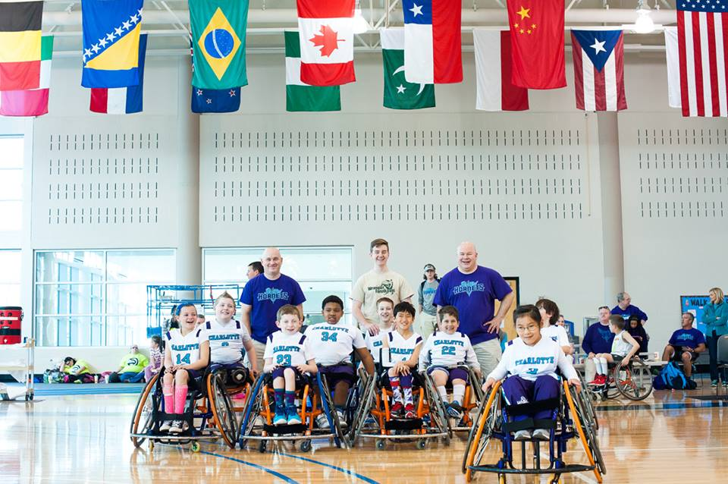
Wheelchair Basketball
Mini Tournament
Invite local businesses or groups to participate in a wheelchair basketball mini-tournament. Include brief introduction prior to competition. Focus of the tournament should be generating awareness for the sport of wheelchair basketball and team play for groups participating in a friendly competition.

Slide 27
Mini Tournament
Instructions
This event should be a basic tournament or competition presentation to minimize cost. Should be scheduled as one-day event; likely 2-4 hours to complete (depending on teams/participants).
Provide each group of participants with a brief overview of the sport and organization. Basic, surface level rules should be covered. Allow participants to get used to the sports chair and practice their skills prior to competition.
Utlize program athletes and coaches to coach/officiate the games.
If there is only one organization, break it into multiple teams. If more than one organization is participating, split participants to ensure even number of teams. Set competition format to ensure at least two games for each team.
Provide winning team of competition with an award(s).

Slide 28
2017 (Organization) Wheelchair Basketball Mini Tournament
In partnership with the NWBA Annual Campaign
When:
Where:
How To Support:
Pay for your business or group to participate
Cheer on the Team
Attend the Event
How it Works:
A group of participants will break into teams for a 5v5 full court scrimmage.
Contact Info:
Insert Team
Logo Here

Slide 29
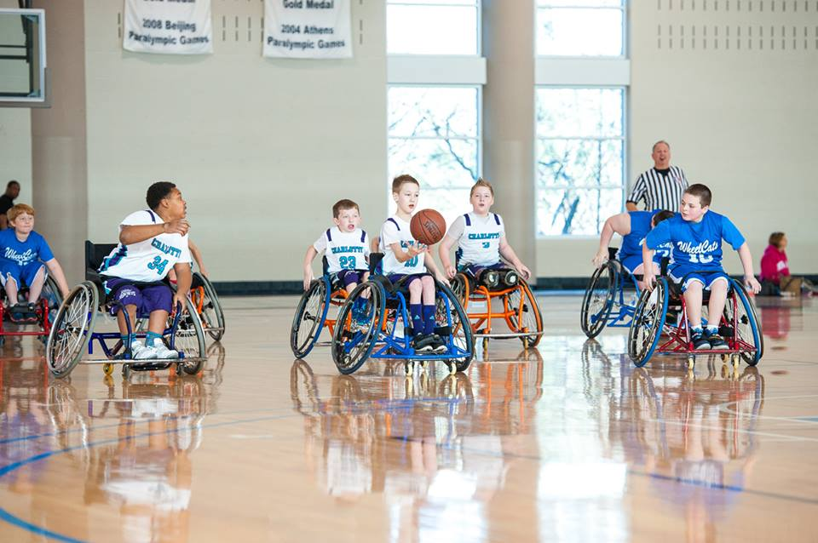
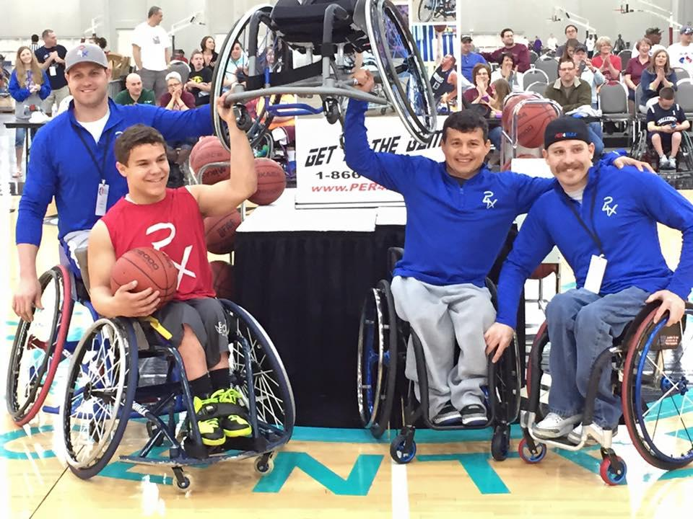
Generating Program
Awareness Activities

Slide 30
Visit A Government Building
State Capitol
Book a tour to visit your state capitol
Set up meeting with political state representative and elected officials to discuss the importance of wheelchair basketball and the benefits that it brings to the community
Make sure to have photos taken and upload them to your social media platforms
Invite the media to attend
Invite representatives to local practice or tournament to experience competition
City Hall
Contact your City Hall Department Directory and set up a visit to City Hall
Setup meetings with different people in office to discuss awareness of the sport of wheelchair basketball and the impact it has on the local community
  Target Mayor if possible
Attend City Council Meeting during this time
Ask Mayor or City Council for designation of Wheelchair Basketball Day in community
Post pictures after the meetings to maintain excitement and keep the community interested
Invite the media to attend
Invite contacts from event to practice or local competition

Slide 31
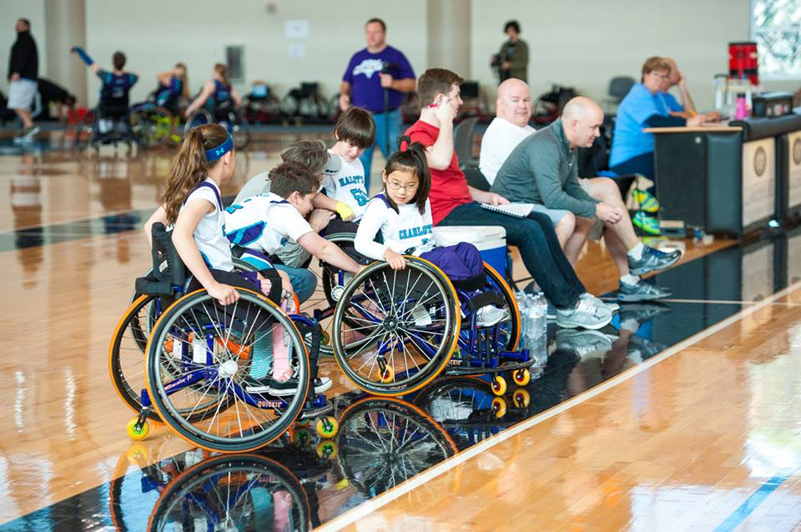
Invite NBA/College Team to Attend An Open Practice
Reach out to nearby NBA/College teams and players to invite them to a practice.
  Contact Community Relations Department and Athletic Department. Use established relationships to make introductions.
  Junior Division programs should focus on Jr. NBA program and register their team
Be flexible with your date to maximize attendance of invitees and outsiders
Use this event as a opportunity to develop relationship with this team/organization.

Slide 32
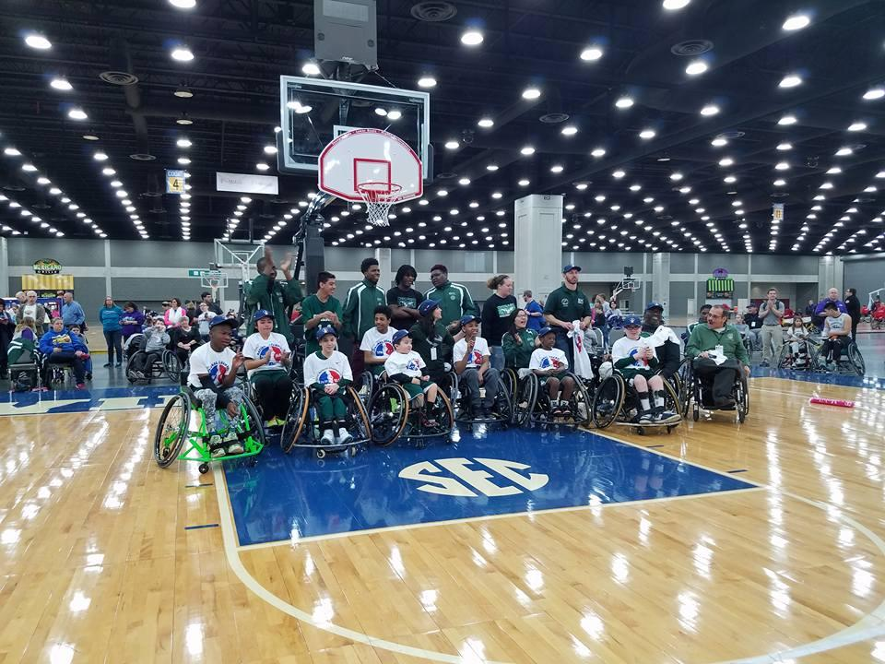
Demonstration at
Local Event
Reach out to local high school, NBA or college basketball teams and ask if you can showcase wheelchair basketball at an upcoming event or competition
Explain your team and highlight achievements
Explain how exposure will be equally beneficial to both your own team and their team and community for bringing more attention the sport
If possible, allow spectators to join in and try and shoot in a sports wheelchair. This will allow the community to participate and become more excited about the sport.
Notes:
Guerrila marketing - people can participate and fundraise money at the same time
Partnering with a local basketball club or organization to run a basketball event where you can split proceeds
Online donations for the team. (rally me or GoFundMe)
Contribution Letter - reword, leave blank for funds are going to be provided to BLANK organization

Slide 33
In-School Activities
Junior Division & Intercollegiate Division
Wear Jersey to School Day
Have all team members wear their team jersey to school on the same day. Team Representatives should send a message to school administration to include on morning announcements, school publications or other internal media forums.
Awareness Booth
Ask the school if you can setup booth at a sporting event, during lunch period or somewhere on campus to education students and staff on team and sport of wheelchair basketball. Have information available and have interactive opportunity if possible (sports wheelchair, basketball/hoop, etc.).
Communication For All Team Events
Team Representatives are encourage to share any team activities during National Wheelchair Basketball Week and the NWBA Annual Campaign with school administrators for all members of your program.

Slide 34
Program Recruitment
Activities
Contact Local Business Partners & Corporations for Volunteer Recruitment
Use Prospect List and local business/corporations for volunteer recruitment. Contact the Human Resources Department to the appropriate contact. Build volunteer base for program (coaches and team administrators) and events (games, tournaments and fundraisers). Request a meeting to present to employees or provide thorough outline of volunteer opportunities.
Visit Medical or Rehabilitation Center for Player & Volunteer Recruitment
Invite all teams members to attend a medical center for volunteer and player recruitment. Ask if there is an opportunity to speak with clients and/employees. Make contacts with physical therapist, provide presentation to educate them about the sport and your program. Make sure you provide your program information for distribution.

Slide 35
Social Media
Make sure to share your team’s experience on social media personal and team pages throughout National Wheelchair Basketball Week and the NWBA Annual Campaign. Please feel free to use the following hashtags to promote your involvement.
#NWBA #RollWithUS
Please tag the NWBA in any of your post using the following social media accounts.
Twitter - @NWBA - https://twitter.com/NWBA
Facebook – @nationalwheelchairbasketballassociation - https://www.facebook.com/nationalwheelchairbasketballassociation/
Instagram - @nwba_official - https://www.instagram.com/nwba_official/

Slide 36
Additional Support
Contribution Letter
Please click here or see the attached contribution letter to be provided upon request by Campaign Chairs for supporters of your program during the NWBA Annual Campaign.
Report Results
Report results to NWBA, by completing a 2017 NWBA Annual Campaign Report on www.NWBA.org at https://nwba.sportngin.com/register/form/082227719. Only funds raised during the NWBA Annual Campaign of October 13 to November 22 should be reported.
Contact Information
Please contact the NWBA with any questions you may have.
Anthony Bartkowski, Executive Director
anthonybartkowski@nwba.org
Brandon McBeain, Director of Membership Services and Programs
brandonmcbeain@nwba.org

