Slide 1

SASA 2017 Annual Meeting April 3rd Presented by SASA Board of Directors:

Slide 2

Board Members
Laura Calderon – President
Erin Campbell
Chuck Eguez – Soccer Operations Director
CJ Lowder
Clint Paul – Treasurer
Jason Pochynok
Mike Slater – Registrar / Club Administrator
Jason Vlcek
Drew Lenhardt – Director of Coaching ( Non Voting Member)

Slide 3
2016-17 Club Review
Established ID sessions and implemented the birth year transition as mandated by US Soccer.
Adopted new club bylaws.
Increased board transparency and communications.
Board Minutes now posted on website
Weekly Coaches Corner updates emailed to members.
Conducted Coach / Manager Meeting to discuss new dues structure prior to vote by board.
Hosting first Annual meeting in recent years open to ALL Club Members to share new financial picture and gain input on possible capital projects.

Slide 4
2016-17 Club Review
Appointed a CPA to serve as club Treasurer to manage club budget.
Conducted club-wide parent survey, seeking member input, and began creating action plan to address concerns.
Elected new board members.
Consistent with new bylaws.
Announced Board Openings on Website to solicit all interested applicants.
A committee formed of majority non-board members.

Slide 5
2016-17 Club Review
Transitioned to a full-time Director of Coaching, who is implementing club wide coaching curriculum and guidelines.
Expanded the Youth Academy to include a fall season and winter training program.
Enrolled 520 players for 2016-2017.
Two Successful SASA tournaments.
109 Teams in Fall
121 Teams in the Spring

Slide 6
Survey Results 4th Quarter 2016
Player experience rated 81 out of 100 as good or better
Team experience rated 78 out of 100 as good or better
Parent experience rated 76 out of 100 as good or better
Coach experience rated 72 out of 100 as good or better
Average = 77 of 100 rated as good or better
Club experience rated 59 out of 100 as good or better.
Roads, Fields & Transparency were the top 3 reasons.

Slide 7
ID Dates
GIRLS ID SESSIONS
Friday April 7th 5:30-6:45 PM (2010,2009) 7:00-8:15 PM (2008,2007)
Friday April 14th 5:30-6:45 PM (2006,2005) 7:00-8:15 PM (2004,2003)
Friday April 21st 5:30-6:45 PM (2010-2007) 7:00-8:15 PM (2006-2003)
BOYS ID SESSIONS
Friday April 7th 5:30-6:45 PM (2010,2009) 7:00-8:15 PM (2008,2007)
Friday April 14th 5:30-6:45 PM (2006,2005) 7:00-8:15 PM (2004,2003)
Friday April 21st 5:30-6:45 PM (2010-2007) 7:00-8:15 PM (2006-2003
THESE ID SESSIONS ARE FREE FOR CURRENT RECREATIONAL OR COMPETITIVE SOCCER PLAYERS INTERESTED IN PLAYING FOR SASA. CURRENT SASA PLAYERS SHOULD BE IN ATTENDANCE TO GIVE REALISTIC IDENTIFICATION ENVIRONMENT.

Slide 8
Player Placement Details
Player Placement sessions is a different approach than a tryout. There will be no cuts. Player placement means that all players will be place on a SASA team from the ages of U8-U14.
SASA is committed to providing development at all levels and to provide the best soccer development environment in Springfield area.
SASA is committed to providing development at all levels and to provide the best soccer development environment in Springfield area. Players will be placed based on ability at three distinct levels.
Blue: Highly competitive and elite levels starting at U-11, will compete in SLYSA and go to local, state and regional tournaments. Teams will have a highly qualified USSF licensed coach. All teams U10 and below, will focus on individual and team development and readiness for the next level. Will participate in the CIYSL and local to state level tournaments.
White: Competitive level focused on short term and long term individual development. White levels will have option to play in SLYSA or CIYSL at U11-U19 and compete in tournaments at the local and state level. All teams U10 and below, will focus on individual and team development and readiness for the next level. Will participate in the CIYSL and local to state level tournaments.
SASA Individual Development Academy (SASA IDA): This level is fully focused on individual development at the U9-U14 level. Every training session will be focused on the development of individual skills. These players will be placed at the player placement sessions and will be offered a training only position at the club. This will be a modified program of SASA and will focus on preparing a player readiness to play at a Blue or White level in the following year. This position will also serve as an alternate to birth year age group for game and tournaments if called upon.

Slide 9

Player Placement Dates
Boys Player Placement Sessions:
Monday May 22nd 5:30-6:45 PM (2010,2009) 7:00-8:15 PM (2008,2007)
Tuesday May 23rd 5:30-6:45 PM (2006,2005) 7:00-8:15 PM (2004,2003)
Wednesday May 24th 5:30-6:45 PM (2010,2009) 7:00-8:15 PM (2008,2007)
Thursday May 25TH 5:30-6:45 PM (2006,2005) 7:00-8:15 PM (2004,2003)
Girls Player Placement Sessions:
Monday May 22nd 5:30-6:45 PM (2010,2009) 7:00-8:15 PM (2008,2007)
Tuesday May 23rd 5:30-6:45 PM (2006,2005) 7:00-8:15 PM (2004,2003)
Wednesday May 24th 5:30-6:45 PM (2010,2009) 7:00-8:15 PM (2008,2007)
Thursday May 25TH 5:30-6:45 PM (2006,2005) 7:00-8:15 PM (2004,2003)
Saturday June 3rd
2:00 – 3:30 PM ( HSG 2002-1999)
Wednesday June 7th
7:00-8:30 PM ( HSG 2002-1999)

Slide 10


Summer Camp Dates
RCD Espanyol Academy Camp
June 25th –June 28th
Academy Director of RCD Espanyol and Coaching Staff.
Andrew Lenhardt IV: SASA DOC
$165 for SASA Player
$215 for non SASA Player
SASA High School Coaches Camp
July 10th – July 14th
Area Springfield High School Coaches.
Andrew Lenhardt IV: SASA DOC
$75 for SASA Player
$100 for non SASA Player
SASA Individual Small Group Training Camp.
Month Long Training Camp: June 5th –July 3 or July 5 - August 7th
Two 1.5 hours training sessions a week.
^{4-6 players per group.}
Place in like groups and abilities.
5:30 -7:00pm or 7:00 pm -830 pm.
$75 for each SASA player per month long training camp. $100 for every non SASA Player.
Pick your group of 6 or be placed in a group by signing up individually.
Full Player Evaluation of each player
Andrew Lenhardt DOC of SASA and Select Coaches

Slide 11
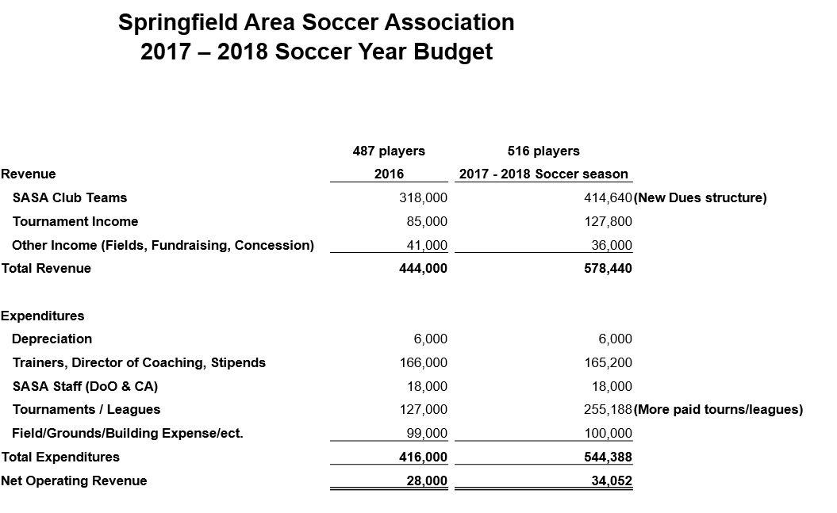

Slide 12
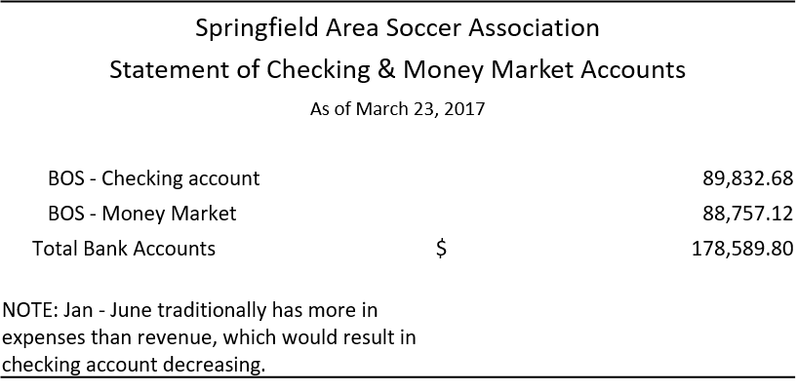

Slide 13
CURRENT Competitive Club Dues
SASA 2005 Birth Year - $650 (2016-17)
Includes CIYSL League Fall and Spring
4 Tournaments
Fusion 2005 Birth Year - $750 ( 2016-2017)
Includes CIYSL League Fall and Spring
Includes 4 Tournaments
Illinois FC 2005 Birth Year -$1160 ( 2016-17)
Includes CIYSL League Fall and Spring
Includes 6 Tournaments
Indoor League
Indoor Training
Integrity 2005 Birth Year -$550 (2016-17)
Includes 4 Tournaments
FC Peoria 2005 Birth Year - $850 ( 2016-17)
Includes No League
Includes 6 Tournaments
SLSG Illinois 2005 Birth Year - $1,575 (2016-17)
Includes 2 SLSG Tournaments
Includes a SLSG in house League

Slide 14
SASA Club Dues 2017-2018
SASA Youth Academy U5-U8 - $250
SASA Spirits Junior U8 - $410
SASA U9-U10 - $750
SASA U11-U12 BLUE - $925 / WHITE - $810
SASA U13-U15 BLUE – $990 / WHITE $820
SASA U15-U16 High School Program BLUE - $810 / WHITE $750
SASA U17-U19 High School Showcase Program - $890 / WHITE $750

Slide 15
2017-18 Program Details
SASA Youth Academy U5-U8 (6):
$250 Full Season & Indoor
Outdoor Only Fall and Spring $150
Fall only or Spring Only $90.
1/week training (Fall & Spring) & 1 game a week (8 Weeks in Fall & 8 weeks in Spring)
Indoor Training (Winter) (10 Weeks)
T-Shirt

Slide 16
2017-18 Program Details Cont’d
SASA Spirits Juniors U8 (12): $410
Age Group Camp (Fall) & 2x/week training (Fall & Spring)
USSF Licensed Volunteer Coach
CIYSL League Games and Cards (Fall & Spring)
Indoor Training (Winter)
Indoor League (Winter)
Supplemental programs throughout the year (i.e. Street Soccer, Finishing/Goal Scoring, Director of Coaching)
Tournaments (SASA Fall & SASA Spring & Two other SASA Assigned tournaments)
SASA Region II Tournament
SASA Lincoln Land Invitational:
FC Peoria Spring Shoot Out
Libertyville Cup
Field maintenance
Director of Coaching and Staff Positions at SASA
Other Expense

Slide 17
2017-18 Program Details Cont’d
U9‐10 Program Detail (12 Players): $750
Age Group Camp (Fall) & 2x/week training (Fall & Spring)
USSF Licensed Coach
CIYSL League Games and Cards (Fall & Spring)
Indoor Training (Winter)
Indoor League (Winter)
Goalkeeper Training Program
Supplemental programs throughout the year (i.e. Street Soccer, Finishing/Goal Scoring, Director of Coaching)
6 Tournaments (SASA Fall & SASA Spring & Four other SASA Assigned tournaments)
SASA Region II Tournament
SASA Lincoln Land Invitational
FC Peoria Spring Shoot Out
Norco Invitational
Libertyville Cup
Illinois FC Fall Cup
Field maintenance
Director of Coaching and Staff Positions at SASA
Other Expense

Slide 18
2017-18 Program Details Cont’d
U11-U12 Program Details: Blue $925
Age Group Camp (Fall) & 2x/ week training (Fall & Spring)
USSF Licensed Coach
SLYSA League Games (Fall & Spring)
Indoor Training (Winter)
Indoor League (Winter)
Goalkeeper Training Program
Supplemental programs throughout the year (i.e. Street Soccer, Finishing/Goal Scoring, Director of Coaching)
7 Tournaments (SASA Fall & SASA Spring & Four other SASA Assigned tournaments & State Competition ex. State Cup/Presidents cup)
SASA Region II Tournament:
SASA Lincoln Land Invitational:
FC Peoria Spring Shoot Out:
Norco Invitational:
Libertyville Cup:
Illinois FC Fall Cup:
State Cup/Presidents Cup/Illinois Cup
Field maintenance
Director of Coaching and Staff Positions at SASA
Other Expense

Slide 19
2017-18 Program Details Cont’d
U11-U12 Program Details: White $810
Age Group Camp (Fall) & 2x/ week training (Fall & Spring)
USSF Licensed Coach
CIYSL League Games (Fall & Spring)
Indoor Training (Winter)
Indoor League (Winter)
Goalkeeper Training Program
Supplemental programs throughout the year (i.e. Street Soccer, Finishing/Goal Scoring, Director of Coaching)
7 Tournaments (SASA Fall & SASA Spring & Four other SASA Assigned tournaments & State Competition ex. State Cup/Presidents cup)
SASA Region II Tournament
SASA Lincoln Land Invitational
FC Peoria Spring Shoot Out
Norco Invitational
Libertyville Cup
Illinois FC Fall Cup
Presidents Cup/Illinois Cup
Field maintenance
Director of Coaching and Staff Positions at SASA
Other Expense

Slide 20
2017-18 Program Details Cont’d
U13-U15 (8th Grade) Program Blue Details: $990
Age Group Camp (Fall) & 2x/ week training (Fall & Spring)
USSF Licensed Coach
SLYSA League Games (Fall & Spring)
Indoor Training (Winter)
Indoor League (Winter)
Goalkeeper Training Program
Supplemental programs throughout the year (i.e. Street Soccer, Finishing/Goal Scoring, Director of Coaching)
7 Tournaments (SASA Fall & SASA Spring & Four other SASA Assigned tournaments & State Competition ex. State Cup/Presidents cup)
SASA Region II Tournament:
SASA Lincoln Land Invitational:
FC Peoria Spring Shoot Out:
Norco Invitational:
Libertyville Cup:
Illinois FC Fall Cup:
State Cup/Presidents Cup/Illinois Cup
Field maintenance
Director of Coaching and Staff Positions at SASA
Other Expense

Slide 21
2017-18 Program Details Cont’d
U13-U15 (8th Grade) Program Details: White $820
Age Group Camp (Fall) & 2x/ week training (Fall & Spring)
USSF Licensed Coach
CIYSL League Games (Fall & Spring)
Indoor Training (Winter)
Indoor League (Winter)
Goalkeeper Training Program
Supplemental programs throughout the year (i.e. Street Soccer, Finishing/Goal Scoring, Director of Coaching)
7 Tournaments (SASA Fall & SASA Spring & Four other SASA Assigned tournaments & State Competition ex. State Cup/Presidents cup)
SASA Region II Tournament
SASA Lincoln Land Invitational
FC Peoria Spring Shoot Out
Norco Invitational
Libertyville Cup
Illinois FC Fall Cup
Presidents Cup/Illinois Cup
Field maintenance
Director of Coaching and Staff Positions at SASA
Other Expense

Slide 22
2017-18 Program Details Cont’d
U15-U16 High School Program Blue Details: $810
Age Group Camp (Fall or Spring) & 2x/ week training (Fall or Spring)
USSF Licensed Coach
SLYSA League Games (Fall & Spring)
Indoor Training (Winter)
Indoor League (Winter)
Goalkeeper Training Program
Supplemental programs throughout the year (i.e. Street Soccer, Finishing/Goal Scoring, Director of Coaching)
4 Tournaments (SASA Fall or SASA Spring & 3 other SASA Assigned tournaments & State Competition ex. State Cup/Presidents
SASA Region II Tournament: (Girls)
SASA Lincoln Land Invitational: (Boys)
FC Peoria Spring Shoot Out: (Girls)
Norco Invitational: (Girls)
Libertyville Cup: (Boys)
Illinois FC Fall Cup: (Boys)
Presidents Cup/Illinois Cup: (Both)
Field maintenance
Director of Coaching and Staff Positions at SASA
Other Expense

Slide 23
2017-18 Program Details Cont’d
U15-U16 High School Program White Details: $750
Age Group Camp (Fall or Spring) & 2x/ week training (Fall or Spring)
USSF Licensed Coach
CIYSL League Games (Fall & Spring)
Indoor Training (Winter)
Indoor League (Winter)
Goalkeeper Training Program
Supplemental programs throughout the year (i.e. Street Soccer, Finishing/Goal Scoring, Director of Coaching)
4 Tournaments (SASA Fall or SASA Spring & 3 other SASA Assigned tournaments & State Competition ex. State Cup/Presidents
SASA Region II Tournament: (Girls)
SASA Lincoln Land Invitational: (Boys)
FC Peoria Spring Shoot Out: (Girls)
Norco Invitational: (Girls)
Libertyville Cup: (Boys)
Illinois FC Fall Cup: (Boys)
Presidents Cup/Illinois Cup: (Both)
Field maintenance
Director of Coaching and Staff Positions at SASA
Other Expense

Slide 24
2017-18 Program Details Cont’d
U17-U19 High School Program Showcase Details: $890
Age Group Camp (Fall or Spring) & 3x/ week training (Fall or Spring)
SLYSA League Games (Fall & Spring)
Indoor Training (Winter
Indoor League (Winter)
Goalkeeper Training Program
Supplemental programs throughout the year (i.e. Street Soccer, Finishing/Goal Scoring, Director of Coaching)
4 Tournaments (SASA Fall or SASA Spring & 3 College Showcase & State Competition ex. State Cup/Presidents
SASA Region II Tournament: (Girls)
SASA Lincoln Land Invitational: (Boys)
3 College Showcase TBD:
Presidents Cup/Illinois Cup: (Both)
Field maintenance
Director of Coaching and Staff Positions at SASA
Other Expense

Slide 25
2017-18 Program Details Cont’d
U17-U19 High School Program White Details: $750
Age Group Camp (Fall or Spring) & 2x/ week training (Fall or Spring)
USSF Licensed Coach
CIYSL League Games (Fall & Spring)
Indoor Training (Winter)
Indoor League (Winter)
Goalkeeper Training Program
Supplemental programs throughout the year (i.e. Street Soccer, Finishing/Goal Scoring, Director of Coaching)
4 Tournaments (SASA Fall or SASA Spring & 3 other SASA Assigned tournaments & State Competition ex. State Cup/Presidents
SASA Region II Tournament: (Girls)
SASA Lincoln Land Invitational: (Boys)
FC Peoria Spring Shoot Out: (Girls)
Norco Invitational: (Girls)
Libertyville Cup: (Boys)
Illinois FC Fall Cup: (Boys)
Presidents Cup/Illinois Cup: (Both)
Field maintenance
Director of Coaching and Staff Positions at SASA
Other Expense

Slide 26
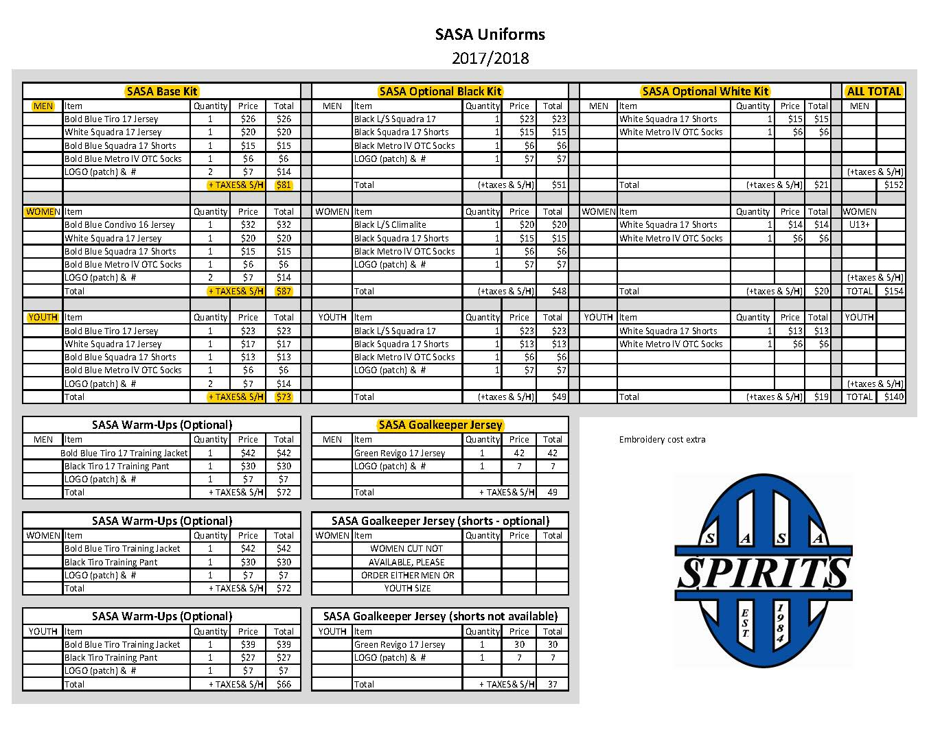

Slide 27
Capital Projects
Roads
SASA Received 4 Bids ( 1 from a club member Company). Looking at West Road ( Train Tracks Side ) and South road ( CWLP plant road).
Phase 1 is to regrade, recompact, and add to existing materials to get us a good foundation to come back and lay whatever material we ( IF ) decide at a later date. ALSO, lay asphalt at the entrance on the South Road. This should be a LARGE Improvement over our Current Roads.
Winning Bid is $26,237 / 2nd place bid was $39,000
Phase 2 Would be to lay a Finished surface of the clubs choosing.
Asphalt the two Roads about $80,000.
Concrete the two Roads about $200-250k
Oil and chip Surface is an option but would require maintenance and is not recommended by these companies for this project.

Slide 28
Capital Projects Cont’d
UIS Turf Project / $1M
UIS is looking for partners for their Turf field project
$150k to $200k
Over a 10 year period SASA would contribute $15k/$20k per year.
This would include a SASA logo on the Turf around Midfield just off the Playing Surface
This would allow SASA to use field for tournaments & practices
15 hour per week of scheduled use
UIS Men/Women game and practice times are in the Fall from mid August to Late October (would need to coordinate field use)
Rest of the Year Field would have more Availability
This would also establish a direct connection between UIS Men’s and Women’s Soccer Programs and SASA

Slide 29
