Slide 1

Hopkins Baseball Association
2017 Parent Meeting

Slide 2
Agenda
Welcome & Introductions – Paul Hurth
HBA Basics – Paul Hurth
Levels of Play – Paul Fabian , Chris Johnson
House Program
A Tournament Teams
AAA & AA Travel Teams
Evaluation & Team Selections – Chris Johnson
New rules – Chris Johnson
Player Development – Ryan Perry & Greg Geiser
Registration & Fees – Paul Hurth
Sponsorships & Fundraising – Mark Campbell
Q & A

Slide 3
Highlights from 2016
15AAA MBT & Gopher State Tournament Champions!
13AAA won their tier of the MBL playoffs and the Lakeville tournament.
13AA won the Edina and Delano tournaments, 4th in MBT
13A won the Glenco wood bat tournament.
13AAA & 14AAA won their MBL regular season section.
13-15AAA, 14AA teams all qualified for both MBT and Gopher State Tournaments.
ALL 3 Single A teams qualified for a state tournament.
AAA Travel teams combined to win 75% of their games.
AA Travel teams combined to win 60% of their games.
All house teams finished above .500 during the regular season.
New vending room at Gulliums Field.
New pitching machines.
Board turnover, 5 retire, 9 new.
New for 2017
Sr. Living home is opening next to the fields.
Pitching pen and parking lot work.
Board turnover, 5 retire , 3 new, still room for more!
New clinic location at Batting Cages of MN
2nd year of our HBA logo gear program.
Added fall evaluation event for the incoming 13s.
Use of new pitch count rules
No games at HHS, hopefully adding Blake’s field

Slide 4
2016 HBA Board of Directors
New board member
Last year of service
First Name | Last Name | Position
Paul | Hurth | President
Dana | Johnson | Registration Coordinator
Brenda | Campbell | Co-Treasurer
Chris | Johnson | Travel Team Coordinator
Greg | Geiser | Player Dev./Evaluations Coordinator
Dave | Stuessi | Scheduler
Ryan | Perry | Player Dev./Evaluations Coordinator
Paul | Fabian | Prep/Majors Coordinator (13s,14-15's)
Jerry | Kellman | Fall Ball Coordinator
Tom | Kanitz | Web Administrator
Mike | Vargas | Co-Fields Coordinator
Mark | Campbell | Fundraising/Sponsorship Coordinator
Michael | Goldfarb | Fields Coordinator
Jayson | Olson | Co-Scheduler
Open |  | Equipment/Uniform Coordinator
Open |  | Secretary
Open |  | Prep/Majors Coordinator (13s,14-15's)
Open |  | Fundraising/Sponsorship Coordinator

Slide 5
HBA Basics
HBA is a community-based youth baseball program for players 13-15 years old (age as of 4/30 each year).
We consider ourselves the primary feeder program for the Hopkins HS baseball program.
Players must attend Hopkins public schools or live within the Hopkins 270 school district boundaries if they attend a private school. (Travel & House program have different eligibility guidelines)
We draw from 4 local youth programs
Glen Lake Mighty Mites
Golden Valley Little League
Big Willow Baseball Association
Hopkins Area Little League
We offer both competitive and recreational play for all skill levels.
We are a volunteer led organization of parents that are passionate about baseball. We love the game and we want to see more kids playing.

Slide 6
High Level HBA Annual Calendar
Evaluations & team selection
Fall Ball Registration Opens
Preseason team practices
State & house tournaments
Registration Opens
HBA Clinics
& Workouts
Games &
tournaments
Fall Games &
tournament
Rest/relax
Preseason/
Winter Club Season
Regular Season
Post
Season
Off
Fall Ball & Club Season
Off Season
January
February
March
April
May
June
July
August
September
October
November
December
Specific dates will be shared later during the meeting.
Notes:
Change made; CMJ

Slide 7
HBA – Volunteering
We are a volunteer led organization with
plenty of ways to get plugged in.
Coaching
13-15 teams X 3 coaches = 40-45 coaches!
Team Coordinator
Field prep before/after games
Board Members – various open roles

Slide 8
Parent Code of Conduct
To ensure that players arrive on time for training sessions and games.
To inform the coaches, in advance, if your child cannot attend training or a game.
To be enthusiastic, yet not critical.
To encourage your child and team, but not insult or discourage the opposition.
To acknowledge the good play of both teams.
To support, and not criticize the coach. If you have any issue with the coach, discuss the matter privately with the coach, or with the appropriate HBA official. Both you and the coach may benefit from period of reflection following a game before taking up the matter.
To refrain from coaching your child or the team; this is the coach’s responsibility.
To assist the coach where appropriate, and only with the coach’s consent.
To refrain from open criticism of the umpire or other game officials, and of the opposing players or coaches. Your conduct in this regard will serve as a powerful example to your child and the other players. If you have an issue with the conduct of the Umpire or of the opposing players or coaches, speak privately with your team’s head coach, and allow him or her to address the matter in the proper forum.
To be positive about the sport, and not allow winning or losing to color your attitude.
Alcoholic beverages are not permitted at games or practices.
Tobacco products are not permitted at games or practices.
Important: Violations may result in a parent being asked to leave park.

Slide 9
C. Player Code of Conduct
To show up for practices and games in the proper uniform and equipment.
To get to practices and games on time.
To perform to the extent of your potential, according to your expectations and standards. You should have fun, work hard, and become the best player you can.
To show proper respect to your coaches and teammates.
To show proper respect to umpires and opposing players, coaches and their spectators. Your conduct on and off of the field should reflect positively on you, your team and the HBA.
To assist with field preparation and clean up as requested by coaches and officials.
Use of tobacco products in ANY setting is strictly prohibited.
Use of alcoholic beverages in ANY setting is strictly prohibited.
Use of illegal drugs in ANY setting is strictly prohibited.
Important: Violations may result in player suspension or dismissal.

Slide 10
HBA – Levels of Play: House Program
Majors Division
14-15 year olds
Play on full size field (60/90)
3-4 HBA Majors house teams
Blend of recreational & competitive play
Play a combined house & interleague schedule
Expect 3-4 days of baseball per week
Focused on development, growth and fun
Play at Guilliams Park, NJH, WJH and Big Willow
Players get shirt and hat
Players provide their own helmet, pants, glove & bat
Bat rules: big barrel bats
-5(14s) BBC -3 (15s)
Prep Division
13 year olds
Play on a intermediate field (52/75)
3-4 HBA Prep house teams
Blend of recreational & competitive play
Play a combined house & interleague schedule
Expect 3-4 days of baseball per week
Focused on development, growth and fun
Play at Guilliams Park, Eisenhower, WJH
Players get shirt and hat
Players provide their own helmets, pants, glove & bat
Bat rules: big barrel bats
-10 or lower
Contact us if you are interested in Coaching!
Notes:
Change made; CMJ

Slide 11
HBA – Levels of Play: Single A Tournament Teams
One team for each age level, 13, 14/15
Rosters include players on house teams not selected to travel teams.
Players play for a house team all season and tournament team on tournament weekends.
Teams selected at the same time as travel evaluations.
2-3 tournaments, possibility of 2 state tournaments
Practices as space/players are available from house team.
Players get jersey and hat
(Jerseys returned for following years use)
Players provide own helmet, glove and bat
Bat rules: big barrel bats, follows age guidelines

Slide 12
HBA – Levels of Play : Travel Program
AAA Travel
1 Team for each age level, 13, 14 & 15
Highest level of competition in state
Highest level of expectations!!
Focused on development, growth, fun and winning
Regular season games vs other local AAA teams in MBL
3-5 tournaments, possibility of 2 state tournaments, MBL playoffs
Expect 4-6 days of baseball per week
Home games at Guilliams Park, Big Willow, NJH, WJH, Blake School
Players get jersey, shirt, hat and pants
(Jerseys returned for following years use)
Players provide own helmet, glove and bat
Bat rules: big barrel bats
-10 (13s) -5(14s) BBC -3 (15s)
AA Travel
1 Team for each age level, 13, 14 & 15
Second highest level of competition in in state
Focused on development, growth, fun & winning
Regular season games vs other local AA teams in MBL
3-5 tournaments, possibility of 2 state tournaments, MBL playoffs
Expect 4-5 days of baseball per week
Home games at Guilliams Park, & Big Willow, NJH, WJH & Eisenhower(13s)
Players get jersey, shirt, hat and pants
(Jerseys returned for following years use)
Players provide own helmet, glove and bat
Bat rules: big barrel bats
-10 (13s) -5(14s) BBC -3 (15s)
Notes:
Changes made; CMJ

Slide 13
Travel/Tournament Team Head Coaches
Overview of selection & nomination process
AAA Teams
13’s Brian Zimmer
14’s Ryan Perry
15’s Chris Johnson
AA Teams
13’s TBD
14’s Tyler Brodersen
15’s John Stoldorf
Single A Tournament Coaches
TBD: Selected from House team head coaches
If you would like to coach House/Single A, contact Chris Johnson, Paul Hurth or Paul Fabian

Slide 14

Evaluations
Evaluation are conducted at Pitch 2 Pitch Inc. of Chanhassen
Players scored on 8+ different baseball skills by independent evaluators.
Coaches and selection committee observe & take notes.
Players should bring glove, helmet, bat & wear athletic attire.
Uniform sizing will happen prior to event during check in.
Evaluations are for all players, house and travel teams
Please arrive 30 minutes early for check in and uniform sizing
HBA coaches attend preseason clinics/workouts. They are watching how your son performs and conducts themselves. Tell your kids to take them seriously and work hard! Your work ethic and focus will leave a positive impression with a potential coach. Clinics performance is one data point in the evaluation process that is considered when determining travel teams.
Notes:
Changes made; CMJ

Slide 15
Evaluation Date/Times
Saturday, March 11th at Pitch 2 Pitch in Chanhassen
13 year olds: 8:00 to 9:30 a.m.
14 year olds: 9:30 to 11:00 a.m.
15 year olds: 6:30 to 8:00 p.m.
CONFLICTS: Please contact Ryan Perry if your player has a conflict with their scheduled evaluation time. We will be monitoring the state basketball schedules.
Call backs (for all age groups)
Will happen Sunday March 12
3:30-5:30 Hopkins Lindburgh Center
Team Notifications
Our goal is to post AAA travel, AA travel and A tournament teams all on the same day.
We are working with the HS staff to coordinate the dates and postings to avoid conflicts/distractions for the freshman team tryouts.
Notes:
Changes made; CMJ

Slide 16
Team Selection – AAA Travel Teams
Multiple Data Points and No Single Individual Decision Maker. It is a joint HBA effort!
Evaluation scores are totaled & assessed.
Prior to evaluations, coaches reach out to feeder program coaches, HBA coaches or other coaches from previous seasons for player strengths & weaknesses.
Feedback from coaches and statistics from 2016 teams
Coach consults with HBA Player Development team and leadership throughout the preseason through selection. Clinic performance and attendance can strongly influence player perception.
Coach selects his initial 12-14 players and presents them to HBA leadership for discussion and approval.

Slide 17
Team Selection – AA Travel & A Tournament Teams
If AA & A Coaches are not preselected, coach is selected from candidates who’s son didn’t make AAA
The same process and data points are used in selecting the AA and A teams.
Remaining player evaluation scores are used
Feedback from feeder program coaches, HBA coaches or other coaches from previous season for player strengths & weaknesses
Direct feedback from coaches and statistics from 2016 teams
Coach consults with HBA Player Development team and leadership about player being considered
Coach selects his initial 12-14 players and presents them to HBA leadership for discussion and approval
If coaches are not selected prior to evaluations, all coaching candidates will be encouraged to help out at preseason clinics/workouts so they can observe players in the event they are coaching. This prepares them with player knowledge in the event their son makes a lower level and they become a coach.

Slide 18
Team Selection – House teams
House coaches are selected after travel/tournament teams are selected.
Typically 1 week after travel teams are announced, we select house coaches and have a draft of remaining players.
Remaining evaluation scores are given to coaches
Coaches can reach out to feeder program coaches, other coaches and HBA coaches from previous year for player strengths & weaknesses
Prep & Majors Coordinators conduct the draft
HBA President and/or VP will be in attendance to help provide feedback on players to coaches who might not know all the players
The goal is to create equally completive teams. Sharing of player information during draft is expected.

Slide 19
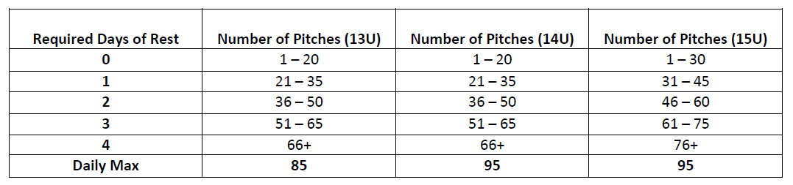
New Rules for 2017
Pitch Count! – new for both HS and HBA
More detail on our website regarding catching rules.
Bat Rules – Not changing in 2017, but there are in 2018. What does that mean for you?
Current bat rules: big barrel bats -10 (13s) -5(14s) BBC -3 (15s)
Equitable Play Rules – 2016 pilot year, now official.
Birthday Age Cutoff Changes – Only rumors so far, but indications are they are coming.
Notes:
Changes made; CMJ

Slide 20
HBA Player Development
Focus areas:
Support player development at all age levels.
Organize Winter Training Program
Coordinate Player Evaluations
Assist in coach selection process
Provide support/training to coaches:
Practice plans, video links, mentoring, etc.
Contacts:
Ryan Perry
Greg Geiser

Slide 21
HBA Winter Training 2016
Objective – Create a winter training program that:
“Shakes off the rust” gets players thinking baseball
Appeals to both the recreational and serious player
Helps prepare players for spring evaluations*
Is a good value for players/families and is cost neutral for HBA
Plan – A 2-tiered program that offers both, structured reinforcement of baseball fundamentals for all players and advanced instruction, skill development and repetitions for the more serious players.
*IMPORTANT NOTE: HBA coaches attend our preseason clinics/workouts. They are watching how players perform and conduct themselves. Tell your player to take them seriously and work hard! Their work ethic and focus will leave a positive impression the potential coach.

Slide 22

HBA Winter Training 2016
Tier 1: Winter Workouts
Series of structured baseball workout sessions that will include stretching, cardio work, and reinforcement of baseball fundamentals through various drills.
Led by Hopkins American Legion Coaches & Players
Schedule:
(5) Sunday afternoons from 1:00-3:00 @ WJH
2/5, 2/12, 2/19, 2/26, 3/5
If you are a potential HBA coach, please try to make as many as possible to observe players.

Slide 23

HBA Winter Training 2016
Tier 2: Player Clinics
Series of training sessions for the more serious players, focused on advanced skill development and repetitions.
Led by Nevers/Larkin Baseball staff.
Schedule:
Friday, 2/4 4-6 PM @ Batting Cages of MN (Hitting Focus)
Friday, 2/11 4:30-6:30 PM @ Edina Dome (Fielding Focus)
Friday, 2/18 5-6:30 PM @ Edina Dome (Hitting & Fielding Focus)
Saturday, 2/25 5-6:30 PM @ Edina Dome (Fielding & Hitting Focus)
Saturday, 3/4 3-5 PM @ Batting Cages of MN (Hitting Focus)
If you are a potential HBA coach, please try to make as many as possible to observe players

Slide 24
HBA Winter Training 2016
Cost Structure
Two different options
Register for winter training on our website
Option 1: Pay per $20/Session.
Attend any that work with the players schedule.
(Note: You can pay at the door, but we prefer that
register in online in advance for planning purposes.)
Option 2: Pay per $150 for all 10 Sessions
Attend any that work with the players schedule. This
option is only available by via online registration.

Slide 25
Additional Training Opportunities
In addition to programs offered by HBA, many other local organizations offer winter camps and clinics to get your player ready for the season.
Hopkins HS Baseball Program (for 9th graders)
Strength training & Captain’s practices
Pine Tar Academy
Players Only
Pitch 2 Pitch
Hit Dawg
US Baseball Academy
The Batting Cages of MN
Minnesota Blizzard
Links are available on the HBA website. . . .

Slide 26
Registration
Registration will be open shortly on our website at:
www.hopkinsbaseball.com
All players complete the basic registration
If new, you will need to register on our website
Indicate within registration what level of play you want to be considered for:
AAA, AA or A (open to all based on evaluation results)
House only (not interested in Travel or the Tournament team.
Payment flexibility – payments can be spread over a couple payments. Travel/Tournament team payments are due only after teams are announced and payments must be made before players can play in their first game.

Slide 27
Registration
Playing Fees:
Basic Registration $250*
All players (house & travel)
* Early bird discount, $290 after 3/1
AAA & AA Travel Program $325 (additional)
Due prior to 1st game
Additional $100 refundable uniform deposit
A Tournament Team $200 (additional)
Due prior to 1st tournament
Additional $100 refundable uniform deposit
Preseason clinics also open for Registration

Slide 28
Sponsorships
Youth sports takes money to put on a quality program. We are self-funded and rely on fees, sponsorships and fundraising to fund our annual budget of around $75k
2017 we are trying to build on that and create a sponsor program with added value for the business
$300-Bronze Level
Exposure on our web site
2-3 Email mentions per season
Signage at our fields, Guilliam’s Field located at 12101 Minnetonka Boulevard
Access to tables to set up at our fields on Game
$500-Silver Level
Bronze Level plus House Team Full Jersey
$750-Gold Level
Bronze Level plus Screen Image on Travel Team Warm Up Jersey
If you own a local business, please consider a sponsorship.

Slide 29
Fundraising
Our fundraising team is actively looking for new opportunities
Our goal is to add fundraising events that are impactful and easy
Trying to avoid kids selling things.
Partnering with local businesses when possible
Look for new HBA wearables coming soon
Support our vending machines at Guilliams Field
We can use your help! Ideas and implementation!
Our goal is to raise a minimum of $3,000
Fundraisers will be communicated via email, coaches and website

Slide 30
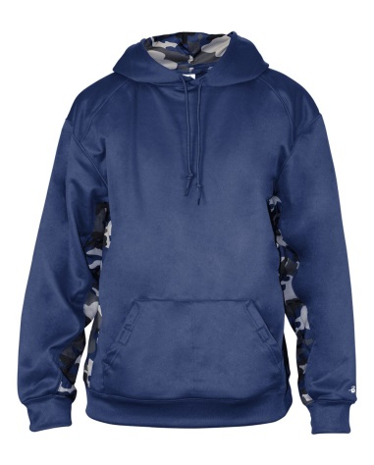
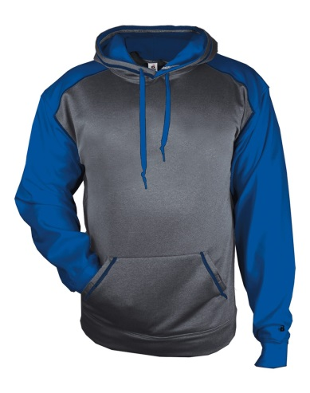
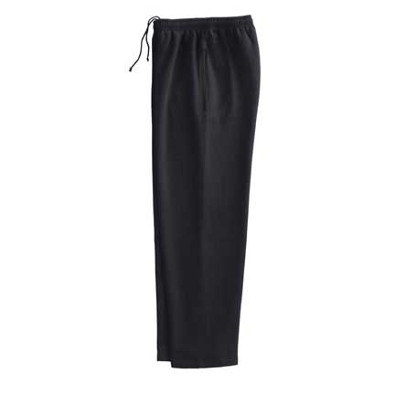
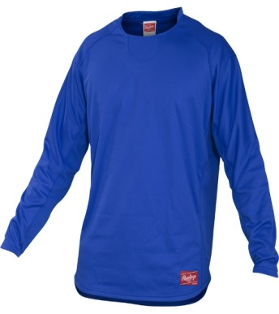
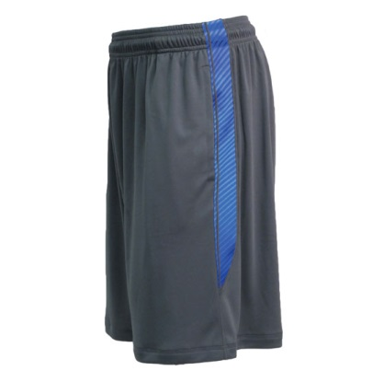
2017 HBA League Gear
Show your league pride with HBA logo apparel
Preview at later preseason clinics
Online ordering will be available
Final day to order will be just after evaluation day 3/12
Affordable options and package saving.
League gets percent of all sales

Slide 31
Open Q&A Time

