Slide 1



FUNdamentals practice plan
4 Corner concept
Hello , and welcome to this week session plan which design for coaches working with children at the FUNdamentals age groups . This is the 2nd stage at the grassroots level . We hope you enjoy this session plan. The focus for this stage should be providing a positive, and fun environment,
concentration on ABC (Agility, Balance, and Coordination), and basic soccer techniques as well as placing the players in to small sided game environments.

Slide 2
FUNdamentals practice plan
4 station concept
In this week’s edition the Grassroots department has focused on the FUNdamentals player.
The activities provided take a look at how stations are being used at the Grassroots level.
During the practice players will spend an allotted time at each station having fun and developing specific skills before moving onto the next station. By using station work we ensure players are continually motivated and we can ensure that their attention is not lost.
In this week’s edition players will travel through 4 stations, one station focuses on general movements, one station on soccer coordination with the ball, one station on soccer technique and the final station focuses on a small sided soccer game of 5v5 which includes the retreat line.
All sessions take a holistic approach to developing our youth. Each game and activity will take a look at how we can focus on 4 main areas of the child's development; these include Social/Emotional, physical, physiological and also technical
Total Practice time 30-45 minutes as per the OSA Recreational and Development Matrices

Slide 3
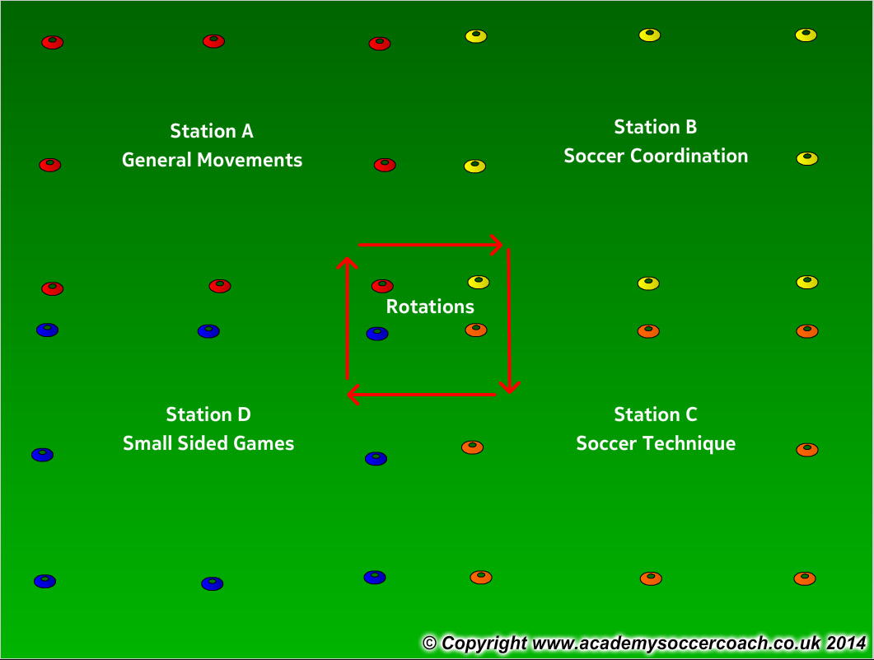
FUNdamentals practice plan
How the 4 stations work
If working with a larger group organize players into groups of 8-10. Each station has a coach who will lead that specific station for the session. Players rotate every 10 -12 minutes with a 2 minute break in between each station to have a water break and move to the next station.
If working with a smaller group you can still have the 4 stations and players will move together through all 4 stations until all are complete.

Slide 4
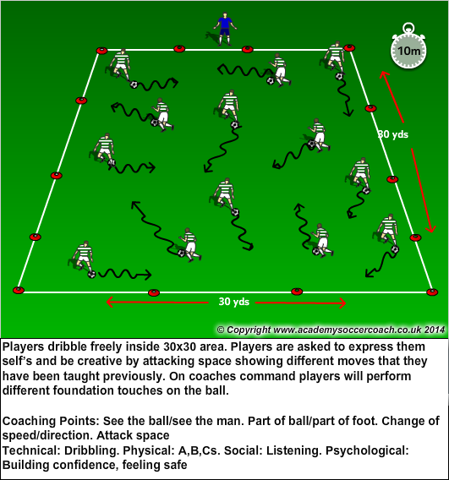
FUNdamentals practice plan
Station A
General Movements with a ball
Time frame. 10 minutes
Emphasis:
Listening
Different types of running
Dribbling
Changing direction
Agility, Balance, Coordination
FUN!
Psychological
Confidence
Being safe
Technical
Dribbling
Moves
Turning
Physical
A,B,C’s
Change of Direction
Social
Listening
Communicating
Celebrating

Slide 5
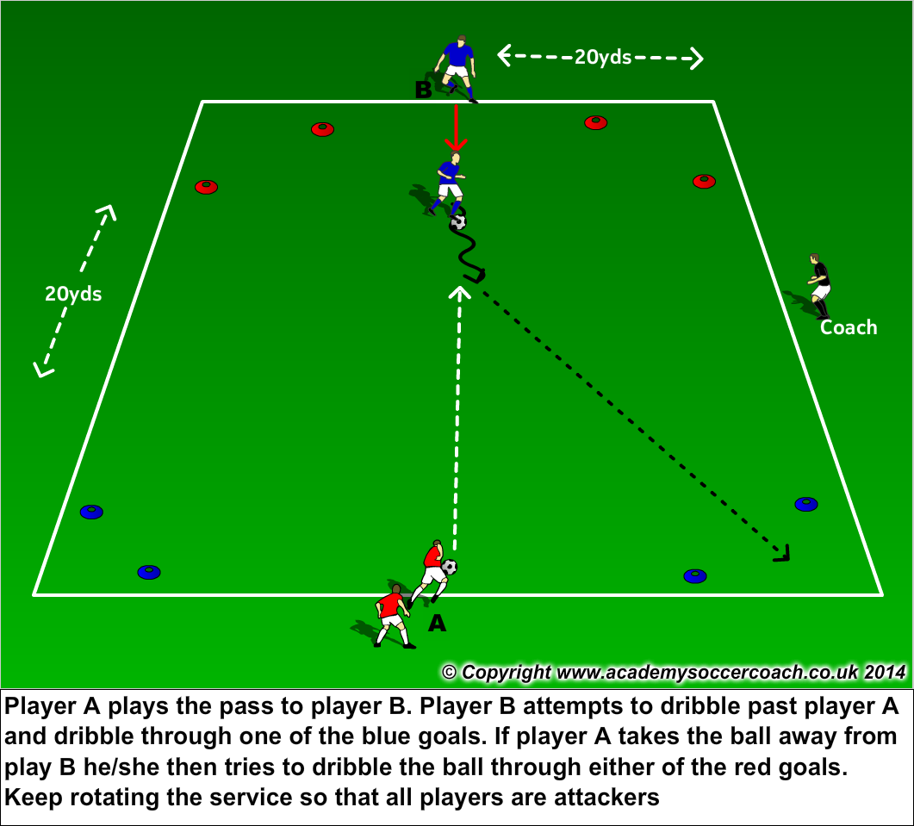
FUNdamentals practice plan
Station B
Soccer Coordination – 1v1 to goals
Time frame. 10 minutes
Emphasis:
Dribbling
1v1 attacking/defending
Changing direction
Agility, Balance, Coordination
Imagination
Change of speed
FUN!
Psychological
Confidence
Being safe
Technical
Dribbling
Running with the ball
1v1 attack/defending
Physical
A,B,C’s
Change of Direction
Social
Listening
Communicating
Celebrating

Slide 6
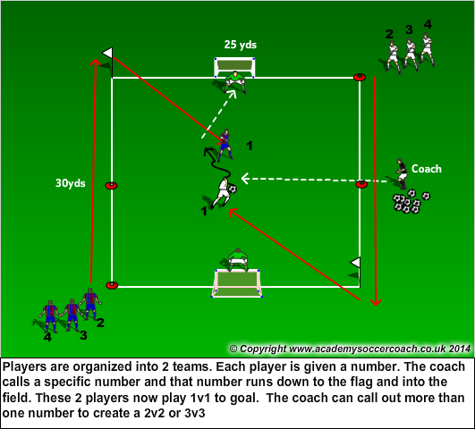
FUNdamentals practice plan
Station C
Soccer Technique – 1v1 to a goal with GKs
Time frame. 10 minutes
Emphasis:
Running with the ball
Dribbling
1v1 attacking/defending
Shooting
Changing direction
Agility, Balance, Coordination
Imagination
FUN!
Psychological
Confidence
Being safe
Imagination
Technical
Dribbling
Running with the ball
Shooting
Physical
A,B,C’s
Change of Direction
Social
Listening
Communicating
Celebrating

Slide 7
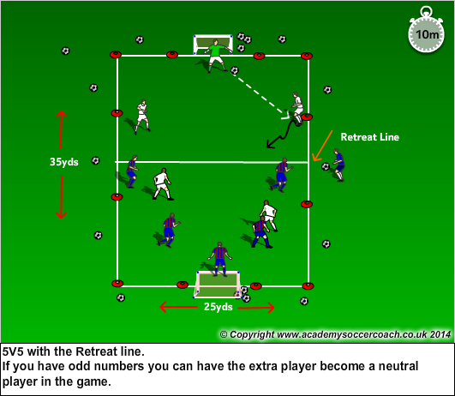
FUNdamentals practice plan
Station D
Small Sided Game – 5v5 with Retreat line
Time frame. 10 minutes
Emphasis:
Listening
Running with the ball
Passing
Shooting
Dribbling
Team work
Changing direction
Agility, Balance, Coordination
Imagination
FUN!
Psychological
Confidence
Being safe
Technical
Dribbling
Running with the ball
Physical
A,B,C’s
Change of Direction
Social
Listening
Communicating
Celebrating

