Slide 1
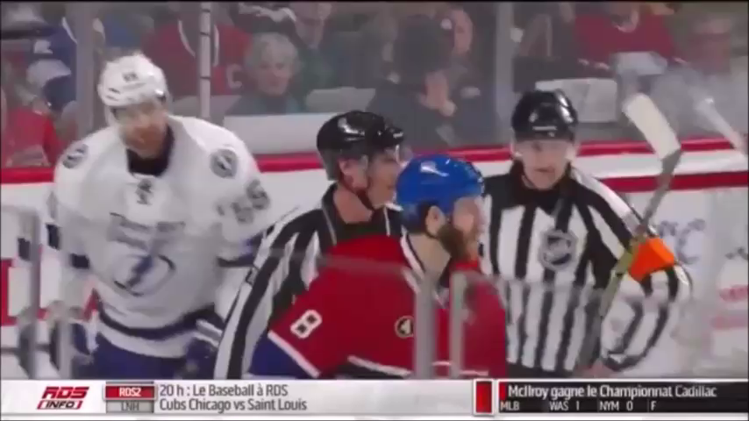
Is this a good procedure?

Slide 2
Purpose
Penalties exist in hockey to maintain rules, maintain respect and maintain order on the ice.
How do officials communicate:
Signals
Verbal Communication
Every action an officials makes on the ice is direct and purposeful.

Slide 3
Assessing Penalties
Understanding proper procedures when calling penalties is key to successful officiating.
remain calm and in control at all times, especially during penalty situations.
Maintain composure.
Be professional, not emotional.
Treat disrespect with respect.
This action displays confidence.
KNOW THE PROCEDURE WELL

Slide 4
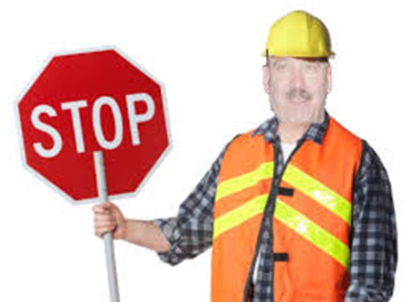
When you seen an infraction:
Mentally record the offending players number
Raise the non-whistle arm straight up, with the Hand open and fingers together.
When the offending team gains possession and control of the puck, blow whistle and come to a stop.
(This allows, coaches and fans to shift focus on the referee before issuing penalty)

Slide 5
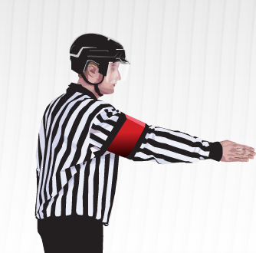
When you seen an infraction:
The official then points to the offender with the non-whistle arm and in clear, calm, loud, assertive voice calls out the offending player’s number, team colour, and infraction.

Slide 6
When you seen an infraction:
After indicating the offending player, give the signal (or multiple signals, if there’s more than one infraction)
2X

Slide 7
After making call:
Skate to the penalty box (backwards)
Keep all players in view
Report the following:
Player’s number, team colour and infraction
Report the duration
Exit the penalty box area keeping clear of the penalized player
Adjusting routes and timing to avoid confrontations with penalized players.

Slide 8
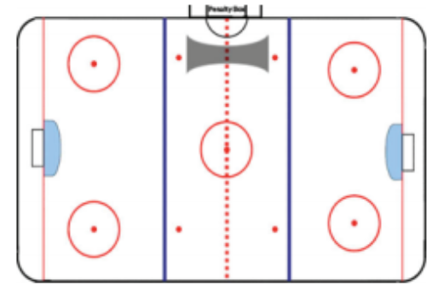
Stop or skate through (area marked above) and report the penalty.
The referee shall avoid penalized players and other players by arcing away, keeping all players in view.

Slide 9
Practical Tips
Know procedure well. Builds confidence.
Stay calm with players and coaches if calls are questioned.
Always treat disrespect with respect.
Give penalty signals at time of infraction and at penalty bench.
Take time to work with inexperienced timekeepers.

Slide 10
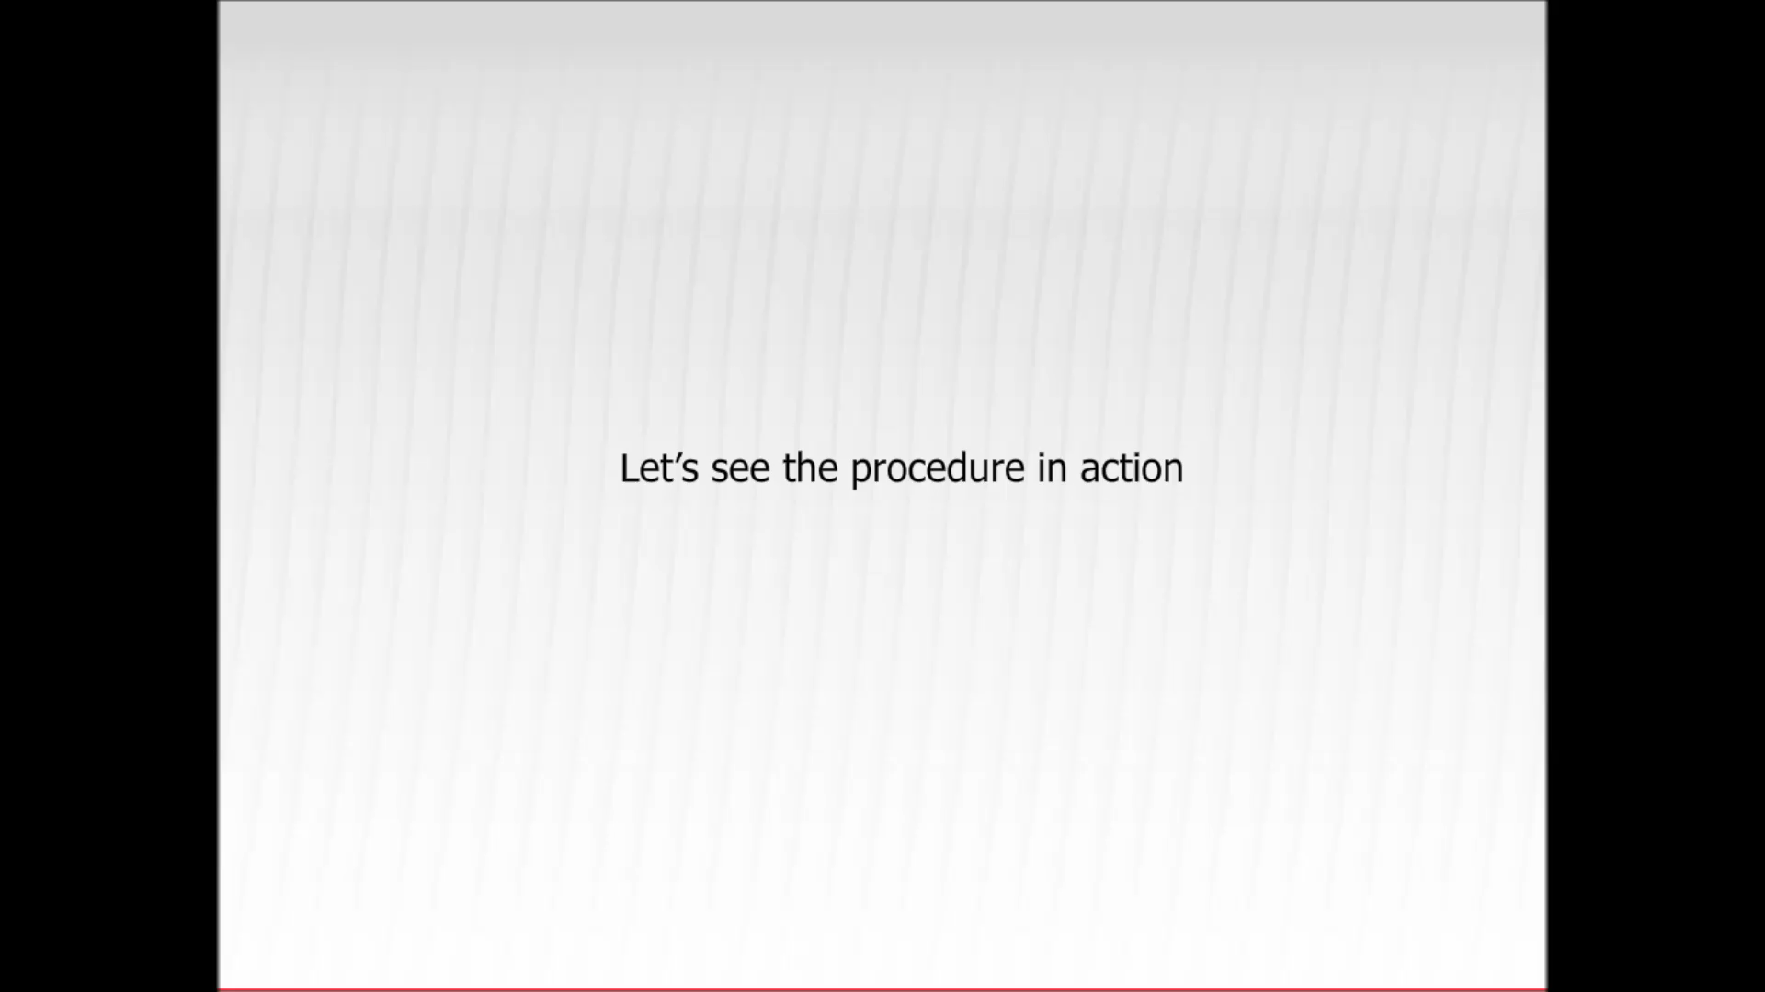
Is this a good procedure?

Slide 11
Quiz – Junior Class
When you assessing multiple penalties of the same kind, you only have to signal the penalty once? (T/F)
How do you identify the offending player?
What are two ways to communicate?
What arm do I raise to signal an infraction?
Should I skate with the penalized player to the penalty bench?

Slide 12
REFEREE’S SIGNALS
BOARDING
Striking the clenched fist
of one hand into the open
palm of the opposite hand
in front of the chest.

Slide 13
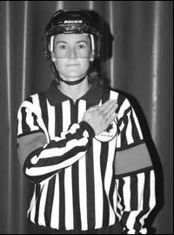
REFEREE’S SIGNALS
BODYCHECKING
Open palm of the nonwhistle
hand, with fingers together, comes
across body on to the opposite
shoulder.

Slide 14
REFEREE’S SIGNALS
BUTT-ENDING
A cross motion of the forearms,
one moving under
the other

Slide 15
REFEREE’S SIGNALS
CHARGING
Rotating clenched fists
around one another in front
of the chest.

Slide 16
REFEREE’S SIGNALS
CHECKING FROM BEHIND
A forward motion of both
arms, with the palms of
the hands open and facing
away from the body, fully
extended from the chest
at shoulder level.

Slide 17
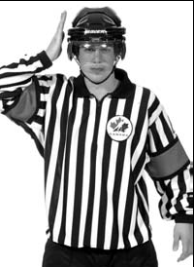
REFEREE’S SIGNALS
HEAD CONTACT
Patting flat (open palm)
of the non-whistle hand
on this side of the head.

Slide 18
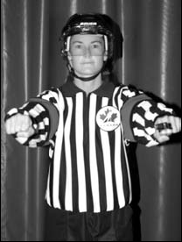
REFEREE’S SIGNALS
CROSS-CHECKING
A forward and backward
motion of the arms with
both fists clenched,
extending from the chest
for a distance of about
one foot.

Slide 19
REFEREE’S SIGNALS
DELAYED OFF-SIDE
Non-whistle arm fully
extended above the head.
To nullify a delayed offside
the Linesman shall
drop the arm to
the side.

Slide 20
REFEREE’S SIGNALS
DELAYED CALLING PENALTY
Extending the non-whistle
arm fully above the head.

Slide 21
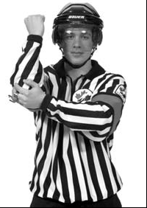
REFEREE’S SIGNALS
ELBOWING
Tapping either elbow with
the opposite hand.

Slide 22
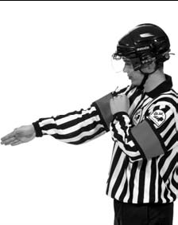
REFEREE’S SIGNALS
GOAL SCORED
A single point directed at
the goal in which the puck
legally entered.

Slide 23
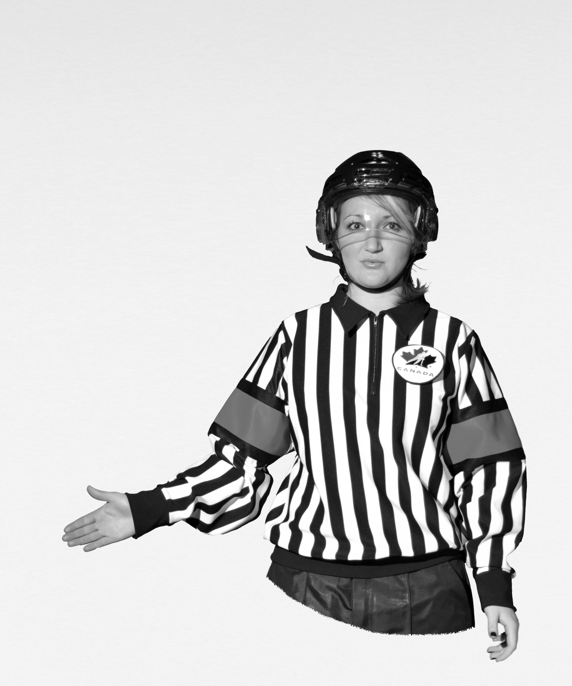
REFEREE’S SIGNALS
HAND PASS
Arm lowered, palm open, forward motion .

Slide 24
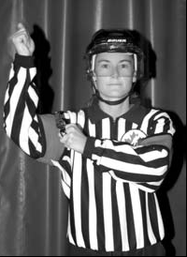
REFEREE’S SIGNALS
HIGH STICKING
Holding both fists
clenched, one immediately
above the other at the
height of the forehead.

Slide 25
REFEREE’S SIGNALS
HOLDING
Clasping either wrist with
the other hand in front of
the chest.

Slide 26
REFEREE’S SIGNALS
HOLDING THE STICK
Two stage signal involving
the holding signal (shown
above) followed by a signal
indicating you are holding
onto a stick with two
hands in a normal manner.

Slide 27
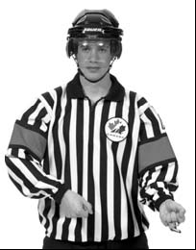
REFEREE’S SIGNALS
HOOKING
A tugging motion with both
arms as if pulling something
from in front toward
the stomach.

Slide 28
REFEREE’S SIGNALS
ICING THE PUCK
The back Referee or Linesman
Signals a possible icing by fully
extending either arm over her
head. The arm should remain
raised until the front Referee or
Linesman, either blows the
whistle to indicate an icing or until
the icing is washed out. Once the
icing has been completed, the
back Referee or Linesman will then
point to the appropriate face-off
Spot.

Slide 29
REFEREE’S SIGNALS
INTERFERENCE
Crossing arms stationary
in front of the chest.

Slide 30
REFEREE’S SIGNALS
KNEEING
Slapping either knee with the
Palm of the hand, while keeping
both skates on the ice.

Slide 31
REFEREE’S SIGNALS
MATCH PENALTY
Patting flat of the hand on
the top of the head.

Slide 32
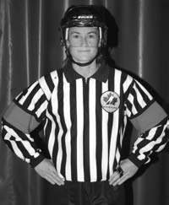
REFEREE’S SIGNALS
MISCONDUCT
Both hands on hips.

Slide 33
REFEREE’S SIGNALS
PENALTY SHOT
Arms crossed above the
head. Give the signal upon
stoppage of play.

Slide 34
REFEREE’S SIGNALS
ROUGHING
Fist clenched and arm
extended out to the front
or side of the body.

Slide 35
REFEREE’S SIGNALS
SLASHING
A chopping motion with
the edge of one hand
across the opposite
forearm.

Slide 36
REFEREE SIGNALS
SPEARING
Jabbing motion with both
hands thrust out immediately
in front of the body
and then hands dropped
to the side of the body.

Slide 37
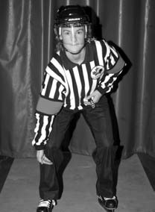
REFEREE’S SIGNALS
TRIPPING
Striking leg with either
hand below the knee,
keeping both skates on
the ice.

Slide 38
REFEREE’S SIGNALS
UNSPORTSMANLIKE CONDUCT
Using both hands to form
a “T” in front of the chest.

Slide 39
REFEREE’S SIGNALS
WASH OUT
A sweeping sideways motion of
both arms across the front of the
body at shoulder level with palms
down. This signal is used:
(a) by the Referee to signal “no goal”;
(b) by the Linesman to signal “no icing” and in certain situations “no off-side”.

Slide 40
Penalty Calling Procedure
Questions?

