Slide 1

PARTNERSHIP

Slide 2
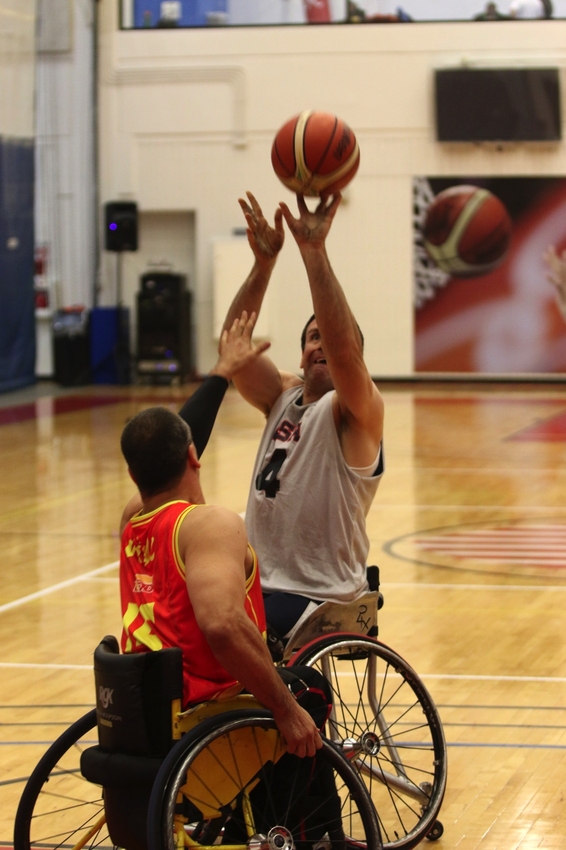

ABOUT THE NWBA
NATIONAL WHEELCHAIR BASKETBALL ASSOCIATION
Founded in 1948, the NWBA is the longest standing and largest Disabled Sports Organization in the World.
The NWBA is comprised of 7 Divisions, 22 Conferences, and over 200 Teams.
NWBA hosts a National Tournament annually featuring the top teams from each division to compete for the National Title.
NWBA is the model sport governing body: We Lead, We Inspire, We Win.
The U.S. Olympic Committee recognizes the NWBA as the National Governing Body for Wheelchair Basketball.

Slide 3
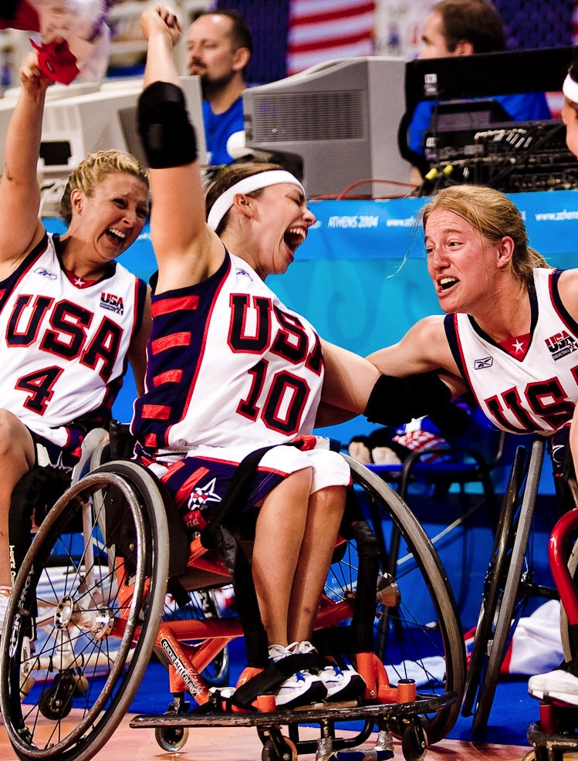
NWBA TEAMS & MEMBERSHIP
NWBA DIVISIONS
Junior Prep
Junior 10’ (Varsity)
3 Adult Divisions (D-I, D-II, D-III)
Intercollegiate Men’s
Intercollegiate Women’s
Women’s
MEMBERSHIP
38 States plus Puerto Rico, Ontario and Quebec
2,678 Athletes
Over 3,100 Total Individual Members
227 Teams
Membership made up of Men, Women, Youth and Veterans

Slide 4

















NWBA TEAMS & MEMBERSHIP
2014-2015 TEAM MEMBERSHIP
25 NBA Team Affiliations
8 Collegiate Programs
38 States (Teams/Athletes)
California (20 / 230)
Illinois (20 / 230)
Texas (14 / 162)
Washington (12 / 145)
N Carolina (9 / 104)
Florida (8 / 104)
Michigan (11 / 100)
Alabama (7 / 89)
Arizona (9 / 88)
Minnesota (5 / 69)
Information from 2014-15 NWBA Membership Database

Slide 5
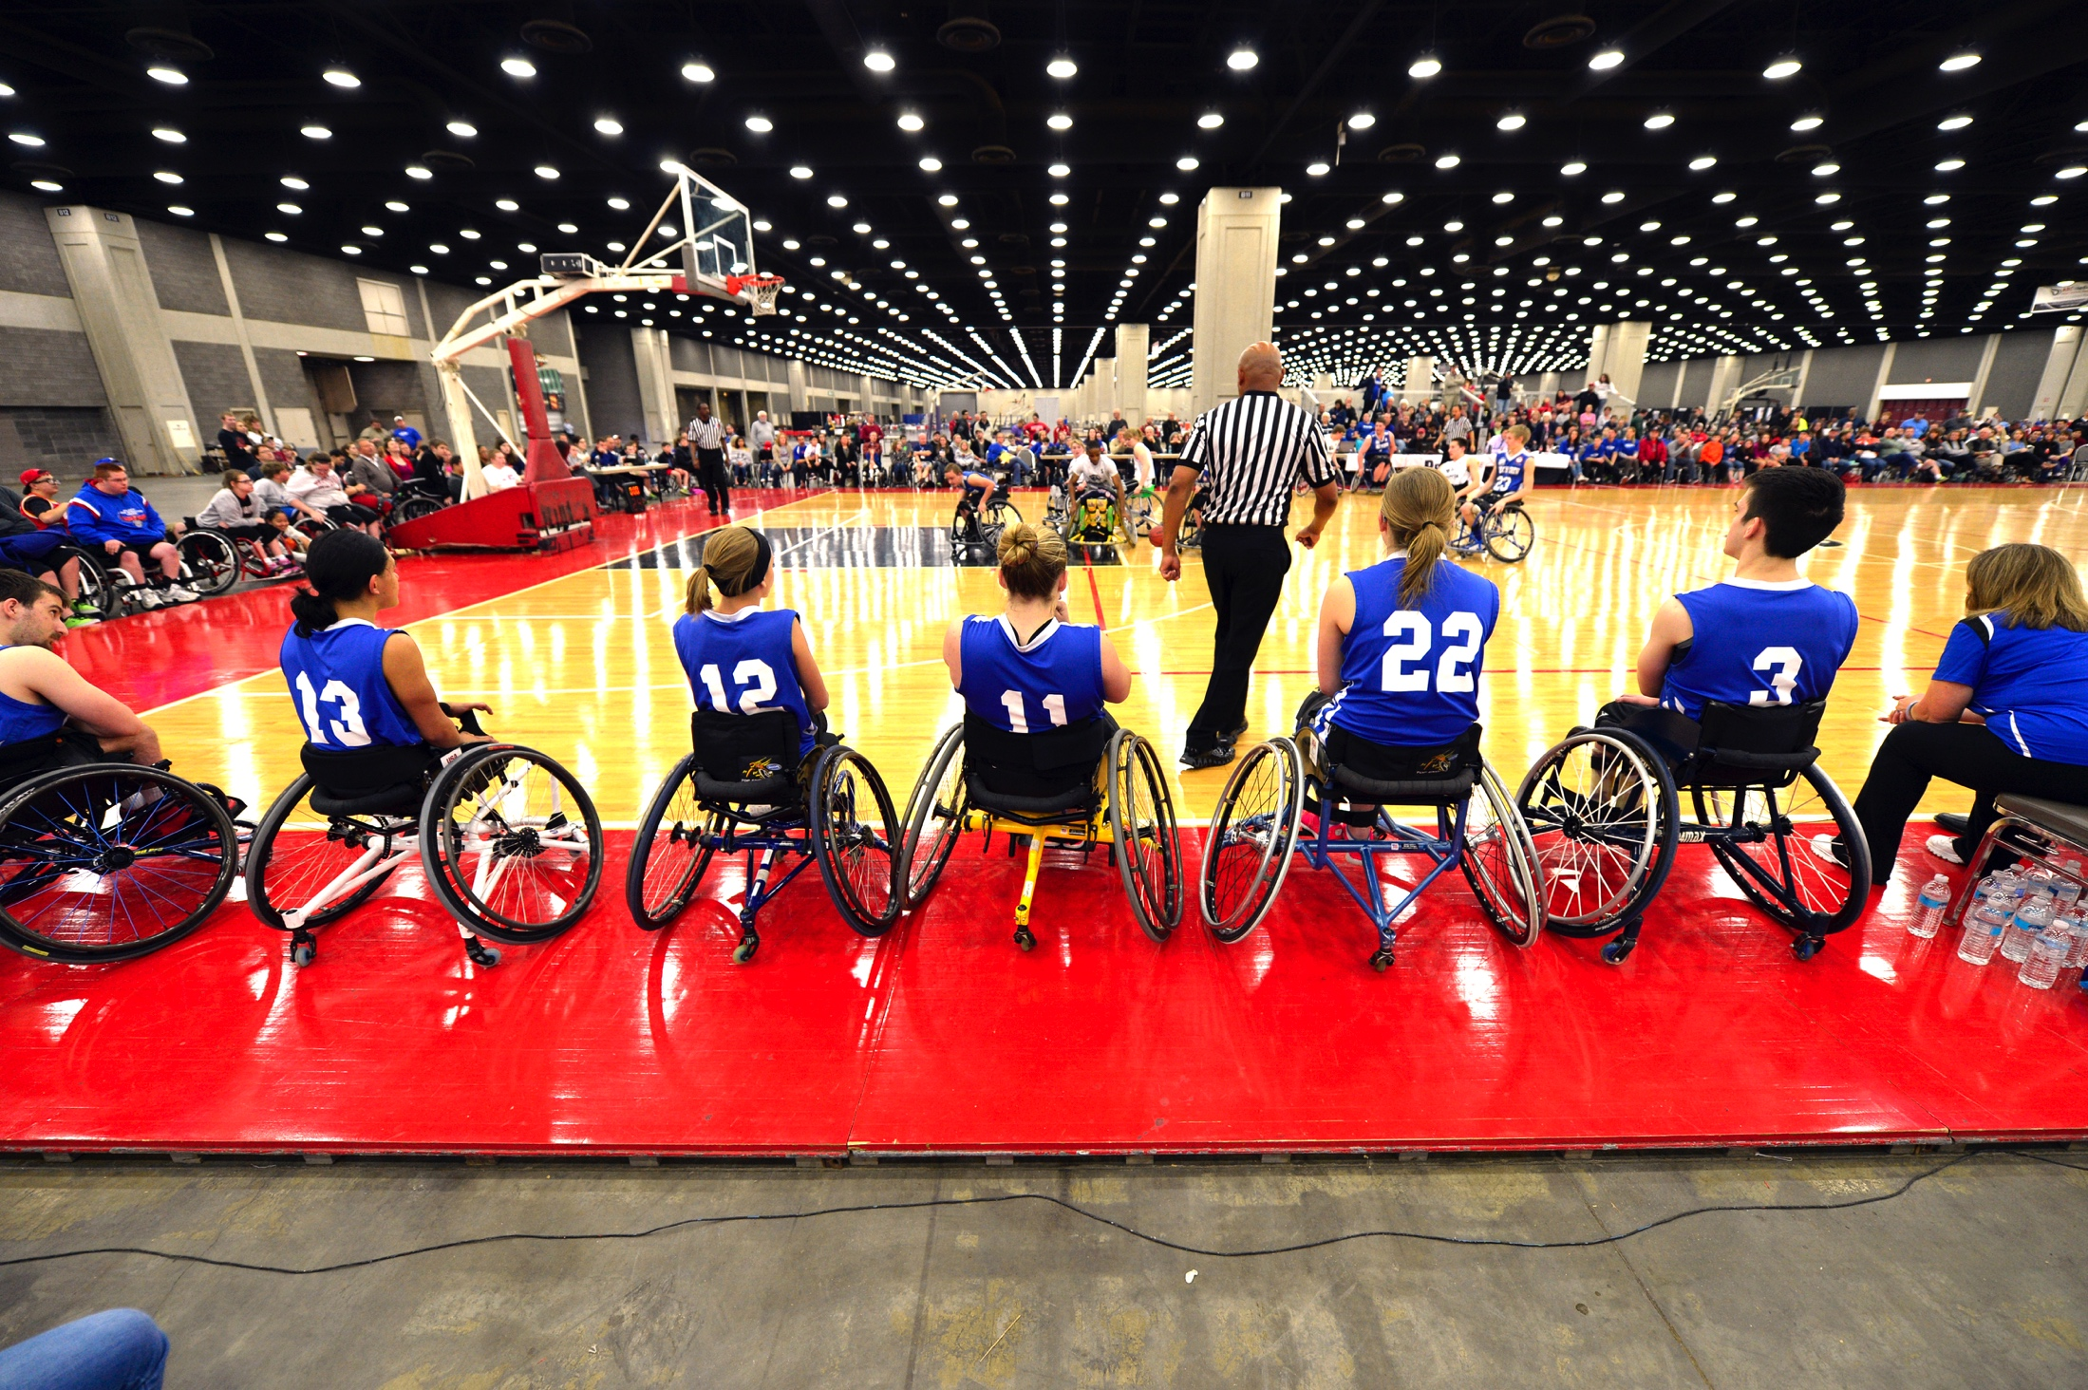

NWBA DEMOGRAPHICS
PARTICIPANTS
Men 68%
Women 32%
Veterans 15%
AGE
13 & Under 18%
14-18 16%
19-30 27%
31+ 37%
Basketball leads all participation in Paralympics
18,461

Slide 6
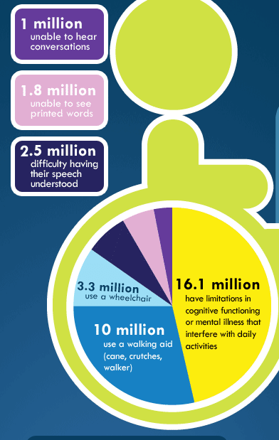
U.S. DEMOGRAPHICS
19.4 million - Number of people 5 and older who have difficulty walking or climbing stairs.
-- Published July 26, 2011 by U.S. Census Bureau
3.6 million - Number of veterans with a service-connected disability rating in 2013.
-- American Community Survey
Disabilities affect One-Fifth of all Americans.
-- U.S. Census Brief, 1997

Slide 7
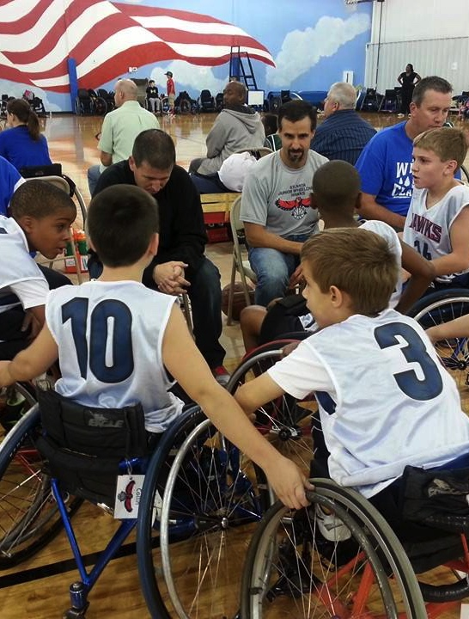
KEY PLATFORMS
NWBA is TRANSFORMING LIVES through its five core services, which are the key marketing platforms for the organization.
Coach and Player Development
Training, education & certification
Men’s and Women’s National Teams
Financial, Logistical, Training & recruitment
Youth, School, Collegiate
School and community-based programs
Events (local, regional, national)
Furthering the lives of disabled persons
Competitive opportunities
Operation Rebound
Transformation & rehabilitation opportunities

Slide 8
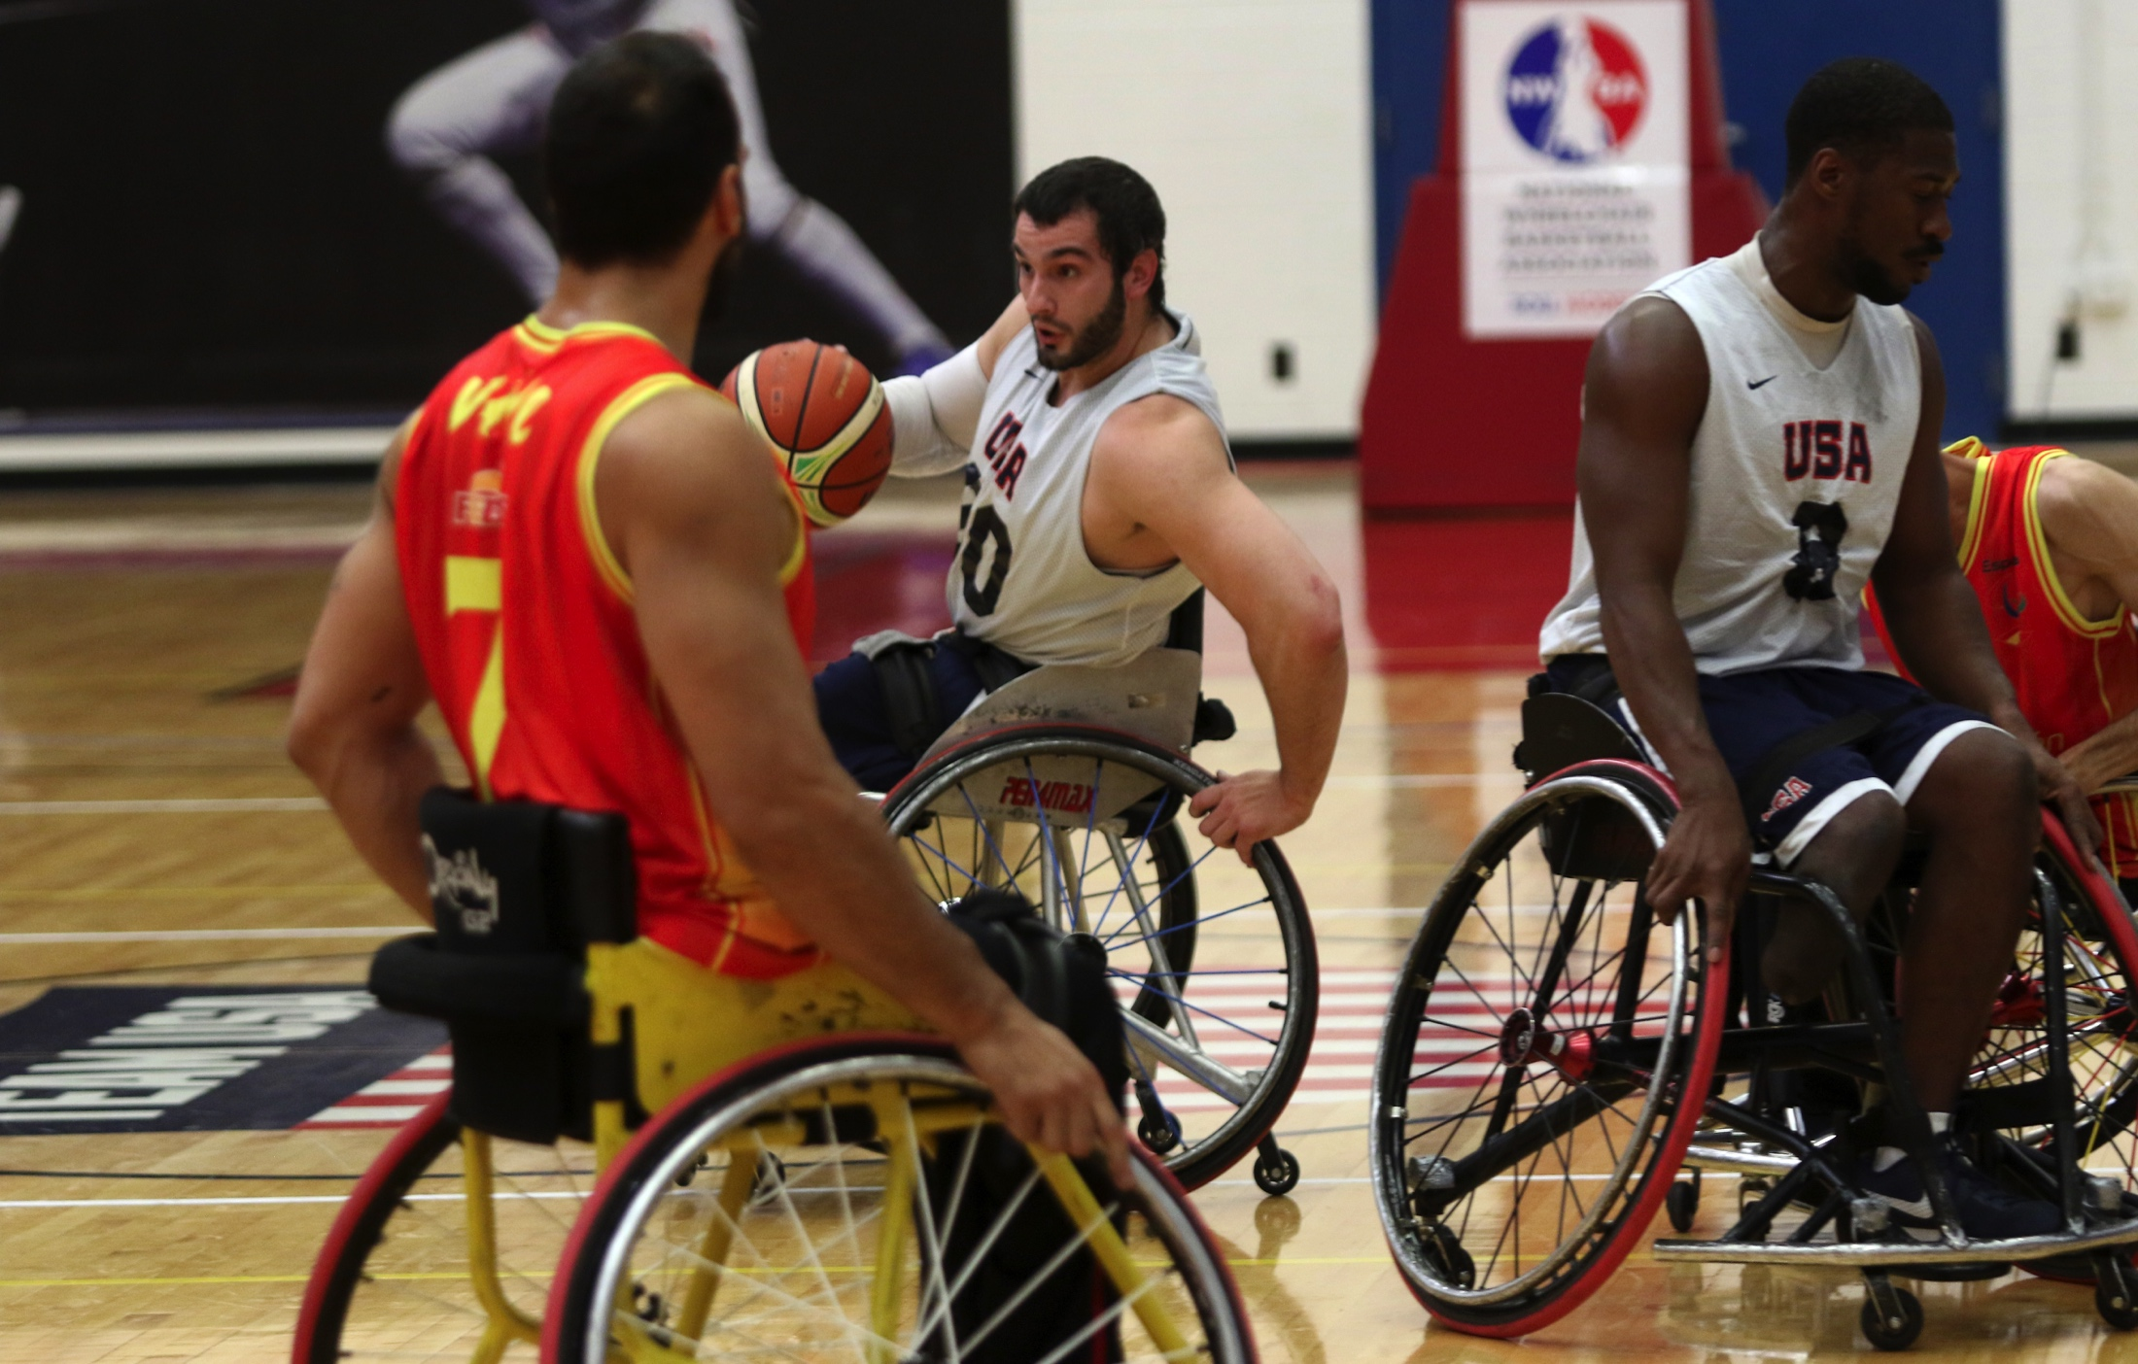


MEDIA INSIGHT
FANS
Men 62%
Women 37%
CITY FANS
Chicago
Los Angeles
Colorado Springs
Houston
New York
FACEBOOK FOLLOWERS
12,168
FACEBOOK
Jan. to July ‘16
1,200%
increase
TIME OF DAY
Peak 5-10 p.m. EST
Average 3,000 Fans

Slide 9
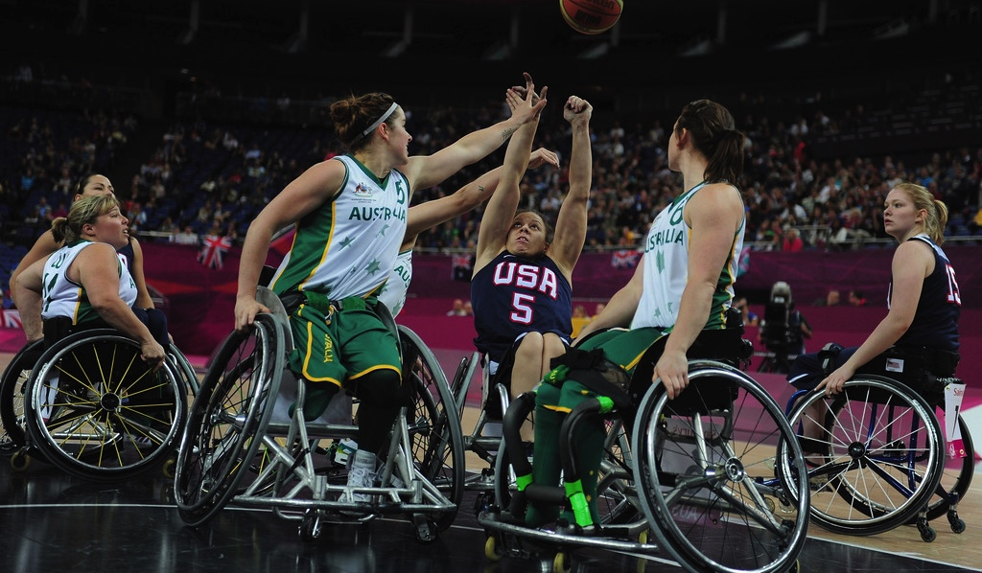
MEDIA INSIGHT
FANS
Men 70%
Women 30%
EDUCATION
High School 46%
College Grads 34%
Graduate 19%
HOUSEHOLD INCOME
$60k-$99k 32%
$100k-$149k 24%
$150k+ 11%
HOME OWNERSHIP
Own 76%
Rent 24%
TWITTER FOLLOWERS
4,475

Slide 10
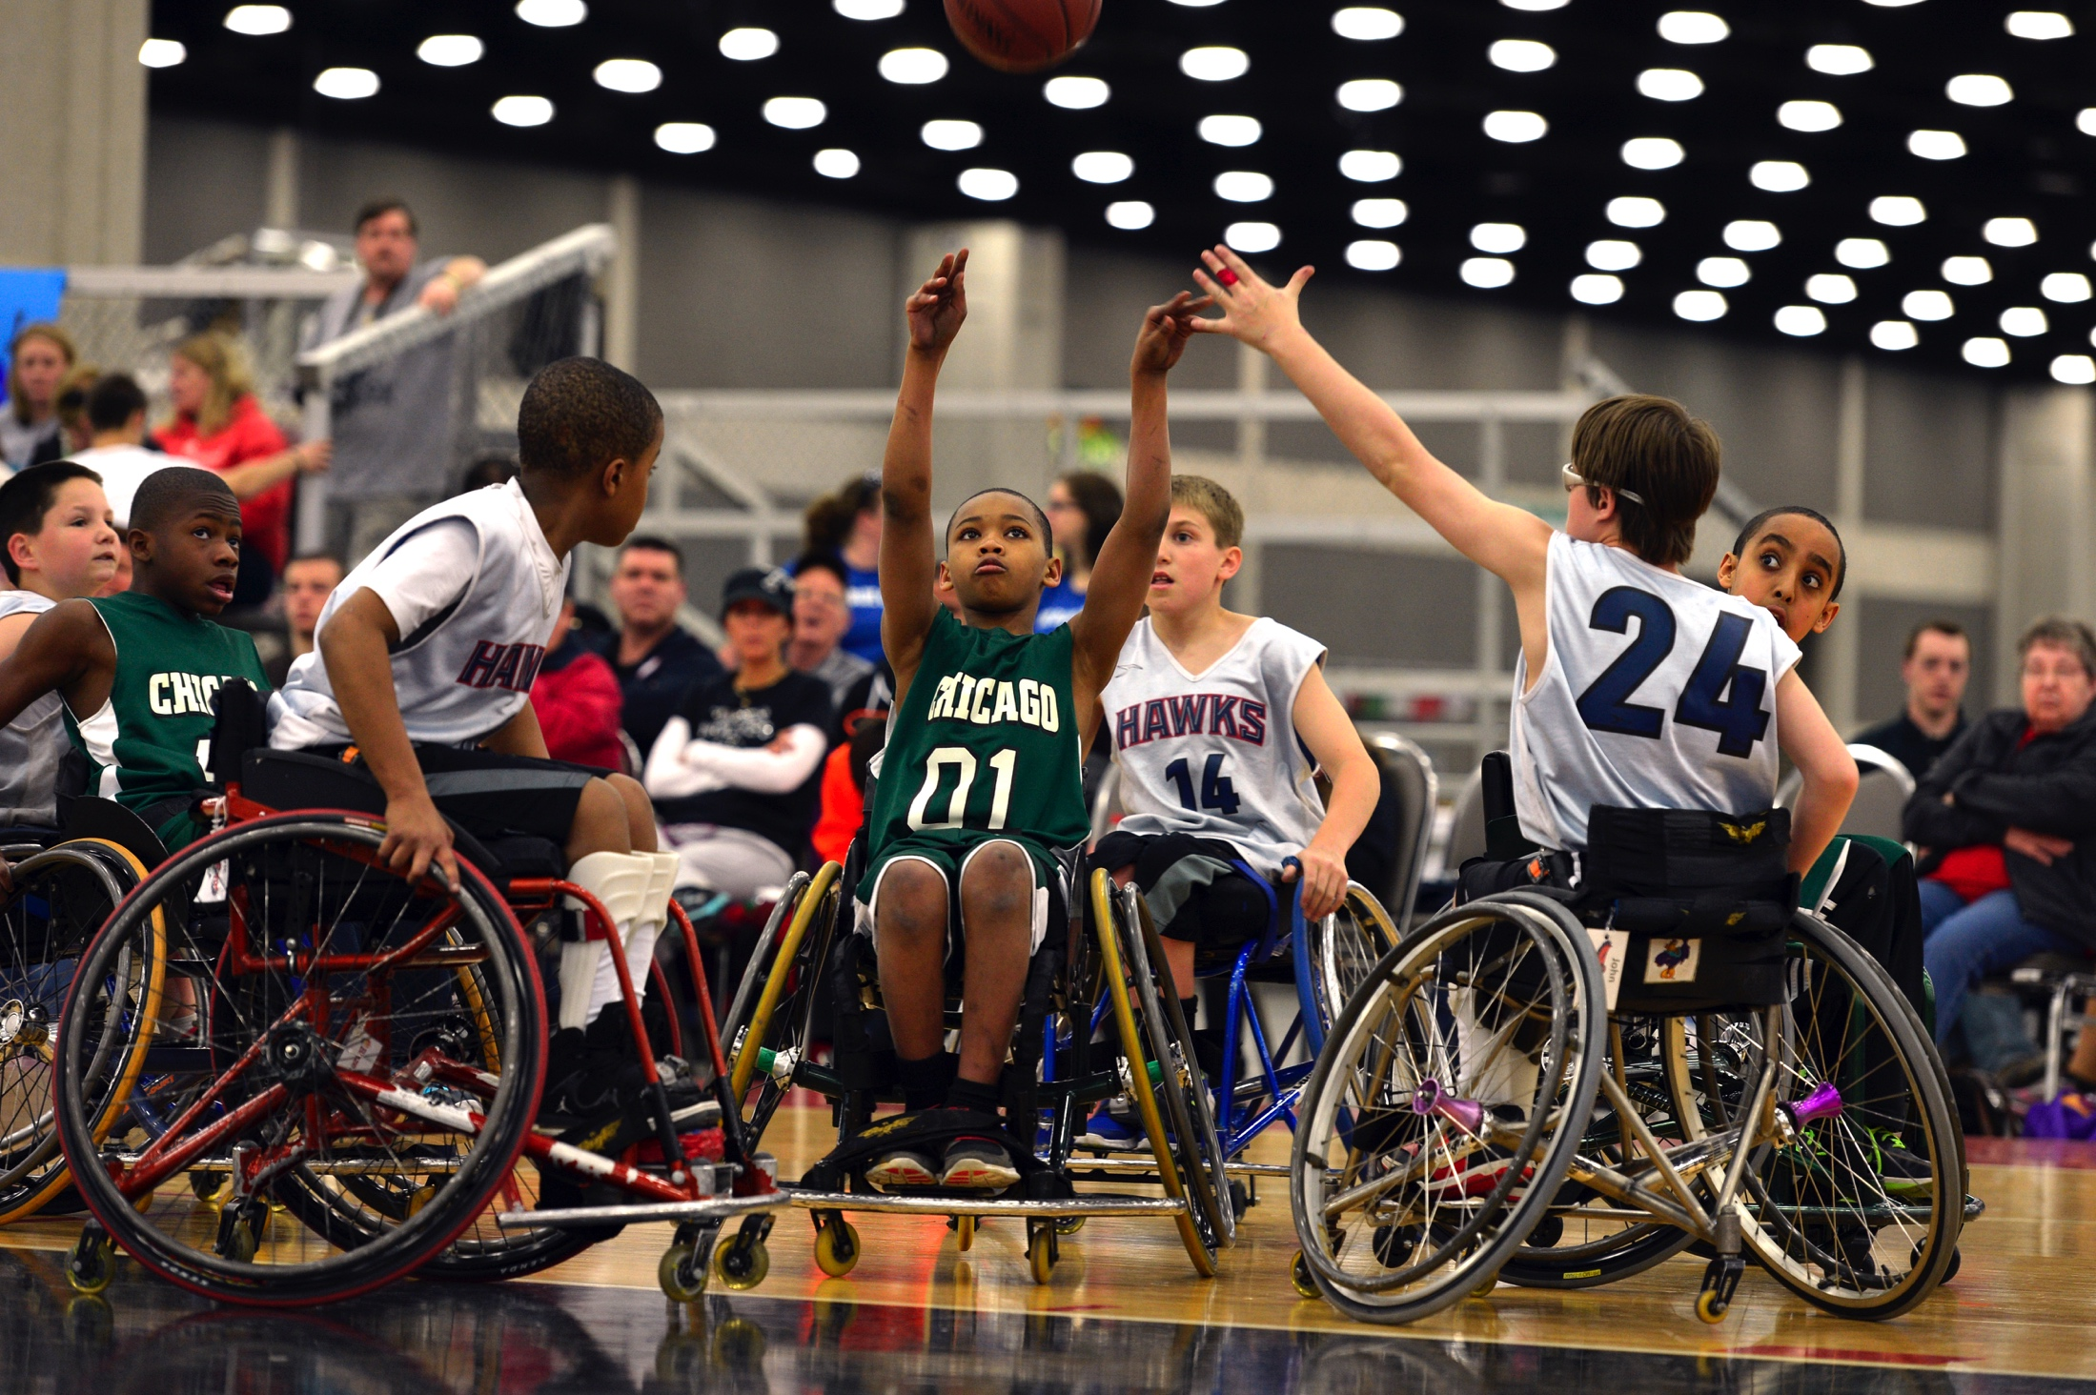
MEDIA INSIGHT
INSTAGRAM FOLLOWERS
1,301
YOUTUBE FOLLOWERS
NWBA.TV
845
NAT’L CHAMPIONSHIPS STREAMED LIVE
5,735
VIEWS

Slide 11
PARTNERSHIP
INSERT PARTNER LOGO
INSERT LARGE PICTURE

Slide 12
RIGHTS
INSERT EVENT NAME
Naming Rights
Marks and Licensing Rights
Selling and Sampling Rights
Marketing & Branding Rights
Entitlements Rights
INSERT PICTURE

Slide 13
TEAM
INSERT TEAM NAME
Team Uniforms Branding
Team Warm-Ups Branding
Casual Apparel Branding
Appearances
Bags
Ball bags
Chair bags
Apparel bags
Wheelchair
Spoke guards
Rear Axle
Wheels
INSERT PICTURE

Slide 14
COMMUNITY OUTREACH
COMMUNITY INTEGRATION
Corporate appearances
Hospital appearances
Military base appearances
INSERT PICTURE

Slide 15
INSERT NAME OF EVENT
EVENT INTEGRATION
Signs
Basket Stanchions
Floor decals
Bench
Front/back court
Top of key
Courtside A Frames
Side out A Frames (large)
Table clothes
Backboard
Shot Clock (runner)
Wayfinder/Welcome banners
Exhibit Space
In-game promotions
PA Announcements
Program Ads
Program – coupons
Social media integration
Autograph Sessions
Tickets
Hospitality & social events
Marketing Collateral (tags)
Lanyards & Credentials
Medical Trainers & Classifiers
INSERT PICTURE

Slide 16
DIGITAL MEDIA
WEB & DIGITAL INTEGRATION
Website
Content enhancements
Ads
Social integration
Live Streaming
Entitlement
Interstitials
Product placements
Enewsletter (entitlement, ads)
Social Media Integration
Media Guides
Scorebooks (electronic, static)
Videos (‘Athlete of the Week’)
INSERT PICTURE

Slide 17
PUBLIC RELATIONS
PR INTEGRATION
Press Releases
INSERT PICTURE

Slide 18
ASSETS
RIGHTS
Naming
Marks
Selling and Sampling
Marketing & Branding
Entitlements
NATIONAL TEAMS
Team Uniforms
Team Warm-Ups
Casual Apparel
Appearances
Bags
Ball bags
Chair bags
Apparel bags
Wheelchair
Spoke guards
Rear Axle
Wheels
COMMUNITY OUTREACH
Corporate appearances
Hospital appearances
Military base appearances
NATIONAL EVENTS
Signs
Basket Stanchions
Floor decals
Bench
Front/back court
Top of key
Courtside A Frames
Side out A Frames (large)
Table clothes
Backboard
Shot Clock (runner)
Wayfinder/Welcome banners
Exhibit Space
In-game promotions
PA Announcements
Program Ads
Program – coupons
Social media integration
Autograph Sessions
Tickets
Hospitality & social events
Marketing Collateral (tags)
Lanyards & Credentials
Medical Trainers & Classifiers
MEDIA
Website (NWBA Hub)
Content enhancements
Ads
Social integration
Live Streaming
Entitlement
Interstitials
Product placements
Enewsletter (entitlement, ads)
Social Media Integration
Media Guides
Scorebooks (electronic, static)
Videos (‘Athlete of the Week’)
PUBLIC RELATIONS
Press Releases

Slide 19
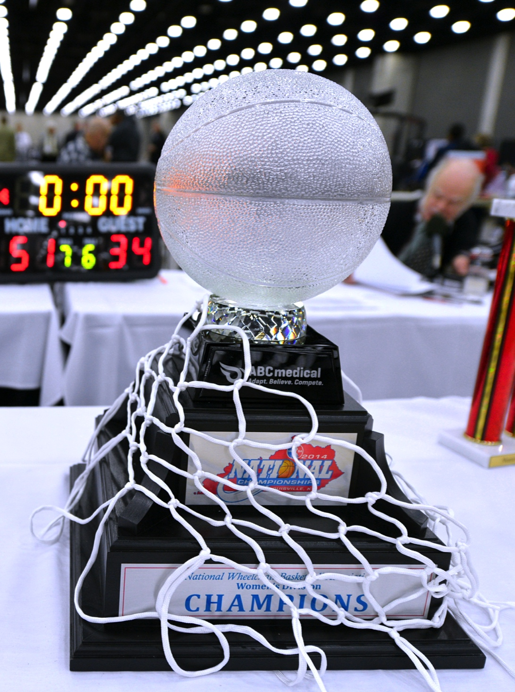
CONTACT
Name
Title
Phone
Email
Organization
Address
City, State, ZIP
WEBSITE

