Slide 1

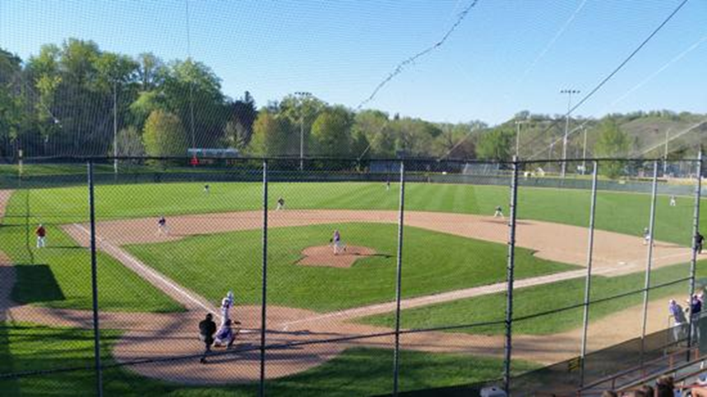
Winger Baseball 2016
Pre-Season Meeting

Slide 2
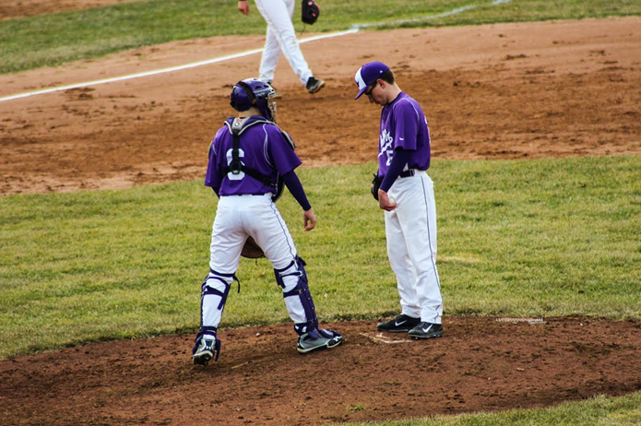
Why are we here?
“The single biggest problem with communication is the illusion that it has taken place.” – George Bernard Shaw

Slide 3
2016 Coaching Staff
Paul Hartmann – Varsity
Kyle Blahnik – Varsity
Chris Guetzlaff – Varsity
Justin Plein – Junior Varsity
Josh Terrio – 9th Grade

Slide 4
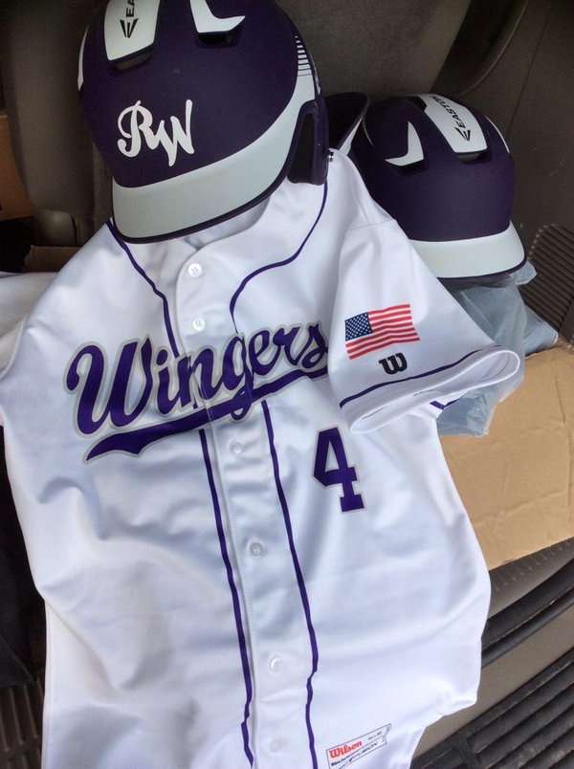
Practice – begins March 21
Inside/outside. Be ready for both
What do I need?
All baseball items, including;
Spikes/Tennis Shoes
Long sleeves/sweatshirts/t-shirts
Practice pants
RW Hat – Last years…
New ones are not in yet.
J Band
Winter hats are ok to wear

Slide 5
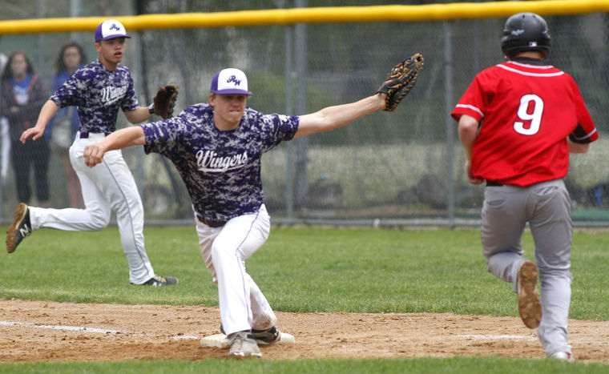
Practice Groups
For the first week of practice, we will have two practice groups.
This is subject to change based on weather – younger group less likely to change.
Practice to be held at the PI Arena and HS fields.
Group 1 (3:00 – 5:30)
Seniors, Juniors, some sophomores
Group 2 (4:30 – 6:30)
Freshmen and sophomores

Slide 6
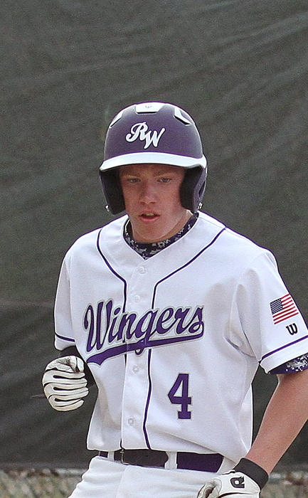
Winger Baseball Philosophy
Varsity Priority (in this order)
Understanding role relative to the TEAM
1. Competitiveness – “Play for the Pile”
2. Player Development
3. Participation
JV Priority (in this order)
Understanding role relative to the TEAM
1. Player Development
2. Participation
3. Competitiveness

Slide 7
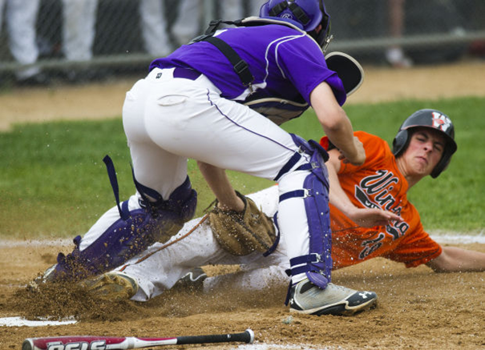
Winger Baseball Philosophy
9th Grade Priority (in this order)
Understanding role relative to the TEAM
1. Player Development
2. Participation
3. Competitiveness
* We will NOT cut at the 9th grade level.

Slide 8
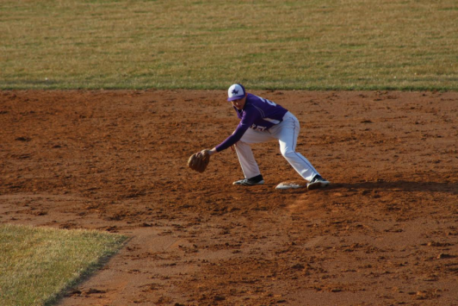
Varsity Roles
We have identified 20 roles throughout our season.
1. First Base 11. Starting Pitcher
2. Second Base 12. Reliever/Spot Starter
3. Third Base 13. Reliever/Spot Starter
4. Shortstop 14. Reliever/Spot Starter
5. Left Field 15. Reserve Catcher/Bullpen
6. Center Field 16. Reserve Mid-Infield/PR
7. Right Field 17. Reserve Corner Infielder
8. Catcher 18. Reserve Outfielder/PR
9. Starting Pitcher 19. LH Pinch Hitter / PR
10. Starting Pitcher 20. RH Pinch Hitter / PR
We will be keeping players in grades 9-12
who have earned 1 or more of these roles.

Slide 9
Varsity Roster
We have found that the ideal varsity roster size is 14-15
Some players will fill multiple roles
Multifaceted players allow us to keep roster size manageable (and playing time for everyone a reality).
The more things a player can do (field, hit, run, pitch) and the more positions they can play- the more they increase their chances of filling a roster spot.

Slide 10
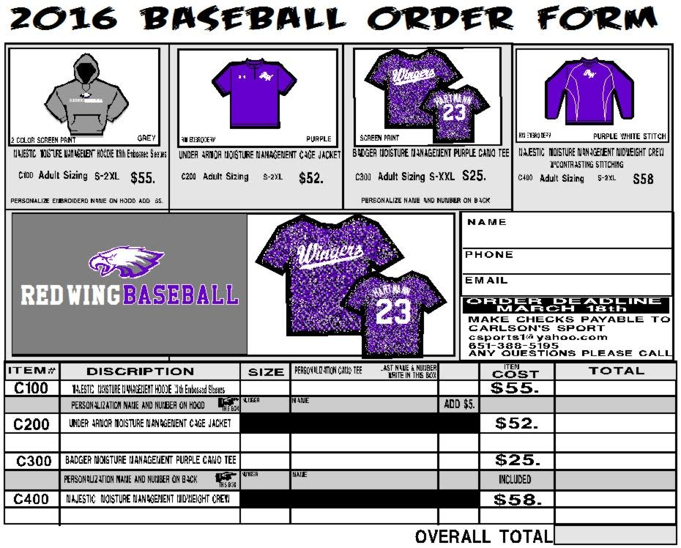
Apparel orders – Due Friday, March 18

Slide 11
Remind 101
Instructions for sign up are on website
http://www.gowingers.com/page/show/2337231-baseball-2016-
9th Graders – “Sign up” for 9th Grade
10th and 11th – JV and Varsity
12th – Varsity
Do not reply to remind messages.

Slide 12
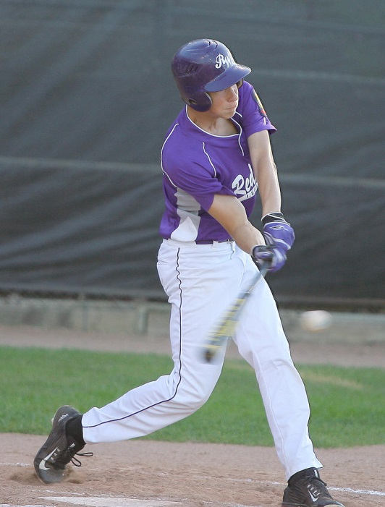
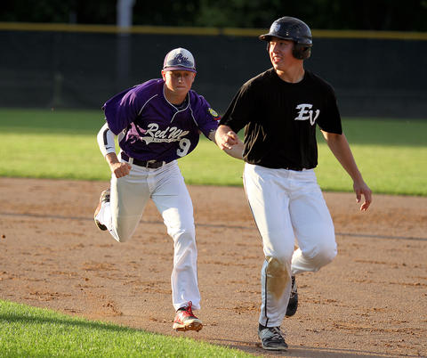
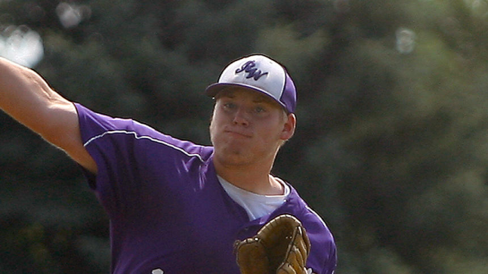
Summer baseball
Legion and VFW Baseball are an extension of our season.
Tryouts for these teams will take place from March 21 – May 21
Signup day and deadline is April 2.

Slide 13
Athletic Field Help
Seniors, juniors, sophomores…
Mr. Newman needs our help – Thursday, 3/17
Taking down old wind screen
We trade our labor for practice time at the athletic field.
Right after school – if we get enough help, Newmy says it will take 30 minutes.

Slide 14
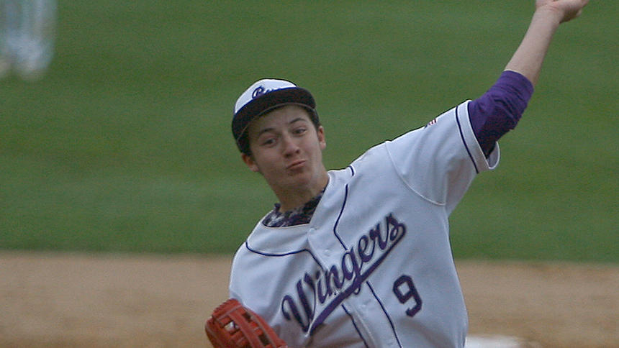
Questions?

