Slide 1

THE ROLE OF THE COACH IN THE DEVELOPMENT OF THE TOTAL PLAYER
Presented by:
Al Bloomer
USA Hockey Director Emeritus
2015
Notes:
How many of you have regular coaching responsibilities?
How many directly involved in Player Development Program?

Slide 2
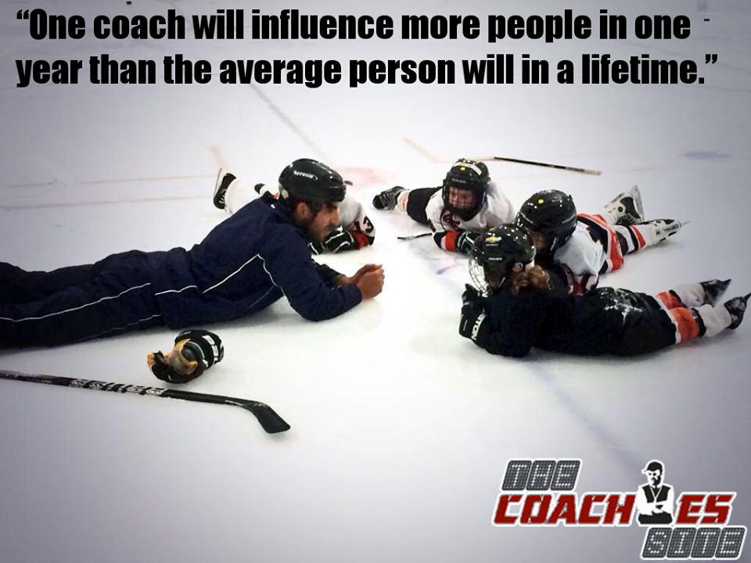


Slide 3


Lou Vairo
A Tradition of Excellence
Notes:
Bob Johnson --- Dave Peterson

Slide 4


What is your why?
Why do you want to be a hockey coach?
Why do you coach this age classification?
What is your coaching Philosophy?
What is your coaching style?
What are your expectations??
What are your long & short term goals?
When things are not going well, remind yourself of your WHY.

Slide 5
Development
Definition
Bring out natural talents
Eliciting hidden skills / potential
Long term commitment
Player, Team, Coach
Impact / Influence of Style of Play
Comfort Zone – target the struggle
Struggle is not an option
Players are visual learners – they become clever through their mistakes.

Slide 6

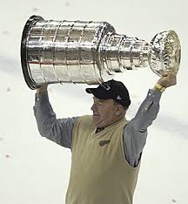
“When a coach stops learning and developing, he begins moving backwards”
Scotty Bowman

Slide 7
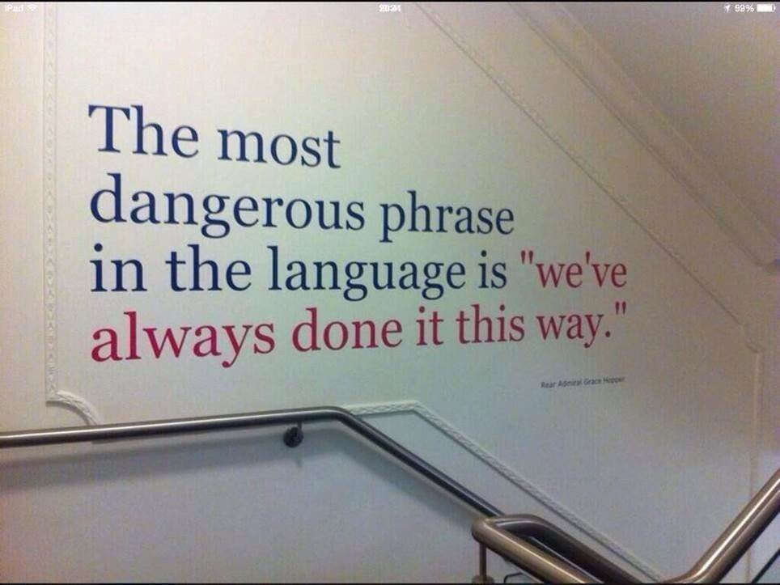

Slide 8

Challenges
Coaching Philosophy / Expectations / Objectives
The foundations of leadership
Parent Issues – communicating expectations, strategies & discipline
Player attitude – purpose - expectations
Community expectations / politics
Team Building – creating and maintaining a foundation for success
Teaching Technical Skills - progressions
Teaching Tactical Concepts – age appropriate

Slide 9
Katey Stone – USA Women’s National Team
Coaching Philosophy

Slide 10

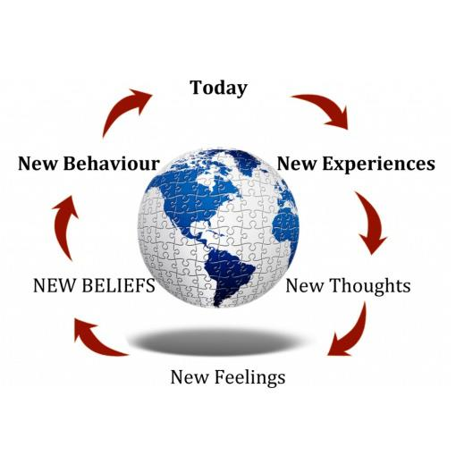
What Shapes Your Coaching Philosophy?
Core values
Personal experiences
Systemic / community expectations
Level of play – athletes available
Time available

Slide 11
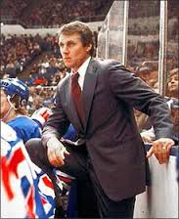

CHARACTERISTICS OF SUCCESSFUL COACHES
Serious – Dedicated
Creative
Passion
Ethical - Reputable
Take Responsibility – Expanded Roles
Politically Aware
Have a Mentor(s)
Life Long Learners
Professional in Manner and Behavior
Have Fun

Slide 12
Coach’s Role
Give players the opportunity to achieve goals and reach expectations.
Be a positive example.
Hold players accountable, development is up to the player.
Talent may not be the determining factor, grit, perseverance, willingness to learn are keys.
Give players your best effort.

Slide 13
Coaching From the Inside Out
You must love the process, love the grind. Embrace the challenge of making your players better.
If you measure your success or effectiveness by wins – it is time to re- evaluate.
If winning becomes a relief – it is time to step back and re-evaluate.

Slide 14
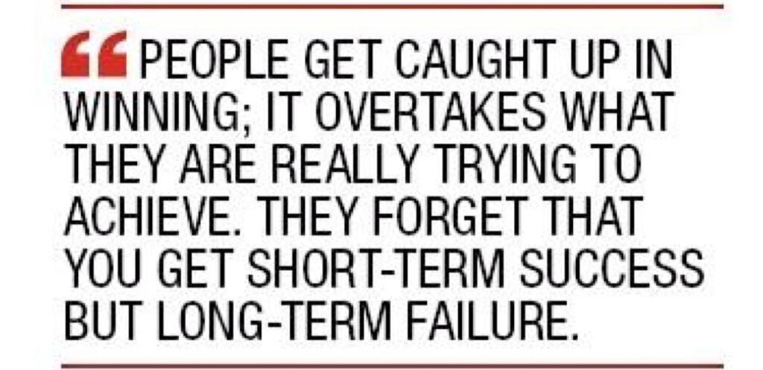

Slide 15
If your players are not learning and improving.
It may be time to evaluate your teaching methods and modify your approach to better fit with the way the players learn.

Slide 16


Slide 17
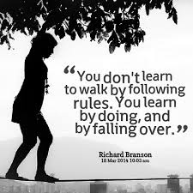
Methods Impact Player Development
Flexible vs. Consistent Skill Circuits
Players decisions
Situations becomes the teacher
Learn by doing – Activity teaches
Walk
Bottom Up method – Early Success
False environment in practice
Top Down Method – Long Term Success
Conceptual
Competitive
Decision making
Variable

Slide 18
“The best teacher / coach is one who makes himself progressively unnecessary”
Thom Caruthers

Slide 19
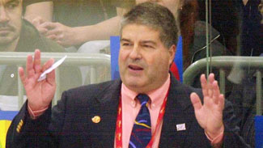
“It is not your job to be liked by your players, your job is to like them”
“Your players will not care what you know, until they know how much you care”

Slide 20
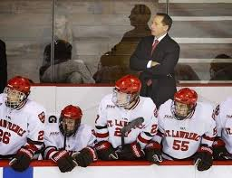
The coach should be the most prepared person at practice.
The coach must be the most disciplined person at games.

Slide 21

What’s Important?
Training, Training, Training!
Practice Habits and Being Coachable
Passion & Purpose
Mental Toughness & Discipline
Rest-Nutrition-Recovery
Respect For The Game and People
“You are crazy if you think 18 year olds are even near their maturation. Hockey players do not reach full development until they are 26 years old.”
Dean Lombardi – GM L.A. Kings

Slide 22
COMPONENTS IN DEVELOPMENT OF THE COMPLETE PLAYER
Competitive Spirit
Next play effort
Wins 1 vs. 1 battles
Play away from puck
Functional Intelligence
Hockey sense
Situational awareness
Puck Possession Skills
Protection
Pass & receive
Shooting
Speed
Recognition – Awareness
Agility

Slide 23

Suggested Reading
Talent Code by Daniel Coyle
Sports Gene by Dave Epstein
Hard Hat by Jon Gordon
Leading With the Heart by Mike Krzyzewski

Slide 24
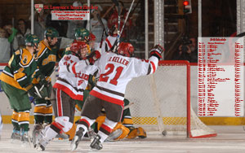

“The habits we develop in becoming good are often the ones that prevent us from becoming great.”
Tiger Woods

Slide 25
IMPACT OF THE COACH
I have come to the frightening conclusion.
I am the decisive element on the ice.
It is my personal approach that creates the climate.
It is my daily mood that makes the weather.
As a coach, I possess tremendous power to make a player’s life miserable or joyous.
I can be the tool of torture or the instrument of inspiration.
I can humiliate, humor, hurt or heal.
In all situations it is my response that decides whether a crisis will be escalated or de-escalated and a player humanized or de-humanized.
Adapted by Al Bloomer from Hiam Ginott

Slide 26


Slide 27
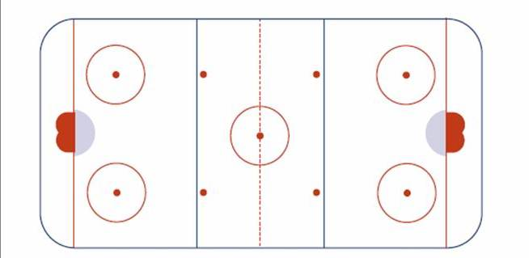
You are given a sheet of ice
and players
What you see is what you coached.

Slide 28
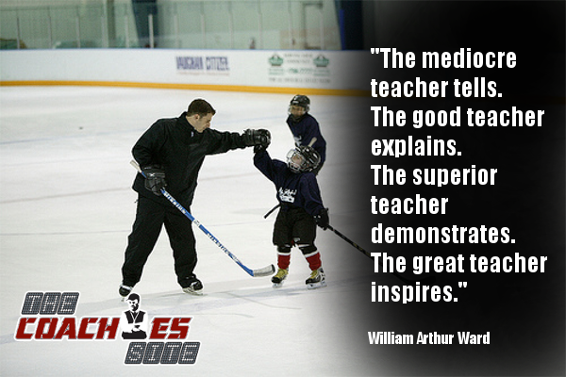
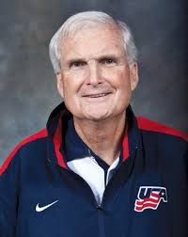
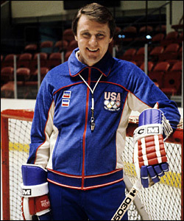
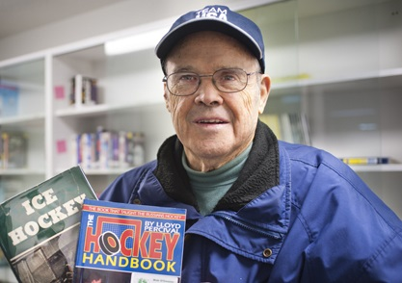
THANK YOU

