Slide 1
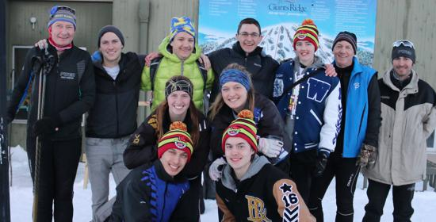
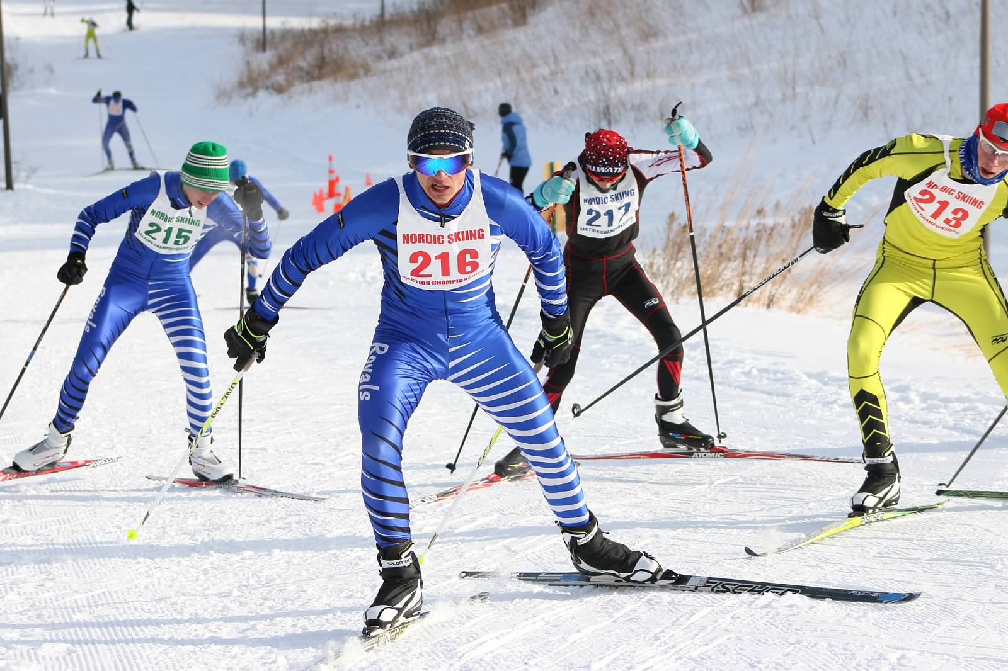
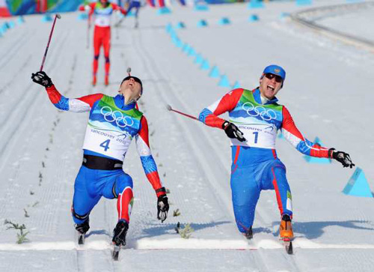
Welcome!!!

Slide 2
Itinerary
Team Website with calendar
Coaches
What is Skiing/Experience
Practices & Races
Season Highlights
What is needed for equipment
Ski pass & Parking Pass for State Parks
Rental Program/Prices & places to buy skis
Team Policies
Team Suits & jackets – Racing policy
Transportation to practices
Open floor for questioning

Slide 3
Team Website/CALENDAR
www.erhsactivities.com
  PWER Nordic
http://www.erhsactivities.com/page/show/1148964-pwer-nordic-ski
Team Calendar
  http://www.erhsactivities.com/page/show/1112222-calendars

Slide 4
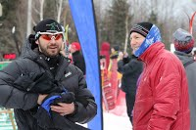
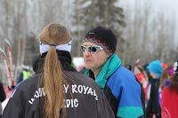
Coaches
Head Coach
-Joe Wacker
Assistant Coaches Volunteer Coaches
-Ryan Jensen -Jim Reckinger
-Matt Maher -Dale Thompson
“Develop a strong Nordic presence in the South Washington community by creating competitive teams and ensuring a great experience for our athletes”

Slide 5
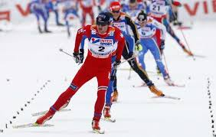
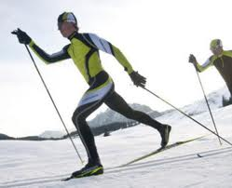
What is Nordic
We teach you how to ski!
(No Experience Needed)

Slide 6



PWER Nordic

Slide 7
Practice Locations & Races
TWO TYPES OF PRACTICES
Individual High School Practices: Begin at 3:30 and end at 5:30
3 School Practice: 4:00 at one site End at 5:30
Meeting Locations @ High Schools
Park – The encased wolf near the activities entrance
Woodbury – Vending machines by the Pool
East Ridge – Trophy case near Activities entrance
Trails
-Lake Elmo Trailhead (Oakdale/Lake Elmo) (Meet at Ski House)
-Battle Creek (Maplewood) (Meet next to the Rec Center)
-The Ravine Regional Park (Cottage Grove) (Meet Next to the Pavilion)
Races:
-Sites vary based on snow, Battle Creek, Como, Lake Elmo, Hyland, Elm Creek, Theodore Wirth
Refer to team calendar

Slide 8
Season Highlights
November 9th First Practice
November 14th Birthday Workout & Order Forms
Novermber 20th Nordic Kick-Off Party
November 21st Ski Rental
November 23rd Wax Clinic (During Practice)
11/23-11/25 Uniform Distribution
December 1st First Race
12/20-12/22 Michigan Trip (35 Athletes)
December 31st Fundraising
January 9th Mesabi East or Loppet Invite
January 18th MLK Pursuit
January/26t h Conference
February 2nd Sections for all schools
February 5th Costume Race
February 11 STATE MEET
February 28th Banquet

Slide 9
Equipment
Skis Skate & Classic or Combi
Poles Skate & Classic Poles
Bindings “Comes with skis”
Boots Skate & Classic / Combi
Kick Wax Purchase starter kit (Blue/Green/Red/)
Packages exist for $300-500
Rental Ski Program for 1st Year Skiers – Nov/21st
$100.00 Deposit Check

Slide 10
Clothes
Light Jacket X1 (preferably 2)
Under Armor/Long Underwear x3 (upper & lower each)
Winter Pants/Ski Pants X1 (preferably 2)
Hats X2
Gloves/Mittens X2
Watch
Drink Belt (Optional)
Running Shoes
Fall/Winter Running Clothes
Ski Bag

Slide 11
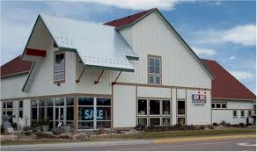

Where to purchase skis
Finn Sisu
Gear West
Joe’s Sporting Goods
www.skinnyski.com
  http://www.skinnyski.com/gear/sales.asp

Slide 12
Equipment Storage & Wax Room
Park High School:
Storage Closet next to the trainer’s office and between the boys varsity and gym locker room
Woodbury High School:
Door #6 Near the Activities Entrance
East Ridge High School: **No Wax Room**
Storage room near the boys locker room and next to the ice machine

Slide 13


Extra Fees
Washington County Park Pass (if you plan on driving)
  $25.00
Hyland Lake (Season Pass for Man Made Snow)
  $32.50 (Begins November 30th at the earliest)
Minnesota State Ski Trail Pass
  16 or older
  $20.00
    Booster Fee
    $40.00

Slide 14
Training Groups
Athletes will be assigned a “School Group” and a “Big Group”
  School Group
    First Day of Practice Athletes will be placed into one of three training groups. Varsity/JV/Devo (Based on Running ability)
    Maher = PHS Jensen/Reckinger = WHS Thompsn/Wacker = ERHS
  Big Group
  Friday November 13th Athletes will be placed into one of three training groups. Varsity/JV/Devo
    Devo = Reckinger & Maher J.V. = Jensen/Thompson Varsity = Wacker
Attendance & check-in/check-out each practice.
Athletes job to remember appropriate group

Slide 15
Expectations
Come to practice everyday willing to have fun, work, & Improve
Zero tolerance with bullying/ inappropriate/illegal behavior.
If you are going to miss practice your responsibility as an athlete to communicate with the Coach responsible for your group before you are absent
  Excused = No Problem Unexcused = Problem
  4 Unexcused = Dismissal
Varstiy & J.V. Skiers race Devo Team skiers train until ready to race
35 Spots for athletes on Michigan Trip
Distribution of Team uniforms & jackets are at coaches discretion

Slide 16
Lettering
Race Varsity @ Conference &/or Sections
No Unexcused absences
Coaches Discretion
No MSHL Rule/PWER Policy violations

Slide 17
Transportation
Busing will be provided for all athletes to meets
Transportation to and from practice is the responsibility of the athlete
Junior High Athletes are responsible for finding a ride to and from practice
Carpooling is an option
Coaches & Boosters are unable to organize carpooling due to liability
  But can help direct people on who to talk to about ride-sharing

Slide 18
PWER Booster Club
Contact Information:
  Mike Besser (mike.besser@comcast.net), president
  Guy Hummel (guy@vocinsight.net), fundraising
  Denny Betz (dennybetz@comcast.net), treasurer
Booster/Team Fees:
  $40 Booster Fee (covers social events, food for meets, Glide Wax and other team expenses)
Fundraising Events:
  Dec 31 – Cub Foods in Cottage Grove
  Jan 11 – Kowalski’s in Woodbury?

Slide 19
Booster Club
Fundraisers
Food at Pursuit Meet
Busing/Lodging/Trail passes for MI Trip
New Uniforms
New Skis in Rental Program
Team Pasta Dinners
Much Much More

Slide 20
Captains
Park:
  Josh Williamson
Woodbury:
  Grant Davis
  Beau Buckeye
  Kathleen Danielson
East Ridge:
  Jake Fabro
  Sam Phipps
  Keri McKenzie
  Olivia Hummel

Slide 21
Register On-line
Each High School has their own website
-PHS -> PHS Website-> Winter Sports Registration-> 11/05/14
-WHS -> Woodbury Activities -> Winter Sports Registration -> 11/05/14
-ERHS ->E.R. Website -> Winter Registration -> 11/05/14

Slide 22
Questions

