Slide 1

LASSITER FOOTBALL RISING FRESHMAN PARENT MEETING
Jep Irwin, Head Coach
January 6, 2015
Lassiter High School

Slide 2
WELCOME TO LASSITER FOOTBALL
THANK YOU FOR LETTING YOUR SON PLAY
2015 IS A GREAT TIME TO BE A LASSITER TROJAN!
PURPOSE OF THIS MEETING
JOIN AND GET INVOLVED IN THE TD CLUB – TEAM EFFORT!
CONTACT INFO:
  Head Coach Jep Irwin
  Lassiter High School Football
  2601 Shallowford Rd
  Marietta, GA 30066
  205-260-6710 mobile
  jepirwin@gmail.com
  http://www.lassiterfootball.net/
  Follow @lassitertrojans on Twitter
  Coach Irwin’s blog updates: http://coachjepirwin.blogspot.com/

Slide 3

LASSITER FOOTBALL PROGRAM
MISSION STATEMENT:
TO DEVELOP CHAMPIONS IN LIFE THROUGH A COMPETITIVE, GOAL-ORIENTED TEAM EXPERIENCE.
BE A CHAMPION

Slide 4

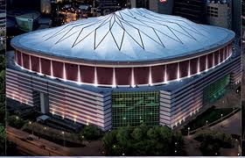











LASSITER FOOTBALL PYRAMID OF SUCCESS
“You must be a champion before you can win a championship”
-Nick Saban
BE A CHAMPION!
DOMINATE OPPONENT DAILY
COMMITMENT – EFFORT - TOUGHNESS
POSITIVELY AFFECT TEAMMATES EVERYDAY
INSPIRATION - CONFIDENCE
BE RESPONSIBLE FOR YOUR OWN SELF-DETERMINATION
DISCIPLINE – FOCUS – FINISH - EXECUTION
BE A TEAM
TRUST – RESPECT – OUT OF YOURSELF, INTO THE TEAM

Slide 5
LASSITER FOOTBALL
APPROACH TO TOTAL ATHLETIC DEVELOPMENT
TOTAL TROJAN ATHLETE
ATHLETIC DEVELOPMENT
CHARACTER DEVELOPMENT
FOOTBALL ESSENTIALS
NUTRITION/ HYDRATION
LEADERSHIP PROGRAM
ACADEMIC SUPPORT
MENTAL CONDITIONING
SPEED/ STRENGTH PROGRAM
FOOTBALL KNOWLEDGE
ATHLETIC TRAINING / REHAB
SPIRITUAL GROWTH
CHARACTER EDUCATION
COMMUNITY SERVICE
GUEST SPEAKERS
4TH Qtr PROGRAM & ENDURANCE
AGILITY & SKILL MOVEMENT
MENTORING

Slide 6
FRESHMAN FOOTBALL BASICS
ALL EVENTS ARE ON TEAM ONLINE CALENDAR
  REGISTER FOR NGIN ACCOUNT (WWW.LASSITERFOOTBALL.NET)
  COMPLETE 2015 PLAYER REGISTRATION
PHSYICAL FORMS – WILL NEED FOR SPRING PRACTICE AND SUMMER
FR. TEAM PLAYS 7 GAMES
PLAYERS ARE CONSIDERED PART OF VARSITY PROGRAM
ONCE SEASON IS OVER, PART OF “VARSITY”
USES VARSITY LOCKER ROOM AND WEIGHT ROOM
SEPARATE STAFF AND PRACTICE FIELD
POSITION COACH IS PRIMARY POINT OF CONTACT W/ PLAYERS
SOMETIMES SCRIMMAGE JV/SOPHOMORES
SUMMER WORKOUTS M-TH 7-10 A.M. (BEGIN 6/1)
FROSH TYPICALLY DON’T TRAVEL IN SUMMER
TEAM WILL PRACTICE LABOR DAY AND DURING FALL BREAK (T-TH)
NUTRITION, REST AND HYDRATION ARE VITAL
IN ORDER TO COMPETE, WE MUST STRENGTH TRAIN YEAR-ROUND
WEIGHT TRAINING CLASSES STRONGLY ENCOURAGED GRADES 9-11

Slide 7
FRESHMAN FOOTBALL BASICS
USUALLY NO WEEKEND ACTIVITIES FOR FROSH
SOME PLAYERS MAY BE CALLED
WEIGHT TRAIN THREE TIMES A WEEK IN-SEASON
SEPARATE BANQUET FOR 9TH GRADE TEAM
2015 TEAM RULES/PROCEDURES ONLINE
10 COMMANDMENTS FOR SPORTS PARENTS
ISSUE ARISES? PROCEDURE TO FOLLOW:
  PLAYER DISCUSSES WITH POSITION COACH FIRST
  PLAYER/POSITION COACH MAY BRING TO HEAD 9TH COACH
  HEAD 9TH GRADE COACH CAN BRING TO VARSITY HEAD COACH
  IF EMERGENCY PARENT CAN CONTACT 9TH HEAD COACH IMMEDIATELY

Slide 8
WHAT’S GOING ON NOW
WEIGHT TRAINING BEGINS 1/12 7:15 A.M. (MON/WED)
  TRANSPORTATION PROVIDED TO MIDDLE SCHOOLS
  REGISTER ONLINE UNDER STRENGTH PROGRAM FOR YOUTH
SPRING TD CLUB MEMBERSHIP MEETING THURSDAY 4/23 7 P.M.
JOIN TD CLUB (PAY DUES) – REGISTER PLAYER ONLINE

Slide 9

Opening Game
August 21, 2015
Hillgrove Hawks 7:30 p.m.
The Frank

Slide 10
Tom Gildea
2015 LTDC CLUB PRESIDENT
tgildea@profitabilityconsultants.com

Slide 11
What’s the role of the Touchdown Club:
Encourage and advance the football program at Lassiter High School (“LHS”)
What is our main objective:
Raise the funds necessary to support the unmet needs of the LHS football program and related student athlete programs
. . . Ensure we meet our team mission:
BE A CHAMPION
Notes:
Role: We encourage, support, help and otherwise advance the football program at Lassiter. We are a non-profit organization made up of – you; parents and guardians of our kids in the program.
Main objective: we raise the funds required to support that unmet needs of the LHS football program and related student athlete programs. We do this to ensure that we meet the mission that Coach Irwin just called out – you cant win a champtionship without being champtions. As you will soon see our student athletes can’t be champions without their coaches, their schoola dn school system and our touchdown club support
Who are we – simple answer is we are you – parents and guardians for our kids in the program!

Slide 12
Lassiter Touchdown Club
2015 Board of Directors
Jep Irwin
Ex Officio & Head Coach
President
Tom Gildea
Executive VP
Rob Brown
Mark Ingram
VP - Game Day
Duane Riopelle
VP - Concessions
Lela Bridgers
Secretary &
VP Communications
Bridget Joseph
CFO & Treasurer
Rod Adams
CIO & VP
Marketing Events
VP Sponsors &
Fundraising
Parking
Kevin Taylor
Friday Night
Senior Mom
Kim Cross
Reserve Seating
Brett Ryan
Kickoff Banquet
Alice Wasson
Corp Sponsors
Stewart Van Horn,
Kelli Reis, et al
Grounds/Game Day
Mark Ingram
Thursday Night
Melinda Donalson
Junior Mom
Missy Beaverson
Youth Programs
Rick Hall
7-on-7
Bob Penter
Food Sponsors
Danielle Cogbill
Volunteers
Jeff Salyer
Trojan House
Lori Lanser
Sophomore Mom
Lori Lanser
Strength Programs
Scott Balot
Banquet
Mary Ann Farrah
Program/Year Book
Paul Bickford
Mom’s Club
Tana Gildea
Varsity Meals
Lauren Penter
Freshman Mom
Kelli Reis
OurFund
Tom Gildea
Dad’s Club
Scott Balot
JV/Frosh Meals
Stefanie Brown
Cheer Liaison
Cindy Curran
Coupon Book
Tom Carroll
Game Day Programs
Stella Rooker
Picture Day
Cindy Curran
Golf Tournament
Greg Park
Jeff Branch
LTDC 120314

Slide 13
How we meet our objective:
      Dues
      Volunteering
      Fundraising Events & Sales
Notes:
Role: We encourage, support, help and otherwise advance the football program at Lassiter. We are a non-profit organization made up of – you; parents and guardians of our kids in the program.
Main objective: we raise the funds required to support that unmet needs of the LHS football program and related student athlete programs. We do this to ensure that we meet the mission that Coach Irwin just called out – you cant win a champtionship without being champtions.

Slide 14
Dues
To run our program, it costs the Touchdown Club $2,500/year per player. That expense is the same regardless of the player’s class or fundraising in any given year.
Have not raised our dues since 2011
For 2014 dues will remain $500 ($41/month)
Dues are not optional – WE NEED YOU!
Notes:
Its year round activity – wrapped up in the one payment

Slide 15
Comparison of Junior Trojan costs to
Lassiter High School Costs
Description Jr Trojan High School
Spring ball $ 70 $0
Winter workouts $200 $0
Summer workouts $125 $0
Season dues $335 $500
Total cost $730 $500
Notes:
When you compare to the to cost of the Junior Trojan program – it works out to be $200 less than that the year round dues in that program
It works out to $1.37 a day. So for less than a cup of coffee a day your son receives five times that amount in value….

Slide 16
Benefits of Club Membership
. . . Goes to our Players!
Additional coaches (8) beyond school funded supplement
Full-time Athletic Trainer/Rehab/Treatment for your child
Practice equipment
Field house upgrades - bathroom and showers
HUDL profile/highlight films – fantastic!
Varsity team camp – Mercer University
National 7on7 trip – Hoover HS, Alabama
Access to TD club hosted events
Summer strength and conditioning workouts
Year round ‘Recovery’ protein drinks
PRO TURF FIELD & FACILITY through LEAF Foundation
Pro Style Weight Room Equipment and Strength Coach
Spring Speed and Agility Training & Equipment
Academic coach/Academic support/Tutoring
Recruiting Services
Pre-Game Meals, Banquet and Awards Program
Player Spirit Pack & Top-of-the-Line Equipment for Player Safety
Much more!
$2,500 per player!
We can’t be champions without YOU!
Notes:
College camps, NIKE combein, GA 7on7 NUC Combine, Recruiting Seminars, Qterback Receiver Camp, USA Football Dev. Camp

Slide 17
Volunteering for Events
For each player family – 4x each season
  Four volunteer ‘slots’ to be filled (standardizing to 3-4 hours each)
  Sign up starting in April at the parent meeting
  If you don’t, you will be assigned to volunteer for what is left (August)
No-Show Penalty – assign another slot to your obligation
Deposit - $150 check made payable to LTDC
  To be submitted before your son can get equipment
  To be returned to you (uncashed) at end of season upon obligation fulfillment
Optional: Opt Out Plan – to eliminate your volunteer obligation is a $150 charge.

Slide 18
Fundraising & Events
Coupon Book Sales – handled by players (May – June)
LTDC Golf Scramble (June 15)
OurFund email fundraiser – handled by players and parents (June)
GA Invitational 7 on 7 (July 10-11)
Tailgate Kickoff Dinner & Silent Auction (August 15)
Concessions during games (August – November)

Slide 19
Membership in Good Standing
  Register and paid (full or plan): player gets equipment before others!
Volunteer sign up
  Remit your deposit check
  Sign-up for your slots
  Show-up for your event
  Get involved & Have Fun
Thank You!!!!
We can’t be champions without YOU!

Slide 20
RODNEY ADAMS
TD CLUB CIO
CIO@LassiterFootball.net

Slide 21
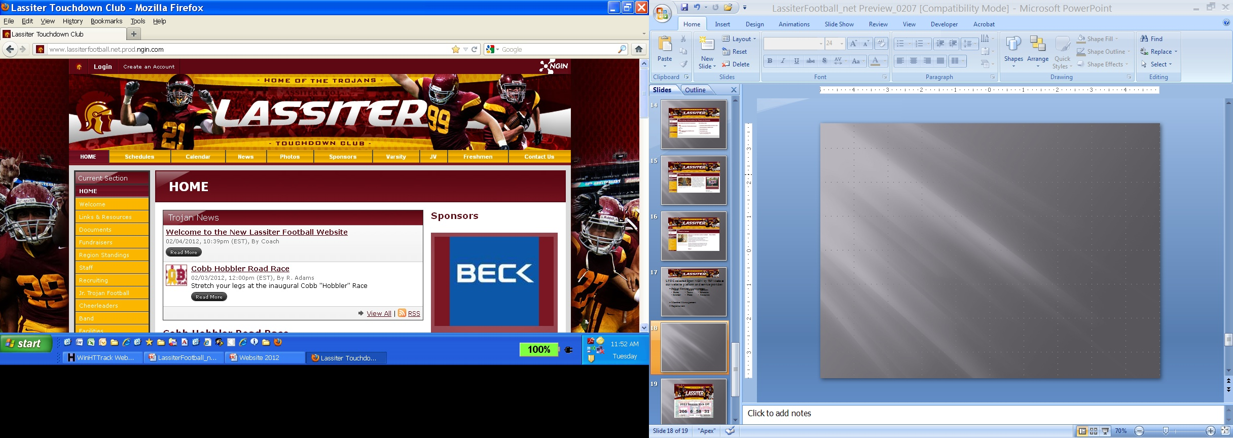

The Lassiter Football Network on
www.LassiterFootball.net

Slide 22
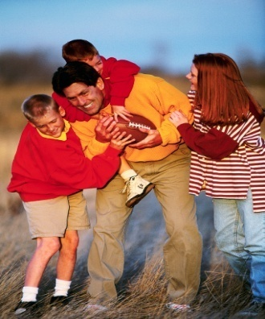






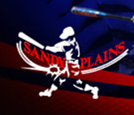
SportNGIN is used by several organizations in the Lassiter sports community allowing families to share membership information across seasons and teams.

Slide 23
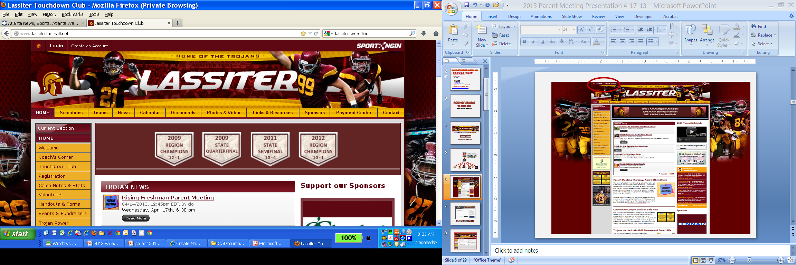
Create your account on the Lassiter Football Network to access exclusive content, features and LTDC communications. The same account can be used across all SportNGIN websites and networks.

Slide 24
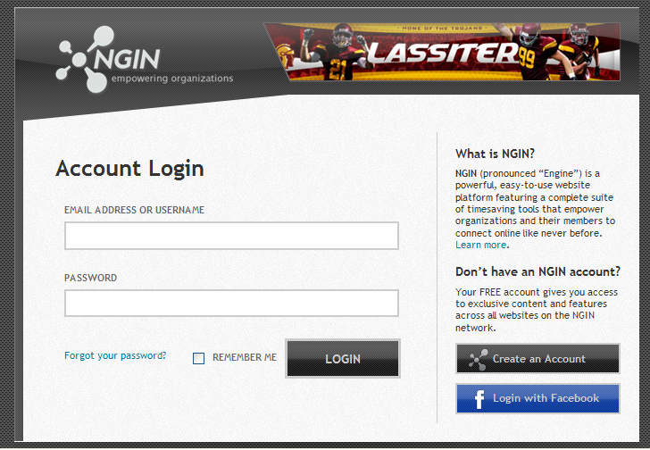
Use your Jr. Trojans account information to link to the Lassiter Football Network. Manage your contact preferences thru the Dashboard.

Slide 25
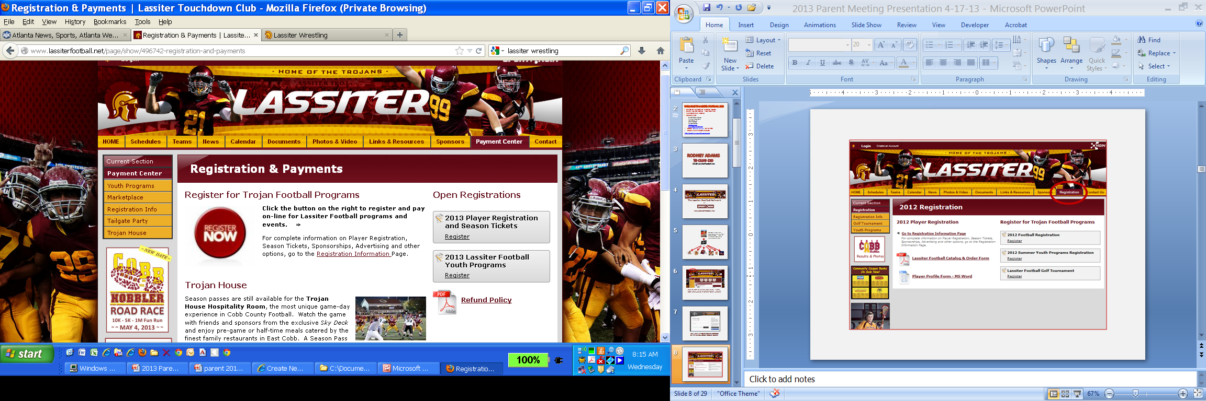
Links to current registration sessions can be found on multiple pages: Payment Center, Registration or News

Slide 26
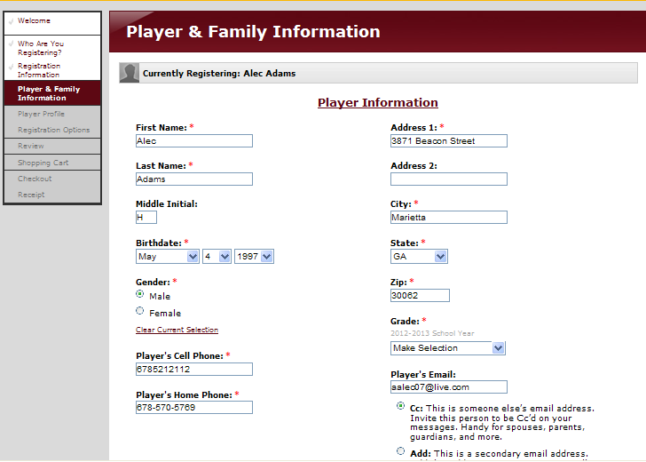
REGISTRATION

Slide 27
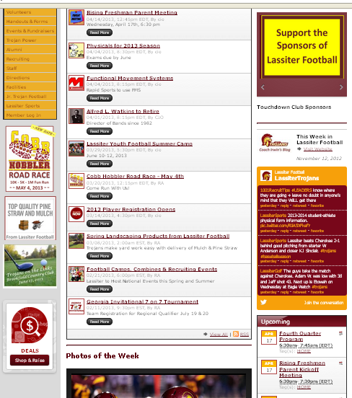
The Home Page features current news, events and programs
Sponsors
Coach’s
Blog
Fundraising and Events
Twitter
Feed
Weekly Calendar
Game
Photos

Slide 28
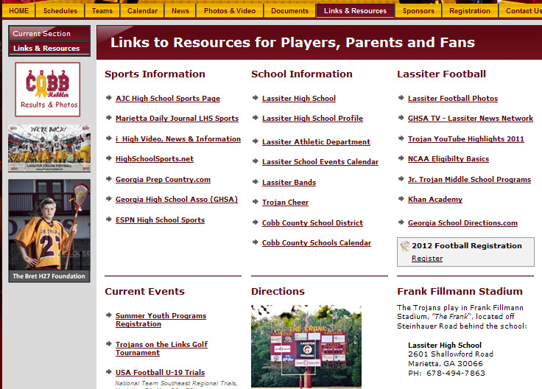
The Lassiter Football Network is a resource for LHS news and sports information

Slide 29
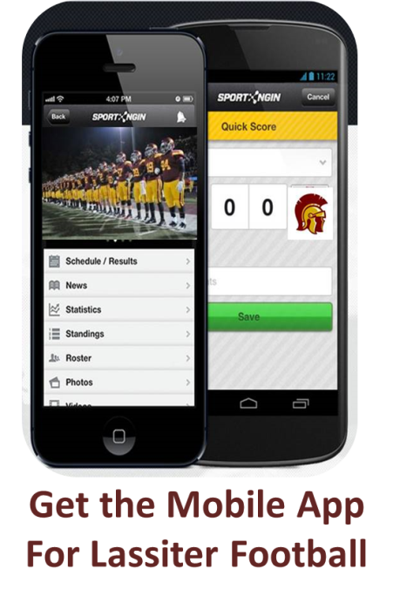
Mobile App
Download the Touchdown Club Mobile App for iPhone or Android and follow Varsity, JV, FR Teams
Schedules
Scores
Rosters
News
Photos
Follow other Sport Ngin Teams: Basketball, Lacrosse, Wrestling, Jr. Trojans & TYL

