Slide 1

Infield Defense
Neil Lerner
Assistant Baseball Coach
Concordia University, St. Paul

Slide 2
Teaching kids to play defense!
Pitching and defense
Try kids at all positions
Maximize your time. No standing around
Notes:
*

Slide 3
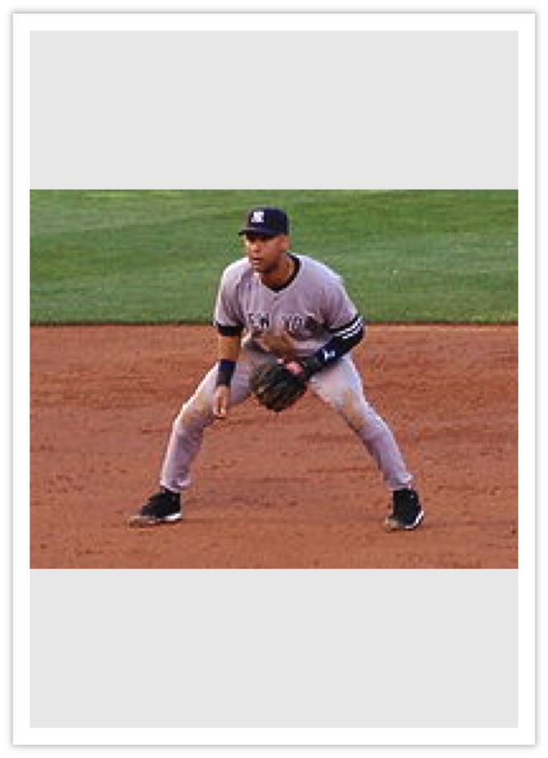
Ready Position
Athletic position
Some kind of movement
Head up
Anticipate the play
5. PRACTICE THIS!!
Ready/Field/Go
Point and go (Crossover)
Slow Roller

Slide 4
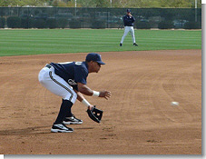
Teaching Infield Technique
Attack (ready) Position
Fielding Position:
Field out in front
Flat Back
Glove out and open
Heel to heel with hands
Notes:
*

Slide 5
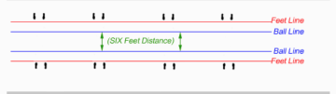
Common Problems:
Fielding the ball too deep
Not getting square
Flipping the Glove

Slide 6
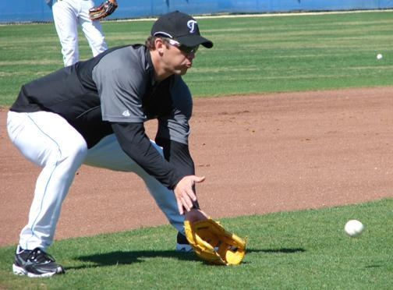
Partner Drills
Bare hand
Glove only (knees)
2 hands
Forehand
Backhand
Hat drill
Short hops
Rapid Fire
Tag Drill

Slide 7
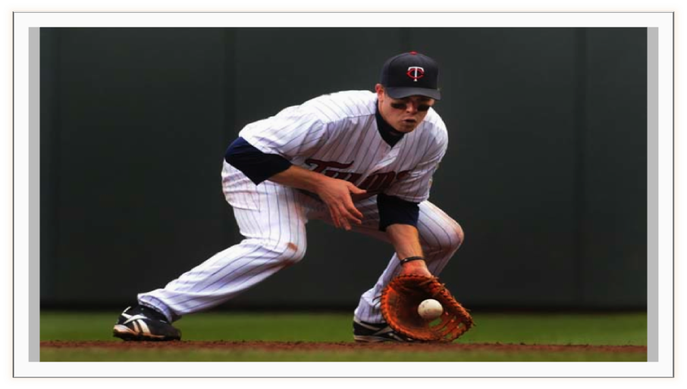
Start with two feet on base
Make sure glove hand is stretched out
Use the bag!
Chest towards the catcher
Drills: Bounce the ball/Picks

Slide 8
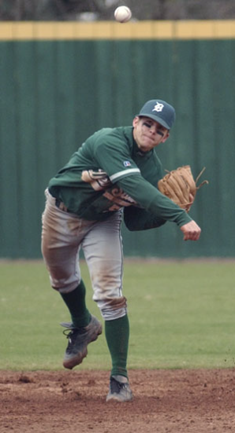
“Good Morning America!” -Everyone at SS-Role Ground Balls
Right at you
Backhand
Forehand
Run Through
Double Crow Hop

Slide 9
Make it FUN! •Hockey Goalie •Team Elimination •Relay Race (Turn towards glove side) •Triangle Drill •Use kids as baserunners for game speed (points)

Slide 10
Advanced Drills:
Four corners (throws and flips)
Shuffle Catch
Circle Catch
Slow-rollers
Barehands

Slide 11
