Slide 1
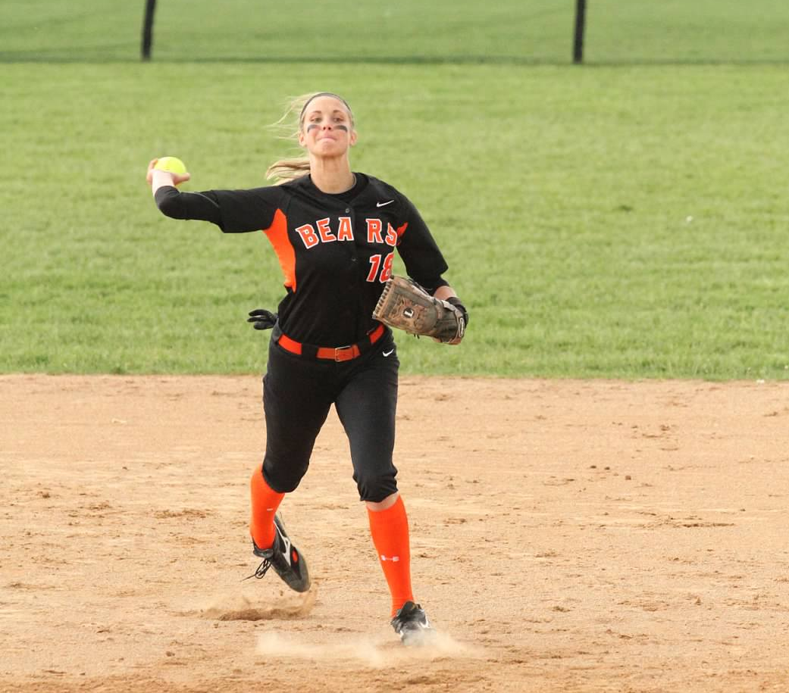
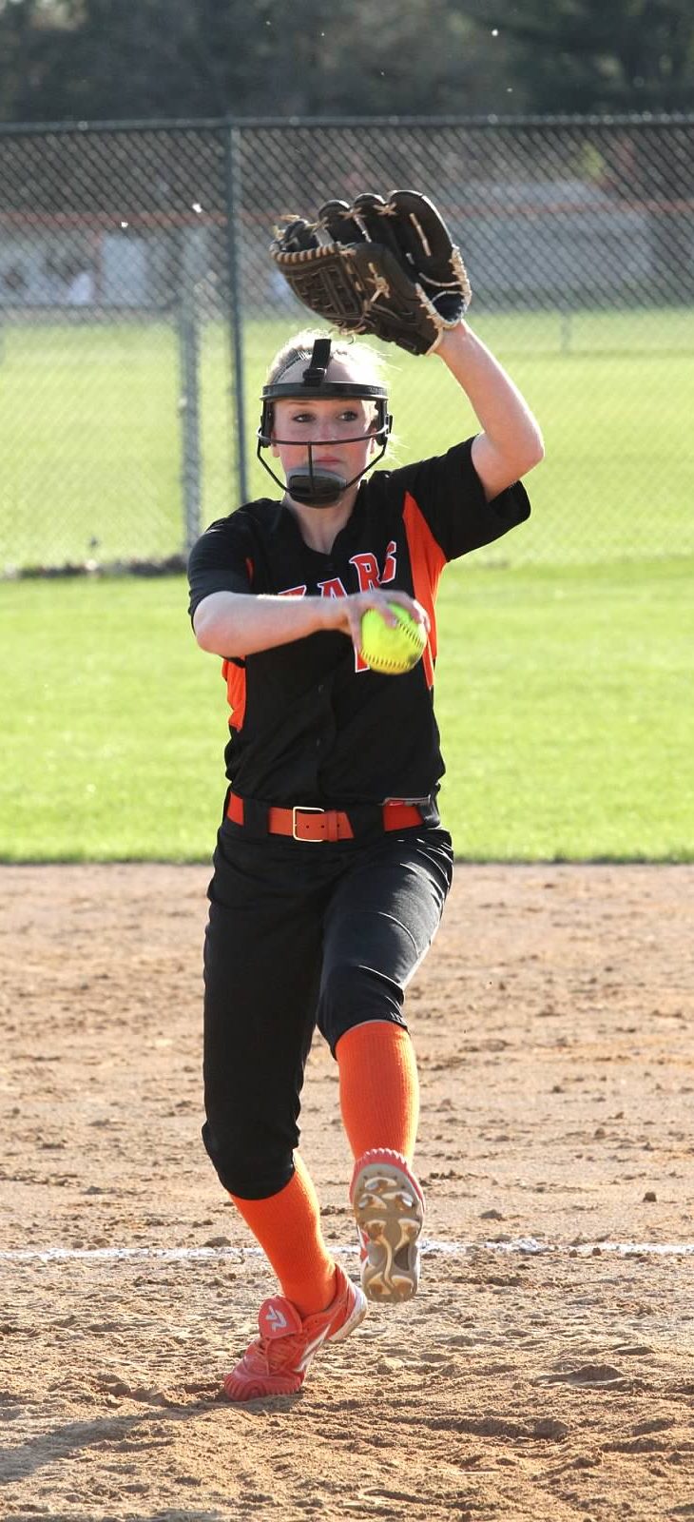
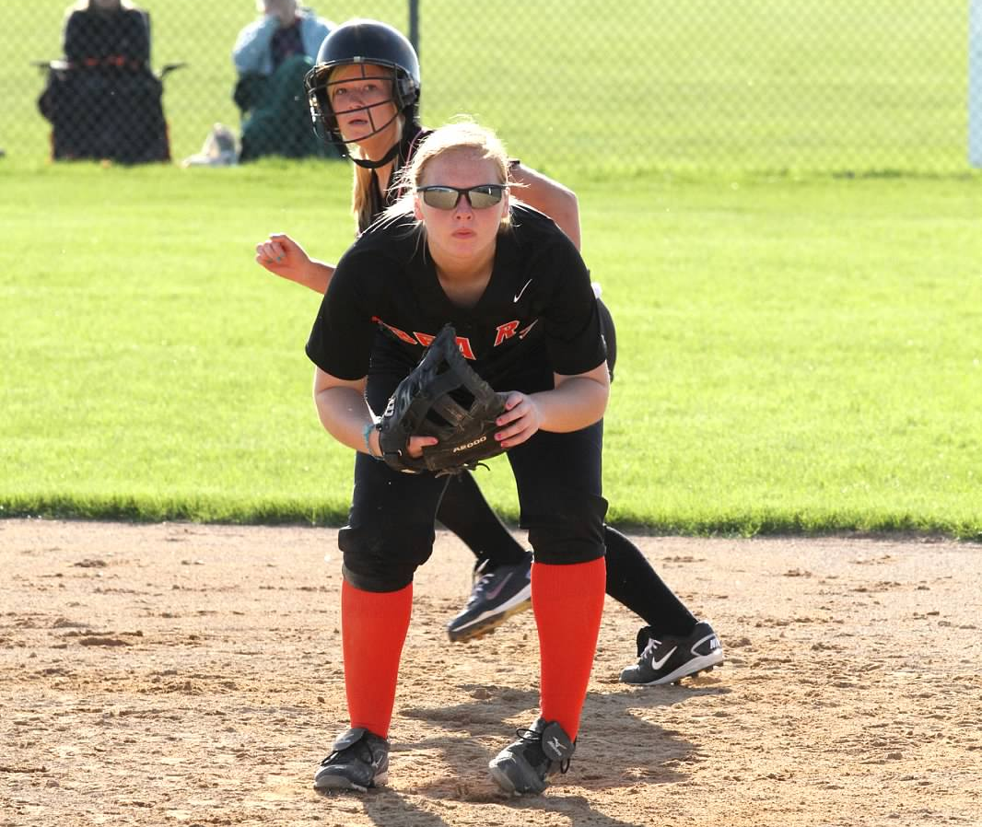
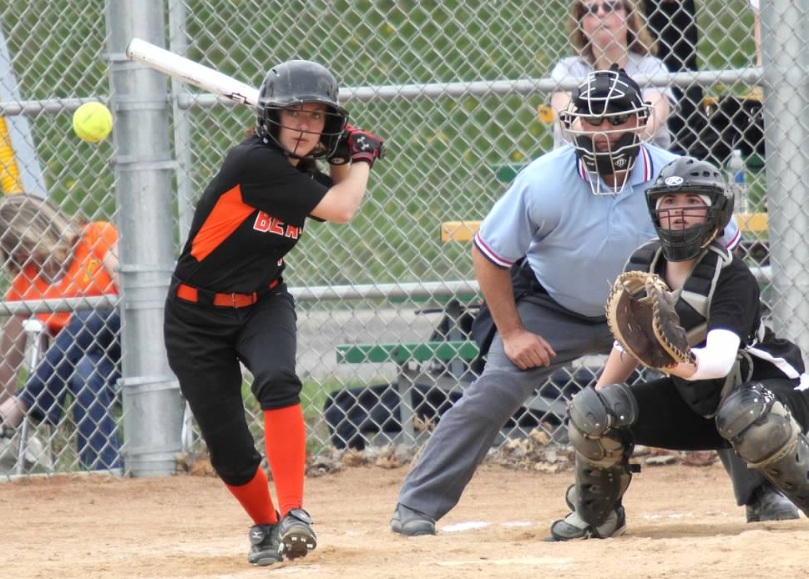


WBL SOFTBALL Coaches Clinic

Slide 2

General Philosophies
Coaching Athletes vs. Softball players vs. Specialization
Coaching Females
Body language, tone of voice, criticism, competition, need to please, public praise, standing out in crowd, social need
5 fundamentals of softball
throw, catch, field, hit, run – 95% rule
Discipline, focus, intensity – game speed – Practice with a purpose

Slide 3
General Philosophies
W.I.N
Focus on the present
No “No” or “Don’t” Thinkers
Rewarded behavior is Repeated behavior
Start with fundamentals and work upwards

Slide 4
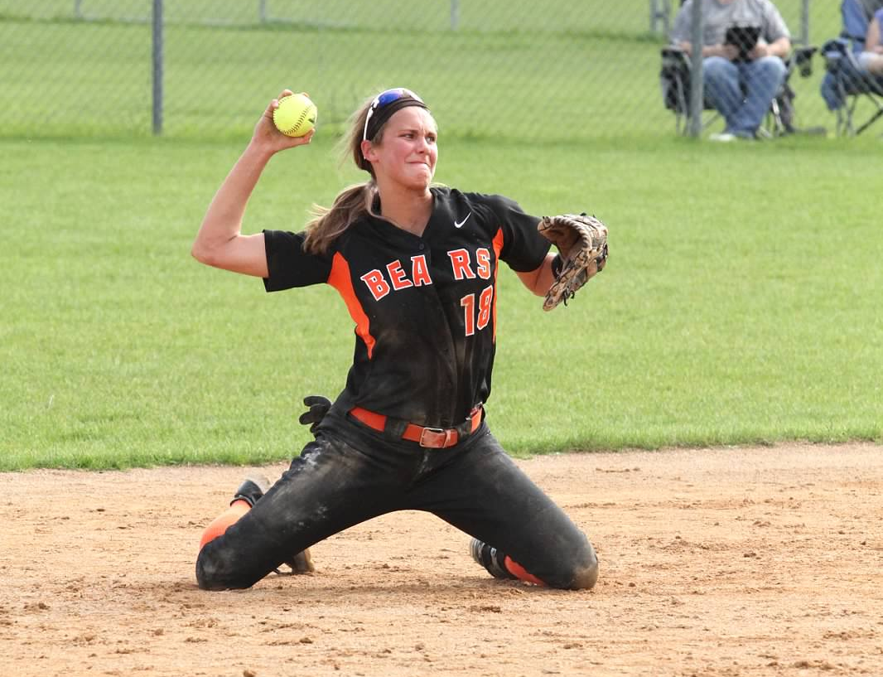
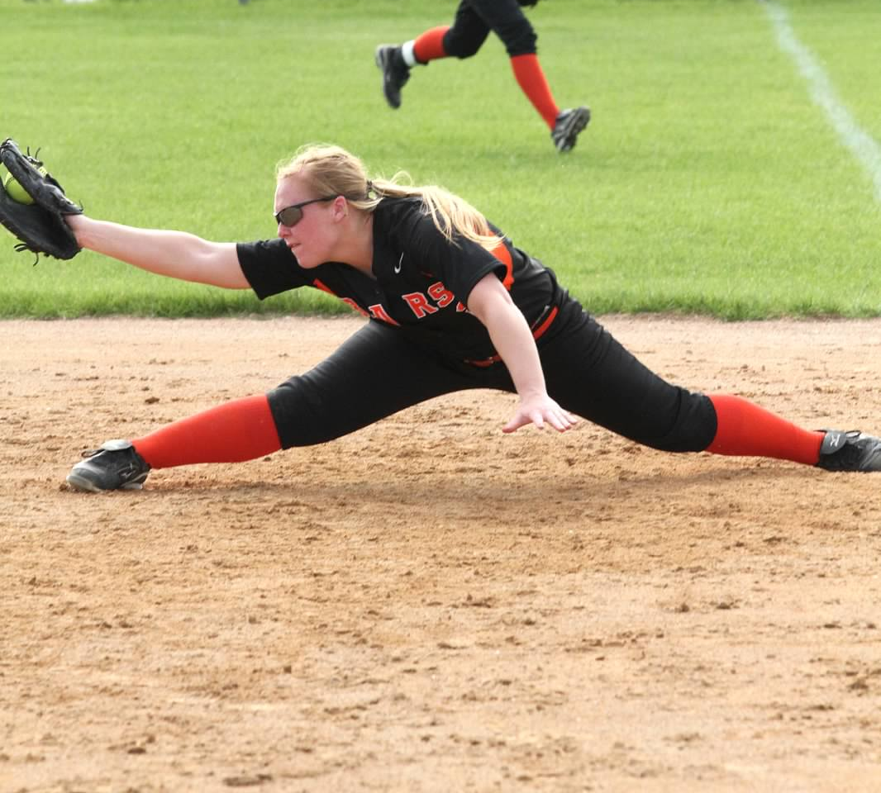
Defensive Mechanics

Slide 5
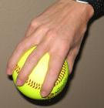
Throwing Mechanics
Grip
4 seams – across the C
Transfer
Thumbs down/elbows up
Stance & Stride
Body perpendicular to target – straight line
Front elbow points to target
Back elbow high, hand above head, relaxed
Hand outside elbow
Feet outside shoulders
Stride should be directly to target
weight transfer

Slide 6
Throwing Mechanics
Motion
Back elbow pulls forward, hand lags behind
Elbow should stay away from body
Shoulder height
Hand outside elbow
Body begins to open following stride
Front elbow pulls down and back
Finishes in back pocket
Glove turns over – palm to sky
Release
Hand should be on top of ball
Ball is released out in front off the tips of the finger, snap down

Slide 7
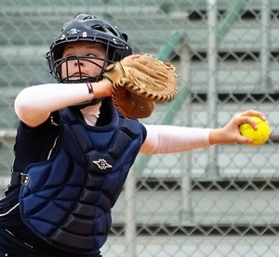
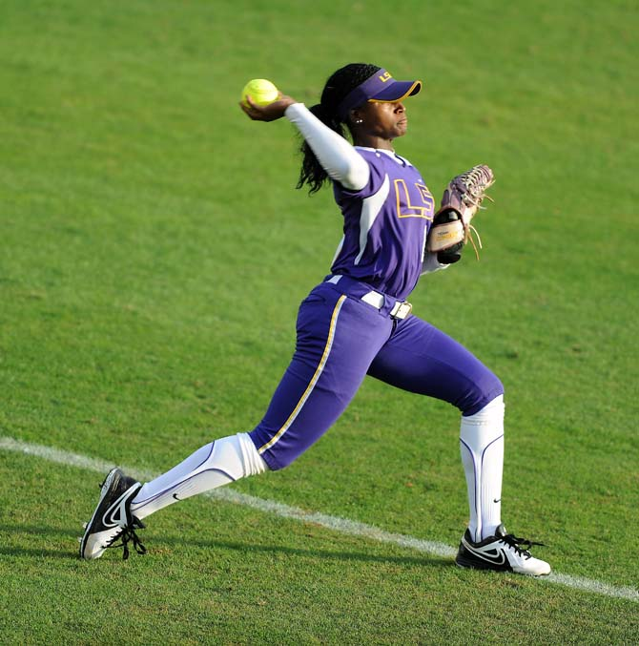
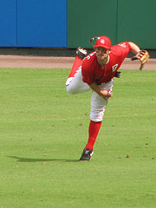
Throwing Mechanics
Follow Through
Arm continues its natural path, out and down across the body
Momentum should bring back foot forward
Waist bent and hand will finish at shin level

Slide 8
Receiving Mechanics
Ready Position
Body squared to thrower
Athletic position – ready to react
Knees bent
Balls of feet
Hands up – glove as a target
Catch
With glove foot – stride to ball
Catch with 2 hands – nose to knuckle

Slide 9
Fielding Mechanics
Perfect Fielding Position (PFP)
Feet outside shoulders
On balls of feet
Toes pointed forward
Knees bent and waist bent
Chest should be over toes
Thumb and Pinky of glove should be on the ground
Skateboard
Field bottom of ball working up into throw
Take away hops – go get the ball & field into stomach
Throwing foot’s instep will step toward target
With short quick steps jump into throwing position

Slide 10
Fielding Mechanics
Forehands
Field in front of foot
Butt low – lunge position, eyes level
Thumb and pinky on ground – glove tall
Flexed elbow
Continue 1 step passed the ball – knee to knee
Backhands
Field in front of foot
Butt low – lunge position, eyes level
Thumb and pinky on ground – glove tall
Throw glove up to

Slide 11
Fielding Mechanics
Pop Flies
First step is always back – easier to run in then back
Play behind the ball working in – into throw
Short choppy steps
Catch the ball 2 hands – nose to knuckle
Catch in front of forehead
Glove foot steps forward as ball is caught
knee gives with catch
Crow Hop
Throwing foot’s instep lifts up over knee
Drive out not up

Slide 12
Fielding Mechanics
Drop Steps
First step should be back
Turn glove side when straight back
First step is most important – push away from ground
Ankle, knee, hip all extended
Throw arms to help turn body
Eyes stay on ball
Pump arms when running – don’t lead with glove
Work to get around ball or catch ball, break down, crow hop and throw

Slide 13
Fielding Mechanics
Fielding Musts:
Ready positions (outfield, infield, corners) – jump stop
Beg for the ball
Attack
Get down early – don’t crash
Field the bottom of the ball coming up into your throw
Ball first, throw second
Communicate

Slide 14
Defensive Checklist: Infield
Grounders
Forehands/Backhands
Pop-ups
Communication
Flips/Tags
Footwork (Tag vs. Force)
Steal Coverage
Bunt Defense
Slapper Defense
Back ups
Double Play Footwork
Relays/Cuts
Pickoffs
Holding Runners

Slide 15
Defensive Checklist: Outfield
Grounders
Fly Balls
Communication
Back ups
Throwing to Bases
Fielding on the Charge
Diving
Playing the Fence
Slapper Defense
Movement and Coverage

Slide 16
Defensive Checklist: Pitchers
Grounders
Pop-ups
Throws to Bases
Bunt Defense
Covering Home
Pitch outs
Intentional Walks
Pitching Mechanics and Strategy

Slide 17
Defensive Checklist: Catchers
Blocking
Pop-ups
Tag plays
Past Balls
Pick offs and Pitch outs
Steals
Bunt Coverage
Back ups
Cut offs
Double Play Footwork
Intentional Walks
Receiving and Giving Signals
Handling Pitchers
Calling a Game

Slide 18
Defensive Checklist: Team
Rundowns
1st and 3rd Plays
Relays and Cut offs
Situational Positioning and Movement
Bunt Coverage
Set Plays
Communication

Slide 19
Defense
Relays and cuts
Rundowns
Flips and Tags
1st base footwork
Double play footwork
Bunt coverage

Slide 20
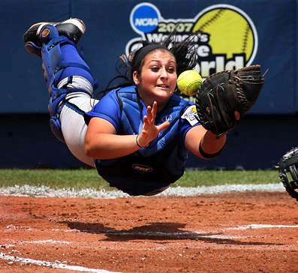
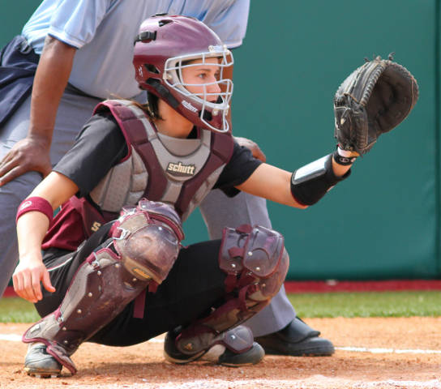
Catching Mechanics

Slide 21
Catching: Stance
Receiving
Wide stance: feet even with or outside of shoulders
Toes can point out so that you are comfortable and can get lower – on balls of feet
Glove elbow flexed outside of knees
Throwing hand behind or down grabbing heel of shin guard
Signal Stance
1st & 3rd basemen should not see your signs
Glove underneath left leg
Runners on base
Staggered stance – slightly higher
2 hand catch

Slide 22
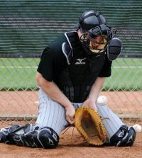
Catching: Stance
Framing
Sway with pitch – quiet movements
Glove beats ball to spot
Catch around the ball – outside
Blocking
Knees replace feet
Glove beats ball to 5 hole
Throwing hand behind glove
Elbows spread - be big
Chin down
Chest over ball – stay tall

Slide 23
Catching Mechanics
Pick offs and Steals
Bring glove to throwing hand – quick
Feet quickly jump into throwing position – step towards target – jump step
Stay low to throw
Throw needs to be quick, strong, and accurate
Throw through 2nd base – not to the base
Key to pick offs = see daylight between runner and receiver

Slide 24
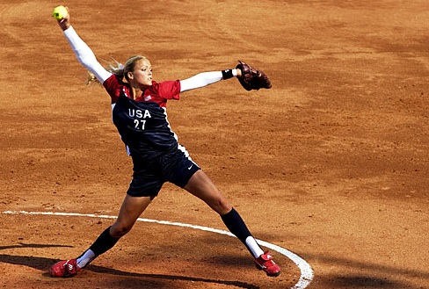
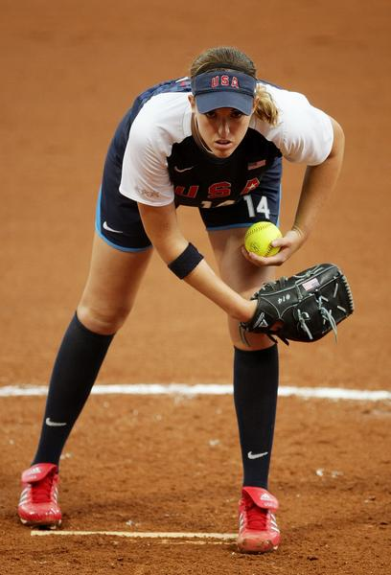
Pitching Mechanics

Slide 25
Pitching Mechanics
Mechanics first, control second, speed third
Control and speed will come with proper mechanics
Always warm-up before throwing any full speed pitches
Pitching Warm-up

Slide 26
Pitching Mechanics
Presentation
Pitchers are required to approach the pitching rubber from behind with hands apart, at their side with the ball in the throwing hand.
The pitcher must then be completely set before starting pitch
Stance
Tall, relaxed, & balanced
Both feet start on the rubber
The “push off” or “pivot” foot will be placed on the front edge of the rubber and the rear “stride” or “plant” will be on the back side of the rubber.

Slide 27
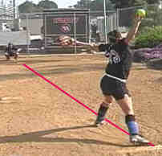
Pitching Mechanics
Power Line
The power line is an imaginary line from the pitchers pivot foot to where they want the ball to go. This line is used for the pitcher to drive down creating the most power and force on their pitch.

Slide 28
Pitching Mechanics
Drive
The drive of a pitcher is much like the form of a sprint runner. It is the drive up and out by the pitchers stride knee which creates the force and power of a pitch. The more power a pitcher uses from the legs the more powerful their pitch will be and the more endurance they will have. A female has the most power in their legs vs. men who have a lot of upper body strength as well. Female pitchers need to use their legs to their advantage and get as much power as they can from them. Make sure that a pitchers eyes stay on their target even during their drive.

Slide 29
Pitching Mechanics
Drive
The pitcher will have a slight angel forward with their body during the beginning of their drive but it is important to make sure that their backs are not hunched over and that there is not an extreme bend at their hips (a slight bend at the hips is ok).
It is important to make sure that younger pitchers are NOT driving more than their arms can handle. Many times younger children have less control of their bodies and if they drive too hard too soon they can put too much strain on their shoulders. The older the athlete and the more aware of their body the more drive they should use

Slide 30
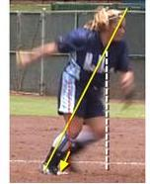
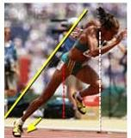
Pitching Mechanics
Similar drive between pitcher and sprinter

Slide 31
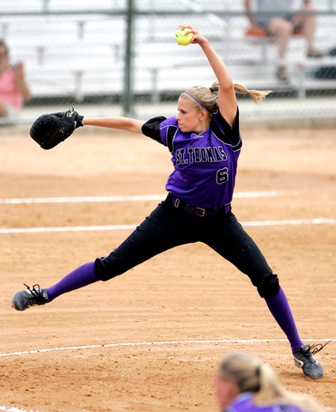
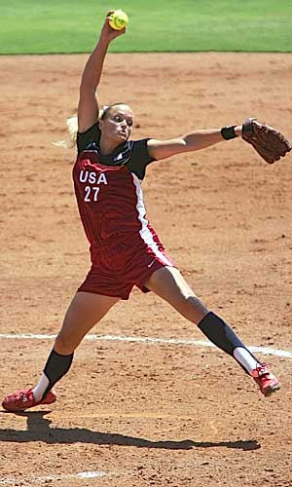
Pitching Mechanics
“K” Position
After the Drive the pitcher should land with both toes on their Power Line, their glove pointing at their catcher and their pitching arm by their ear. This position is called the “K” Position. A slight bend in their hips is necessary here to give the pitcher’s arm room to move through on the Power Line.

Slide 32
Pitching Mechanics
Snap
The snap is a very important part of the pitch. It is necessary for pitchers at all levels to work on the snap for all pitches they pitch and to do so regularly. For a fastball it is important that the pitcher has their wrist cocked back as they deliver the pitch and on the snap their hand should act as a whip with the tip of their middle finger being the last thing touching the ball and last crossing past their hip.
A half a second after the pitcher snaps the ball their back foot (foot on the pitching rubber the longest) should be meeting their stride foot. Back foot toe to front foot heel and knees come together as well.

Slide 33
Pitching Mechanics
Finish or Follow Through
A pitcher’s throwing arm should be as relaxed as possible and allowed to go wherever is comfortable for it after the snap. Forcing a pitcher to have her hand or arm do something or touch a certain part of the body (the shoulder is a common one) only makes the pitcher tense and will slow their snap along with the pitch. On the finish the pitcher should be prepared for a ball to be hit directly back at them! They should have their glove ready to react and should be squaring up to home plate as much as possible.

Slide 34
Pitching Mechanics
Warm-UP
It will take each pitcher a different amount of time to get fully game prepared however if they are working hard and they are focused on preparing it should not take them more than a half hour to get ready. (a half hour would be if they have multiple pitches that they can throw and need to warm up.) The most efficient way I have found to warming up is to start with snaps (from “K” Position but with arms down) and then slowly working back to full distance gradually using more and more arm and legs (staying sideways until reaching full length then squaring up to catcher.) Depending on the strength of the pitcher doing walk-through pitches a little farther than full distance is also a good way to really warm up the arm. Once warm then a pitcher should pitch all of their pitches until they have each pitch “Game Ready”. They can do this by warming one type of pitch up at a time or by rotating through all of them to warm them up.

Slide 35
Pitching Mechanics
One thing very important to remember for young girls as they are learning to pitch is to learn a fastball and be able to pitch it for a strike whenever they want BEFORE moving on to learn other pitches. There are far too many pitchers that have many pitches that are all inaccurate. A pitcher with a good fastball that can hit her spots is much more dominating then a pitcher that throws lots of different pitches but none where intended!

Slide 36
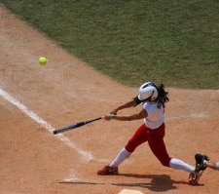
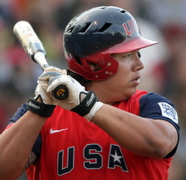
Hitting Mechanics

Slide 37
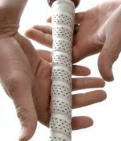
Hitting Mechanics: Pre-Pitch
GRIP
In fingers - golf grip
Choke up - Hand off knob of bat
Wrist cocked - Hammer, motorcycle grip
POSITION IN BATTERS BOX
Plate coverage
Parallel Foot position (closed, open)
Routines – Rhythm

Slide 38

Hitting Mechanics
STANCE
Feet just outside hips. "Balanced and athletic"
Toes slightly pointed in
Weight on balls of feet
Knees bent, inside feet - Linear motion
Slight bend in waist
forward - chest over toes – hands hang off legs
Head level and both eyes looking at pitcher
How do you read a book?

Slide 39
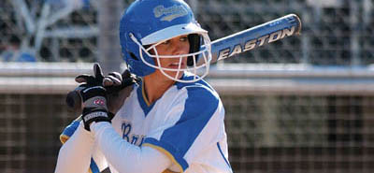
Hitting Mechanics
STANCE Cont.
Hands at top of Zone, above elbow
Hands are a fist inside and above shoulder
Bat at 45o Angle and slightly wrapped behind head
Elbows down and relaxed, shoulders relaxed - Vertical clap
Small Rhythm with feet and hands

Slide 40
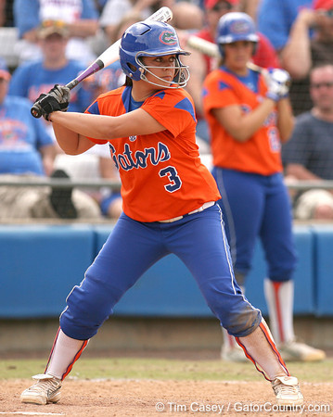
Hitting Mechanics: On Pitch
TRIGGER / LAUNCH
Go back to go forward (kicking, punching)
Weight shifts to back leg
Hands travel off the back shoulder 2 in
Weight should be:
60% on back leg - 40% on front leg.
Back forearm stays outside bat/hands

Slide 41
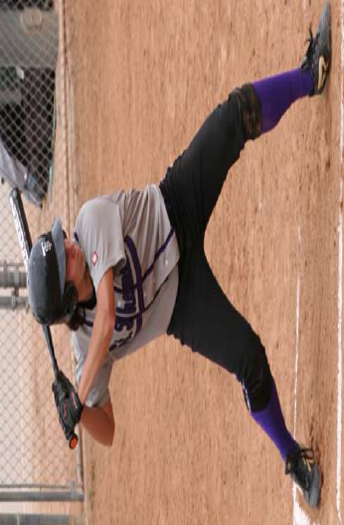
Hitting Mechanics
STRIDE
Short, soft, soon enough (better early - 45º angle)
Soft toe touch - hard heel plant. Should be separate.
Linear motion on heel plant
Hips stay closed on heel plant
Head stays behind belly button
Knees stay close, Hands stay back
Eyes at same level through stride.
Short stride helps timing
Shoulders stay level

Slide 42
Hitting Mechanics: The Swing
SWING
After striding on ball of front foot, swing begins by getting front foot heel plant while back foot begins to raise and turn toward the pitcher.
Heel up / Heel down - causes weight from backside to go into midline of body (hit against front leg, not over front leg)
Timing = linear + rotation
Shoulders level, chin on front shoulder
Throw a Frisbee
lead with front shoulder, elbow, then wrist - front elbow pulls down and hands go from back shoulder to center of chest and then down and out (release shoulders and elbows when hands get to chin.
Hands move separately than elbows and shoulders

Slide 43
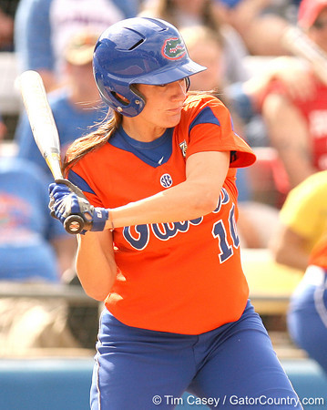
Hitting Mechanics
Bat head should slide between back shoulder and ear (bat lag)...does not drop below shoulder at beginning of swing
Back elbow connects with belly button and then extends out
Hips stay square to plate until released at toe touch
Hands stay inside the ball/plate (extend arms just after contact and NOT before contact)

Slide 44
Hitting Mechanics
Pull with front arm and then push or throw with back arm
extend through ball and point bat at pitcher
Elbow stays at a vertical angle - hands above elbow
Chest should point at ball and follow plane of ball
bench press ball you are hitting
Bat head stays higher than hands as long as possible and bat travels down to the ball NOT up to the ball

Slide 45
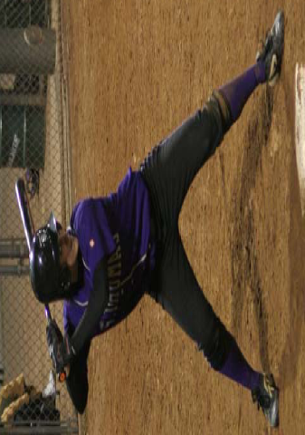
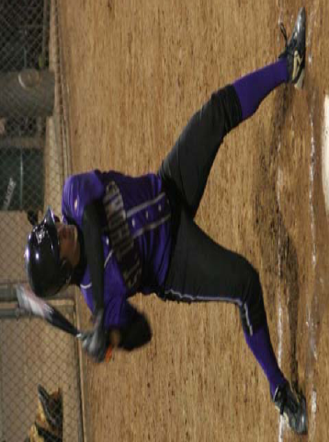
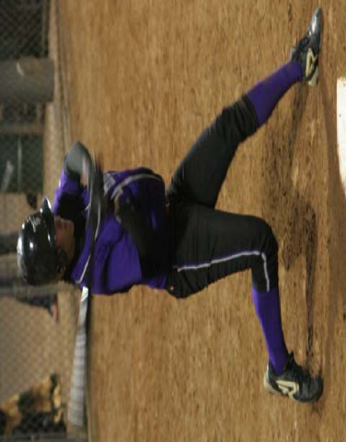
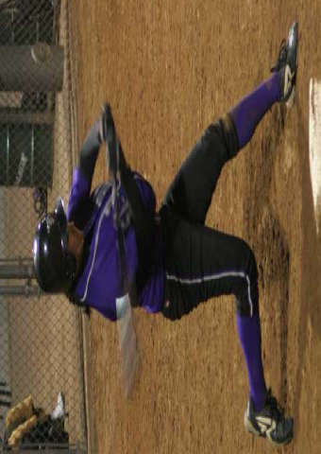

Slide 46
Hitting Mechanics
CONTACT TO FOLLOW THROUGH
Back foot pushes forward and rotates
weight should be on inside of big toe, heel ends vertically
Weight transfers to 51% on front foot
Front leg is straight - not locked - chin behind belly behind
Contact should be made in front of front hip/foot

Slide 47
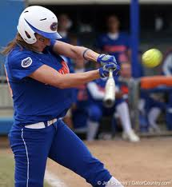
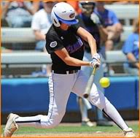
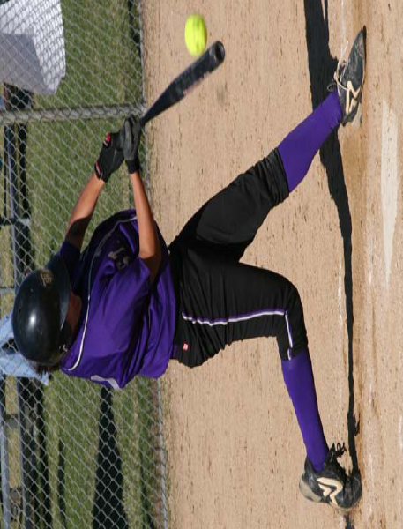
Hitting Mechanics
Back knee should point where the ball should be hit
follows angle of bat (at ball)
Eyes should match shoulder angle and shoulder angle matches bat angle - depending on position of ball - high, mid, low
Slight bend in elbows at contact - palm up palm down (power L)

Slide 48
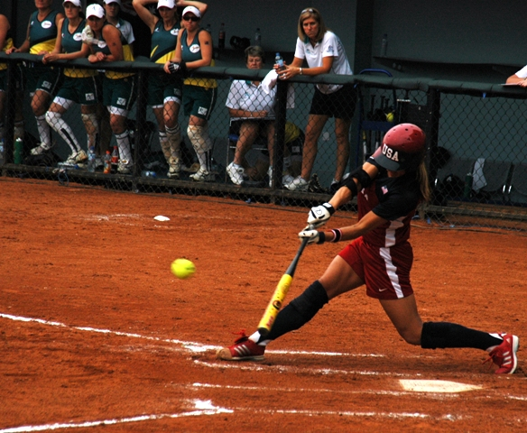
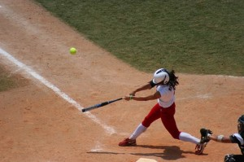
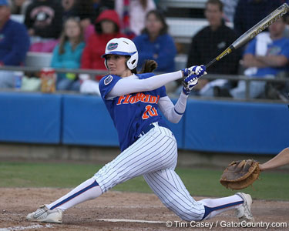
Hitting Mechanics
Head still with eyes at contact zone throughout swing
Arms fully extend through ball and bat head points at pitcher
Hips, shoulders, eyes stay at same angle throughout swing
Follow through long with hands to the shoulder - bat should not slap against back

Slide 49
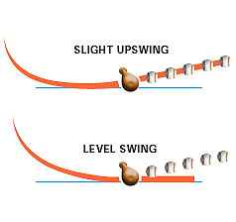
Hitting Mechanics
Level Swing?
SLIGHT UPSWING
LEVEL SWING

Slide 50
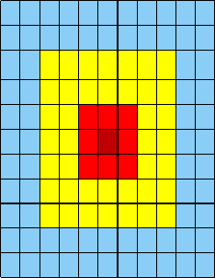




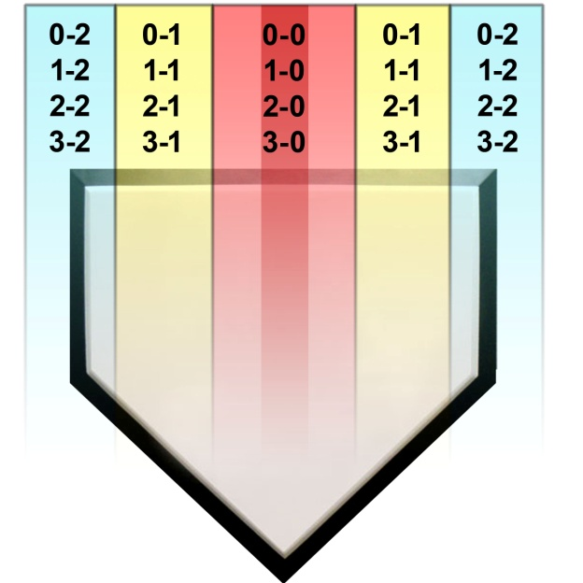

Hitting Mentality
There are Five Strike Zones
Best pitch to hit
Zone based on the count

Slide 51
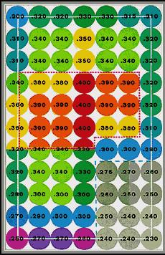

Slide 52
Bunt Mechanics
Start with a slightly open stance – This will help maintain balance
Pivot completely toward the pitcher
Shoulders, hips, and back knee should finish facing the pitcher
On your pivot, you should have complete plate coverage
Knees bent
bat should end up at the top of the strike zone
Bat should be almost fully extended to the pitcher
slight bend in elbows with bat at eye level

Slide 53
Bunt Mechanics
Bottom hand stays near knob and controls the bat to give direction
Bat head is slightly above bat knob – directs ball downward
Use the last 3 inches of the bat to deaden the ball
Body should stay balanced
chest stays behind front knee
Do not reach or jab at the ball
just stop it or give with the ball
Use your knees to go down to a low ball, don’t reach down
Look to bunt the top half of the ball
you should never go up to a ball

Slide 54
Bunts
Sacrifice Bunt – Begin pivot when pitcher begins her motion
Drag Bunt – Begins when pitchers arm passes ear. Take a short, jab step toward 1st and quickly get into pivot position. All other mechanics are the same. Ideally down 1st base
Suicide Bunt – similar to a sacrifice – if ball is outside, release top hand and reach outside with bottom hand and angle bat back toward pitcher
Right Handed Slap – show like a sacrifice, on ball release pull bat back to shoulder
DO NOT pivot back – chop/punch at the ball. Keeping bat head above hands – punch ball past charging infielders.

Slide 55
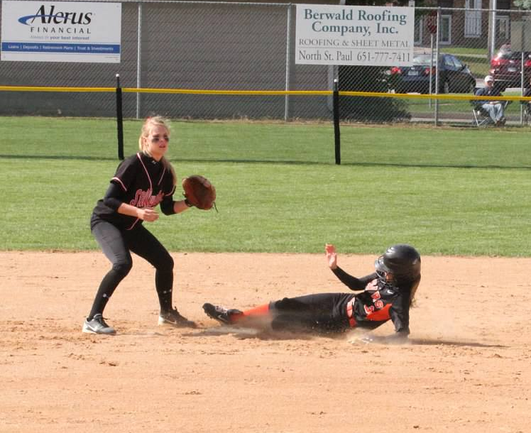
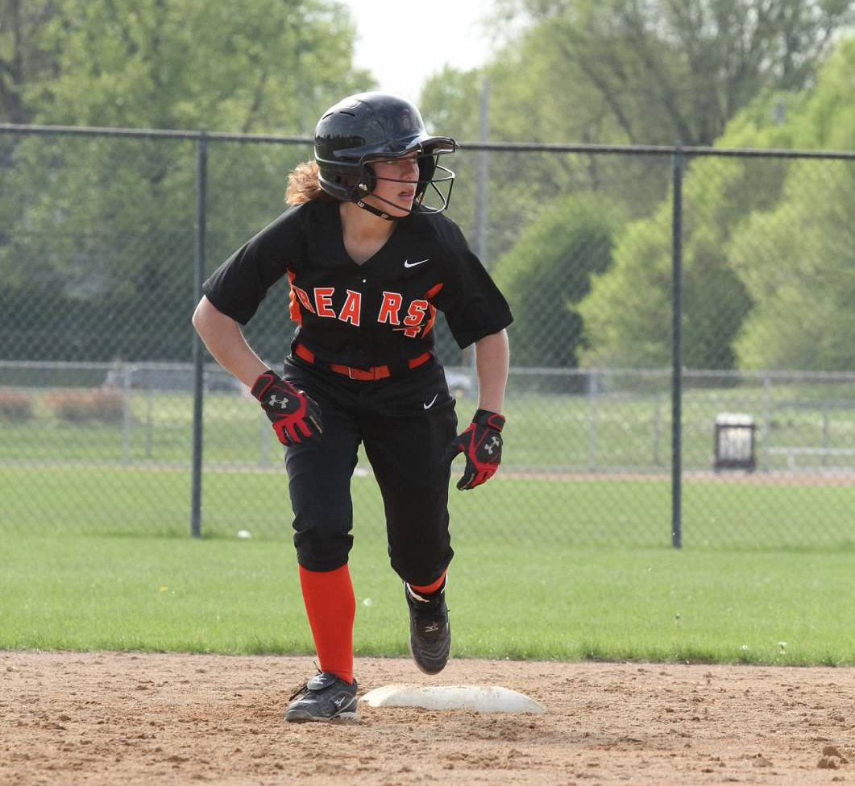
Baserunning

Slide 56
Baserunning
Practice It!
Can use as part of warm-up
Baserunning stations
Girls at each base work on something different
Baserunning is about being Smart, not fast

Slide 57
Baserunning: Basics
Out of the Box
First Step is the most important
Big an Quick
Through 1st Base
Don’t slow down
Hit Front of base
Breakdown – short/choppy steps
Look for over through
Don’t peel off or round too far
Turn straight around and return to first

Slide 58
Baserunning: Basics
Rounding Bases
Inside shoulder lines up with outside corner of the base
Angle to hit the inside corner of the base
Body lean inside
Arms are important
NO BANANAs
Round with Intent to go to 2nd
Stay only if defense stops you
Stay athletic, open to the ball

Slide 59
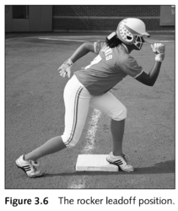
Baserunning: Lead Offs
Rocker Start
Left foot starts on the outfield side of the base
Right foot start behind base
Athletic position
Arms up and ready
Use 2” of base as a launching pad
First Step is most important
Baserunners should start sprinting motion when pitchers arm is straight above her head in the pitching motion
Must work on Timing

Slide 60
Baserunning: Lead Offs
Leads from 1st Base
3 step lead
Stay athletic – ready to dive back
Feet should keep moving
No concrete leads
Get away from base on pop flies – let ball dictate
Leads from 2nd Base
5 Step lead – longer throw from catcher
Scoring position
Freeze on line drives and immediately retreat on pop flies
Including foul balls

Slide 61
Baserunning: Lead Offs
Leads from 3rdBase
3 step WALKING lead
Each step should be quicker then the last
3rd step lands when ball crosses plate
Easy to score from 3rd – no reason to jump off the base
Very easy to get doubled off
Body should stay facing home plate
Always be ready to get back

Slide 62
Baserunning Tips
Good Baserunning is not only about being fast, being smart is just as important. It starts in the Dugout
Touch Every Base
Always know where the ball is
Listen to and watch your base coaches
When in doubt – slide
Always know:
How many outs there are
Type of hitter up to bat
Where the defense is playing
The arms of the catcher and position players
The field conditions – soft/hard dirt
As a batter, run out every hit no matter what. Never assume a ball is foul, a pop up caught, or a grounder is a sure out. Always put pressure on the defense by sprinting down the line.
If a pop fly is dropped, runners should be well on their way to 2.
When beating out a play at 1st, never watch the ball or the play.
Explode off the bag every lead off. First two steps should look the same as your steal
On deck batters are responsible for communicating to player on 2nd or 3rd
Never turn your back to the ball
Always look for opportunities to advance – advance until the defense stops you without getting out
Base runners should hold number of outs on chest so coach knows you know the outs and are focused and paying attention

Slide 63
Baserunning Checklist - First
Know the number of outs
Get coaches signs
Know the type of hitter at the plate
Know where the defense is playing
Steal catchers signs
Know the arm of the catcher
Know the arms of position players
Know the field
3 step lead mixed with fake steals
Know if the catcher likes to throw pick offs
Know if the right fielder backs up
Know your importance as a runner
Tag on all foul balls
Stay off the base as far as you can as long as you can without getting doubled off
Pop up slide into 2 on a bunt
Know where the ball is at all times
On lead – front foot lands as ball crosses plate
Never run into a tag
Freeze on all line drives
Always be ready for over throws and passed balls – never fall asleep
Avoid all batted balls and defense making plays on batted balls
Always make sure you are called out before leaving a base
If bases loaded, easy off base
3-2 count with 2 outs - Steal
When leaving 1st on a hit, pick up coaches signs before reaching 2nd Base
Read how fielder sets up at base – determines how you slide
Always look to take extra bases

Slide 64
Baserunning Checklist - Second
Know the number of outs
Get coaches signs
Know the type of hitter at the plate
Know where the defense is playing
Steal catchers signs
Know the arm of the catcher
Know the arms of position players – Outfielders
Know the field
5 step lead mixed with fake steals
Know who covers the base
Know if the catcher likes to throw pick offs
Know your importance as a runner
Don’t run off teammates in front of you
Tag on all foul balls
Tag on all balls in the air. Unless un-tagable. Then stay off as far as you can without getting doubled off.
Stay off the base as far as you can as long as you can without getting doubled off
Balls hit in front of you, up middle, to the right – get to third.
Don’t run into an out
Always know where the ball is
Know if you can beat the shortstop on a steal
Know if you can delay off the pitcher or catcher
Know if 3rd or short covers 3rd base
Relay catchers signs to batter
Balls hit to outfield, face the ball to get read
Never make 1st or 3rd out at 3
Watch for overthrows and passed balls
Always look to take extra bases – base hit, expect to go home and coach will stop you
Read how fielder sets up at base – determines how you slide

Slide 65
Baserunning Checklist - Third
Know the number of outs
Get coaches signs
Know the type of hitter at the plate
Know where the defense is playing – Outfielders
Know the arm of the catcher
Know the arms of position players – Outfielders
Know the field - Backstop
3 step walking lead
3rd step lands as ball crosses plate with body facing home
Know who covers the base
Know your importance as a runner – Losing? Tie game? Insurance? Blow out?
Know if the catcher likes to throw pick offs
Tag on all foul balls
Tag on all balls in the air. Unless un-tagable. Then stay off as far as you can without getting doubled off.
Don’t run into an out – stay in a run down as long as you can
If you hesitate, your late
If a bunt, make sure it is good and you can score
Do not get doubled off
Lead into foul territory
Sprint through or slide into home plate – never expect to be safe.
Watch for overthrows and passed balls
Taggable balls – leave on your judgment, don’t wait for coach – it’s too late
Always back on line drives
Slow rollers, choppers – Go! Unless back to pitcher

Slide 66

Practice Organization & Drills

Slide 67
Importance of a Warm-up
Warm- up to throw vs. throw to warm-up
Purpose
Enhance performance
Prevent injury
10-15 Minutes

Slide 68
Warm-up Routine
5 min Jog
Leg swings
Arm Swings - Arm Circles
Arm Stretches
Walking Lateral Squats
Walking Lunges
Walking Quad
Inverted Hamstring
High Knees
A skips
B skips
Backward run
Butt Kickers
Bounders
Carioca
Sprints (2-50%)
Independent Stretch
Sprints (2-100%)

Slide 69
Everydays
Throwing
Wrist Flips
One Knee Throwing
Sideways Catch
Quick Feet/Quick Hands
Long Toss
Position Player Catch
Outfield
Drop Knee Grounders
Do or Dies
Pop fly Footwork w/Partner
Drop Steps
Quarterback
Fielding
Short Hops – Off Knees
Forehands
Backhands
PFP Short Hops
Forehands/Backhands
Roll with Approach
4 Corners Flips/Tags
Forehands/Backhands
4 Corner Roll with Approach

Slide 70
Sample Practice Plan
Practice Plan 3-21
3:30-6:00
3:30 WARM UP – Stretches Pitchers Warm-up
Strength: Squat jumps, Planks, Leg-overs, Sprint sit ups, Lunge jumps
4:00 EVERYDAYS
4:15 USA DRILL
SS-1B, 2B – 1B, 1B – 3B, 3B – 2B
4:30 DEFENSE ROTATIONS
P, C, 1B, 3B – bunt defense – to 1b/home
SS, 2B – triangle drill
OF – communication
P, C 1B, 2B – pick offs to 1b
P, C, 3B, SS – pick offs to ss
OF – angles
P, 1B – plays to 1b
P, C, SS, 2B – steals
3B, OF – plays at 3b
OF – plays at home (everybody moves to positions)
5:00 HITTING STATIONS
3-Tee extension
Insider bat
Bustos
Live
Ball on a rope with mirror
2 Person bunting
6
2
1
4
3
5

Slide 71
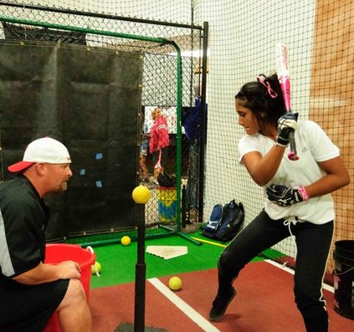
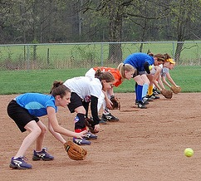
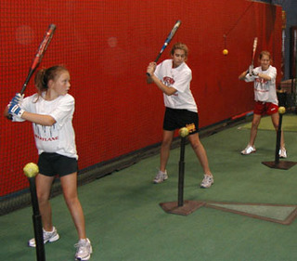
Drills

Slide 72
Hitting Drills
Lower Body
Bat on hip
Ball by back foot
Front Knee Barrier
Load & Transfer
Bustos
Flamingo
Happy Gilmore
Step Back
Balance Beam
Upper Body
Frisbee Toss
Ball throw
Barrier
Top/Bottom Hand
Top hand bat lag triangle
Reverse Top Hand
Putting it Together
Plyo-Tee
Front Toss
Long tee Hitting
Three Plate Hitting
Numbered Toss
Drop Ball (1, 2, 3)
Bounce Toss
Numbered Toss
Rapid Fire
Back Toss
Dog toy
Ball on a Rope
3 Tee hitting
Total Control Balls Or Basketball toss
High/low toss
Skinny bat with Golf ball wiffles

Slide 73
Defensive Drills
Infield
PFP
Short hops
Short hops off knees
Back hands
45 degree back hands
Fore hands
Long hops
Roll with approach
2 ball shuffles
One hand with small balls – no glove
Wally ball
Wally ball with tennis ball – no glove
Do or dies
Flips and tags
USA drill - Link
Star drill
Cross fire
Chinese drill
Quick hands drill
Outfield
Roll with approach with throws
3 hop crow hops
Drop steps
Octagon
Quarterback
Wrap around drill
Partner flys
Target throwing
Grounders to gaps – angles
Slides, dives, shoe string catches

Slide 74
Resources
Softballexcellence.com – blog, videos, tons of resources
Sklz.com – training videos
The Talent Code – book and blog
Brian Cain - 2 books and a blog/online resources
Championship Productions – tons of videos
Championship Coaches Network
Positive Coaching – book by Jim Thompson
Fastpitch TV Network - Online
Gamechanger –App
Ubersense/Right View Pro - video app

Slide 75
Questions?
Contact me at
Kaity.wightman@gmail.com
or
(651) 353-6968
Good Luck this Season!
Go Bears!

